Slide 1
Adjusting Budgets: Household
Grade 9+

Slide 2

A Special Note for Teachers

Slide 3
Students will Learn…
Common living expenses and bills
Adjusting a budget according to unexpected financial changes
Considerations for budgeting a household spending plan

Slide 4

Minds On Activity
Think-Pair-Share
How can we respond to changes in our finances within a household?
Examples:
Someone in the family experiences reduced income
A family member becomes sick
Family works together to decide on a collective expense

Slide 5





Introducing: The Hookimaw’s
Here is the Hookimaw household, and it has five people. There are two adult brothers who live together and look after three young children aged 5, 3, and 1 year old.

Slide 6
Build a Monthly Budget
The two adults in the household work full-time. One member earns $3,960 every month and the other earns $3,780 every month.
Using the Monthly Budget sheet, fill in:
Income #1
Income #2
Calculate the household’s “Total Income”

Slide 7
Build a Monthly Budget
Expenses | Initial Budget
Rent | $2,500
Utilities | $110
Food | $2,400
Clothing | $80
Entertainment | $200
Internet & Cable | $250
Cell Phone Family Plan | $120
Transportation | $180
Household Items | $250
Daycare | $1,600
Savings | $50
The household knows some of the monthly living expenses. Here is the amount they budgeted.
Fill in the “Initial Budget” column and calculate the total.

Slide 8
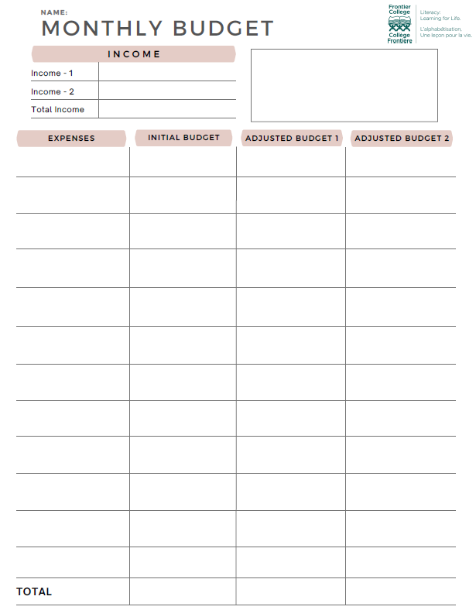


Balance Your Budget
“Total Initial Budget” should equal “Total Income”
Pro Tip:
This means you are only spending the money you earn.

Slide 9



Slide 10




Scenario 1: Adopting a Pet
After discussing with your household, everyone decided to adopt a new pet! Hooray!
Choose your new pet from below, or create your own. Name your pet. You can write or draw inside the empty box on the budget sheet.

Slide 11
Scenario 1: Adopting a Pet
You understand that a new pet comes with new expenses! Here are some estimated expenses for this month.
Add “New Pet” in your monthly expenses and enter the total cost.
Expenses |  | Estimated Cost
Flexible Expenses
Food |  | $100
Treats |  | $30
Toys |  | $20
Pet’s personal items |  | $15
Veterinarian visits |  | $200
One-Time Expense
Living area | $130
Total “New Pet”
You must include the one-time expense in your budget for this month.

Slide 12
Adjusted Budget 1
With your new family pet, how will you adjust your monthly budget?
Review slides 12-16 for options on expenses.
Adjust your budget, and fill in the “Adjusted Budget 1” column.
Note: You have the option to choose which expense(s) to adjust. You are not required to adjust all budgeted expenses shown on slides 12-16.

Slide 13

Expense Options
Saving
Do you want to adjust your saving?

Slide 14

Expense Options
Food
Currently the household uses Option 1.
Option 1
Have a restaurant meal once a week
Mostly buy groceries and make meals at home
Groceries are fresh and of good quality
Children have desserts and snacks
$ 2,400 per month
Option 2
Have a restaurant meal once a month only
Groceries are mostly fresh
Children have snacks and desserts once-in-a-while
Save on groceries by using coupons
$ 2,100 per month
Option 3
Do not eat out at restaurants
Groceries are mostly fresh, but not always the best quality
Only buys what you need, not what you want
Only buy items that are on sale
$ 1,900 per month

Slide 15



Expense Options
Entertainment
Currently the household uses Option 1.
Option 1
3 streaming services every month (movies, videos, songs, etc.)
2 gaming apps or video games every month
Brand new hobby supplies for children (ie. crafts, helmet, sports gear, etc.)
$ 200 per month
Option 2
2 streaming services every month (movies, videos, songs, etc.)
1 gaming app
Purchase some hobby supplies on sale
$ 130 per month
Option 3
1 streaming services every month (movies, videos, songs, etc.)
Purchase all hobby supplies on sale, trading platforms
Must wait a few months before getting all the supplies
$ 90 per month

Slide 16

Expense Options
Internet & Cable
Currently the household uses Option 1.
Option 1
Unlimited 5G high-speed internet
Internet is always reliable
Basic cable + 20 TV channels
$ 250 per month
Option 2
Unlimited 4G internet
Internet is often reliable
Basic cable (includes kids' channels)
$ 180 per month
Option 3
Unlimited 4G internet
Internet is unstable during busy hours
No cable TV
$ 90 per month

Slide 17

Expense Options
Household Items: Diapers
Currently the household uses Option 1.
Option 1
Brand name diapers
Very comfortable and high-quality materials
Buy big packs for some savings
$ 200 per month
Option 2
Generic brand diapers
Comfortable and similar quality materials as brand name product
Buy big packs for some savings
$ 170 per month
Option 3
Generic brand diapers
Slightly less comfortable than Options 1 or 2
Buy bulk packs for bigger savings
Subscribe for monthly refills to save additional 3%.
$ 120 per month

Slide 18
Balance Your Budget
Does your “Adjusted Budget 1” equal “Total Income”?
Pro Tip:
Try to spend only the money you earn.
If your budgeted expenses are more than your income, where can you reduce expenses?
If your budgeted expenses are less than your income, where do you want to put the extra money?

Slide 19

Scenario 2: Visit Grandma
Grandma lives in a house 60 km away. She is walking more slowly these days and needs to get a walker. You decide as a household to visit her on the weekend and pick up the walker and bring it to her!

Slide 20




Visit Grandma
You haven't seen grandma in a while. You are all very excited and decided to buy her a gift! Choose a gift from below or create your own.
Reading tablet
$90
​
Warm slippers
$25
Tea pot
$18
Box of chocolates
$36

Slide 21
Build a Monthly Budget
There are a few one-time expenses for this trip. Here are some estimated expenses for this trip:
Add “Road Trip” in your monthly expenses and enter the total cost.
Expenses | Estimated Cost
Gas | $120
Snacks for the car | $60
Crutches | $75
Gift
Total "Road Trip"
Again, you must include the one-time expense in your budget for this month.

Slide 22
Adjusted Budget 2
With the road trip, how will you adjust your monthly budget?
Review slides 12-16 for options on expenses.
Adjust your budget, and fill in the “Adjusted Budget 2” column.
Note: You have the option to choose which expense(s) to adjust. You are not required to adjust all budgeted expenses shown on slides 12-16.
Remember, does your “Adjusted Budget 2” equal “Total Income”?

Slide 23

Student Reflection
At the beginning of the activity did you choose all the options that you wanted the most or not? Why?
Choose one expense that you adjusted and explain how you decided between the options available.
When there is a need to adjust our budget, do you think it is easy to make compromises in our lifestyle? For example, opting for less data on your phone or switching diaper brands?
Making choices for a household is different than making them for a single person. What were some of your priorities taking the household into consideration?

