Slide 1
Adjusting Budgets: Business
Grade 9+

Slide 2

A Special Note for Teachers

Slide 3
Students will Learn…
Common categories in a business budget
Adjust a business budget according to unexpected changes
Calculate revenue, expenses, and profit

Slide 4

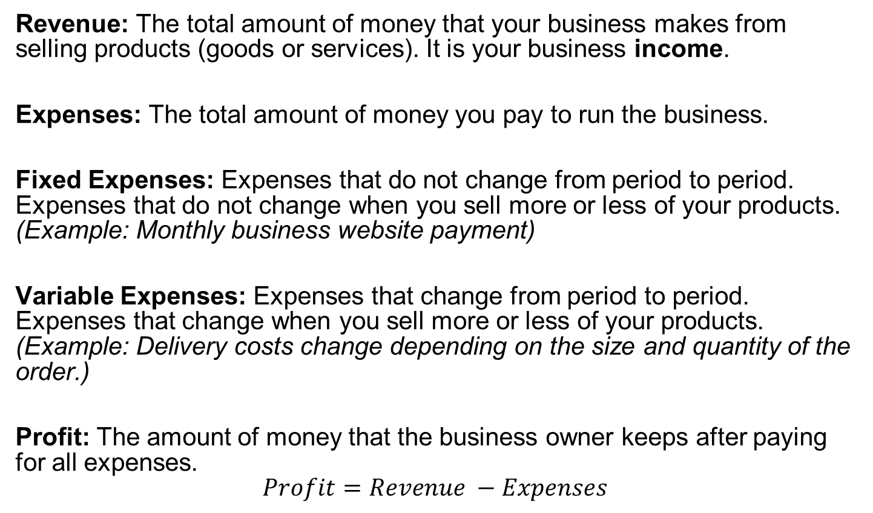
Academic Language
Revenue: The total amount of money that your business makes from selling products (goods or services). It is your business income.
Expenses: The total amount of money you pay to run the business.
Fixed Expenses: Expenses that do not change from period to period. Expenses that do not change when you sell more or less of your products.
(Example: Monthly business website payment)
Variable Expenses: Expenses that change from period to period. Expenses that change when you sell more or less of your products.
(Example: Delivery costs change depending on the size and quantity of the order.)
Profit: The amount of money that the business owner keeps after paying for all expenses.
$$Profit=Revenue −Expenses$$

Slide 5

Expenses Explained
Fixed Expenses
Top-tier business website includes:
  Website features you use: premium website themes, personal domain name, website hosting, business email account. (Base fee = $32/month)
  Website features you do not use, but are paying for: website shop, online checkout, customer payment options, 24/7 tech support. (Add-on’s = $28/month)
Advertising includes costs of business cards ($20/month), online ads ($60/month).
Dog-walking equipment includes costs of four leashes, four safety clips, a wrap-around harness, water bowl. You renew your equipment once a year. (Total cost of $240 over 12 months = $20/month)

Slide 6
Expenses Explained
Fixed Expenses
Weather appropriate clothing includes sturdy walking shoes, waterproof windbreaker, sweat wicking layers, UV protective hat, sunglasses. You renew your equipment once every 2 years. (Total cost of $792 over 24 months = $33/month)
Business insurance protects you as the business owner and your clients. (total cost of $204 over 12 months = $17/month)

Slide 7

Expenses Explained
Variable Expenses
Dog treats: On each walk, you treat the dogs to a little something for behaving well! On average, the treats cost $1 per dog for one walk.
Poop bags: You buy in bulk, and spend $0.0625 per poop bag. Assume that every dog uses one poop bag per walk.

