Slide 1
Investments & Debt
Grade 8+

Slide 2

A Special Note For Teachers

Slide 3
Students will be able to…
Visually identify the difference between simple and compound interest
Explain how simple and compound interest rates can affect their financial goals on investments and debt
Understand the components of interest rates, including the percentage, simple vs. compound, and the length of time

Slide 4

Interest on Investment and Debt
Do you pay interest?
Or do you earn interest? Let’s watch the video to find out.
Watch video: Interest on Borrowing vs. Investing
Financial Literacy: Interest On Borrowing vs Investing – YouTube

Slide 5
Activity: Lender or Borrower?
Situation A
Jose lends $10 to Abby.
Questions:
Who is the lender?
Who is the borrower?
Who earns interest?
Who pays interest?

Slide 6
Activity: Lender or Borrower?
Situation B
Danny borrows $20 from David.
Questions:
Who is the lender?
Who is the borrower?
Who earns interest?
Who pays interest?

Slide 7
Activity: Lender or Borrower?
Situation C
Amelia lends Jasmine $15.
Questions:
Who is the lender?
Who is the borrower?
Who earns interest?
Who pays interest?

Slide 8
Academic Language
Principal refers to the set amount of money borrowed or invested.
Simple interest is calculated based on the principal amount of debt or investment.
Compound interest calculated based on the principal amount and the accumulated interest of debt and investment
Interest is the amount of money you are charged as a fee for borrowing debt, or the amount you earn for investing.

Slide 9
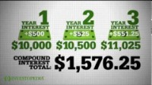
Simple vs. Compound Interest
https://www.youtube.com/watch?app=desktop&v=wf91rEGw88Q

Slide 10
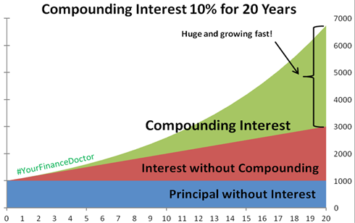
Over a long period of time…

Slide 11
It can work for or against you…
Remember, whether you pay interest or earn interest depends on the situation.

Slide 12
Online digital tools
Use the following online calculators for slides 13 to 16:
Simple Interest Calculator: http://www.moneychimp.com/features/simple_interest_calculator.htm
Compound Interest Calculator: https://www.getsmarteraboutmoney.ca/calculators/compound-interest-calculator/ (in the calculator, for “regular addition”, input $0)

Slide 13
Compare Interest Rates on Debt
Borrow $1,000 at 10% annual simple interest for 5 years
Borrow $1,000 at 10% monthly compound interest for 5 years
Which one should you choose?

Slide 14

Compare Interest Rates on Debt
Borrow $500 at 8% monthly compound interest for 15 years
Borrow $500 at 8% quarterly compound interest for 15 years
Which one should you choose?

Slide 15

Compare Interest Rates on Investment
Invest $100 at 7%
semi-annually compound interest for 20 years
Invest $100 at 7%
quarterly compound interest for 20 years
Which one should you choose?

Slide 16

Compare Interest Rates on Investment
Invest $100 at 10% annual simple interest for 15 years
Investing $100 at 5% monthly compound interest for 15 years
Which one should you choose?

Slide 17
Compare Interest Rates on Investment
Invest $100 at 10% annual simple interest for 15 years
Investing $100 at 5% monthly compound interest for 15 years
Tricky! Because the investment is only for 15 years, the annual simple interest rate of 10% is actually higher than the monthly compound rate of 5%.

Slide 18
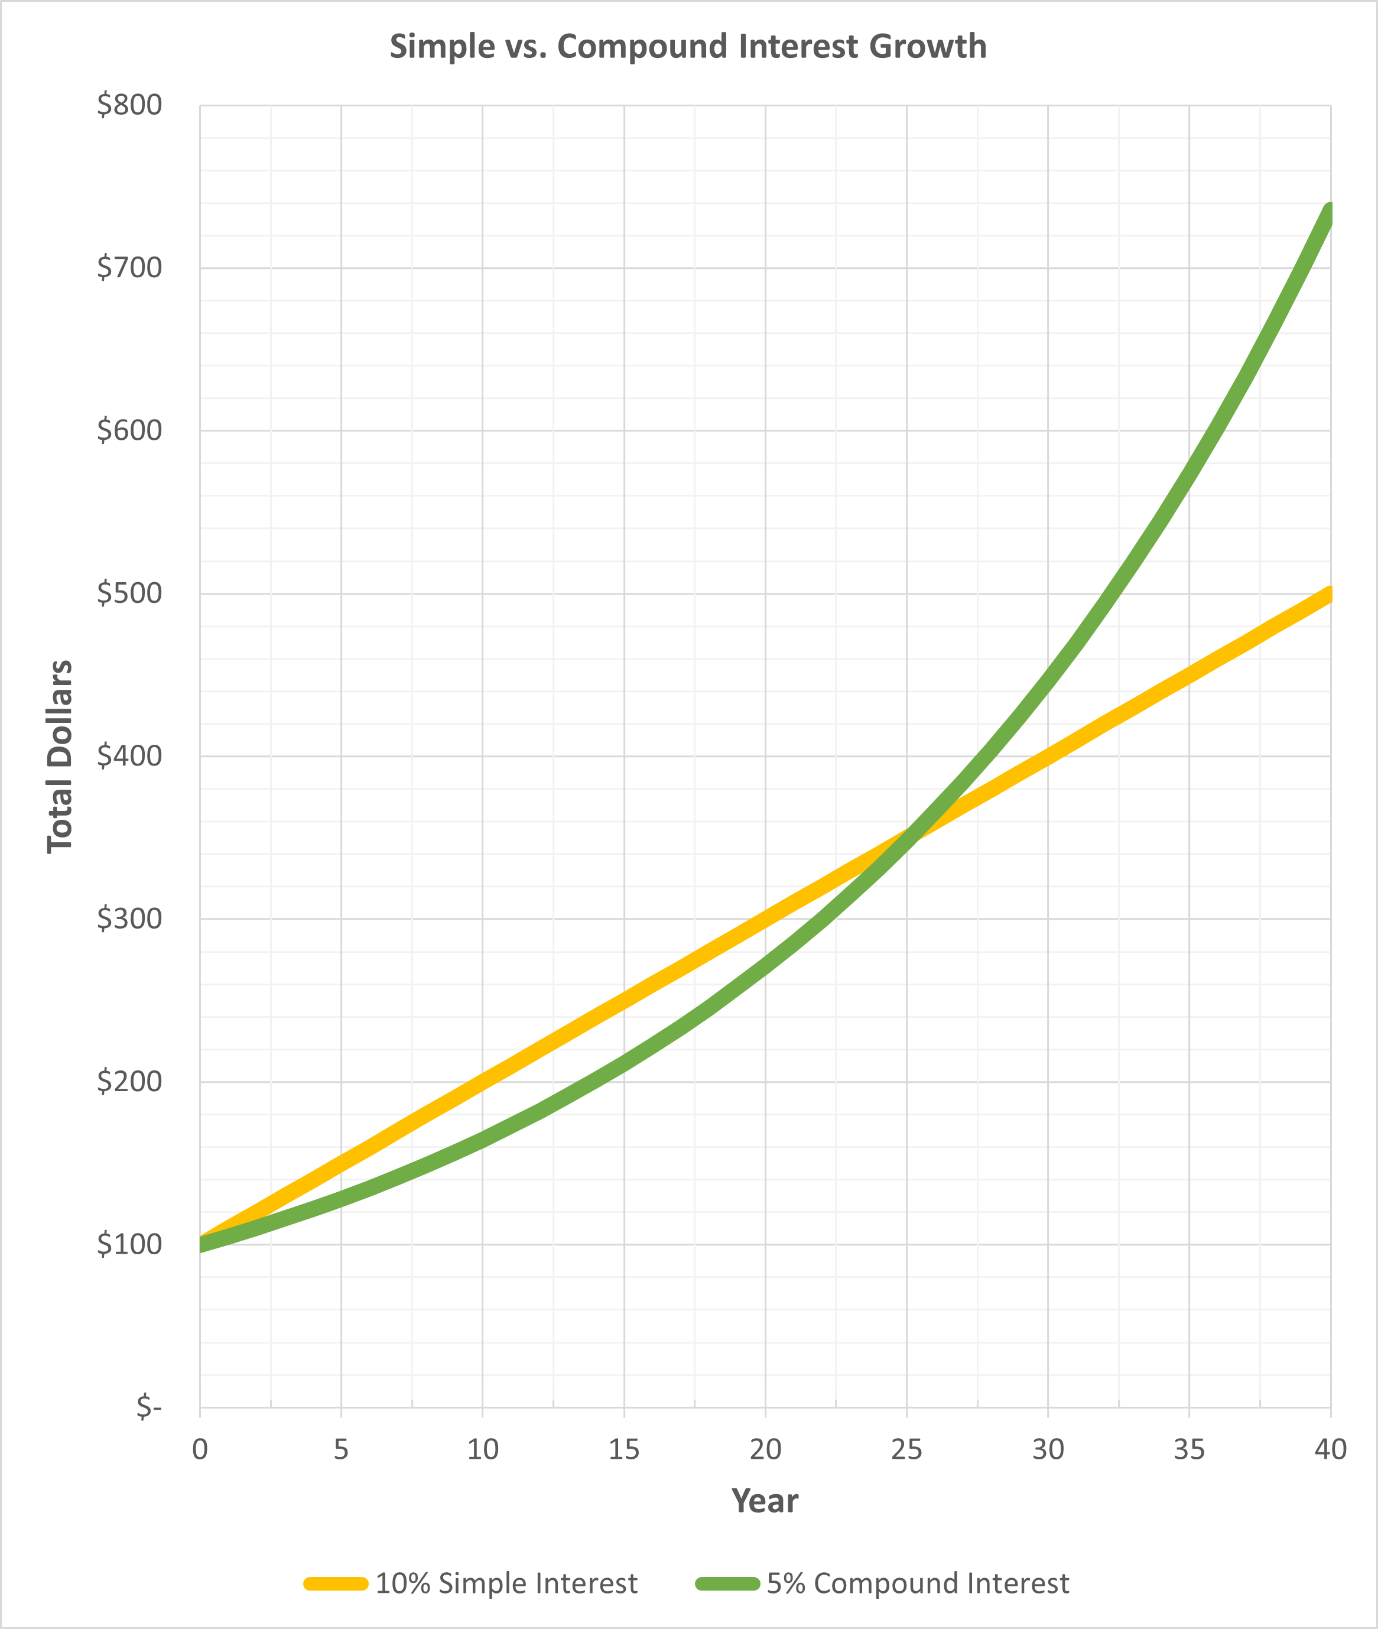
At year 15, your total investment is higher with 10% simple interest than 5% monthly compound interest

Slide 19
At year 25, your total investment is the same with simple interest or compound interest

Slide 20
After year 25, your total investment grows very fast with compound interest compared to simple interest

Slide 21
Summary
For borrowing debt, you tend to prefer:
A lower interest rate
Simple interest
Because you pay interest!
For investments, you tend to prefer:
A higher interest rate
Compound interest
Because you earn interest!
But as we saw, it also depends on the length of time.

