Slide 1
Customer Incentives
Grade 8+

Slide 2

A Special Note For Teachers

Slide 3

Minds On Activity
Think-Pair-Share
What are “customer incentive programs” or “customer loyalty programs”? Have you heard of it before?
Can you think of some examples of customer incentives?

Slide 4

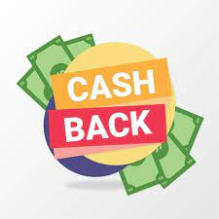
What Are Customer Incentives?
Rewards Points
Cash Back
Freebies
Exclusive sales of products
Advanced access to new releases, etc.

Slide 5
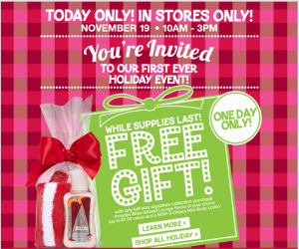

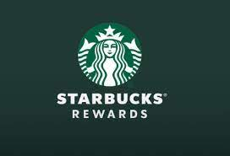


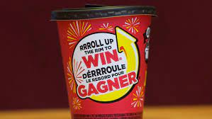
Bath & Body Works: Earn a gift with purchase
PC Optimum Rewards Program: Earn 15 points per dollar you spend
Starbucks Rewards Program: Every dollar spent = 1 star
Customer Incentive Examples
SCENE Rewards program: Turning your dollars into FREE movies
Sephora Beauty Insider Program: Earn 1 point per dollar you spend
Tim Hortons ”Roll Up The Rim To Win” & Points

Slide 6


Comparing Customer Incentive Programs
Pros | Cons
Earn 10 points per eligible visit when you scan your card Access to Weekly Exclusive Offers Reward on Birthday Access to Contests and Games | Points do expire in 12 months Points are earned per purchase not per dollar. Less value/incentive for larger purchases
Pros | Cons
When you buy 7 hot beverages/fries, earn one free! Coupons & Weekly Offers Rewards don’t expire | Takes longer to redeem incentives. Less “bang for buck”

Slide 7
Based on the pros & cons of each company, who has the better incentive program and why?

Slide 8

Benefits of Customer Incentives
Increased sales!
Information on your consumers
Identify your target market:
  How is the economy right now?
  Where and how often are consumers spending money on things
  What offers/rewards appeal most to consumers to drive sales

Slide 9

Benefits of Customer Incentives
Promotes customer retention & customer loyalty- customers are more likely to come back
Makes customers feel appreciated
Creates an exciting experience– customers feel like they
are making free money just by shopping

Slide 10
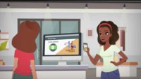
How to Create a Successful Incentive Program
Watch the video to learn about how to start your company’s own rewards program.
www.youtube.com/watch?v=jdJhHdpdjU4

Slide 11

Brainstorm Effective Customer Incentives for Your Business
Students should work independently, in pairs or small groups to discuss what customer incentives they want to offer as part of their business
Students are encouraged to collaborate with their peers
Students could combine their businesses together and create a cross-merchandise customer incentive program (for example: Raptors win + free fries at McDonald’s)

