Slide 1
Making Sense of
Business Goals and Budgets
Grade 8+

Slide 2

A Special Note For Teachers

Slide 3
Purpose of Lesson
Create a Financial Goal
Students will conduct research and create their own financial business plan, considering long term and short-term goals, expenses and taxes, all while maintaining a balanced budget.
Setting Goals – YouTube

Slide 4

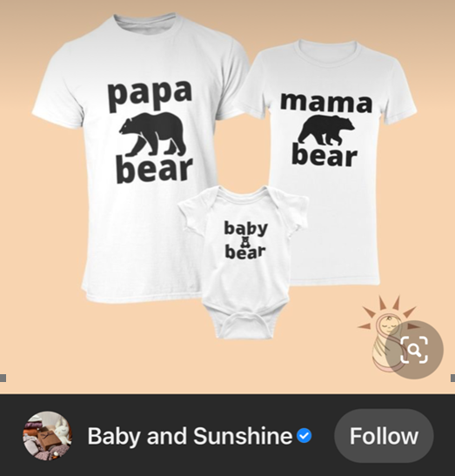
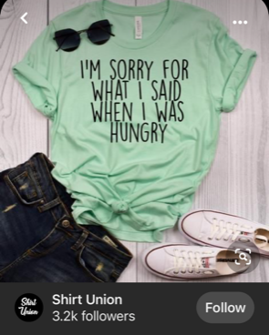
Sample Business: Making & Selling T-shirts
Adult size X-Small to 4X-Large
Gender Neutral
All T-shirts are $35 (+tax,+ shipping)
Personalize their shirts

Slide 5
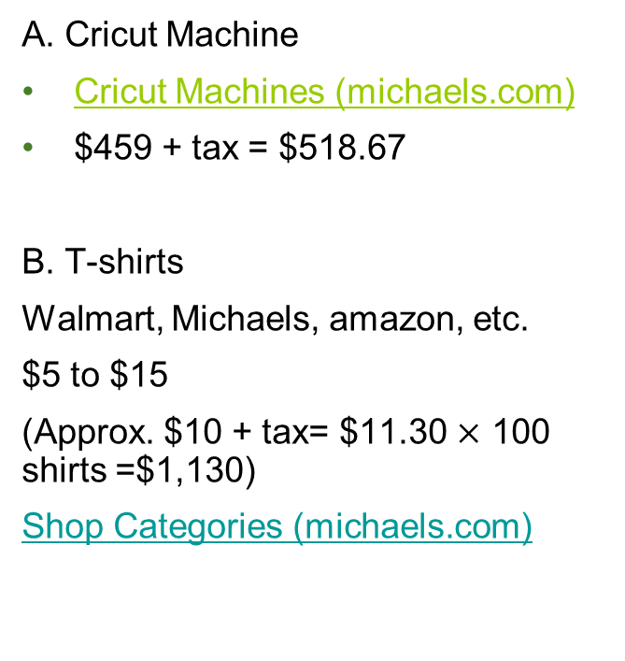
What will I need to make my product?
A. Cricut Machine
Cricut Machines (michaels.com)
$459 + tax = $518.67
B. T-shirts
Walmart, Michaels, amazon, etc.
$5 to $15
(Approx. $10 + tax= $11.30 $×$ 100 shirts =$1,130)
Shop Categories (michaels.com)
C. Cricut Machine Accessories
Ink, Mat, cutting tools
Cricut Accessories & Cutting Materials | Michaels
$500
D. Design technology: Canva Pro
$16.99/month + tax= $19.20/month
Start-up costs: $2,166.87
(Month 1)

Slide 6
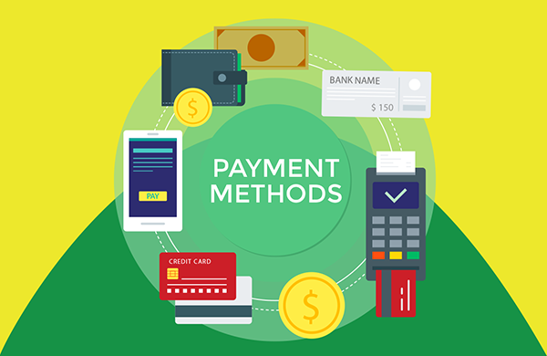
Payments
What payment methods will you accept ?
E-transfer,
Cash,
Debit,
Credit Card,
Cheque

Slide 7

How will you advertise your product?
How much money will you spend on advertising your product?
How will customers get their items? Will you offer shipping?
Compare shipping companies (i.e. Canada Post, FedEx, UPS, etc.)

Slide 8

Class Discussion
What is a budget?
Why are budgets important?

Slide 9
Why Is Budgeting Important?
1. A budget helps you predict cash flows and avoid surprises.
2. A budget shows your banker/investors how you plan to pay back a future loan.
3. A budget quickly highlights areas that need improvement.
4. A budget helps you keep your operations running smoothly.
5. A budget helps you project the future and take actionable steps.

Slide 10
Budget Fundamentals
Business budgets should be “balanced”,
Budgets should include revenue and expenses
$$Revenues −Expenses=Profit$$
𝑅𝑒𝑣𝑒𝑛𝑢𝑒𝑠 −𝐸𝑥𝑝𝑒𝑛𝑠𝑒𝑠=𝑃𝑟𝑜𝑓𝑖𝑡
Income & Revenue examples: profit, sales, etc.
Expense examples: salaries, materials used and purchased, cost to rent space, advertising, payment methods etc.

Slide 11
Income vs. Expenses
Income | Expenses
Selling T-shirts | Website
 | Payment methods (square)
 | Purchase Cricut machine + ink
 | Purchasing T-shirts (bulk orders)
 | Shipping (Free or charging)
 | Incentives (discounts/ loyalty )
 | Rent (if needed)

Slide 12
Your sales are doing great!
Classroom Exercise:
You now have Customers from USA
Let’s convert from Canadian to American dollars
Exchange Rate × Canadian Dollars:
0.79 x $19.99 = $15.80 US Dollar
Cost of T-shirt: $19.99 CAD
Exchange Rate: 0.79
Exchange Rate × Canadian Dollars:
(use google to see the current daily exchange rate)
Notes:
Teachers may choose to skip this slide if students are not yet familiar with currency exchange. You may choose to comeback to this slide after reviewing currency exchange.

Slide 13




Students will work individually, in pairs or in small groups to develop a business plan and review the assignment expectations.
Sample Business Ideas:
Creating & Selling T-shirts
Cultural art & designs,
Making Jewelry,
House Cleaning,
Babysitting,
Painting
Yard work
Food & Restaurant work

