Slide 1
Budgeting
Grade 8+

Slide 2

A Special Note For Teachers

Slide 3
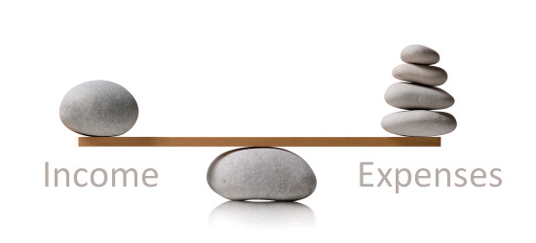
Review – What is a budget?
What is an expense?
Money spent on items or services.
Example: Paying for an end of school trip to Wonderland
What is Income?
Income is the money you receive from different sources. Generally, this is called earned income, which is money you earn from various sources, like a job, chores & allowance.
Example: You earn $25.00 dollars a week for completing all your chores. This money is considered part of your income.
Handout/worksheet

Slide 4
Why Is Budgeting Important?
Helps you save money for future expenses
Allows you to track how much you earn and how much you spend
Budgeting creates a spending plan for your money and can help ensure there is always enough money for your expenses and possible emergencies

Slide 5


Slide 6



How Can You Save Money?
Make good spending decisions. I.e., don’t buy the first thing you see
Set Savings Goals!
Track your spending (expenses) in a budget plan!
Know the difference between needs and wants
Save regularly! For example: Save $5 every week from your allowance

Slide 7
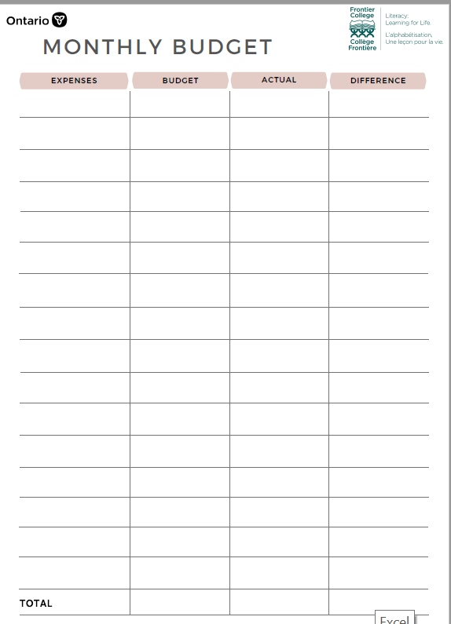

Sample Budget Plan
Check out this sample monthly budget planner! Use this to help track your spending!

Slide 8
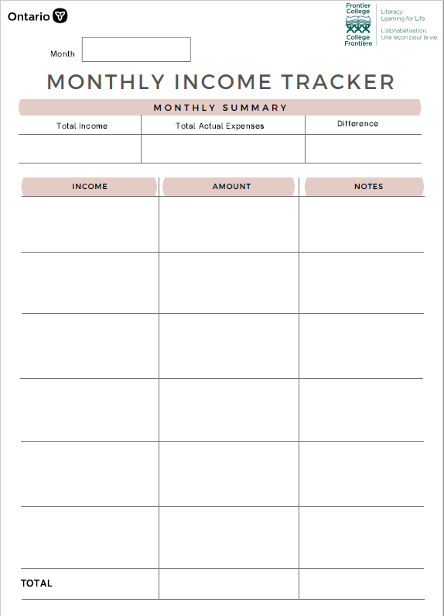
Sample Budget Plan
Check out this sample monthly budget planner! Use this to help track your Income!

Slide 9
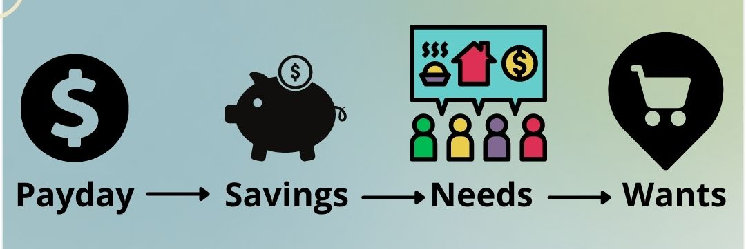
1. Reverse Budgeting
Identify your Income and all your expenses
Your budget is what you have left over after all your expenses
2. Zero Based Budget
Subtract all your expenses from your income
Ensure every dollar is accounted for

Slide 10
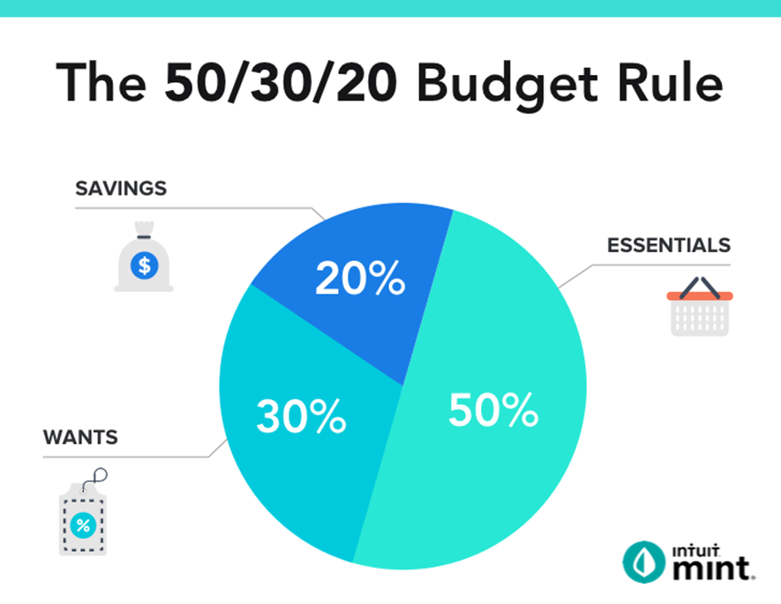
3. Percentage / Bucket Budget
A. Set aside a certain amount to save (20%) and spend the rest (80%) on whatever you want.
You can change the proportions (80/20 to 70/30 or 60/40) depending upon what your goals are.
B. 50/30/20
Divides your money into three buckets
Bucket 1 is for fixed expenses (50% of your income),
Bucket 2 is for lifestyle expenses (30% of your income)
Bucket 3 is for future expenses (20% of your income).

Slide 11
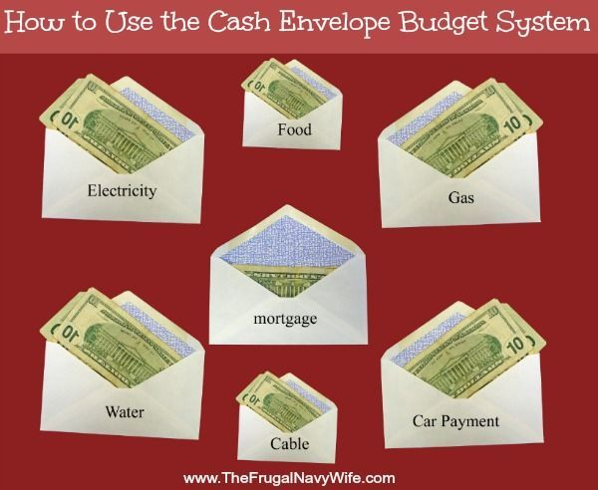
4. Cash Only Budget / Envelope System
Since tapping your debit or credit card is so easy and convenient, sometimes we don’t even pay attention to how much something costs.
By using cash, you are forced to be more aware and physically limit your spending by budgeting how much you have towards various expenses.

Slide 12
5. Calendar Budgeting
(Bi-weekly or Monthly Budget)
Each time you get a paycheck, you make a budget to determine where that money goes.
Calendar budgeting is similar to Reverse Budgeting & Zero-Based Budgeting
Use a calendar to adjust your budget weekly based on incomes and expenses
This is a good option when you have multiple incomes

Slide 13
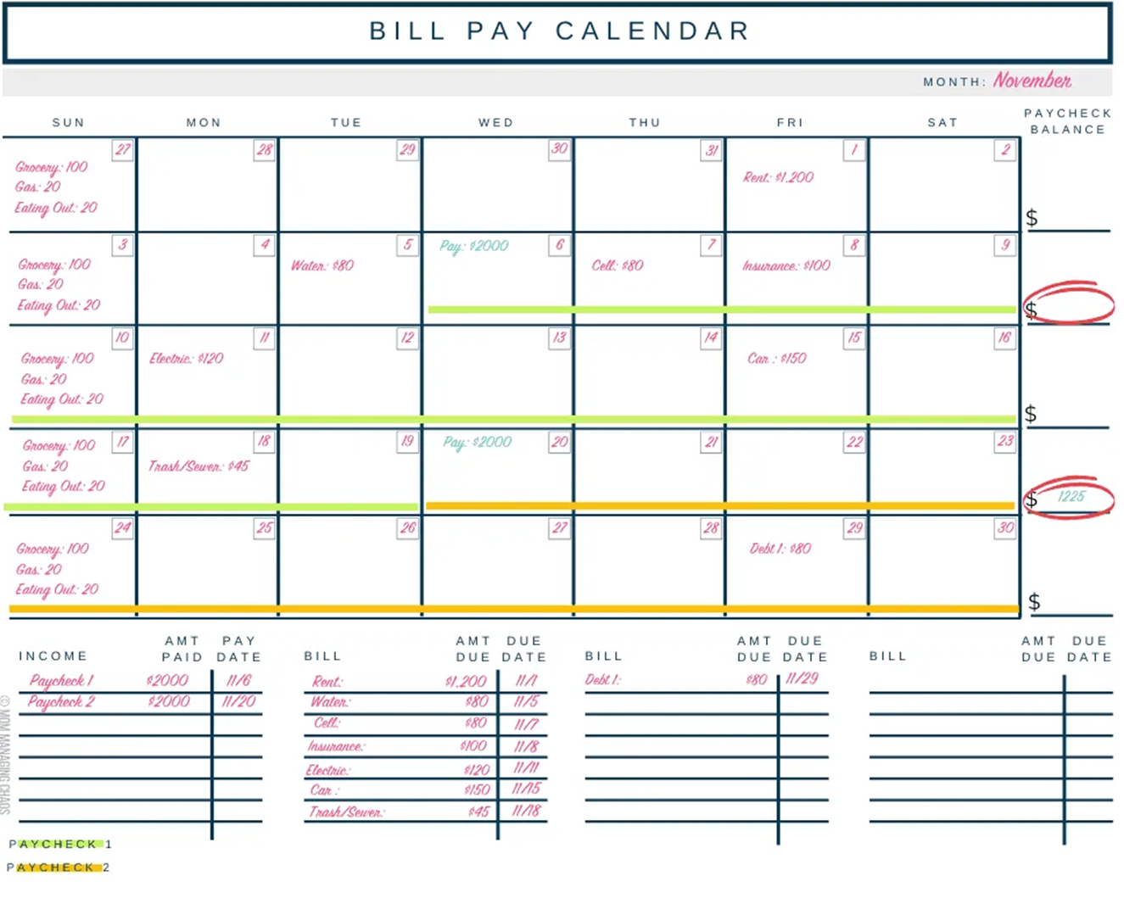

Slide 14
6. Digital Budgeting
Using an App or online tool
You estimate how much money you should be spending in various categories
As you spend money the tool puts the items and amount spent into the correct categories
Automatically graphs and shows you where you might be overspending
Potentially automatically rounds purchases up and places additional change into savings
Note: you may need to pay for this budgeting tool

Slide 15
Don’t Forget About Taxes
When creating a budget, it is important to remember there are taxes on items you plan to purchase and that taxes are taken off your income.
When you do your taxes, you may need to pay additional taxes. Your tax return is due on April 30th each year.
In Ontario, Employers must deduct the following off your earnings:
Income tax
Employee contributions to Employment Insurance (EI)
Employee contributions to the Canada Pension Plan (CPP)
Ontario Health Premium (OHP) – if your income is more than $20,000 a year.

Slide 16
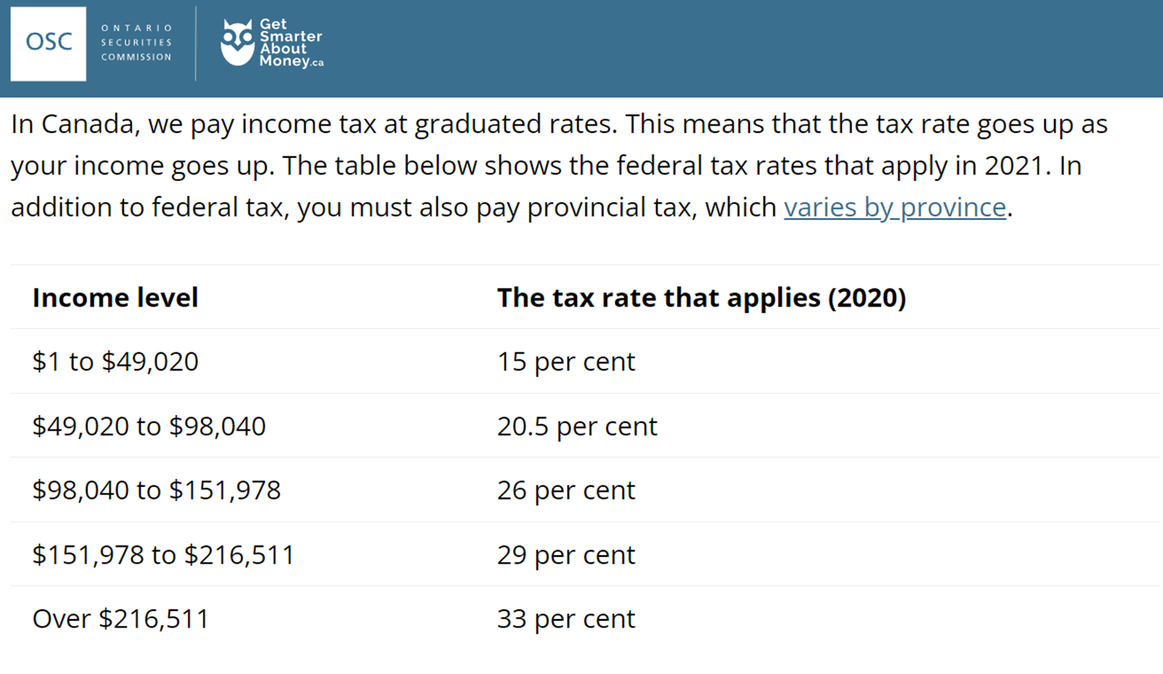
Federal Income Tax
Notes:
Understanding the tax deductions on your pay stub | Understanding tax | GetSmarterAboutMoney.ca

Slide 17
Gross Vs. Net Pay
Gross pay – Your “gross” pay is the amount you make every week, every month or every hour before your employer deducts any income taxes, payroll taxes (EI and CPP) or other items.
Net pay – Your “net” or “take home” pay is your gross pay, less all amounts deducted and remitted to CRA on your behalf by your employer.
Why is it important for you to know the difference between gross pay and net pay?

Slide 18
Assignment Options
1. While watching the YouTube video about six styles of budgeting, fill out the attached worksheet and describe the various kinds of budgets.
The 6 Styles of Budgeting Explained | How to Make A Budget – YouTube:
https://www.youtube.com/watch?v=jSpvkaRIsOM
2. Let’s look on a website to calculate taxes on potential incomes:
Ontario Income Tax Calculator | WOWA.ca: https://wowa.ca/ontario-tax-calculator
https://www.getsmarteraboutmoney.ca/plan-manage/planning-basics/understanding-tax/understanding-the-tax-deductions-on-your-pay-stub/

