Slide 1
The Finance of Adulting
Teacher Version
Grade 7+

Slide 2

A Special Note For Teachers

Slide 3
Students will learn…
Through this game of simulation, students will learn:
Monthly budgeting and longer-term financial planning
Common living expenses and paying bills
Interest rates on debt
Interest rates on investment
How marketing influences our buying decisions and financial planning

Slide 4
Task: The Finance of Adulting
Help your avatar organize their monthly budget while they live on their own! It can be easy to fall into debt if we are not careful with our bills, or if we don’t have strong budgeting habits.
In this task, you pick an avatar and you will:
Pay bills and make financial decisions for 2 years,
Choose a financial goal and achieve it within 2 years (see slide 6),
Have no debt after 2 years.
Notes:
Notes for Teachers: This slide lays out the three objectives of the task. Continue to remind students of these three objectives throughout the game. Students can achieve their financial goal any time within the 2 years (or the span of the game). Even so, they will need to carry on until the end to ensure they have no debt.

Slide 5




Choose Your Avatar…
Tanisha
DeShawn
Age: 17, currently in high school
Interests: Watch cat videos on YouTube, snowboarding and coffee
Life goals: Travel around the world
Age: 17, currently in high school
Interests: Reading, soccer, guitar and making music
Life goals: Start his own business
Brie
Toshi
Age: 18, currently in high school
Interests: Baking, surfing and watercolors
Life goals: Become a certified scuba diver, research about the oceans
Age: 18, currently in high school
Interests: Basketball, rock music and stand-up comedies
Life goals: Become a sports coach

Slide 6
Choose Your Financial Goal…
Within the next 2 years, what would you like to achieve financially?
Choose your amount:
$ 1,200
$ 1,100
$ 1,000
$ 900
$ 800
$ 700
Choose your goal:
Money for post-secondary tuition!
Payment going towards your first car!
Vacation to a destination you choose…
Or anything else - Pick your own financial goal!
Notes:
Notes for Teachers: Students can mix and match the stated amounts with any financial objective. For example, they can choose $1,000 for post-secondary tuition or $1,000 for a vacation.

Slide 7

Task Overview
You will create monthly budgets and see how a monthly budget affects a 2-year financial plan.
Overspending across many months will have a negative impact on your 2-year financial plan. You would be in debt.
Creating a monthly budget is a great way to track your income and spending!
You can see if you underspent or overspent.
Notes:
Notes for Teachers: At this point, show your students the two main worksheets for this project: the Monthly Budget Planner and the 2-Year Financial Planner.

Slide 8
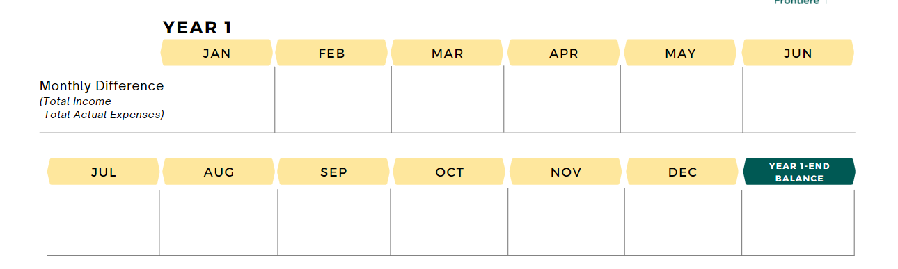

Task Overview
Overspending can lead to debt. Debt is written as a negative number in math. Overspending for many months can have a negative impact on your financial health!
For example:
− $100
$15
− $150
− $40
− $70
− $65
$55
− $95
$20
− $125
− $30
$40
− $545
In this task, you will learn how to complete a monthly budget and a financial plan.

Slide 9


Slide 10

Build a Monthly Budget
In Year 1 January, your avatar found a part-time job at a restaurant that pays minimum wage and tips. They earn $1,920 every month. They also do chores around the house and earns $40 a month. These are the income or earnings.
Using the Monthly Budget sheet, fill in:
Month: January
Income #1
Income #2
Calculate “Total Income”

Slide 11
Build a Monthly Budget
Budget
A plan for how you will use your money.
Your avatar knows some of the monthly expenses that come with living on their own. Here is the amount they budgeted. Fill in the “budget” column.
Expenses | Budget
Rent | $ 700
Utilities | $35
Internet & Cable | $120
Cell Phone Plan | $60
Transportation | $50
Personal Items | $35
Medical Expenses | $40

Slide 12

Flexible Expenses
Help your avatar decide how to budget for 4 flexible expenses.
You will make decisions for saving, food, clothing, and entertainment.
Rules:
You must choose one of the available options (expenses cannot be $0).
You cannot pick Option 3 for all flexible expenses.
The key to financial wellbeing is trying your best to spend only the money you earn.
Notes:
Notes for Teachers: Students cannot choose Option 3 (the cheapest option) for all flexible expenses in slides 14-16.

Slide 13

Flexible Expenses
Decision 1: Saving
Budget how much your avatar will save this month.
“Do not save what is left after spending, but spend what is left after saving.”
~Warren Buffett
Notes:
Notes for Teachers: Warren Buffett is one of the most successful investors of all time. His current net worth is more than $100 billion, making him the 6th richest person in the world. He pledged to donate 99% of his wealth.

Slide 14

Flexible Expenses
Decision 2: Food
Option 1
Order take-outs very often
Almost never buy groceries to cook at home
Best tasting meals
Often have desserts and snacks
$ 800 per month
Option 2
Order take-outs sometimes
Buy groceries and make meals at home
Good quality & good-tasting meals
Occasionally have desserts and snacks
$ 650 per month
Option 3
Order take-outs once in a while
Groceries are mostly fresh, but not always
Mostly good quality & good-tasting meals
Snacks and desserts once in a while
$ 535 per month

Slide 15

Flexible Expenses
Decision 3: Clothing
Option 1
Best quality
You shop to follow fashion trends
You do not like buying clothing on sale
You prefer branded clothing
Newest and hottest trends
$ 140 per month
Option 2
Good quality
You shop occasionally
You like to look at discounted items first
Some purchases are name brands, others are not
$ 85 per month
Option 3
Medium quality
You shop once in a while
You are saavy with online selling and trading platforms to get deals
You mostly buy what you need, not what you want
$ 50 per month

Slide 16

Flexible Expenses
Decision 4: Entertainment (movies, concerts, music festivals, etc.)
Option 1
Entertainment events are very important to you
You enjoy the VIP experience, so you buy more expensive tickets
You attend at least 2 entertainment events a month
$ 100 per month
Option 2
You sometimes go to entertainment events
You buy medium-priced event tickets
You attend an entertainment event every few months
$ 65 per month
Option 3
You go to entertainment events once in a while
You compare prices and search for the best value tickets
You attend 2 entertainment events a year
$ 40 per month

Slide 17
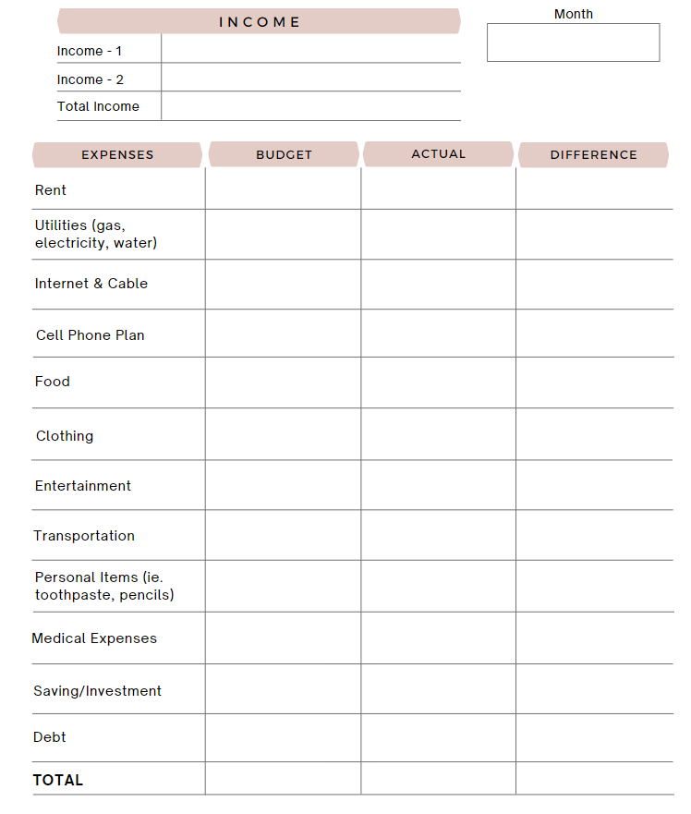

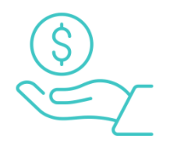
Balance Your Budget
January
Does your “Total Budget” equal “Total Income”?
Pro Tip:
Try to spend only the money you earn.
If your budgeted expenses are more than your income, where can you reduce expenses?
If your budgeted expenses are less than your income, where do you want to put the extra money?
Notes:
Notes for Teachers: Students can go back and adjust their budget NOW, before you show them the actual expenses. Advise students if they have remaining income, they can decide to put it in savings or spend it on flexible expenses. If their budget exceeds their income, they can reduce their savings amount or flexible expenses.

Slide 18
Actual Expenses
At the end of the month, your avatar looks through their bank records and receipts. Here are the actual expenses. Fill in the “actual” column.
Expenses | Actual
Rent | $ 700
Utilities | $20
Internet & Cable | $120
Cell Phone Plan | $60
Food | Same as budgeted
Clothing | Same as budgeted
Entertainment | Same as budgeted
Transportation | $40
Personal Items | $45
Medical Expenses | $40
Saving | Same as budgeted
Notes:
Notes for Teachers: This slide is visible only in the teacher version. Present this slide to the class and ask students to record these numbers under the “actual” column of their budget planners.

Slide 19
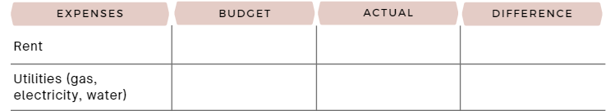
Budget vs. Actual
Difference = Budget − Actual
$ 1,000
$ 1,000
1,000 − 1,000
= $0
$ 35
$ 25
35 − 25
= $10
$ 50
$ 55
50 − 55
= − $5
If you spent the budgeted amount, the difference is zero.
If you underspend, the difference is a positive number.
If you overspend, the difference is a negative number.
Calculate the difference.

Slide 20
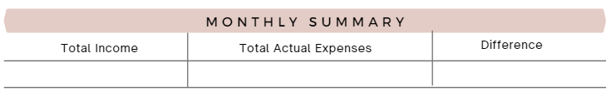
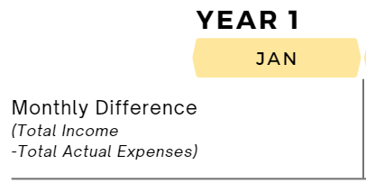
Monthly Summary: Year 1 Jan
Did you spend within your income this month?
Input your monthly difference into the 2-year financial plan,
in Year 1 January.
Notes:
Notes for Teachers: Teachers can go back to slide 8 to remind students of the potential dangers of overspending across many months. The key is “many months”. Overspending in the short-term may not have a significant impact. For example, if you overspend this month but underspend in the next month, it may balance out depending on the situation.

Slide 21



Savings
Input your actual savings amount (not budgeted) in your financial plan.

Slide 22
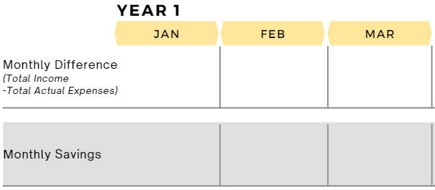
Monthly Summary: Year 1 Feb-Mar
Your avatar maintains the same level of income and expenses for the months of February and March in Year 1. Therefore, the monthly difference and saving will remain the same as January.
Input the monthly difference and actual saving in your 2-year financial plan.

Slide 23


Slide 24
Scenario 1
Starting in May, your avatar has a new extracurricular activity after-school, so they have to work less hours. Their income decreases, and they earn $1,640 every month. They continue doing chores and earns $40 a month.
According to the new level of income, create a new monthly budget.
Below are some budgeted expenses:
Expenses | Budget
Rent | $ 700
Utilities | $35
Transportation | $25
Personal Items | $45
Medical Expenses | $50
Your avatar estimates:
Possibly lower transportation cost because they are going to work less?

Slide 25
Flexible Expenses
Because of the new income, your avatar wants to adjust some of their flexible expenses. It is up to you whether you want to adjust those expenses. Your avatar also wants to shop around for a different internet plan and cell phone plan.
Rules:
You must choose one of the available options (expenses cannot be $0).
You cannot pick Option 3 for all flexible expenses.

Slide 26

Flexible Expenses
Decision 1: Saving
Do you want to adjust your saving?

Slide 27
Flexible Expenses
Decision 2: Food
Option 1
Order take-outs very often
Almost never buy groceries to cook at home
Best tasting meals
Often have desserts and snacks
$ 800 per month
Option 2
Order take-outs sometimes
Buy groceries and make meals at home
Good quality & good-tasting meals
Occasionally have desserts and snacks
$ 650 per month
Option 3
Order take-outs once in a while
Groceries are mostly fresh, but not always
Mostly good quality & good-tasting meals
Snacks and desserts once in a while
$ 535 per month

Slide 28
Flexible Expenses
Decision 3: Clothing
Option 1
Best quality
You shop to follow fashion trends
You do not like buying clothing on sale
You prefer branded clothing
Newest and hottest trends
$ 140 per month
Option 2
Good quality
You shop occasionally
You like to look at discounted items first
Some purchases are name brands, others are not
$ 85 per month
Option 3
Medium quality
You shop once in a while
You are saavy with online selling and trading platforms to get deals
You mostly buy what you need, not what you want
$ 50 per month

Slide 29
Flexible Expenses
Decision 4: Entertainment (movies, concerts, music festivals, etc.)
Option 1
Entertainment events are very important to you
You enjoy the VIP experience, so you buy more expensive tickets
You attend at least 2 entertainment events a month
$ 100 per month
Option 2
You sometimes go to entertainment events
You buy medium-priced event tickets
You attend an entertainment event every few months
$ 65 per month
Option 3
You go to entertainment events once in a while
You compare prices and search for the best value tickets
You attend 2 entertainment events a year
$ 40 per month

Slide 30

Flexible Expenses
Decision 5: Internet & Cable
Currently your avatar uses Option 1.
Option 1
Unlimited 5G high-speed internet
Internet is always reliable
Basic cable + 20 TV channels
$ 120 per month
Option 2
Unlimited 4G internet
Internet is often reliable
No cable
Includes Netflix & Crave
$ 90 per month
Option 3
Unlimited 3G internet
Internet is unstable during busy hours
No cable TV, no streaming platforms
$ 60 per month

Slide 31

Flexible Expenses
Decision 6: Cell Phone Plan
Currently your avatar uses Option 1.
Option 1
Data: 10GB per month
Unlimited calling and texting
Includes Caller ID and voicemail
Stable connection
$ 60 per month
Option 2
Data: 2.5GB per month
Unlimited calling and texting
No Caller ID, no voicemail
Connection is okay
Pay-as-you-go plan
$ 35 per month
Option 3
Data: 500 MB per month
100 minutes calling
Unlimited texting
No Caller ID, no voicemail
Connection not always stable
Pay-as-you-go plan
$ 25 per month

Slide 32


Notes:
Notes for Teachers: The Instagram ads on slides 32-37 are visible in the student version. Students can scroll through and decide if they would like to purchase something. They can make multiple purchases. Give them time to decide before showing them the actual expenses on slide 39.

Slide 33

Notes:
Notes for Teachers: The Instagram ads on slides 32-37 are visible in the student version. Students can scroll through and decide if they would like to purchase something. They can make multiple purchases. Give them time to decide before showing them the actual expenses on slide 39.

Slide 34
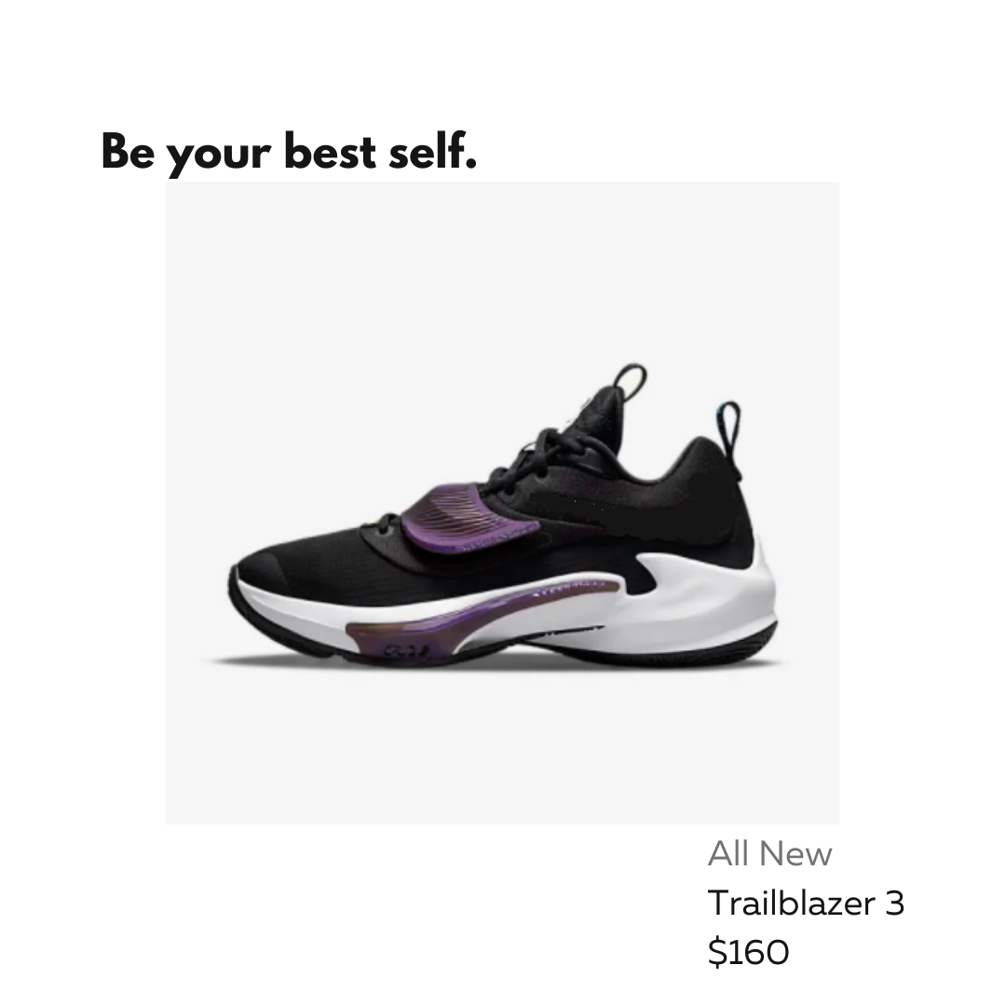
Notes:
Notes for Teachers: The Instagram ads on slides 32-37 are visible in the student version. Students can scroll through and decide if they would like to purchase something. They can make multiple purchases. Give them time to decide before showing them the actual expenses on slide 39.

Slide 35

Notes:
Notes for Teachers: The Instagram ads on slides 32-37 are visible in the student version. Students can scroll through and decide if they would like to purchase something. They can make multiple purchases. Give them time to decide before showing them the actual expenses on slide 39.

Slide 36

Notes:
Notes for Teachers: The Instagram ads on slides 32-37 are visible in the student version. Students can scroll through and decide if they would like to purchase something. They can make multiple purchases. Give them time to decide before showing them the actual expenses on slide 39.

Slide 37

Notes:
Notes for Teachers: The Instagram ads on slides 32-37 are visible in the student version. Students can scroll through and decide if they would like to purchase something. They can make multiple purchases. Give them time to decide before showing them the actual expenses on slide 39.

Slide 38
Balance Your Budget
Did you buy anything? Include the cost in your monthly budget. Add it to your “personal items” expense.
Remember to balance your budget! Does your “Total Budget” equal “Total Income”?

Slide 39
Actual Expenses
At the end of the month, your avatar looks through their bank records and receipts. Here are the actual expenses. Fill in the “actual” column.
Expenses | Actual
Rent | $ 700
Utilities | $30
Internet & Cable | Same as budgeted
Cell Phone Plan | Same as budgeted
Food | Same as budgeted
Clothing | Same as budgeted
Entertainment | Same as budgeted
Transportation | $25
Personal Items | $40 + purchases from Instagram ads
Medical Expenses | $30
Saving | Same as budgeted
Notes:
Notes for Teachers: This slide is visible only in the teacher version. Present this slide to the class and ask students to record these numbers under the “actual” column of their budget planners.

Slide 40
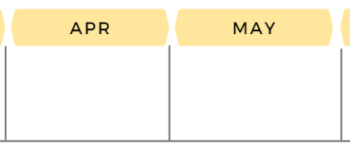

Monthly Summary: Year 1 April
Calculate the monthly difference for April.
Input the monthly difference and actual saving in the financial plan for Year 1 April.

Slide 41
Monthly Summary: Year 1 May
If you made purchase(s) from the Instagram ads, cancel the cost from your expenses in May. Re-calculate your monthly difference and input it for Year 1 May.
If you did not purchase anything, input the same monthly difference as April for Year 1 May.
Input your actual saving.

Slide 42

Student Reflection
At this point, let’s take a pause and reflect on what we have learned so far.
Did you make compromises on some of the flexible expenses? Why or why not?
Do you think it is easy to make compromises in real-life? For example, opting for slower internet or less data on your phone?
Do you think it is necessary to make compromises in real-life? Why or why not?
How do you think ads, “good deals”, and promotions can interrupt our financial goal in life?
What are some ways we can minimize these interruptions and focus on our financial goal(s)?

Slide 43
Scenario 2
Your avatar comes across an opportunity:
1) You may borrow money and achieve your financial goal now, OR
2) Invest your money and achieve the financial goal later.
To understand the available options, let’s learn more about debt and investment and their pro’s and con’s.
Watch video: Interest on Borrowing vs. Investing
https://www.youtube.com/watch?v=-tXFAVMyl7I

Slide 44
Activity: Lender or Borrower?
Situation A
Jose lends $10 to Abby.
Questions:
Who is the lender?
Who is the borrower?
Who earns interest?
Who pays interest?
Notes:
Notes for Teachers: This activity is also available in the video on the previous slide. You have the option of doing the class activity using the video or the slides.

Slide 45
Activity: Lender or Borrower?
Situation B
Danny borrows $20 from David.
Questions:
Who is the lender?
Who is the borrower?
Who earns interest?
Who pays interest?

Slide 46
Activity: Lender or Borrower?
Situation C
Amelia lends Jasmine $15.
Questions:
Who is the lender?
Who is the borrower?
Who earns interest?
Who pays interest?

Slide 47
Scenario 2 continues…
So…you can either earn interest or pay interest.
Now, let’s see some of the pro’s and con’s for debt and investment.
Watch video: Debt vs. Investment – The Pro’s and Con’s
https://www.youtube.com/watch?v=xZ6qBfLdcsM

Slide 49

Borrow or Invest?
Now that you understand a little more about debt and investment, help your avatar:
1) To borrow money and achieve the financial goal now, OR
2) To invest money and achieve the financial goal later.
Look through the options carefully on slides 50 and 51. Choose an option that best fits your financial goal. You can only choose one option.

Slide 50




Borrow or Invest?
Borrowing Debt
Debt A: Credit Card Borrowing
You borrow $400 starting in Year 1 June
Interest rate of 19.99% collected monthly
You repay the debt over the next 18 months (until Year 2 December)
You pay $27.21 per month to pay off your debt
$ 27.21 per month
(for the next 18 months)
Debt B: Personal Loan
You borrow $400 starting in Year 1 June
Interest rate of 10% collected annually
You repay the debt over 18 months (until Year 2 December)
You pay $24.57 per month to pay off your debt
$ 24.57 per month
(for the next 18 months)
You can have these things NOW!
Notes:
Notes for Teachers: If students choose to borrow debt, some will get closer to their financial goal, and some may even achieve their financial goal. They will get their car or vacation; this is instant gratification. However, the game is not finished yet, because they will have to repay their debt over the next 18 months.
Teachers may show the calculations included in the guide. For your information, Debt A is a compound interest and grows exponentially. Debt B is a simple interest and grows linearly. Grade 7 students are not expected to learn simple vs. compound interest rates.

Slide 51


Borrow or Invest?
Making an Investment
Investment A:
Stock Market
Yearly interest rate of 30% collected monthly
You make monthly deposits of $30 starting in Year 1 June
You will pay $50 in fees when you take the money out in Year 2 Dec
By Year 2 December, you will have $688.38 in total investment
$ 30 per month
+ $50 one-time fee
Investment B:
High-Interest Savings Account
Yearly interest rate of 15% collected monthly
You make monthly deposits of $25 starts in Year 1 June
You will pay $15 in fees when you take the money out in Year 2 Dec
By Year 2 December, you will have $507.42 in total investment
$ 25 per month
+ $15 one-time fee
Notes:
Notes for Teachers: There is no instant gratification when it comes to investment. We can watch our money grow over time. Teachers can show the calculations included in the guide and/or additional videos illustrating that a high vs. low interest rate makes a difference over time.

Slide 52


If you chose debt…
The amount you borrowed is your extra income for Year 1 June.
Did you reach your financial goal? Are you close?
New car
Vacation
Notes:
Notes for Teachers: If students chose debt, they may benefit from instant gratification.

Slide 53
If you chose debt…
It’s time to budget for the repayment of your debt. Input the monthly payment amount under “Debt” expenses.
For example: Debt A monthly payments are $27.21
$ 27.21
$ 27.21
$ 0
Putting away money in savings is optional while you repay your debt.

Slide 54
If you chose investment…
You will budget for the monthly deposit of your investment. Input the monthly amount under “Investment” expenses.
For example: Investment A requires a monthly deposit of $30.
$ 30
$ 30
$ 0
Optional: You can save money in addition to your investment option.

Slide 55
Monthly Budget: Year 1 June
Create a new monthly budget for Year 1 June to include the new debt or investment option:
You can use your May budget as a starting point.
Add in the amounts for your debt or investment option.
You may need to re-adjust your budgeted amounts for the other expenses. (For food, clothing, entertainment, internet & cable, cell phone options: see slides 27-31)
Remember to balance your budget.
Notes:
Notes for Teachers: At this point, most students should feel comfortable creating/adjusting a monthly budget on their own.

Slide 56
Actual Expenses
Expenses | Actual
Rent | $700
Utilities | $30
Internet & Cable | Same as budgeted
Cell Phone Plan | Same as budgeted
Food | Same as budgeted
Clothing | Same as budgeted
Entertainment | Same as budgeted
Transportation | $25
Personal Items | $40
Medical Expenses | $30
Saving | Same as budgeted (optional)
Investment | Same as budgeted
Debt | Same as budgeted
Notes:
Notes for Teachers: This slide is visible only in the teacher version. Present this slide to the class and ask students to record these numbers under the “actual” column of their budget planners.

Slide 57
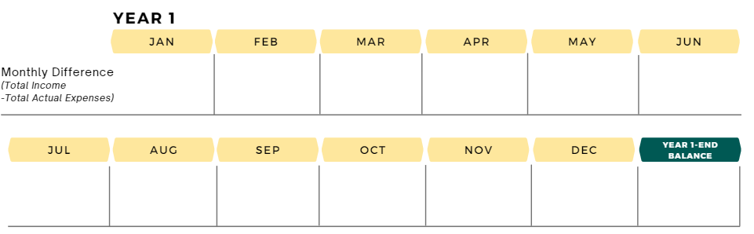
Year 1 End Balance
Input your monthly difference and saving for Year 1 June through December.
Find out your “Year 1 End Balance” by adding the monthly differences from January to December. Are you in the positive or negative by the end of Year 1?
Notes:
Notes for Teachers: Students will add up the monthly differences for the year. Depending on their decisions in the game thus far, they will most likely add integers at this point (positive and negative numbers).

Slide 58
Year 1 Savings
Find out your total savings at the end of Year 1 by adding your saving amounts from January to December.

Slide 59
Student Reflection
Congratulations on reaching the end of Year 1! At this point, let’s take a pause and reflect on what we have learned so far.
Did you end Year 1 in the positive or negative?
Is there something you would like to do differently in Year 2?
Looking at your total savings for Year 1, would you like to save more in Year 2? Save less? Maintain the same level? (To help answer the question, look at the financial goal you chose and compare the two amounts.)
Would you like to keep working towards the same financial goal, or would you like to choose a new one?
How did you decide between borrowing debt and investing your money?
Why did you pick your debt or investment option over the other option?

Slide 60

Year 2
Input the same monthly difference and saving from Year 1 December in Year 2 January through June.
If your monthly difference continues to be negative, you may want to adjust your monthly budget and expenses starting in Year 2 January. Remember, overspending for many months can have a negative impact on your financial health! (See slide 8)
If you are happy with your monthly difference and saving,
no adjustments are needed.

Slide 61

Notes:
Notes for Teachers: The Instagram ads on slide 61-62 are visible only in the teacher version. Give students time to decide if they want to make a purchase.

Slide 62
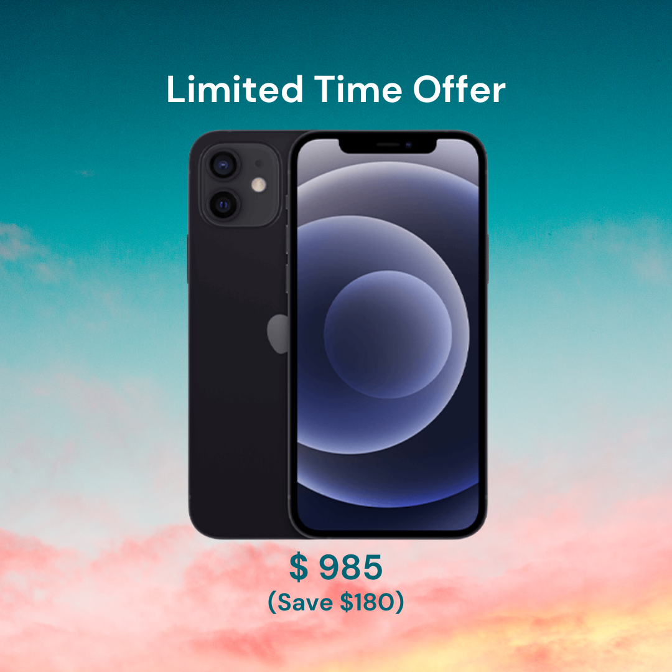
Notes:
Notes for Teachers: The Instagram ads on slide 61-62 are visible only in the teacher version. Give students time to decide if they want to make a purchase.

Slide 63
Year 2 July
Did you take the new phone deal? You can pay for it with your savings partially or fully, or you can add it to your “personal items” expense for Year 2 July. Input your monthly difference and saving in Year 2 July.
Helpful tip for students: Those who purchased the phone, you do not need to redo the monthly budget. Simply subtract the amount from the monthly summary in June. If you want to pay for it with your savings, here is a sample calculation:
Total savings = $500
Purchased the $825 phone ($825 - $500 = $325 still owing)
$325 extra spending this month. Subtract $325 from June’s monthly summary.
Notes:
Notes for Teachers: This slide is only visible in the teacher version. Provide these instructions to your students, so they can proceed with Year 2 July calculations.

Slide 64
Year 2 August - December
Your avatar maintains the same level of income and expenses for Year 2 August through December.
Input the monthly difference and savings from Year 2 June for August through December.

Slide 65

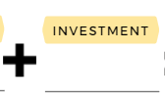
For those who invested…
It is time to collect your reward!
If you borrowed debt, move on to the next slide.
If you invested in Option A High-Interest Rate Savings Account, you earned $688.38. You must pay $50 as a withdrawal fee.
If you invested in Option B Regular Savings Account, you earned $507.42. You must pay $15 as a withdrawal fee.
Input in your financial planner (Make sure
you subtracted the withdrawal fee):
Notes:
Notes for Teachers: This is the reward for those who invested. Ensure that the students subtracted the withdrawal fee from the investment earnings. (For example: Option A earnings are $655.20 before the withdrawal fee. $655.20 - $125 = $530.20. Students input $530.20 in their financial planner.)

Slide 66
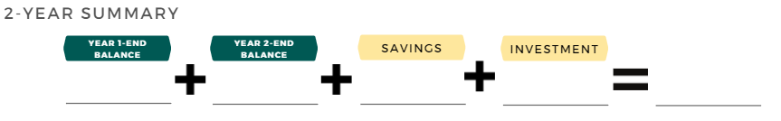
Were you successful in adulting?
Did you…
Pay bills successfully and make wise financial decisions for 2 years,
Achieve your financial goal, and
Do not have any debt.
If you borrowed debt, leave this blank.
If the grand total is negative, it means you are in debt.
Enter your total savings amount.

Slide 67


Slide 68
Student Reflection
What did you enjoy learning the most?
What would you do differently if you were to play this game again?
Did you choose a different financial goal halfway through the game? Did you make it close to your financial goal? Or did you overachieve it?
a) If you reached your financial goal, what were some decisions that helped you? OR
b) If you did not achieve your financial goal, what do you think affected your outcome?
a) If you do not have any debt by the end of Year 2, what were some decisions that helped you? OR
b) If you have debt, what may have contributed to that? What could you have done differently?

