Slide 1
Foreign Currencies &
Exchange Rates
Grade 7+

Slide 2

A Special Note For Teachers

Slide 3

Minds On Activity
Think-Pair-Share
What is a currency? Have you heard of it before?
What is a currency exchange rate?

Slide 4
Academic Language
Currency
Domestic currency
Foreign currency
Exchange rate
Convert

Slide 5





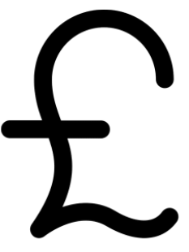
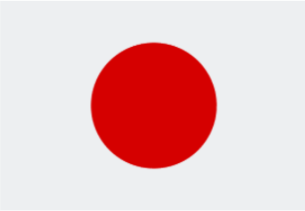


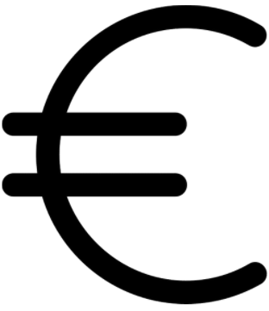
What is a currency?
Currency is the money (bills and coins) used in a country.
Each country has its own currency. In Canada, we use Canadian dollars. In the United States, they use US dollars.
Each currency has its own name. (In Canada, we use dollars. Mexico uses pesos, England uses pounds, Japan uses yen).
Some countries share the same currency (the Euro is used by 19 countries in Europe.)

Slide 6
What is a foreign currency?
A foreign currency is the currency of a foreign country.
Scenario 1:
Sandra lives in Edmonton, Canada. She is traveling to New York, USA.
In this scenario, Canadian Dollars is the domestic currency, and US Dollars is the foreign currency.

Slide 7
What is a foreign currency?
A foreign currency is the currency of a foreign country.
Scenario 2:
Pradeep grew up in Kolkata, India. His family is preparing to immigrate to Ottawa, Canada.
As his family is planning to immigrate, the Indian currency (Rupees) is the domestic currency, and the Canadian Dollars is the foreign currency.
Pradeep and his family lived and worked in Canada for a while. They want to travel back to Kolkata for a visit.
As he works in Canada, Pradeep earns Canadian Dollars. It is now the domestic currency. Indian Rupees are now the foreign currency.

Slide 8

What is currency exchange?
https://www.youtube.com/watch?v=Kw30kGVPeXA

Slide 9
What is an exchange rate?
If you want to change one currency into another, you need to find out how much you can get.
Let’s say you are converting from Canadian Dollars to US Dollars. We know that 1 Canadian Dollar does not equal 1 US Dollar (that is why you see a Canadian price and a different US price on a product).
So then, how much is 1 Canadian dollar in US Dollars?
We need to find the exchange rate!
Notes:
Notes for Teachers: Teachers can have a longer discussion with students about the different Canadian prices and US prices for the same product. This shows that Canadian Dollars and US Dollars are not worth the same.

Slide 10
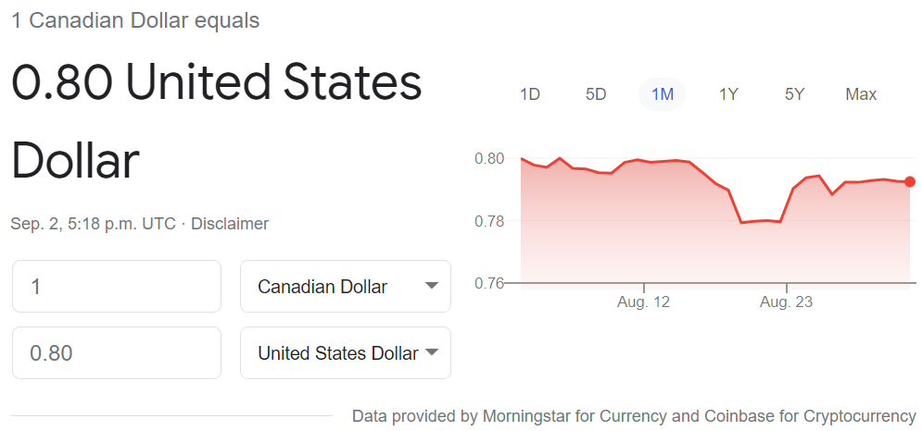
Student Exploration Activity
Students access Google on a device (phone, tablet, or laptop).
On Google website, search for “Canadian Dollar to US Dollar”. You may see something like the screenshot below.
Hover your mouse on the graph, and look for the exchange rate for 1 day, 5 days, 1 month, 1 year, and 5 years. What do you notice?

Slide 11
Student Exploration Activity
Discussion questions:
What do you think this means: “1 Canadian Dollar equals 0.80 United States Dollar”?
In this scenario, you are converting Canadian Dollars into US Dollars. Which one is the foreign currency?

Slide 12

Student Exploration Activity
Let’s flip it!
What about converting from US Dollar to Canadian Dollar?
On Google, search for “US Dollar to Canadian Dollar”. Then discuss the questions below:
How much is one US Dollar worth in Canadian Dollars?
Comparing the exchange rates, do you think Canadian Dollar is the stronger currency or the weaker one?
In this scenario, which one is the foreign currency?

Slide 13

The Stronger Currency
How do you know if a currency is the stronger one? It is the currency that’s worth more.
If one Canadian Dollar equals more than a dollar in a foreign currency, then Canadian Dollar is stronger.
If one Canadian Dollar equals less than a dollar in a foreign currency, then the Canadian Dollar is weaker. The foreign currency is stronger.

Slide 14

Student Exploration Activity
Let’s compare the Canadian Dollars to foreign currencies around the world! Which one is the stronger currency?
Egypt
South Africa
Jamaica
Argentina
Brazil
China
India
Turkey
Germany
United Kingdom (England)
Iceland
Your family’s home country
Or any other countries you can think of!

Slide 15
Let’s calculate the currencies
Method 1: Ratios
Method 2: Cross-Multiplication

Slide 16

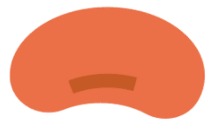
Review: Ratio and Fraction
Ratio
1 red
:
2 blue
Fraction
numerator
denominator

Slide 17
Review: Ratio and Fraction
Ratios
1 red
:
2 blue
Bag 1
:
1 blue
3 red
Bag 2
Fractions
numerator
1 red
3 red
denominator
2 blue
1 blue

Slide 18







Method 1: Ratios
Sandra is traveling from Edmonton, Canada to New York, USA. The exchange rate is 1 Canadian Dollar to 0.80 US Dollar. Sandra budgeted to spend $800 Canadian Dollars on her trip. How much is her budget worth in US Dollars?
:
1 Canadian Dollar
0.80 US Dollar
$$×800$$
$$×800$$
$800 Canadian Dollars
:
$$x$$
$$?$$
$$x=0.80 US Dollar×800$$
$$x=640$$
$800 Canadian Dollars
:
$$\$640 US Dollars$$

Slide 19












Method 2: Cross Multiplication
Sandra is traveling from Edmonton, Canada to New York, USA. The exchange rate is 1 Canadian Dollar to 0.80 US Dollar. Sandra budgeted to spend $800 Canadian Dollars on her trip. How much is her budget worth in US Dollars?
:
:
$$?$$
$800 Canadian Dollars
1 Canadian Dollar
0.80 US Dollar
numerator
$$=$$
$$x$$
denominator
$$(1 Cdn Dollar)(x)$$
$$=$$
$$(800 Cdn Dollar)(0.80 US Dollar)$$
$$(1)(x)$$
$$=$$
$$(800)(0.80)$$
$$x$$
$$=$$
$$\$640$$

Slide 20
















Method 2: Cross Multiplication
What goes wrong here?
Sandra is traveling from Edmonton, Canada to New York, USA. The exchange rate is 1 Canadian Dollar to 0.80 US Dollar. Sandra budgeted to spend $800 Canadian Dollars on her trip. How much is her budget worth in US Dollars?
:
:
$$?$$
1 Canadian Dollar
$800 Canadian Dollars
0.80 US Dollar
$$x$$
numerator
$$=$$
denominator
$$(1 Cdn Dollar)(800 Cdn Dollar)$$
$$=$$
$$(0.80 US Dollar)(x)$$
$$(1)(800)$$
$$=$$
$$(0.8)(x)$$
$$800$$
$$=$$
$$0.8x$$
$$0.8$$
$$0.8$$
$$\$1,000$$
$$=$$
$$x$$
Notes:
Note to Teachers: The units in the numerator and denominator do not match. Therefore the answer is wrong. Students can reason that US Dollar is the stronger currency (Canadian Dollar is the weaker currency), therefore they should receive less than $800 after the conversion.

Slide 21
Let’s calculate the currencies
Which method do you prefer more?
The trickiest part is deciding what goes on top of the fraction (numerator), and what goes on the bottom of the fraction (denominator).
The units on the numerator must be the same, and the units on the denominator must be the same.
Let’s practice!

Slide 22
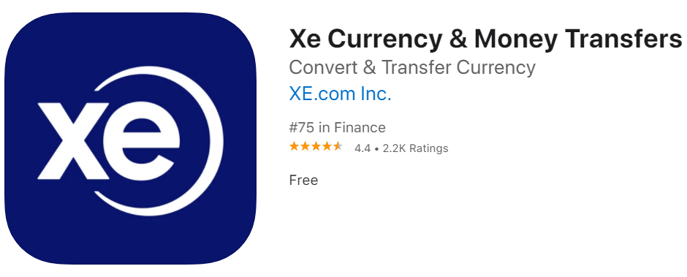
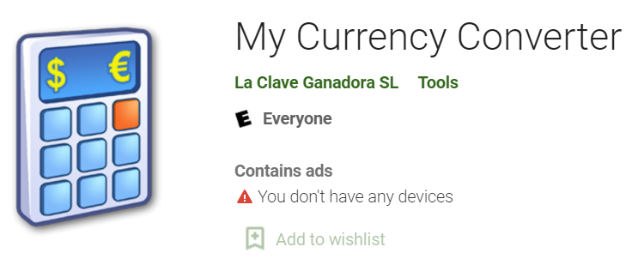
Apps for Phones and Tablets
And many more!

