Slide 1
Money In Words & Numbers
Grade 5+

Slide 2

A Special Note For Teachers

Slide 3
Agenda
1. Brainstorm: K-W-L Chart
2. Match the Coin
3. Which One Doesn't Belong?
4. Virtual Trip to the Store
5. The Price Is Good
Notes:
1.Match the coin: Basic literacy & numeracy
2.Which one doesn’t belong? Basic literacy & numeracy
3.Virtual trip to the store: Curriculum standard gr. 4 F1.2, gr. 5 F1.2
4.The Price is Good: Curriculum standard gr. 4 F1.1, gr. 4 F1.5, gr. 5 F1.5

Slide 4
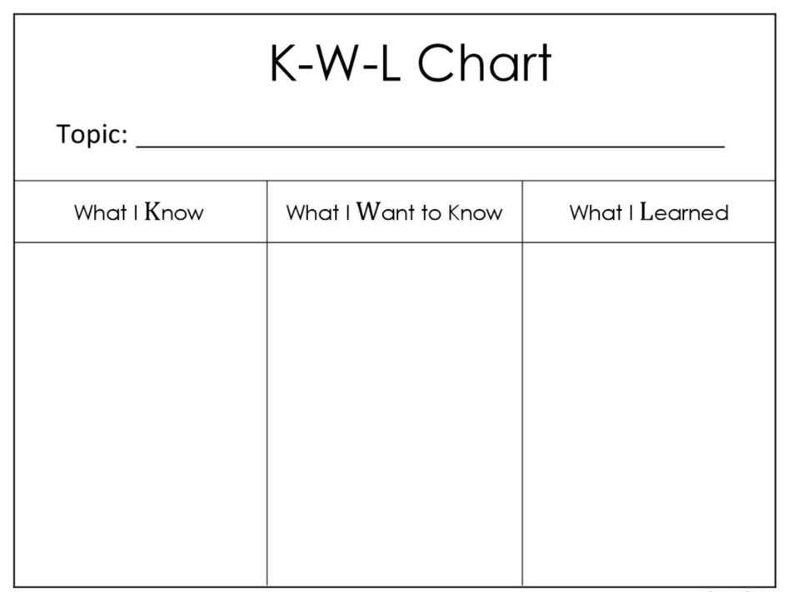

Money!

Slide 5
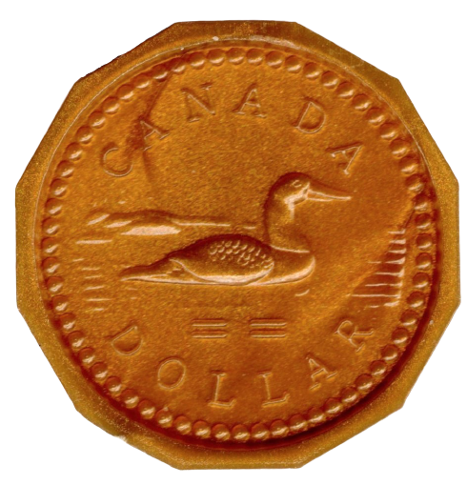
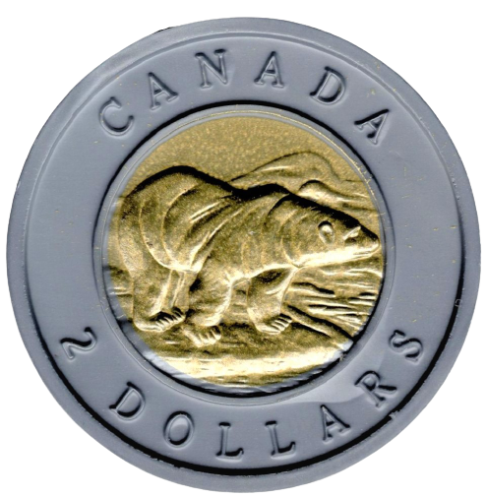
Canadian Coins
Loonie
One Dollar = $1.00
Toonie
Two Dollars = $2.00

Slide 6
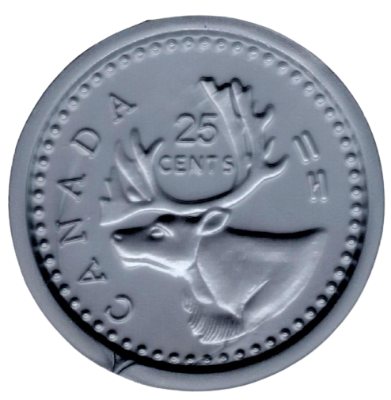
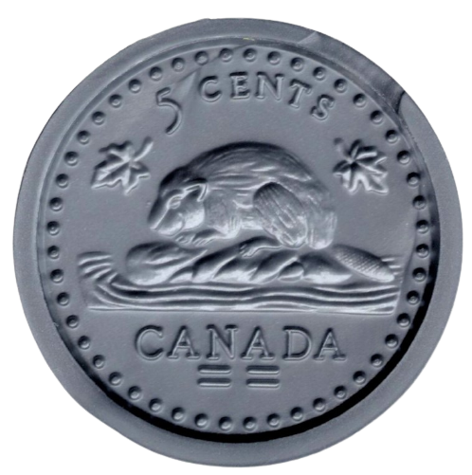
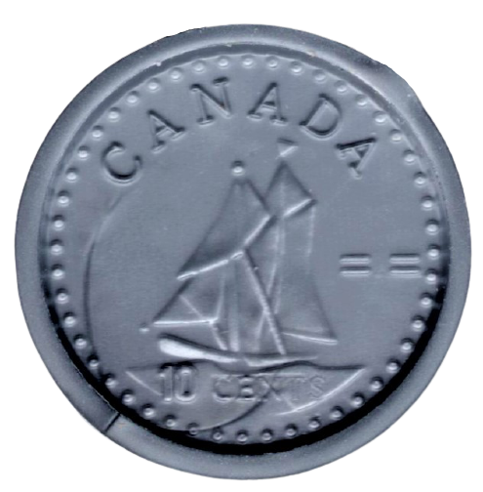

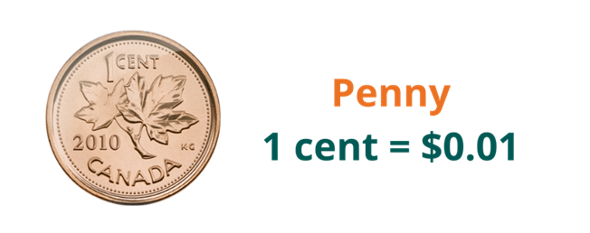
Canadian Coins
Quarter
25 Cents = $0.25
Nickel
5 Cents = $0.05
Dime
10 Cents = $0.10

Slide 7
Match the Coin
Toonie
Loonie
Quarter
Dime
Nickel

Slide 8
Match the Coin
Toonie
Loonie
Quarter
Dime
Nickel

Slide 9
Match the Coin
Toonie
Two Dollars = $2.00
Quarter
One Dollar = $1.00
Nickel
Loonie
25 cents = $0.25
Dime
10 cents = $0.10
5 cents = $0.05

Slide 10
Match the Coin
Toonie
Two Dollars = $2.00
Quarter
One Dollar = $1.00
Nickel
Loonie
25 cents = $0.25
Dime
10 cents = $0.10
5 cents = $0.05

Slide 11
Match the Coin
Toonie
Two Dollars = $2.00
Quarter
One Dollar = $1.00
Nickel
Loonie
25 cents = $0.25
Dime
10 cents = $0.10
5 cents = $0.05

Slide 12
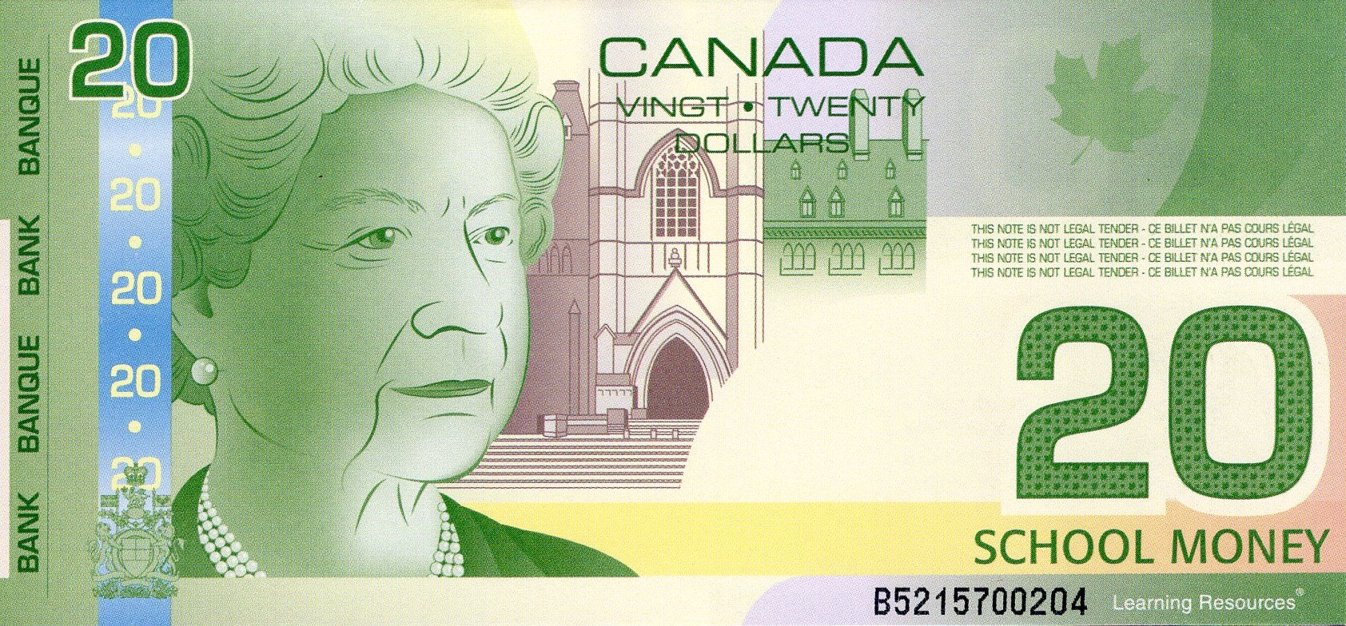
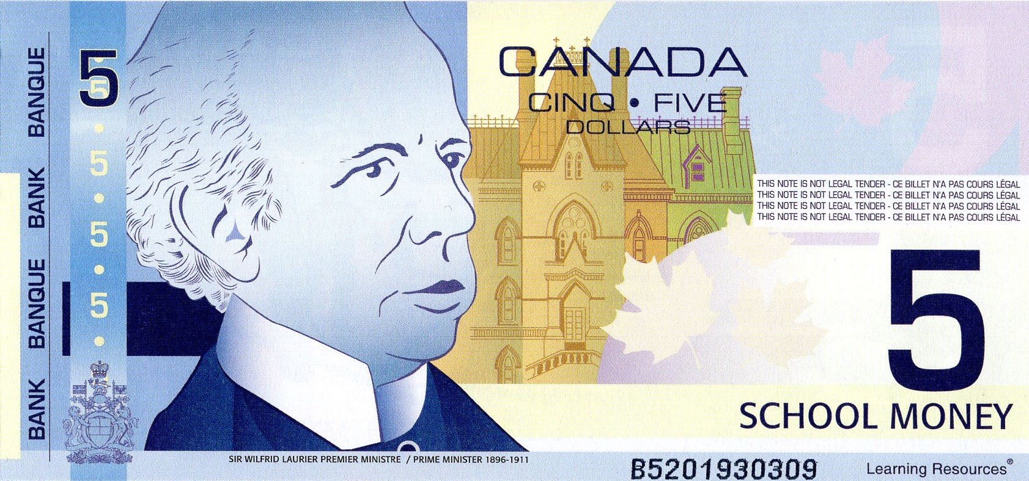
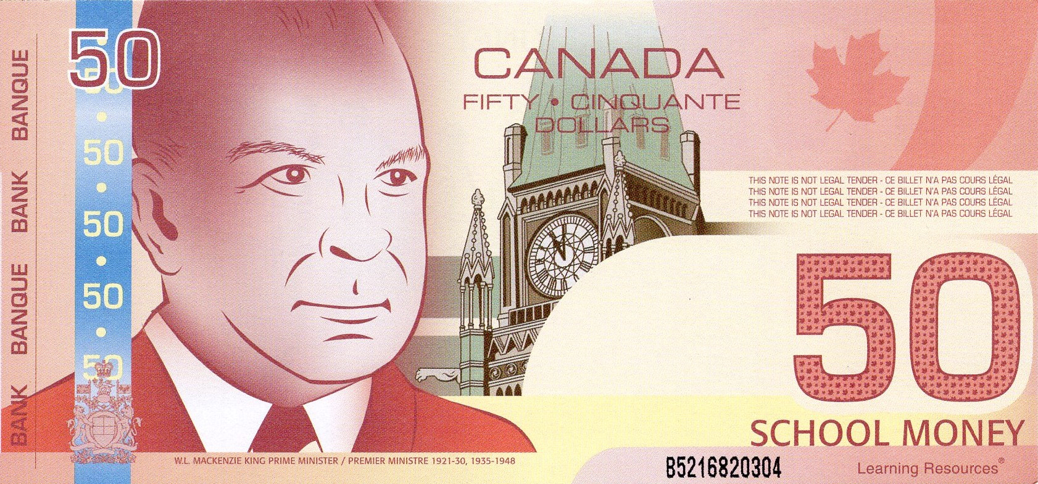
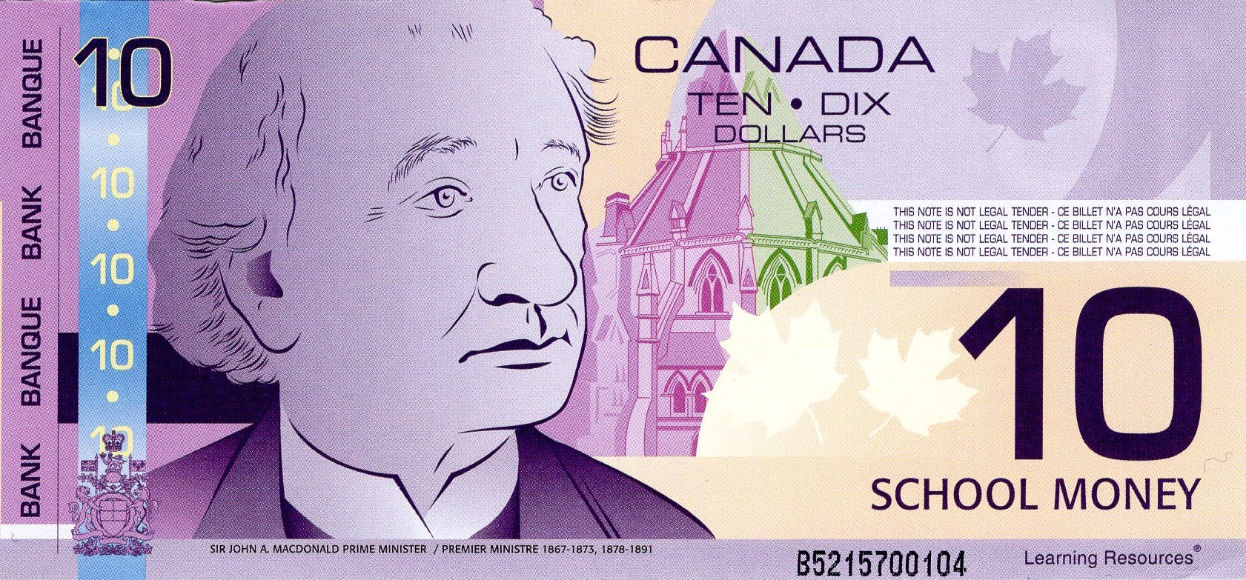
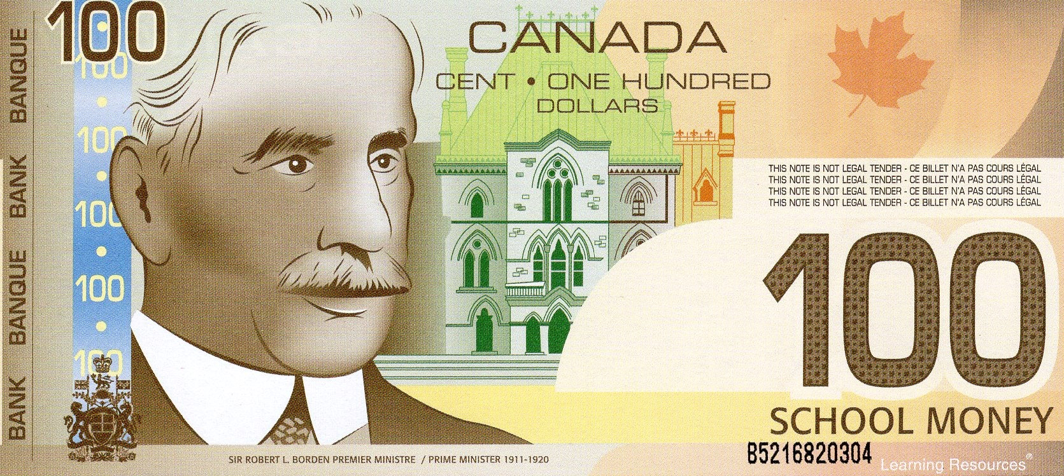
Canadian Bills

Slide 13
Canadian Bills
Five Dollars
$5.00
Ten Dollars
$10.00

Slide 14
Canadian Bills
Twenty Dollars
$20.00
Fifty Dollars
$50.00

Slide 15

Canadian Bills
One Hundred Dollars
$100.00

Slide 16

Which One Doesn’t Belong?
$4.50
A
B
C
D
$3.25

Slide 17
Which One Doesn’t Belong?
$6.75
A
$8.00
B
C
D

Slide 18
Which One Doesn’t Belong?
$10.25
A
B
$8.00
C
D

Slide 19
Which One Doesn’t Belong?
$2.25
A
B
C
D
$2.15

Slide 20
Which One Doesn’t Belong?
$14.25
A
$14.20
B
C
D

Slide 21
Which One Doesn’t Belong?
$50.30
A
B
$50.20
C
D

Slide 22
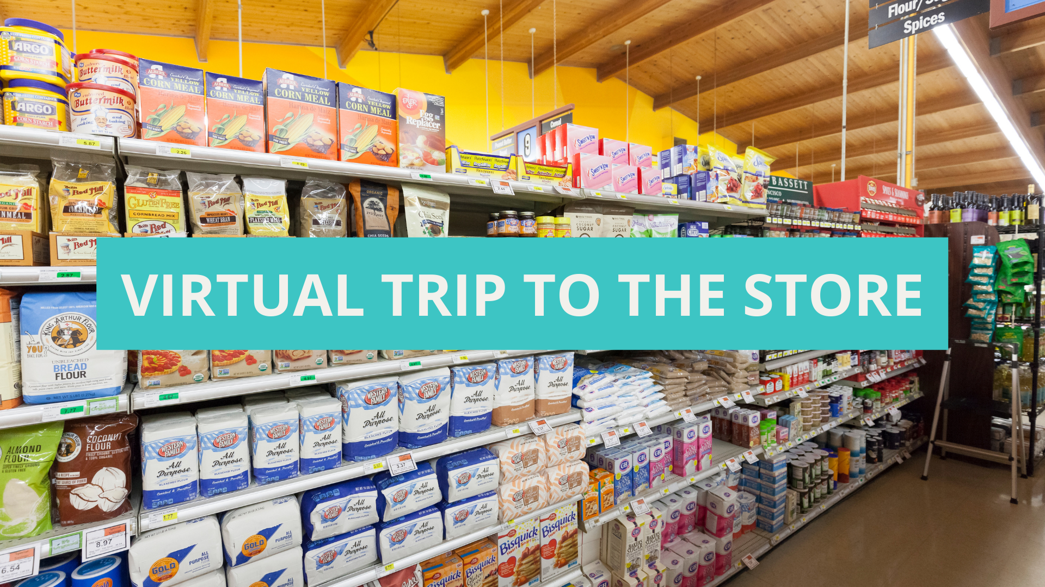

Slide 23





Virtual Trip to the Store
An option for classrooms with available technologies:
Which grocery store do you go to most often?
  No Frills
  Food Basics
  Superstore
  Sobeys
  Walmart
  Neighbourhood grocery store
Students look for an online flyer and “purchase” items for the next week
Students work in groups and shop at different stores. The whole class can compare prices afterwards.

Slide 24

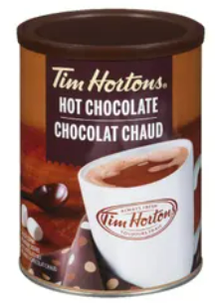
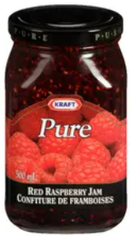
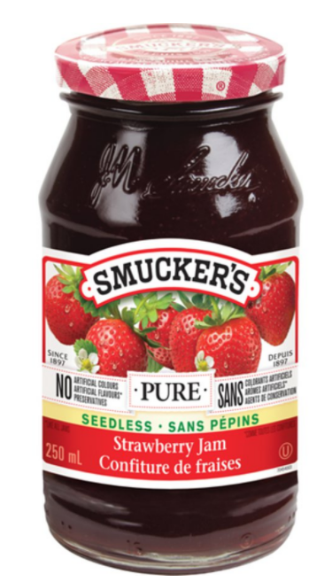
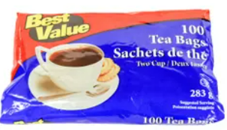
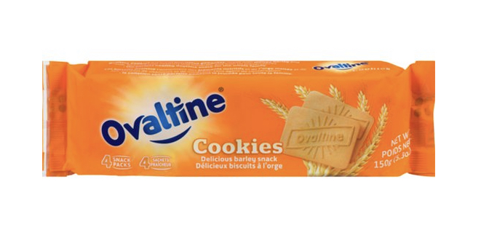
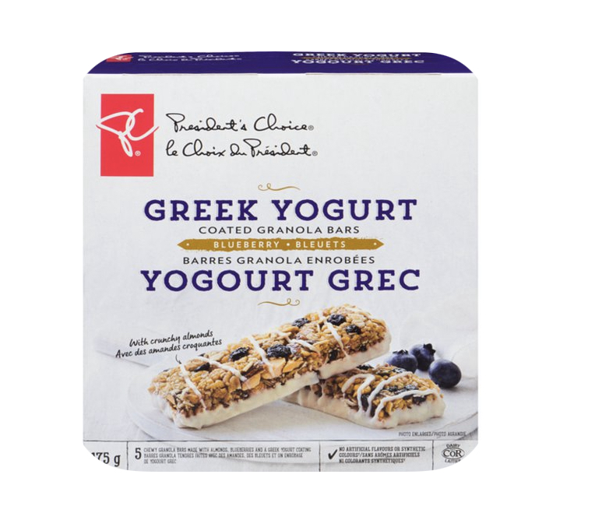
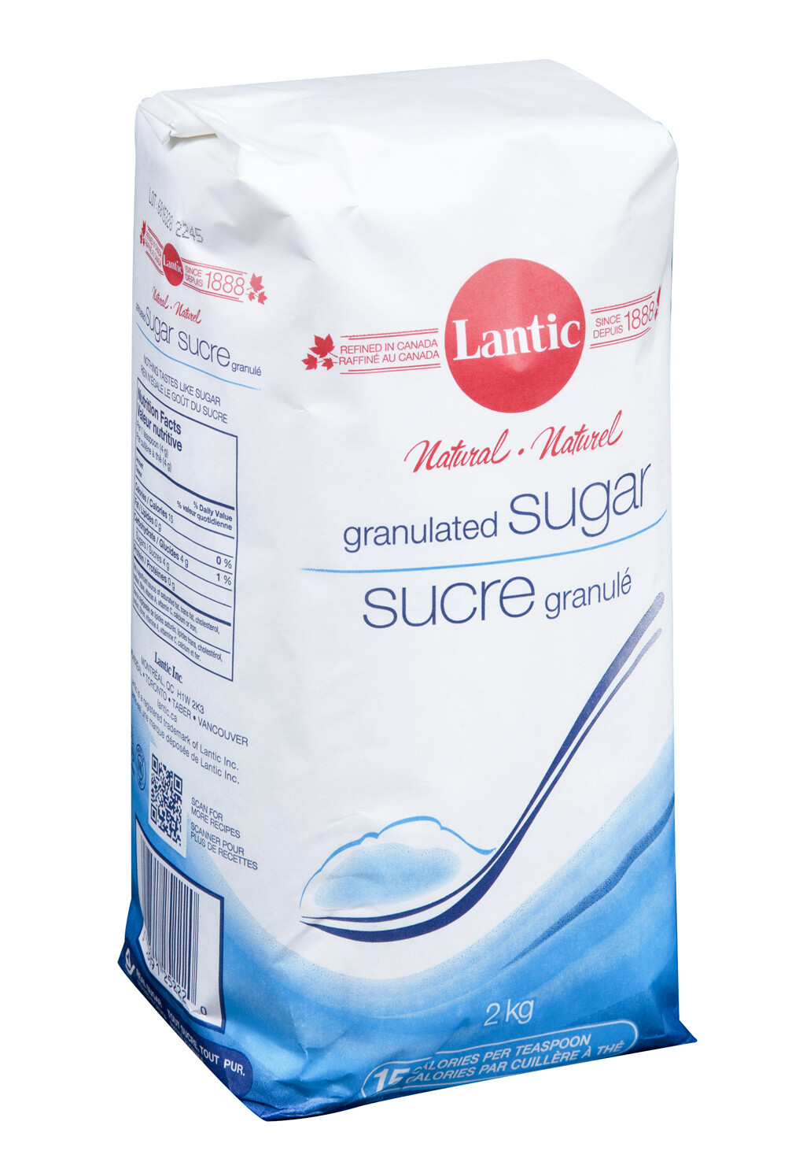
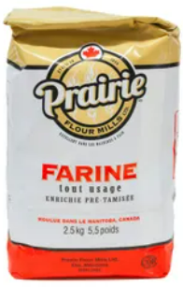
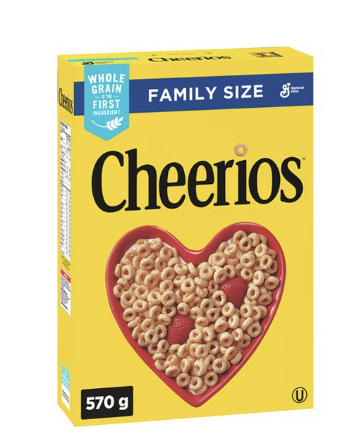
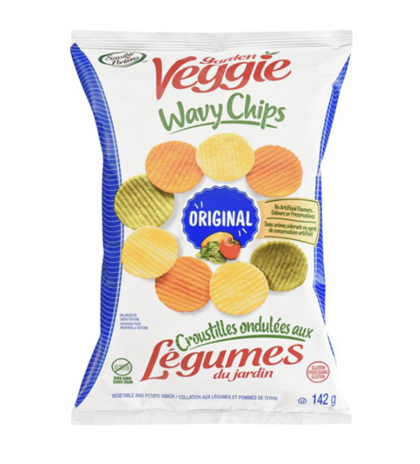
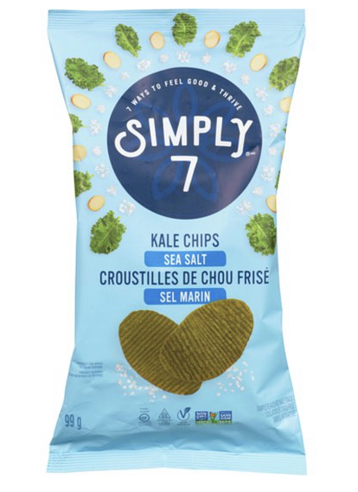
PANTRY
Hot Chocolate (500 g)
$4.99 + tax
Tea Bags (100 count)
$2.99
Jam 250ml
Sale $2.59
Jam 250ml
$3.99
Ovaltine
Sale $1.79 + tax
Greek Yogurt & Blueberry Granola Bars
$2.99 + tax
All Purpose Flour
(2.5 kg)
$4.79
Kale Chips
$5.49 + tax
Granulated Sugar (2kg bag)
$2.49
Veggie Chips
$3.99 + tax
Cereal
(Family Pack)
$7.49 + tax
Notes:
Disclaimer

Slide 25
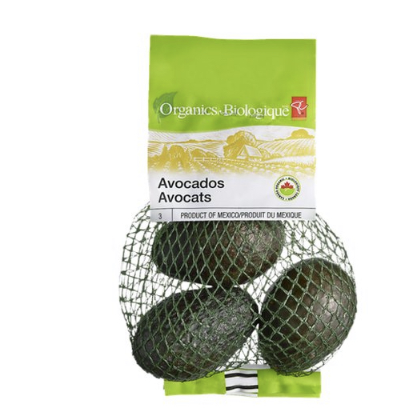
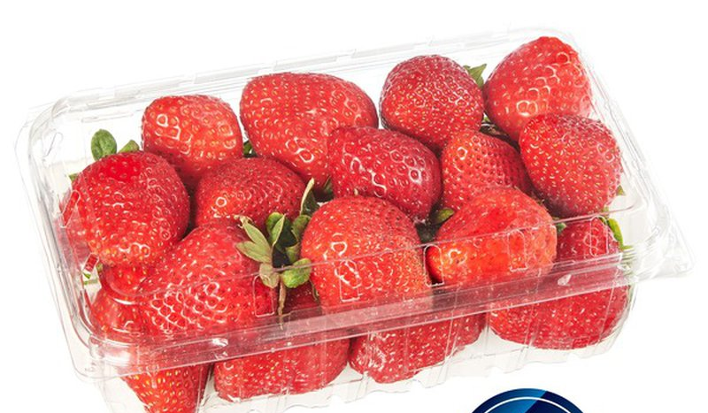
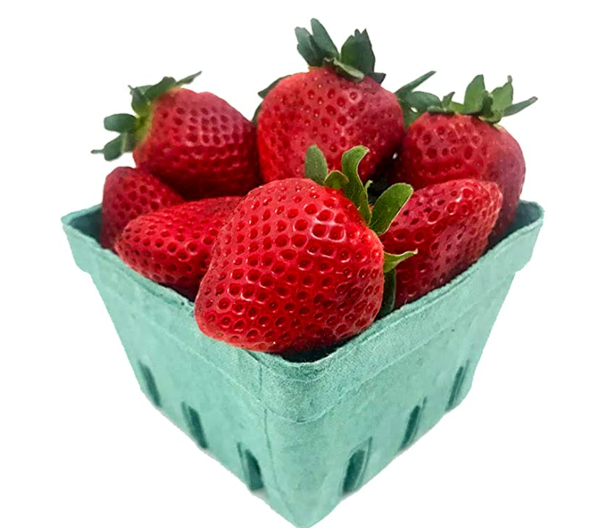
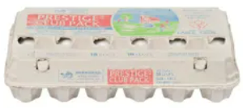
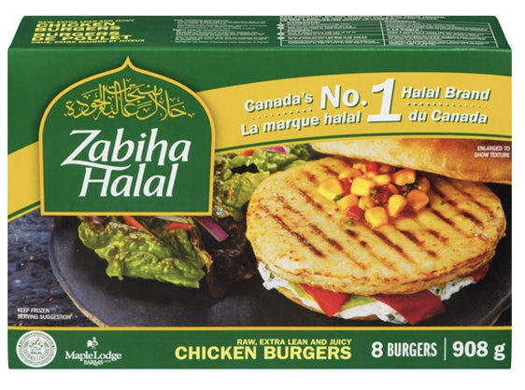
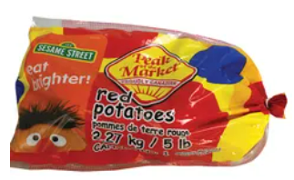
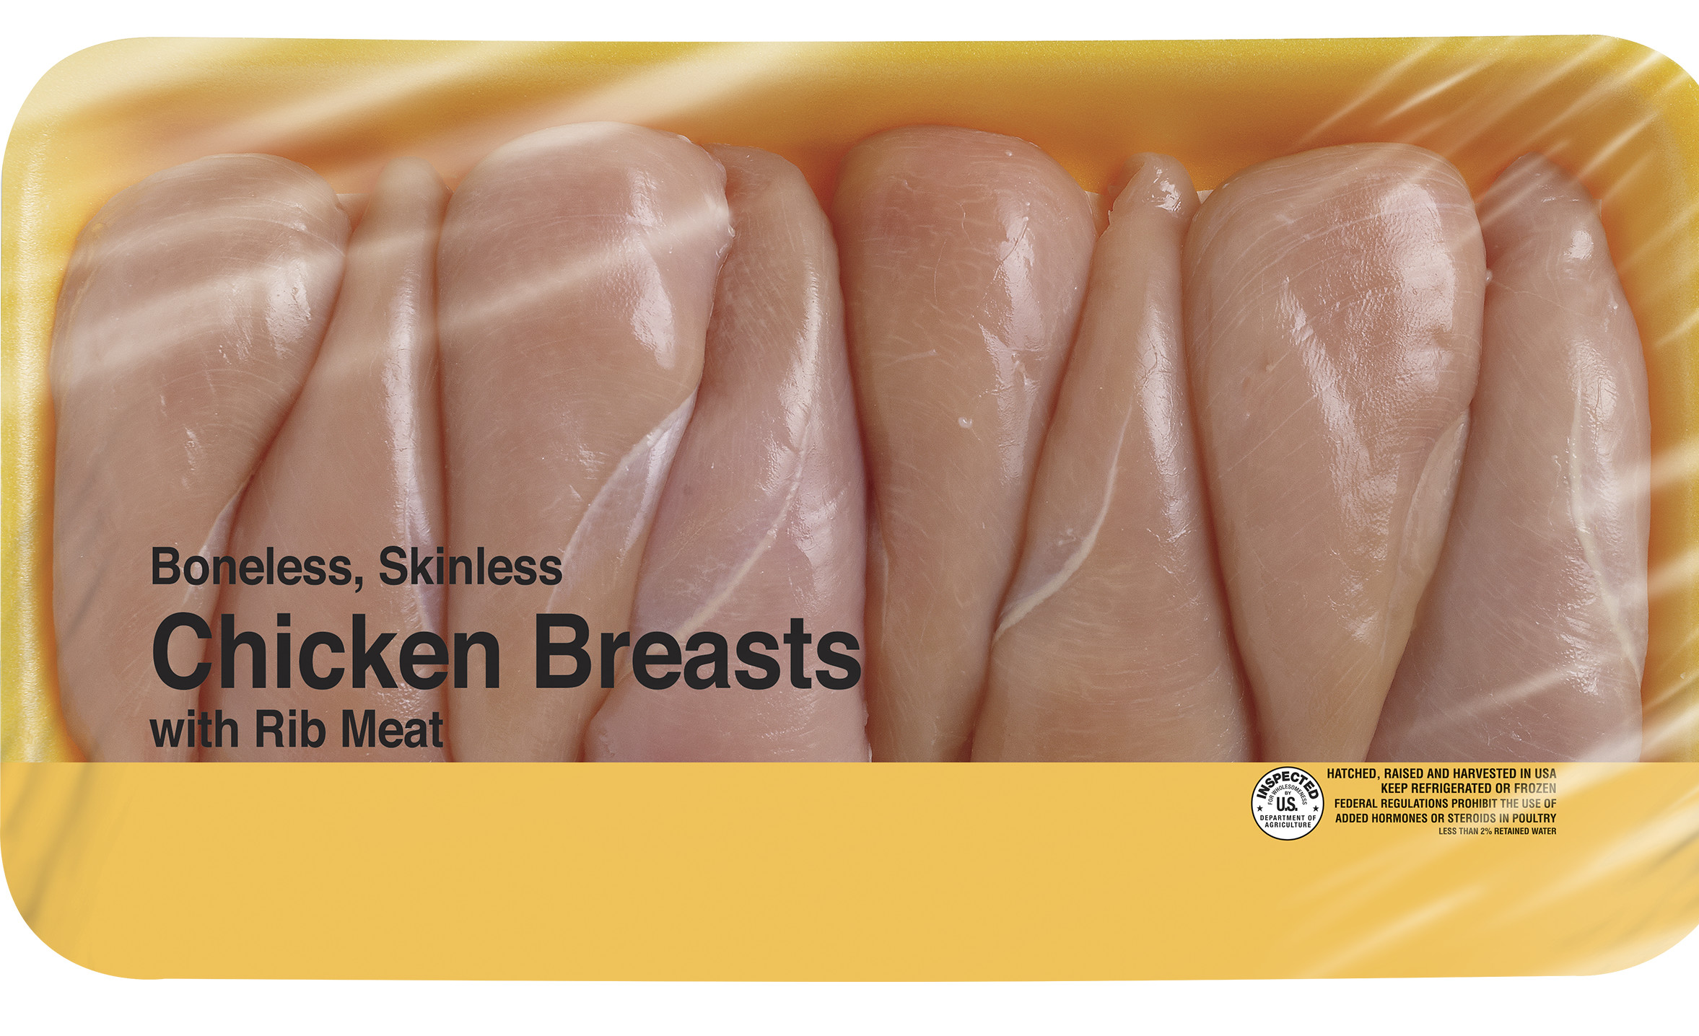
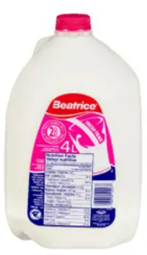
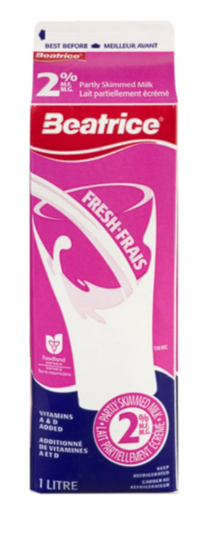
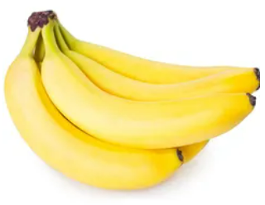
FRESH
Avocados (Bag)
$5.99
Eggs Large (18 count)
$6.29
Strawberries (12oz)
$4.99
Organic Strawberries (10 oz)
$7.40
Halal Chicken Burgers
$14.50 + tax
Potatoes (5 pounds)
Sale $5.49
Chicken Breast
$9.00
2% Milk (4 L)
$4.69
2% Milk (1 L)
$3.09
Bananas (1 kg)
$1.26

Slide 26


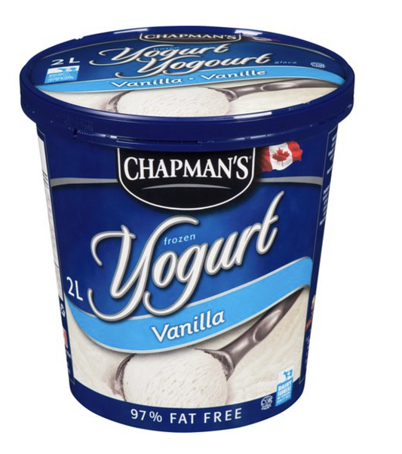
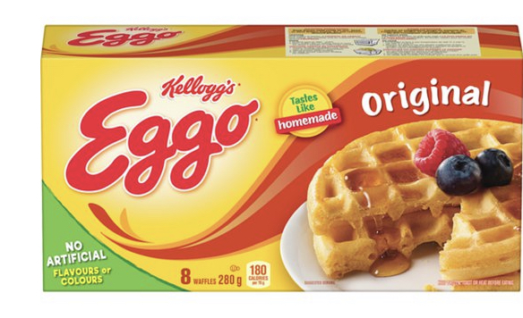
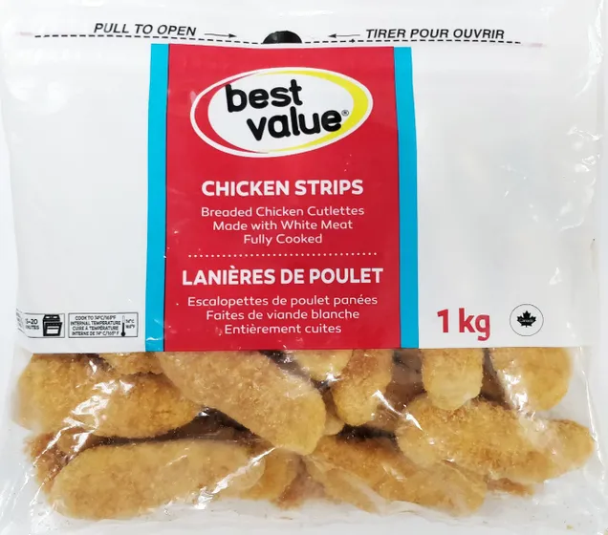

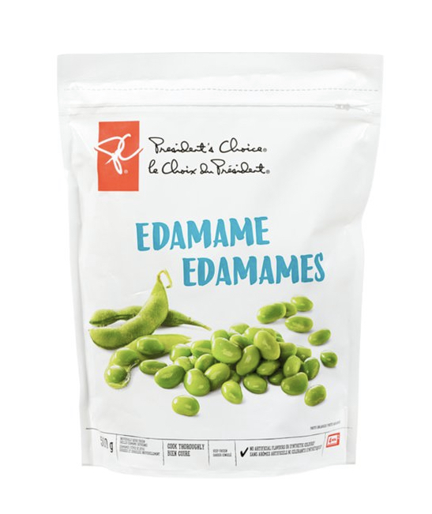
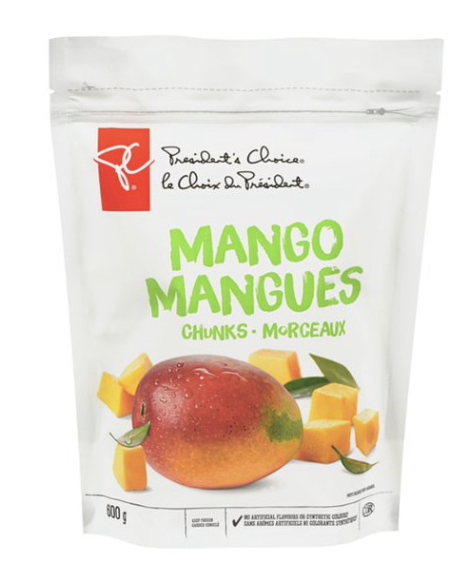
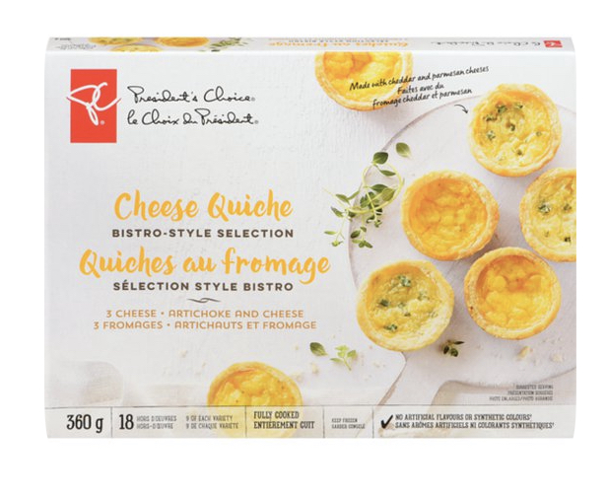
FROZEN
Cauliflower Crust Frozen Pizza
$6.99 + tax
Frozen Waffles
$3.49 + tax
Frozen Broccoli
$4.99 + tax
Frozen Yogurt
$6.49 + tax
Chicken Fingers (Club Size)
$11.49 + tax
Frozen Quiche
$7.99 + tax
Organic Frozen Mango
$7.99 + tax
Frozen Edamame
$5.49 + tax
Frozen Mango
$4.99 + tax

Slide 27
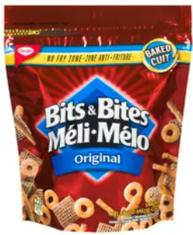
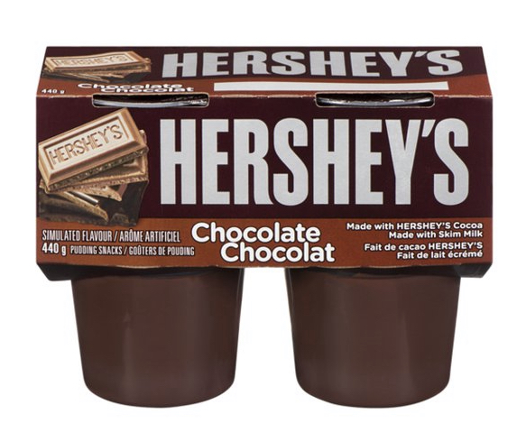
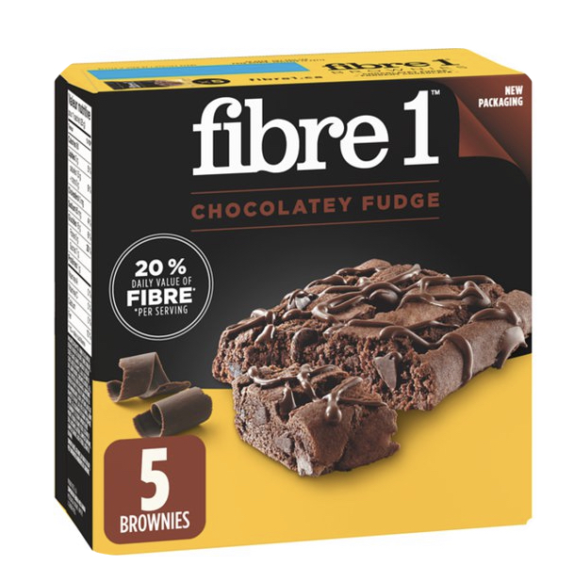
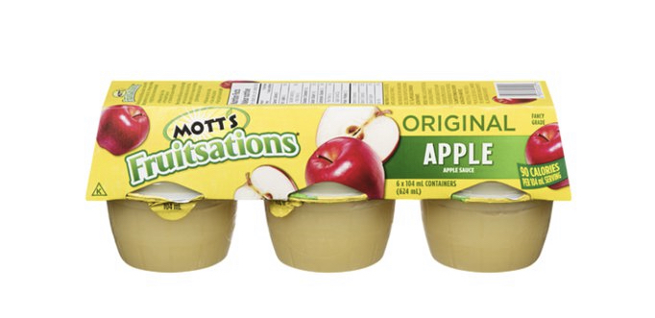
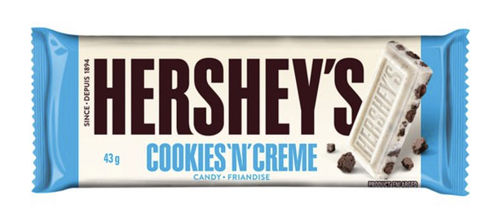
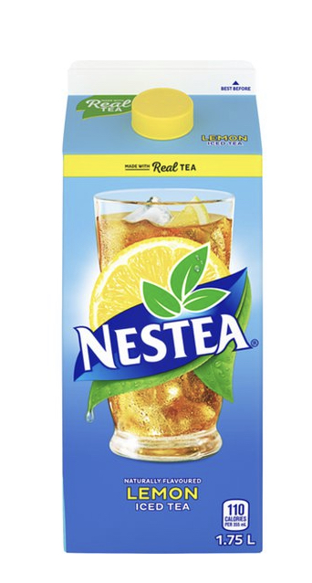
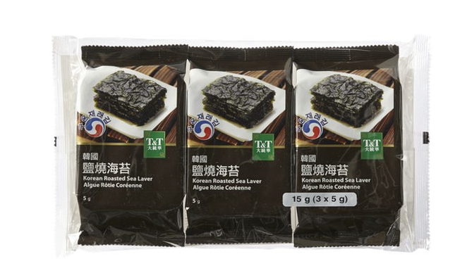
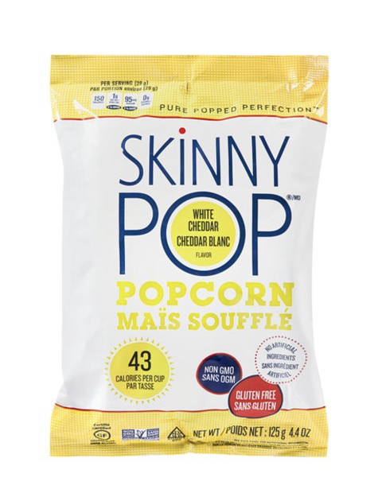
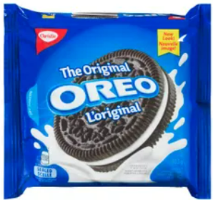
SNACKS
Pudding (5 pack)
$ 4.29 + tax
Chocolate Bar
$1.29 + tax
Apple Sauce
$3.29 + tax
Fiber 1
Brownie (5 pack)
$ 4.29 + tax
Bits & Bites Snack
Sale $3.49 + tax
Korean Roasted Seaweed (100 grams)
$1.99 + tax
Nestle Iced Tea
$2.99 + tax
Popcorn
(100 grams)
$4.69 + tax
Oreo
$5.29 + tax

Slide 28

Online Shopping

Slide 29

How to Calculate Tax
Taxed items: processed foods, junk foods, packaged foods
Pro Tip:
Ask yourself, “Do I really need these?”
Pay extra 13% on…
Frozen pizza
Pop
Chips
Cookies
Cheese slices
etc.

Slide 30
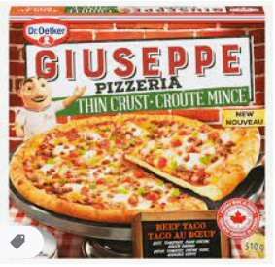




How To Calculate Tax
$13\%=\frac{13}{100}=0.13$
Step 1: To find the tax amount, multiply the cost of an item by 0.13:
$$\$ 8.99×0.13=\$ 1.1687$$
Step 2: To find the subtotal, add the tax amount to the cost of an item:
$$\$ 8.99+\$1.1687=\$ 10.1587$$
Frozen Pizza
$8.99 + tax
Step 3: Round the subtotal to the nearest hundredths:
$$\$ 10.1587 or \$10.16$$

Slide 31
The Price Is Good

Slide 32




Goods
Pepsi
2 for $6.00
Crush
1 for $2.50

Slide 33

Goods
Pro Tip:
Buying bulk!
Buying a bigger size is usually cheaper.
Milk (4 L)
$7.99
Milk (1 L)
$3.05

Slide 34




Service
Wonder Woman Package
New wheel
Wash your bike
New chains
Polish wheels
$85.00
Deadpool Package
New wheel
$10.00
What are some questions to consider?
What do I need?

Slide 35

Service
Shipping Cost
Not expedited
(7-10 business days)
$9.70
Shipping Cost
Expedited
(3-day delivery)
$24.00
It depends!
Is it urgent? (ex. Medicine)
What are some questions to consider?
Will it spoil?
Which option do you have money for?

Slide 36
Money!

