Slide 1
Budgeting: Where Is My Money?
Grade 5+

Slide 2

A Special Note For Teachers

Slide 3
Agenda
Minds On Activity: Think-Pair-Share
My Weekly Budget
Student Reflection Questions
Closing Activity: Exit Slip

Slide 4

Minds On Activity
Think-Pair-Share
Have you heard of a ‘budget’ before? What is it?
Do you think it is important to budget our money? Why or why not?

Slide 5




My Weekly Budget
How much money do you earn in one week?
$

Slide 6
My Weekly Budget
Budget
How much do you think you’re going to spend? It’s a plan for how you will use your money.
Actual
How much did you actually spend?

Slide 7
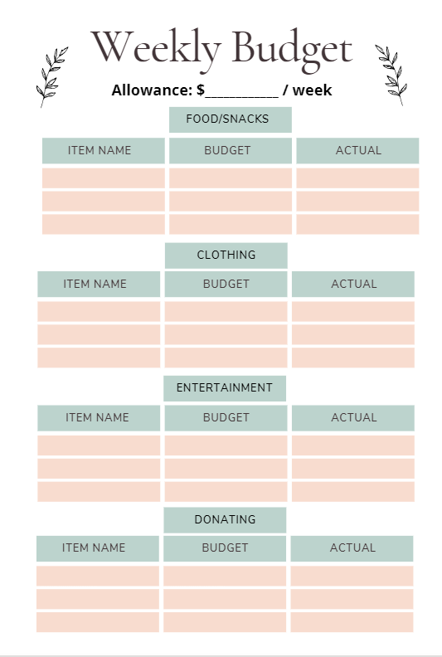
At the start of the week…
At the start of the week, how much do you think you spend on…?

Slide 8
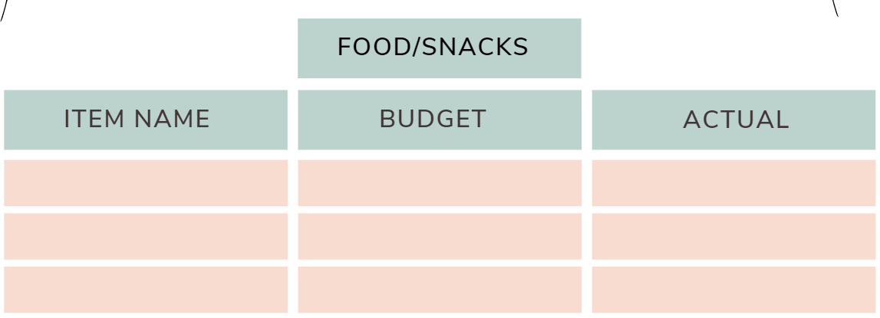
My Weekly Budget
Budget
How much do you think you’re going to spend on…
Fried chicken
$ 8.00

Slide 9
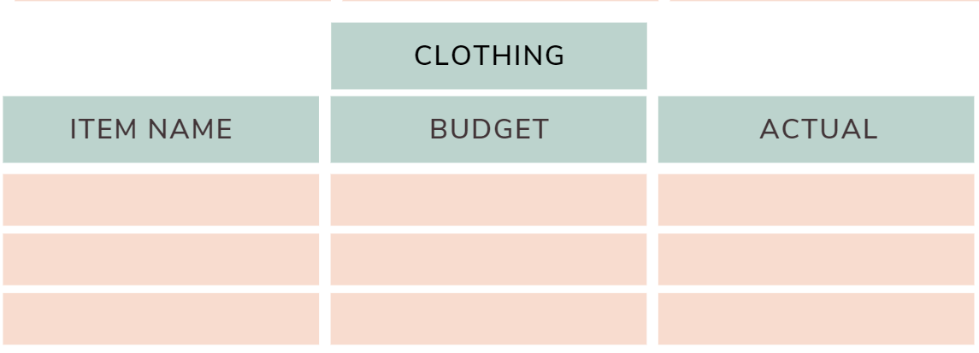
My Weekly Budget
Budget
How much do you think you’re going to spend on…
T-shirt
$ 11.00

Slide 10
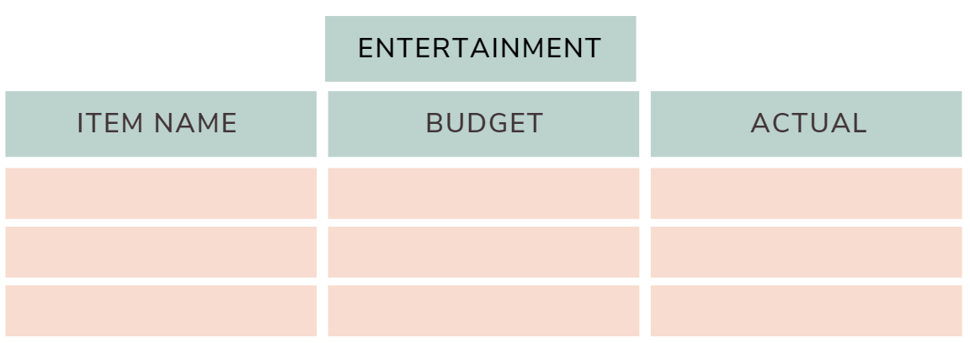
My Weekly Budget
Budget
How much do you think you’re going to spend on…
Netflix
$ 3.49

Slide 11
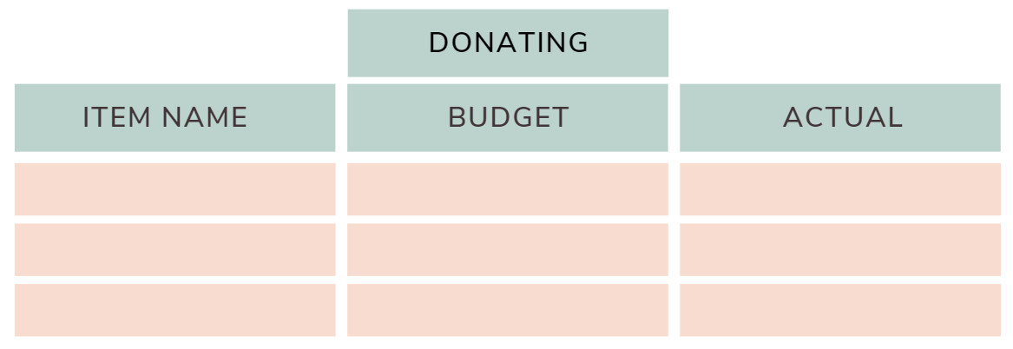
My Weekly Budget
Budget
How much do you think you’re going to spend on…

Slide 12

What is “donating”?
https://www.youtube.com/watch?v=Pbf-mb5L6JY

Slide 13
My Weekly Budget
Budget
How much do you think you’re going to spend on…
School Bake Sale
$ 2.50

Slide 14
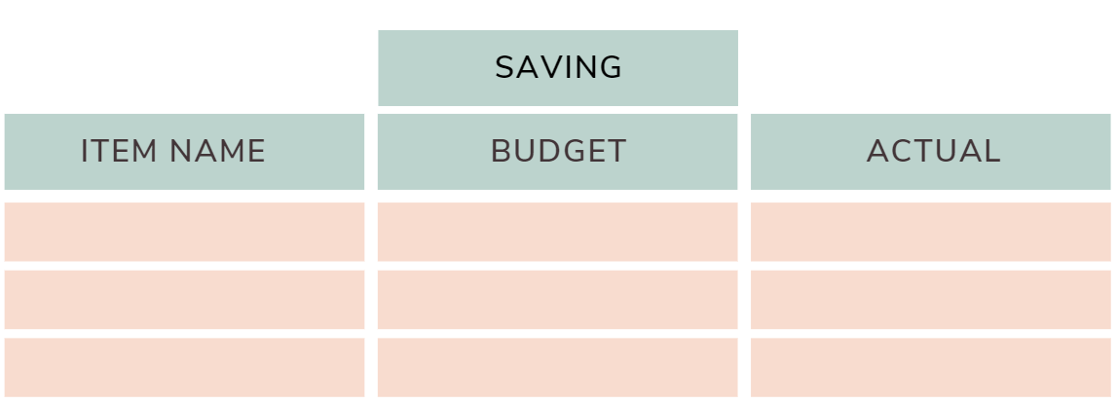
My Weekly Budget
Budget
How much do you think you’re going to save?

Slide 15

What is “saving”?
https://www.youtube.com/watch?v=JkCmIxraWlM

Slide 16
My Weekly Budget
Budget
How much do you think you’re going to save?
Video game: Animal Crossing
Price $80.00
$ 5.00

Slide 17

My Weekly Budget
Now! Add up your ‘budget’ column!
Is your budget total more than your weekly earnings? You can’t spend more than what you have!

Slide 18
At the end of the week…
At the end of the week, fill in how much you actually spent.

Slide 19
At the end of the week…
How much did I actually spend?
Compare it to the ‘budget’ column. Do this for all categories.
Fried chicken
$ 8.00
$ 10.00

Slide 20
At the end of the week…
Just like the ‘budget’ column, add up the ‘actual’ column:

Slide 21

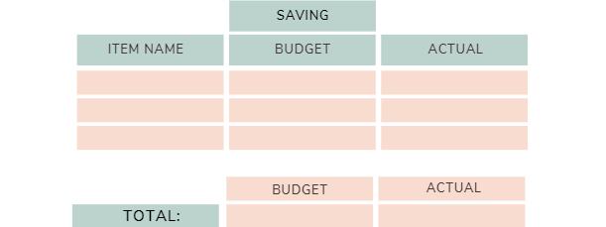
For example…
30.00
Fried Chicken
$ 8.00
$ 10.00
T-shirt
$ 11.00
$ 0.00
I actually spent $9.00 less than my budget!
What will I do with my $9.00?
Netflix
$ 3.49
$ 3.49
Bake Sale
$ 2.50
$ 2.50
For Video Game
$ 5.00
$ 5.00
$ 29.99
$ 20.99

Slide 22
Big Spender...
30.00
Fried Chicken
$ 8.00
$ 10.00
How much money do I have left at the end of the week?
I was given $30.00
I spent $40.98
Now I have −$10.98.
I am in the negative. I spent money that I don’t have.
I am now in debt.
T-shirt
$ 11.00
$ 15.00
Socks
$ 0.00
$ 4.99
Netflix
$ 3.49
$ 3.49
Bake Sale
$ 2.50
$ 2.50
For Video Game
$ 5.00
$ 5.00
$ 29.99
$ 40.98

Slide 23

Student Reflection Questions
In pairs or in groups, answer the following questions:
How do your actual expenses compare with your budgeted expenses?
What are some factors that affected your expenses?
Is there anything you will do differently next week?
How many dollars a week are you saving?
How many dollars a month are you saving?
What can you do with your leftover money? List some things you would save now, so that you can buy later.

Slide 24

Closing Activity
Exit Slip
Tell me something new you learned today.
Is there something you will do differently next week when you do your budgeting?

