Slide 1
Why ‘Interest’ Should Interest You: TFSAs
Grade 11+

Slide 2

A Special Note for Teachers

Slide 3
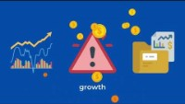
Introduction
Let’s apply our knowledge of compound interest to a real-life situation: investing.
But why should a young person, like you, think about investing?
Watch this video: https://www.youtube.com/watch?v=gO_ImU2LT3Y

Slide 4

In this activity…
We will learn:
What is a TFSA account?
What are the advantages of saving in a TFSA account?
What are the benefits of compounding income within a TFSA as compared to a taxable account?

Slide 5

Minds On Activity
Think-Pair-Share
Have you heard of a “TFSA”?
Can you describe one thing about it?
What is compound interest?

Slide 6

TFSAs
“TFSA” stands for Tax-Free Savings Account.
To open a TFSA, you must be a Canadian resident with a valid Social Insurance Number, and 18-years-old or older.
TFSA is the best savings/investment account you can have. It allows you to set money aside tax-free throughout your life. You can pull money out of the account without paying additional taxes.
You can hold investments in your TFSA, including bonds, stocks, GICs, and mutual funds. Any income you earn from these investments become tax-free!
This is huge because the government usually taxes you when you earn interest, dividend, or capital gains.

Slide 7
TFSAs
TFSAs have a contribution limit, which is a limit on how much money you can put into the account. The Government of Canada determines this limit, called contribution room.
For example: In 2022, you were able to contribute $6,000 a year in your TFSA.
To find the contribution room, go to:
  Tax-free Savings Account Contributions
  TFSA Annual Limit Contribution Room Penalties

Slide 8

TFSA Warnings
Warning #1:
Do not overcontribute! Overcontributing leads to heavy fines from the Canadian government.
Warning #2:
Do not open more than one TFSA account and add the maximum to each account.
While you can open many different TFSA accounts, the maximum contributed across all TFSA accounts cannot exceed the contribution room.
Warning #3:
If you withdraw from your TFSA, you can add money back in only if you have remaining contribution room.
For an example, see here: Making and Replacing Withdrawals in a TFSA

Slide 9

TFSAs
As long as you understand the contribution room and do not exceed it, a TFSA is a very useful tool for saving and investment!
With a TFSA, you compound your investment income tax-free. This will lead to much higher returns over time.

Slide 10

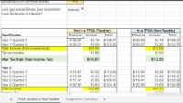
TFSA Exploration Activity
We will explore how taxes affect our investment by using a spreadsheet.
We will compare two options:
A taxable scenario (no TFSA) vs. a non-taxable scenario (using a TFSA).
To complete the activity, download the TFSA Calculator at https://www.unitedforliteracy.ca/resources (filter for “Grade 11”).
Refer to this video for instructions on how to use the calculator:
https://www.youtube.com/watch?v=MLHOvKo0Kvc

Slide 11
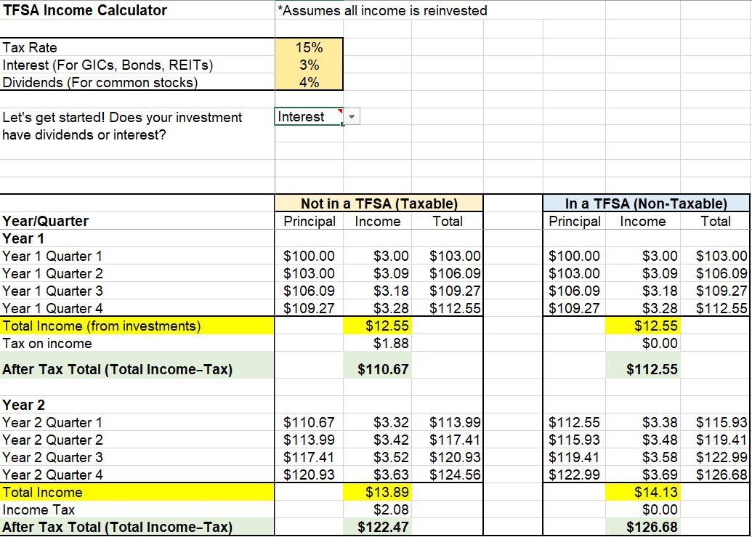
TFSAs: Compounding Comparison
Your spreadsheet will look like this:

Slide 12

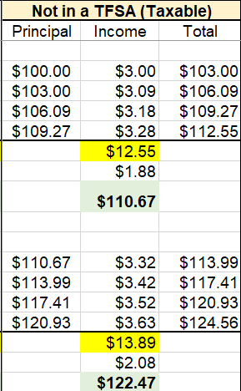

TFSAs: Compounding Comparison
Not in a TFSA (Taxable)
You will likely be at the lowest tax rate when you start earning. Imagine what you will lose to taxes as you earn more!
Different investments have different earnings rates. 3-5% is usually what you will get on a safe investment.
This tax comes out of your pocket and decreases your ability to compound your earnings.
On the next slide you will see the difference taxes make to your income.

Slide 13
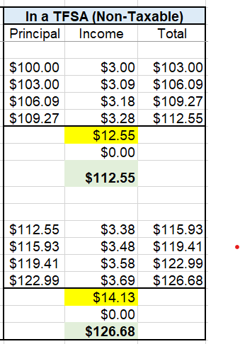
TFSAs: Compounding Comparison
Since you are not taxed on your income in a TFSA, your money will grow exponentially faster over time.
When your tax rate is 0, look at how much more you will earn. Why is that?

Slide 14

Quick Reflection
  How much tax do you pay if you do not invest inside a TFSA account?
  How much more money do you earn (after-tax total) if you use a TFSA to compound your investments?
  You can look at the examples from the previous slides to answer these questions.

Slide 15
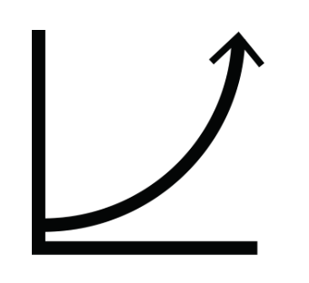
Quick Note
  If you are just starting out and don’t have a lot of money, it makes sense to use your TFSA to turbocharge your compounding.
  Over time, your earnings will increase exponentially.

Slide 16
TFSAs: Compounding Comparison
Try different numbers for the two calculators to see what kind of returns you will get.
Try different tax rates and principal amounts. See the difference of compounding your returns within a TFSA.
What do you notice when you use the two different calculators? How much difference does it make on your returns?

Slide 17
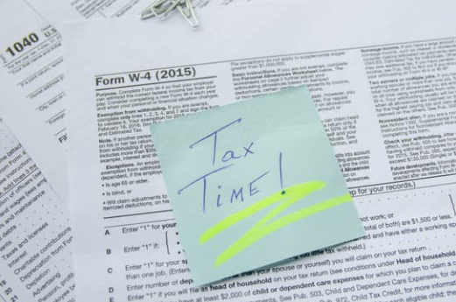
TFSAs and Compound Interest
You now know the compounding power of using a TFSA as your first savings account.
Keeping taxes in your pocket is the best way to compound your savings.
Now let’s look at a common first-time investment, a GIC (Guaranteed Investment Certificate).

Slide 18
TFSAs and Compound Interest
GIC Background:
GICs are backed by the Canadian Government, meaning the Canadian taxpayer. (Hence, guaranteed)
This makes them a very safe investment.
Interest rates are generally lower on these investments, due to their low level of risk.
GICs are offered by practically every regulated institution in Canada.

Slide 19
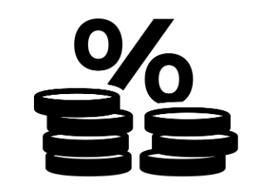
TFSAs and Compound Interest
GIC Risks
Government default. If the government can’t pay its debts, the currency will collapse, making the money in the GIC worthless.
Duration risk. The longer you lock in your GIC, the longer you will not have access to your cash.
Interest rate risk. If you lock in your cash for 5 years at 4% and rates go up to 8%, you will miss out on the rising interest rates.
Opportunity cost. With your funds locked in a GIC, you will miss out on other opportunities that have greater possibility for gains (or losses)
While these risks are real, the risk to your principal is essentially zero.

Slide 20
TFSAs and Compound Interest
Assignment:
Imagine you were given (or earned) $6,000 for savings.
Your task:
  Choose a variety of GICs (durations and interest rates) to invest for a five-year period.
  Calculate the compound returns on both a taxable account and TFSA (Use the Excel Assignment Calculator).
  State how much you will earn in each of those accounts, and what the difference is between the taxable account and TFSA.
  Explain why you chose those GIC durations.

Slide 21
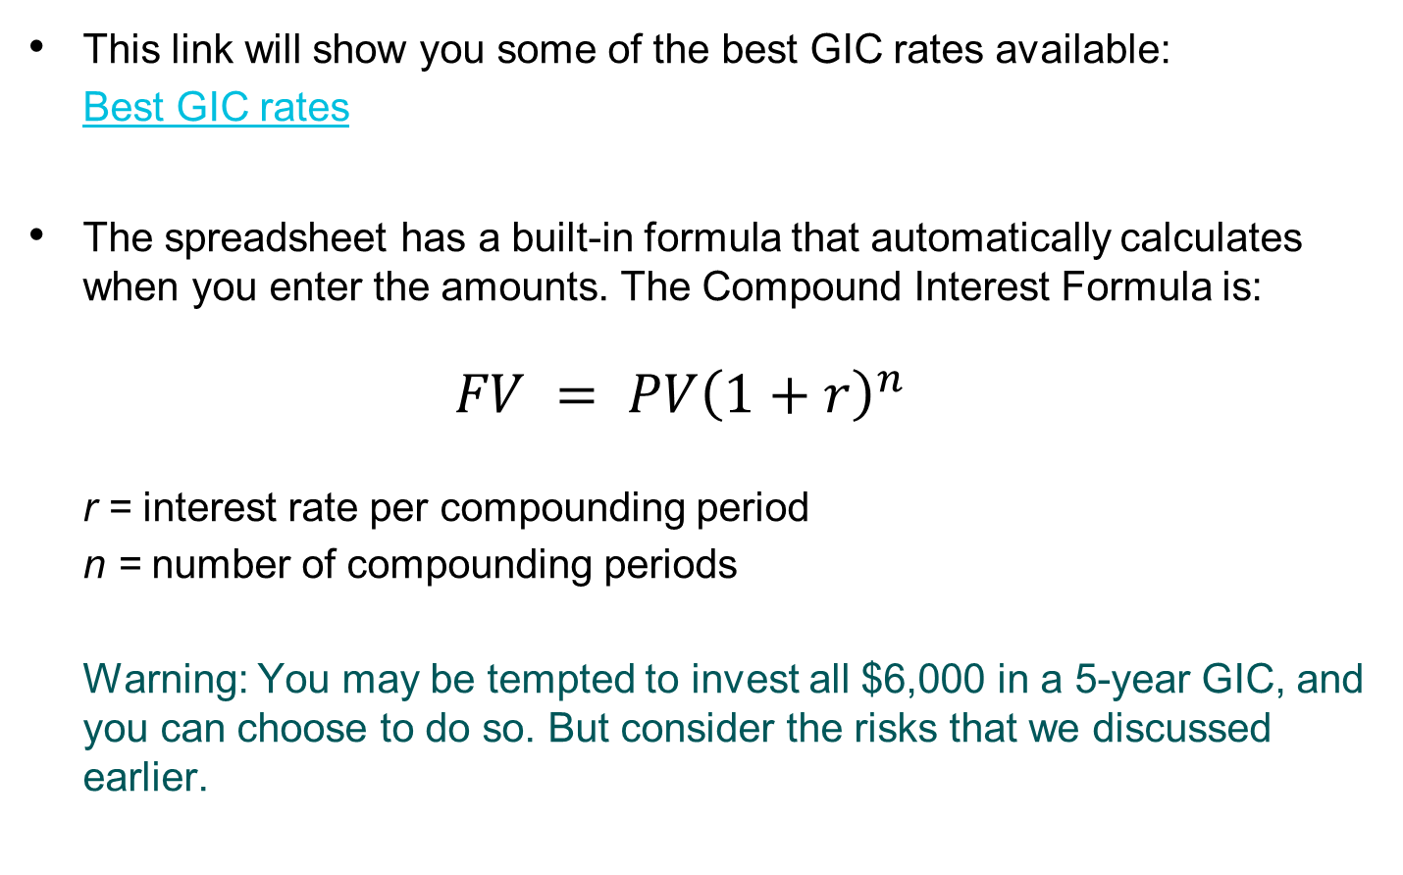
TFSAs and Compound Interest
This link will show you some of the best GIC rates available:
  Best GIC rates
The spreadsheet has a built-in formula that automatically calculates when you enter the amounts. The Compound Interest Formula is:
  $$FV = PV{\left(1+r\right)}^{n}$$
  r = interest rate per compounding period
  n = number of compounding periods
  Warning: You may be tempted to invest all $6,000 in a 5-year GIC, and you can choose to do so. But consider the risks that we discussed earlier.

Slide 22
Reflection Questions
After you completed the activity, take a moment to reflect.
What durations did you choose when locking up your money into the GICs? Why did you choose those durations?
What did you notice when you calculated the 5-year returns in the taxable and TFSA accounts?
How does using a TFSA as your savings account help speed up the compounding process?

Slide 23
TFSAs and Compound Interest
Want a new challenge?
Perform the same activity, but this time use a combination of Canadian stocks, GICs, and bonds.
If you choose Canadian stocks, make sure you select “dividends” as Canadian dividends have different tax implications. The calculator will approximate the taxes. Use the current dividend rate and assume it will stay the same over time.
If you choose bonds, select “interest”.
Ignore capital gains/losses (increases or decreases in price).
Question: If a company increases its dividend over the time period, what might happen to income as it compounds over time?

Slide 24
Additional Resources
https://www.canada.ca/en/revenue-agency/services/forms-publications/publications/rc4466/tax-free-savings-account-tfsa-guide-individuals.html
https://www.canada.ca/en/revenue-agency/services/tax/individuals/topics/tax-free-savings-account.html
https://www.investopedia.com/terms/t/tax-free-savings-account-tfsa.asp
https://www.td.com/ca/en/personal-banking/personal-investing/products/investment-plans/tfsa/
https://www.cooperators.ca/en/Resources/plan-ahead/tfsa-vs-rrsp.aspx
Important note: Some of these references are from financial institutions.

