Slide 1
Why ‘Interest’ Should Interest You: Credit Cards
Grade 11+

Slide 2

A Special Note for Teachers

Slide 3
Introduction
Let’s apply our knowledge of compound interest to a real-life situation: managing our credit card bill.
Credit cards are a very convenient way to make purchases. Using them helps build our credit score.
But if we are not careful, we can easily slip into debt.

Slide 4
In this lesson…
We will learn:
How credit card debt grows.
The options you have to repay your credit card bills.
You have the power to control your finances!

Slide 5

Credit Cards and Compound Interest
When you make purchases on a credit card, you are borrowing money from the bank. You must pay the money back, plus interest.
What is the quickest way to pay back your credit card bill?
The best option:
Pay the full amount (balance) each month! You will not incur any interest!

Slide 6
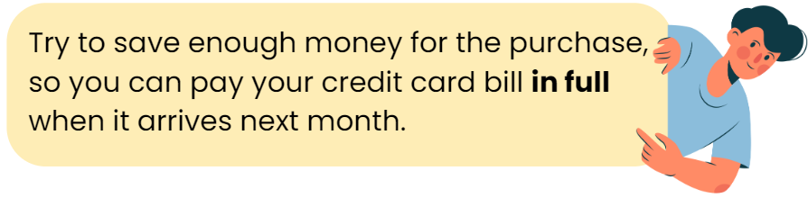
Credit Cards and Compound Interest
Credit Card Statement
ACCOUNT SUMMARY
TRANSACTIONS
Previous Balance
Payments and Other Credits
Purchases and Debits
Interest
Fees
TOTAL NEW BALANCE | $ 556.72
Pay the “Total New Balance” in full, you will not incur any interest!
TOTAL NEW BALANCE $556.72

Slide 7
Credit Cards and Compound Interest
What if you cannot pay your credit card bill in full? There are two possible scenarios:
You cannot pay your credit card bill at all.
You make small monthly payments.
The purchases on your credit card will start incurring interest.
Because credit cards charge compound interest, the debt will grow exponentially.
In this activity, we will look at these two scenarios.

Slide 8

Credit Cards and Compound Interest
Brainstorm: Have you started using a credit card? If so, what is your current balance? If you don’t have a credit card yet: Is there something you purchased recently? Or is there something you want to purchase? The cost will be your principal.
Research for a credit card that appeals to you. If you already have a credit card issued under your name, please use it for this activity.
Find the Annual Percentage Rate (APR). This is the annual interest rate for credit cards.
Annual Percentage Rate (APR): The interest rate for credit cards and some loans are called an APR. The APR includes interest and fees. Some institutions charge hefty fees! The APR gives credit card users and borrowers a better idea of what they will really pay.

Slide 9


Credit Cards and Compound Interest
First, let’s see what happens if you do not repay your credit card debt at all.
Go to the Compound Interest Calculator: https://www.calculatestuff.com/financial/compound-interest-calculator
See next slide for input suggestions.

Slide 10
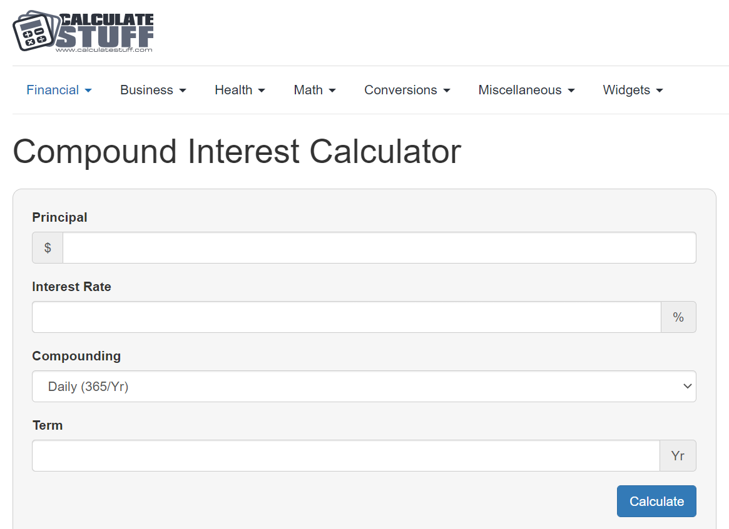




Enter a principal amount.
Think: Do you have a credit balance? Or…is there something you purchased recently? Is there something you want to purchase? This can be your principal amount.
Enter the APR.
Set it to Daily (365 days/Year). Credit card interest compounds daily.
Enter different terms. Try 3 years, 5 years, 10 years, etc.

Slide 11
Student Reflection #1
The only variable you can adjust is the term. After you tested out different terms, complete “Student Reflection #1” on your activity sheet.

Slide 12
Credit Cards and Compound Interest
In reality, most people make monthly payments on their credit card bills . Financial institutions ask for a minimum monthly payment. It is the greater of the two following amounts:
A fixed amount (usually $10), or
3% of the balance you owe (for example: 3% of $1,500 = $45)
Let’s see what happens to your credit card balance when you make small monthly payments.
Go to the Credit Card Payment Calculator by the Government of Canada:
https://itools-ioutils.fcac-acfc.gc.ca/CCPC-CPCC/CCPCCalc-CPCCCalc-eng.aspx

Slide 13
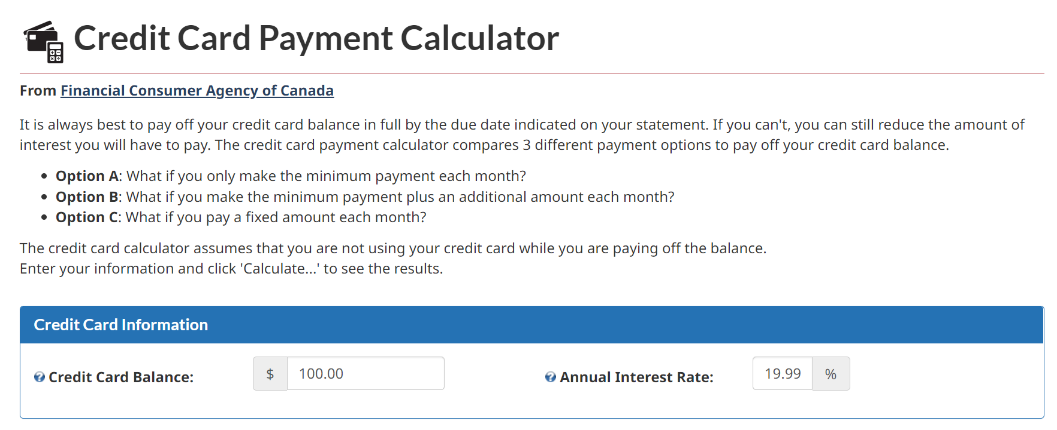


Enter a principal amount.
Enter the APR.
Important to know: This calculator assumes that you are not using your credit card while you are paying off the balance.

Slide 14
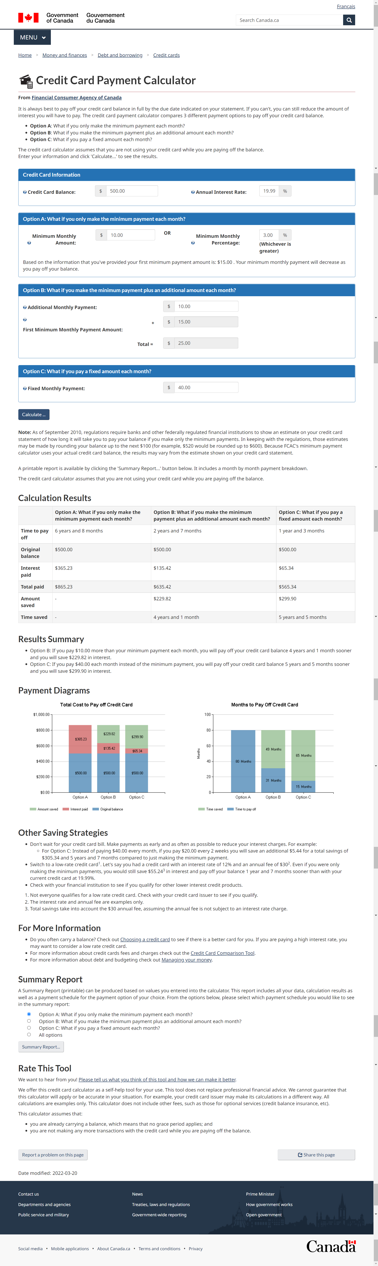
Check the terms and conditions of your credit card to ensure these numbers apply to you.
Try a fixed amount that is larger than Options A and B.
Hit “Calculate”

Slide 15
Your numbers will be different from this example.
You will see the results for Options A, B, and C.
…and explanation
…and graphs.

Slide 16
Credit Cards and Compound Interest
Scroll down and you will find more tips and tricks:
“Other Saving Strategies” section: Gives you personalized advice on how to repay your credit card balance.
“For More Information” section: Includes other tools to help you choose the right credit card and compare credit cards.

Slide 17
Credit Cards and Compound Interest
Go back to the Credit Card Payment Calculator and test out different numbers:
Try changing Option B: Increase or decrease the “additional monthly amount”.
Try changing Option C: Increase or decrease the “fixed monthly payment”.
How does the change affect…
The time it takes to pay off the credit card balance?
The interest paid?
The amount saved?
The time saved?

Slide 18
Student Reflection #2
After you tested out different numbers for Options B and C, input monthly payments that are realistic for you. Then, complete “Student Reflection #2” on your activity sheet.

Slide 19
Wrap-Up
When we understand our options, we can make informed decisions, and feel more in control of our finances!

