Slide 1
The Business Cycle and You!
Grade 11+ Project

Slide 2

A Special Note for Teachers

Slide 3
Students will…
Learn the basics of the business cycle
Describe historical business cycle events and evaluate the impacts of those events on different groups in Canada
Learn about government and central bank interventions and programs at each stage of the business cycle

Slide 4
Project Introduction
The project is divided into four parts:
Part 1: Nuts and Bolts: The Business Cycle
Part 2: History of Booms and Busts
Part 3: Government Policies: Impacts and Effects
Part 4: What is a Person to do to do? Life Planning for the Business Cycle

Slide 5

Part
Nuts and Bolts

Slide 6

Minds On Activity
Think-Pair-Share
What is a cycle? Can you think of examples in life of anything that moves in cycles?
How do you think cycles apply to business and the economy?
Why is it important to think in terms of cycles when looking at the business world and the economy?

Slide 7
Stages of the Business Cycle
Expansion:
Money is cheap to borrow..
businesses build up inventories again.
Consumers start spending.
GDP rises, per capita income grows, unemployment declines, and equity markets generally perform well.
Peak:
The expansion phase eventually peaks. The economy hits rock bottom, paving the way for a recovery.
Sharp demand leads the cost of goods to soar, and suddenly economic indicators stop growing.
https://www.investopedia.com/terms

Slide 8
Stages of the Business Cycle
Contraction:
Economic growth begins to weaken.
Companies stop hiring as demand tapers off and then begin laying off staff to reduce expenses.
        Recession - A recession is the phase of the business cycle when aggregate (overall) economic activity is contracting.
        Depression - An extreme recession that lasts three or more years or which leads to a decline in real gross domestic product (GDP) of at least 10% in a given year.
Trough:
The economy transitions from the contraction phase to the expansion phase.
The economy hits rock bottom, paving the way for a recovery.
After the trough in the cycle, it starts over from the beginning.
https://www.investopedia.com/terms

Slide 9
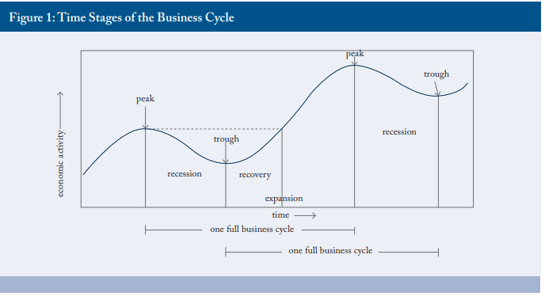
Stages of the Business Cycle
C.D. Howe Commentary No. 366, 2012

Slide 10
Academic Language
  Related Key Terms:
  Bust - A bust is a period of time during which economic growth decreases rapidly.
  Boom - A boom illustrates a period of elevated or increased growth within a business, market, industry, or economy.
  Bubble - An asset bubble occurs when the price of an asset, such as stocks, bonds, real estate, or commodities, rises at a rapid pace that is not caused by major changes in the company.
  Bull Market – The condition of a financial market in which prices are rising or are expected to rise.
  Bear Market - A market in which prices are falling, encouraging selling.
  Economy - The wealth and resources of a country or region, especially in terms of the production and consumption of goods and services.

Slide 11
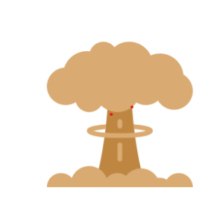
Extreme Cases: Booms
  Often at the end of an expansion, the economy will experience a boom.
  A boom is an extreme end to an expansion, where stocks, the economy, and all assets accelerate in price.
  There is often a sense of euphoria or extreme optimism during a boom.
  IMPORTANT: Not every expansion ends with a boom at the peak.

Slide 12

Extreme Cases: Busts
  After a large, irrational boom, an economy will often experience a bust (also known as a crash).
  During a bust, asset prices (housing, stocks, cryptocurrencies, etc.) will fall at an incredible rate.
  Busts are usually proportional to the size of the boom (small boom, small bust; large boom, large bust).
  Crashes cause economies to cut jobs, leading to recessions or even depressions.

Slide 13

Assignment
  Individually or with a partner, do the following on the provided worksheet:
  From your own experience, what stage of the business cycle do you think we are in now? How do you know?
  Now, do a little research. You can use the provided links to news sites to guide you or do your own research. After your research, do you still hold the same opinion about the stage of the business cycle? Explain your reasoning.
  What are some key words that led you to believe that we are currently living in that stage of the business cycle?

Slide 14
Resources
Text
https://www.cdhowe.org/sites/default/files/attachments/research_papers/mixed/Commentary_366_0.pdf
https://www.businessinsider.com/personal-finance/what-is-business-cycle
https://www.investopedia.com/terms/b/businesscycle.asp
Videos
https://www.youtube.com/watch?v=VzZ2iJDFT_o
https://www.youtube.com/watch?v=BRwezLnN5G0

Slide 15
Business News Resources
https://www.bnnbloomberg.ca/
https://ibftoday.ca/
https://financialpost.com/
https://www.cbc.ca/news/business
https://www.cnbc.com/
https://www.foxbusiness.com/
https://www.theglobeandmail.com/business/
https://www.euronews.com/news/business
https://www.economist.com/

Slide 16

Part
History of
Booms and Busts

Slide 17
Expansions
An economic expansion is defined as:
A period of elevated or increased growth within a business, market, industry, or economy.
An Economic Contraction is defined as:
A decline in economic output. It's accompanied by falling incomes and rising unemployment. (https://www.thebalancemoney.com/economic-contraction-4067683)
It can be set off by a bust which is:
A period of time during which economic growth decreases rapidly.

Slide 18
Part 2: History of Expansions
Your task:
Choose at least one of the famous expansions on the next slide.
Research the expansion and determine:
How and when the expansion began
Some of the characteristics of the expansion
The positive and negative consequences of the expansion
How and when the expansion ended

Slide 19
Economic Expansions
Choose from one of the following economic expansions or research one of your own.
Post World-War II (1945-1948)
Tech Boom (1995-2001)
Post GFC (Great Financial Crisis) (2009-2020)

Slide 20
Part 2: History of Contractions
Your task:
Choose at least one of the famous economic contractions (Recessions, Depressions, and Busts) on the next slide.
Your task is to research the bust. Determine:
How and when the contraction began
Some of the characteristics of the contraction
The positive and negative consequences of the contraction
How and when the contraction ended

Slide 21
History of Contractions
Throughout history, there have been many economic contractions.
Choose one of the famous contractions below or research your own. There have been many contractions. These are just a few of the more famous ones:
The Credit Crisis of (1772)
The OPEC Oil Price Shock of (1973)
The Asian Crisis of (1997)
The great depression (1929-1939)
The great recession (2007-2008)

Slide 22
Resources
https://www.britannica.com/list/5-of-the-worlds-most-devastating-financial-crises
https://www.britannica.com/event/Asian-financial-crisis
https://www.history.com/topics/great-depression/great-depression-history
https://www.federalreservehistory.org/essays/great-recession-and-its-aftermath

Slide 23

Part
Government Responses to Economic Expansions and Contractions

Slide 24

Part 3: Government Intervention
There are many ways that governments can deal with economic cycles.
Their responses are generally different during periods of economic expansion and recession.
These responses are intended to smooth the volatility that occurs during the good times and the bad.

Slide 25
Part 3: Responses to Economic Expansions
Governments often choose to intervene in different ways at different stages of the business cycle.
The purpose is to use tax dollars (the people’s money) to help smooth out the cycle for everyone.
(IMPORTANT: Remember, the government doesn’t have money. The tax money they spend belongs to the citizens.)
These programs are very different depending on whether they are provided during good times or bad.

Slide 26
Part 3: Responses to Economic Expansions
For the next ten minutes, look up the type of responses a responsible government could take.
On your individual worksheet, fill out at least 3 possible government responses for each situation.
Question #1: What are some possible government responses during expansions (the good times)?
Question #2: What are some possible government responses during contractions (the bad times)?

Slide 27
Group Discussion
Share your answers with the class. Write down any responses from the class which you did not think of on your own worksheet.
Question #1: What are some possible government responses during expansions (the good times)?
Possible answers:
Raise interest rates to slow down investments (technically this is the job of the independent central bank such as the Bank of Canada)
Raise taxes to build revenue to save for future recessions
Cut government spending to build revenue for the bad times
*Raising and lowering interest rates are technically the purview of the independent central bank, but they often respond in lockstep with the government

Slide 28
Group Discussion
Share your answers with the class. Write down any responses which you did not think of on your own worksheet.
Question #2: What are some possible government responses during recessions (the bad times)?
Possible answers:
Lower interest rates to ease burden on borrowers
Spend on infrastructure to create jobs and stimulate the economy
Put money into social programs such as E.I. (employment insurance)
Lower taxes to encourage investment and stimulate spending
*Raising and lowering interest rates are technically the purview of the independent central bank, but they often respond in lockstep with the government

Slide 29
Debate
A debate is defined as
“a regulated discussion of a proposition (an idea) between two matched sides.” (Merriam – Webster Dictionary)
People in a debate generally:
Are assigned (this is the best way to do it) or choose a topic and a side
Research their points and potential opposing arguments
Present their points to the judges in rounds (often three or more rounds of proposition and opposition)
*Raising and lowering interest rates are technically the purview of the independent central bank, but they often respond in lockstep with the government

Slide 30
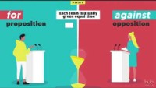
Debate
Watch the video: https://www.youtube.com/watch?v=1TSkkxu8on0&t=2s
Discussion:
Why do you think it is a better debate if you are assigned a topic and side rather than choose one?

Slide 31
Debate
Possible debate topics:
Remember: Your job is not to prove your own personal opinion. Your job is to win the argument. You may disagree with the point you are arguing.
Should governments provide employment insurance?
Should central banks lower interest rates to stimulate the economy?
Should governments be involved in the economy at all? Should the free market determine the economy?
Should the government help disadvantaged areas of the country more than richer areas, or should we all be treated the same?

Slide 32
Tough Talk
Gather in groups of 3-5 students to discuss your thoughts after the debates.
Have your opinions changed?
Did they stay the same?
Were there any points in the debate that struck you as particularly important or something you would like to research further?

Slide 33
Debate: Reflection Questions
Why is choosing a government response so difficult to achieve?
Should governments be responsible for providing aid during times of economic recession?
What costs are there for providing government aid? Is it worth it?
Why do governments attempt to slow down the economy during a boom? What can happen if an economy “runs hot” (is in a boom phase) for too long?

Slide 34
Debate Resources
https://www.open.edu/openlearncreate/mod/oucontent/view.php?id=161813&section=4.7
https://www.wikihow.com/Perform-Well-in-a-Debate
https://www.mcgill.ca/tls/files/tls/burgos-debate-structure.pdf

Slide 35
Resources
COVID-19: Financial support for people, businesses and organizations - Canada.ca
Employment Insurance benefits - Canada.ca
What Are the Pros and Cons of Unemployment Benefits (stlouisfed.org)
What Are the Pros and Cons of Central Banking? (reference.com)
Fiscal Stimulus Needed to Fight Recessions | Center on Budget and Policy Priorities (cbpp.org)
Public workforce programs during the Great Recession : Monthly Labor Review: U.S. Bureau of Labor Statistics (bls.gov)

Slide 36

Part
What is a Person to do to do? Life Planning for the Business Cycle

Slide 37
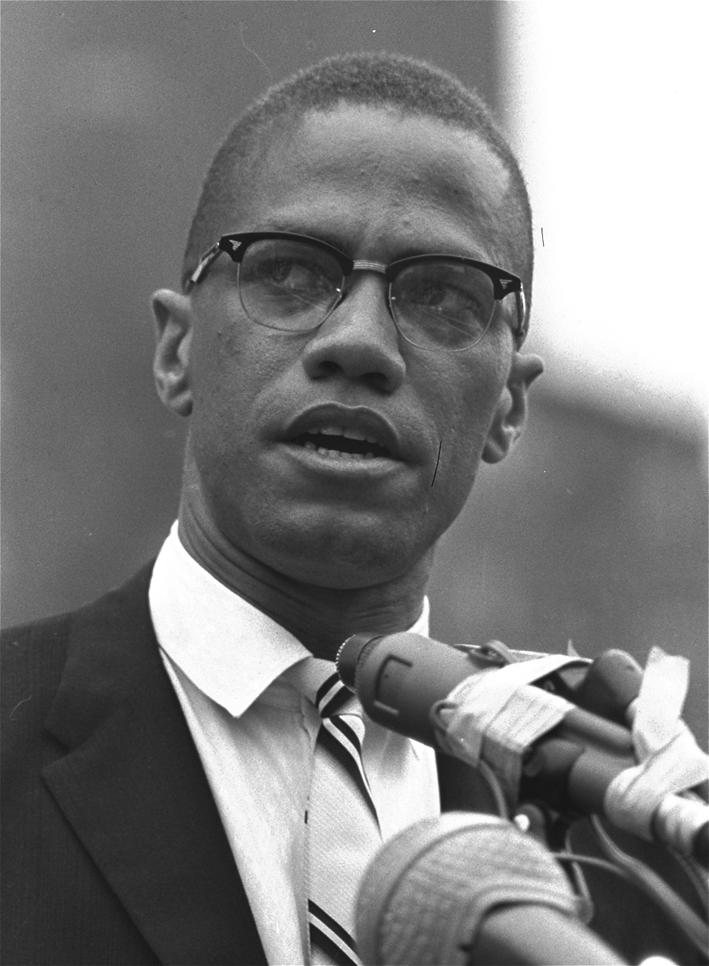
Why plan for different economic cycles?
For one thing, remember the effects each cycle generally has on people’s lives.
For example, remember the situation during expansions:
Jobs are plentiful
Wages are rising
Asset prices (stocks, bonds, real estate, etc.) are rising
Interest rates are low
“The future belongs to those who prepare for it today.”
- Malcolm X

Slide 38

Minds On - Why plan for different economic cycles?
Let’s consider some questions to warm up:​
Why is it important to prepare for bad times during the good times?​
What are some strategies you can use to prepare for the bad times during the good?​
If that is the wisest course of action, why is it so difficult to prepare for bad times during the good times?
Are there any positive aspects of the bad times (during an economic contraction)?

Slide 39
Minds On Activity: (Sample answers)
Why is it important to prepare for bad times during the good times?
  Bad times can hurt the most vulnerable.
  Bad times make it difficult to catch up financially.
  You have more earning power.
  You can lose your finances if you make poor financial choices during bad times.
What are some strategies you can use to prepare for the bad times during the good?
  Save money
  You can sell assets that have gone up a lot and build cash.

Slide 40
Minds On Activity: (Sample answers)
If preparing for the bad times during the good is the wisest course of action, why is it so difficult to do during the good times?
  People tend to think and plan short term.
  People tend to expect that what has happened in the recent past will continue forever.
  People tend to want immediate gratification instead of saving and preparing for the future.
  The longer it takes to change from one cycle to another, the more people begin to believe one stage of the cycle will continue forever.

Slide 41
Minds On Activity: (Sample answers)
Are there any positive aspects of the bad times (during an economic contraction)?
  Assets are often cheaper due to a fall in prices.
  Interest rates are often high, so long-term GICs may have high rates.
  Rents may be cheaper, due to deflation.

Slide 42
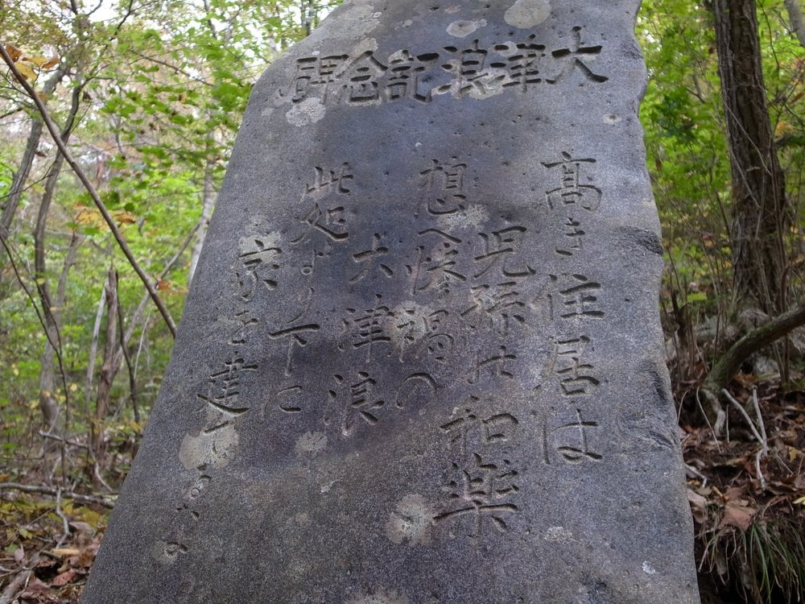
The Lesson of the Tsunami Stone
In Japan, there are centuries old stones that warn about building beyond a certain point indicated by a stone marker.
When tragedy struck, many of the affected areas built below these markers were destroyed, but areas built above them were saved.
We need to look back to the wisdom of history (beyond our own memories) to prepare for the future.
“Those who cannot remember the past are condemned to repeat it.”
- Attributed to George Santayana

Slide 43



The Turkey Problem
Taken from “The Black Swan” by Nassim Taleb
Imagine a turkey on a farm
Every day of that turkey’s life, the farmer feeds it and cares for it.
A graph of the turkey’s life would look like this:

Slide 44

The Turkey Problem
Even though some turkeys start to notice that some friends are missing, the turkey thinks back to the past year and projects that the future will continue as the past has done.
As the months pass, the turkey speculates tomorrow will be the same
The turkey is beginning the good life. The farmer feeds it each day.
Thanksgiving
Each passing day confirms that the next day will be even better.

Slide 45
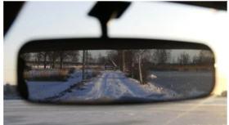

Don’t be a Turkey
Many people live their lives like the turkey. They don’t read about history and only judge what may happen tomorrow by what happened the day before.
It’s kind of like driving while looking in the rear-view mirror, expecting the road ahead to look like the road behind.
This may work for a while, but when the road curves unexpectedly it’s catastrophic.

Slide 46
Don’t be a Turkey
Thankfully, you no longer have to be a turkey.
With your knowledge of the business cycle, you can make decisions of what will likely come in the future, because you know what happened in the past.
In this activity you will look at 3 different scenarios:
  A financial plan for when you are studying
  A financial plan for if you are working
  A financial plan for if you are working while studying
For each plan, you will examine how your financial plan will change whether you are in an economic expansion or a contraction.

Slide 47
Cyclical Planning
Your assignment:
Choose one of the following scenarios:
a. earn money only
b. studies only
c. study and earn money
If you like, choose the scenario that you think you will be interested in pursuing in the future.
2) Describe how you will plan for each of the following scenarios, how you will get money to support yourself, and how you will budget for each of the three options.

Slide 48
Cyclical Planning
Your assignment:
3) Describe the situation you will be in during a contraction or an expansion. Use the information you know about contractions or expansions to defend your analysis. Mention the positive and negative aspects of each.

Slide 49
A Primer for the Financial Plans Assignment
Complete the questions on the Financial Plans worksheet for your chosen scenario. (link to Excel/Google spreadsheet)
Remember to fill out the sections for both economic expansions and economic contractions.
Try to come up with at least three ideas for each of the questions.
In particular, remember there are both positive and negative aspects to economic expansions and contractions.
Be creative in your answers and ideas!

Slide 50
Studies Only
In this scenario, you plan to be a full-time student (no part-time work).
Common financial goals for a Studies Only scenario are:
  Graduate with minimal debt.
  Live within your means.
The business cycle highly influences the achievement of these goals.
Examine the likelihood of achieving these goals, then plan your strategy by completing the Financial Plans worksheet.
Use the STUDIES ONLY worksheet Tabs of the Financial Plans.

Slide 51
Studies and Work
In this scenario, you plan to be a full-time student while working part time to earn income.
Common financial goals for a Studies with Work scenario are:
  Graduate with minimal or zero debt
  Live within your means
  Build an emergency fund
The business cycle highly influences the achievement of these goals.
Examine the likelihood of achieving these goals, then plan your strategy by completing the Financial Plans worksheet.
Use the Studies AND Work worksheet Tabs of the Financial Plan.

Slide 52
Work Only
In this scenario, you plan to enter the workforce full time.
Common financial goals for a Full-time work scenario are:
  Plan for a big-ticket future purchase
  Build an emergency fund
  Live within your means
  Investing for Retirement
The business cycle highly influences the achievement of these goals.
Examine the likelihood of achieving these goals, then plan your strategy by completing the Financial Plans worksheet.
Use the WORK ONLY worksheet Tabs of the Financial Plans.

Slide 53
Discussion Questions
What negative aspects of an economic contraction did you have to plan for? What positive effects did you have to plan for?
What negative aspects of an economic expansion did you have to plan for? What positive effects did you have to plan for?
Were you surprised to know that there were positive aspects of an economic contraction or negative impacts of an expansion?
Why is it so hard for most individuals to plan for a contraction when in an expansion, or an expansion when in a contraction? (remember the turkey!)

Slide 54
Key Takeaways
For each of these scenarios, the way you plan is affected greatly by whether you are living in an economic expansion or contraction
Most adults under the age of 45 have never lived through an economic contraction.
The business cycle, however, indicates that a contraction or expansion are as likely as the seasons.
Therefore, you need to plan your finances so that you can thrive in either case.
Learning from history (not just the past few years) can help you understand what is coming so that you won’t end up getting wiped out. (like the turkey!)

Slide 55
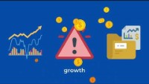
Bonus Video
After learning about the business cycle, we understand why we should invest while we are young.
You, as a young person, can benefit the most!
Watch this video: https://www.youtube.com/watch?v=gO_ImU2LT3Y

Slide 56
Resources
The Black Swan: The Impact of the Highly Improbable – Wikipedia
What Is an Economic Contraction? (thebalancemoney.com)
These Century-Old Stone "Tsunami Stones" Dot Japan’s Coastline | Smart News| Smithsonian Magazine

