Slide 1
Your Credit Score
Grade 10+

Slide 2

A Special Note for Teachers

Slide 3
Students will Learn…
What is a credit score or credit rating?
The importance of getting having a good credit score and the dangers of not having one
Obtaining a credit card

Slide 4

Minds On Activity
Think-Pair-Share
Have you heard of a “credit score” or “credit rating”?
What is it? How do you get one? Why do people need it?

Slide 5
Academic Language
Credit Score or Rating: An estimate of the ability of a person or organization to fulfill their financial commitments, based on previous dealings. (Credit score is usually for individuals; Credit rating is usually for businesses.)
Credit Cards: Allows cardholders to buy goods and services by borrowing from the bank. It is a type of debt. Cardholders pay interest on their credit card debt. Interest rates are high, generally around 20-30% per year.
Interest Rate: The amount a lender charges a borrower and is a percentage of the principal—the amount loaned.

Slide 6

What is a Credit Score?
A credit score is an important element in adult life. Essentially, it is your all-access pass to participate in the financial world.
Having good credit is essential! But what is good credit?

Slide 7
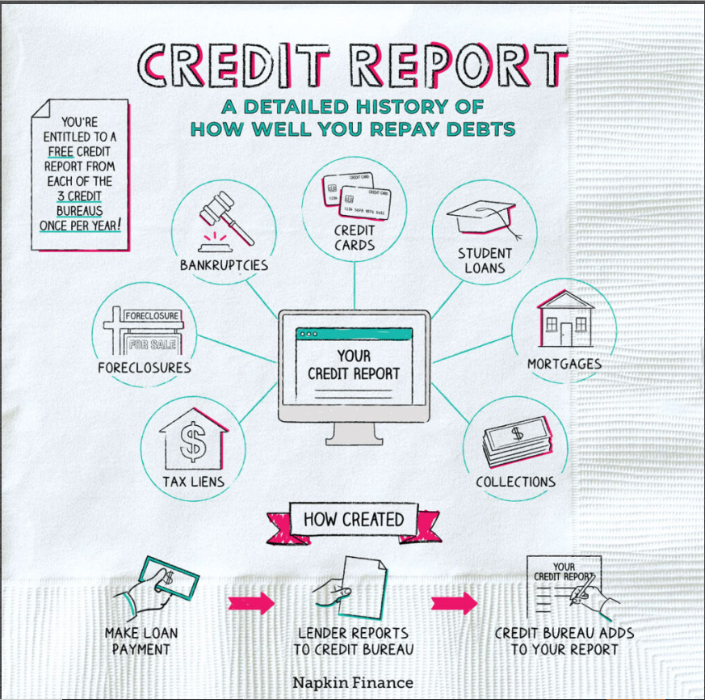
What is a Credit Score?
Source: Napkin Finance
Link: https://napkinfinance.com/napkin/credit-report/
*Note: Some of these terms are complex and may require review.
The next slide will give a short review.

Slide 8
What is a Credit Score?
Terms from the Napkin Finance example:
Tax Liens: A claim the government places on property when the owner has not paid their taxes.
Mortgages: A loan used to buy a home or other property.
Foreclosures: The act of taking back property when a mortgage isn’t being paid.
Bankruptcy: When a person or business is unable to repay their debts, bankruptcy is a legal process to free them. It will stay in their credit reports making it difficult to borrow in the future.

Slide 9
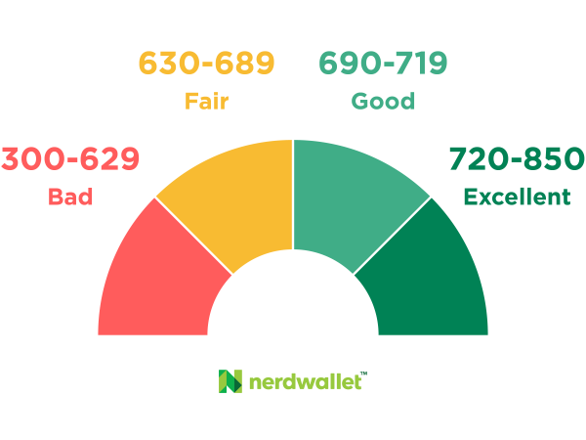
What is a Credit Score?
With a credit score this high, you can borrow money for anything you want!
You haven’t been paying your bills!
Good luck getting a credit card or a mortgage for a house.

Slide 10
What is a Credit Score?
Take a moment to discuss:
It is possible to have bad credit due to life circumstances beyond your control! What are some examples?
Is it fair to have your score lowered in this case ?
You haven’t been paying your bills!

Slide 11
What is a Credit Score?
Here are some examples of circumstances beyond your control. Did you come up with any others?
Health issues.
Need to support family members.
Inflation.
What are some things you can do to improve your credit score?
Set up payment reminders for your credit card and utility bills.
Pay the minimum required amount for your credit card bill if you can’t pay in full right away.
When possible, you will save money by paying in full and on time.

Slide 12
What is a Credit Score?
The truth is, most people fall somewhere in-between a good and bad score.
In Canada, the average credit score is somewhere between 650 to 725.
Nevertheless, you should aim to have the highest credit score possible.

Slide 13

What is a Credit Score?
Watch video: https://www.youtube.com/watch?v=xxwmaQNPf24

Slide 14
What is a Credit Score?
A credit score is an important element in adult life. Essentially, it is your all-access pass to participate in the financial world.
Instructions:
With a partner, look up four benefits that you get by having an excellent credit score.
Discuss these benefits with your partner.
By yourself, or with a partner, look up four negative effects of having a poor credit score.
Discuss these negatives with your partner

Slide 15

Building your Credit Score
In order to get a credit score, you have to begin to interact with our economy.
Ways to build credit:
  Paying bills on time (Utilities, internet, cell phone).
  Taking out loans (Credit cards, student loans, home mortgage).
Each interaction you have with credit, positive or negative, will impact your credit score over time.

Slide 16
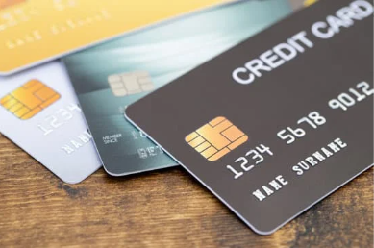
Credit Card Application: Activity
Believe it or not, your first credit score is 0. Nothing. Nada. The worst credit possible.
It is 0 because you haven’t started to build your credit score yet. You have not borrowed any money.
Most Canadians start their credit score adventure by getting a credit card.

Slide 17
Credit Card Application: Activity
Instructions:
Research at least three different credit card issuers.
Look at the application. What information does the credit card application ask for before they give you a card?
Look at the interest rate. Do you think the interest rate on the credit card is worth getting it and establishing a credit score?
If interest rates are so high on credit cards, why do people use them?

Slide 18
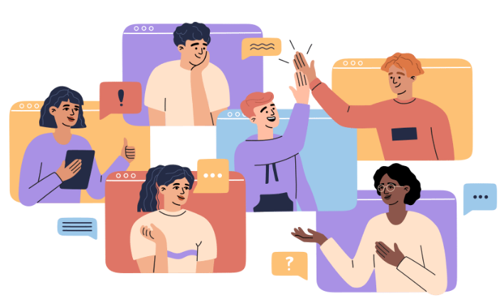
Discussion (Exit Card)
Use your answers from the exit card to discuss the following questions.
What are some positive aspects of using credit cards to build your credit rating?
Why are credit cards usually the first method young adults encounter to build their credit rating?
How can a credit card be dangerous? How can it destroy your credit rating instead of building it?

Slide 19
Additional Resources
Links
https://napkinfinance.com/napkin/credit-report/
https://www.canada.ca/en/financial-consumer-agency/services/credit-reports-score.html
https://financialpost.com/moneywise/what-credit-score-do-you-start-with-in-canada-13
https://www.transunion.ca/credit-card
Videos
https://www.youtube.com/watch?v=xxwmaQNPf24
https://www.youtube.com/watch?v=7QcbDhGp4PY
https://www.youtube.com/watch?v=Ezgr6qC38BY
https://www.youtube.com/watch?v=sMRWfrcjKL8

