Slide 1
How To Use Money Manipulatives
All Grade Levels

Slide 2

A Special Note For Teachers

Slide 3
Materials
Money manipulatives
Manipulative mat
Scissors

Slide 4
Instructions
Teacher or parent provides money manipulatives.
Give each student or group a manipulative mat.
Follow this learning session, and guide students in understanding that dollars go on the left side of the decimal (blue side), and cents go on the right side of the decimal (yellow side).
Using the money manipulatives, students can represent the total value in multiple ways.

Slide 5
Dollars
Cents
$ ______ . ______

Slide 6
X`
On your mat, show…
Dollars
Cents
$ 2 . 00

Slide 7
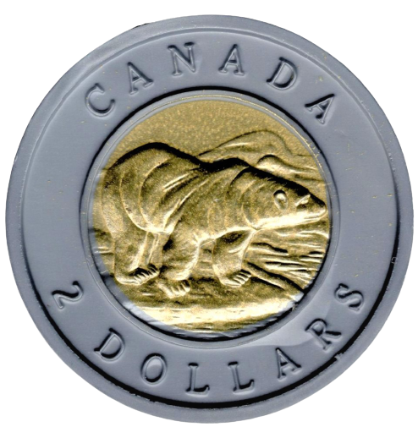
X`
On your mat, show…
Dollars
Cents
$ 2 . 00

Slide 8
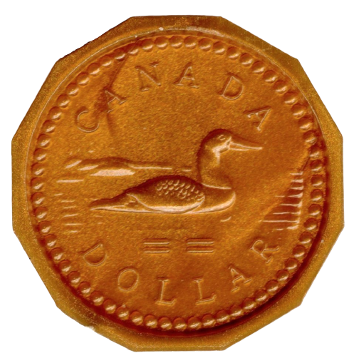
X`
On your mat, show…
Dollars
Cents
$ 2 . 00

Slide 9
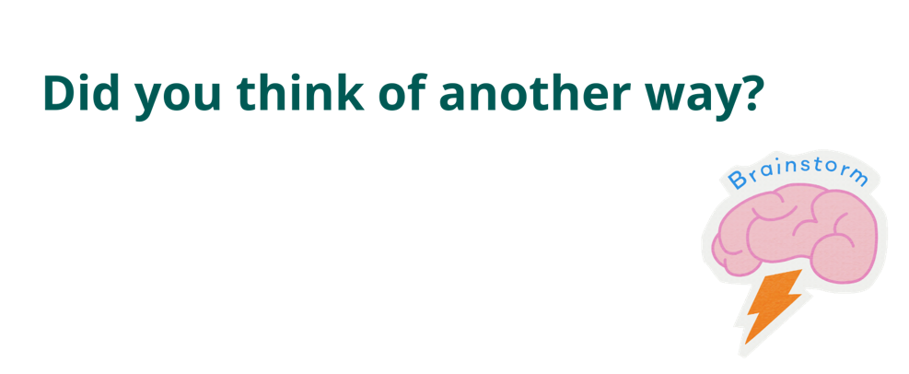

Slide 10
X`
On your mat, show…
Dollars
Cents
$ 3 . 00

Slide 11
X`
On your mat, show…
Dollars
Cents
$ 3 . 00

Slide 12
X`
On your mat, show…
Dollars
Cents
$ 3 . 00

Slide 14
X`
On your mat, show…
Dollars
Cents
$ 1 . 25

Slide 15
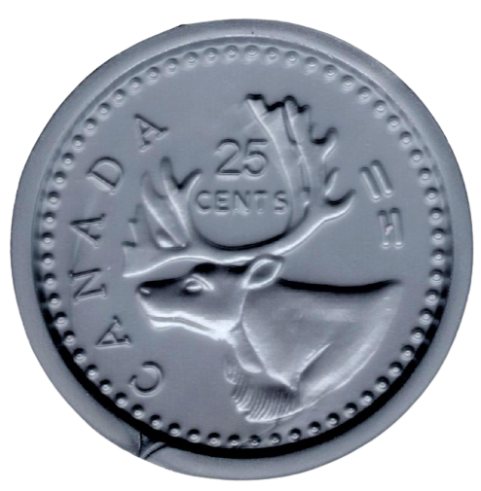
X`
On your mat, show…
Dollars
Cents
$ 1 . 25

Slide 16
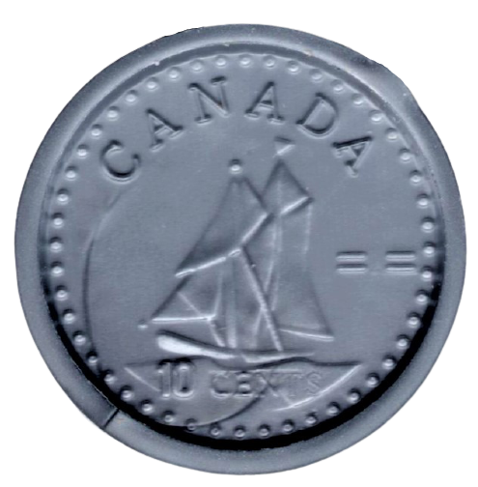
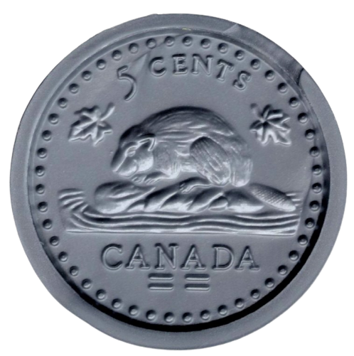
X`
On your mat, show…
Dollars
Cents
$ 1 . 25

Slide 18

X`
On your mat, show…
Dollars
Cents
$ 1 . 30

Slide 19
X`
On your mat, show…
Dollars
Cents
$ 1 . 30

Slide 20
X`
On your mat, show…
Dollars
Cents
$ 1 . 30

Slide 21
X`
On your mat, show…
Dollars
Cents
$ 2 . 15

Slide 22
X`
On your mat, show…
Dollars
Cents
$ 2 . 15

Slide 23
X`
On your mat, show…
Dollars
Cents
$ 2 . 15

Slide 24
X`
On your mat, show…
Dollars
Cents
$ 10 . 00

Slide 25
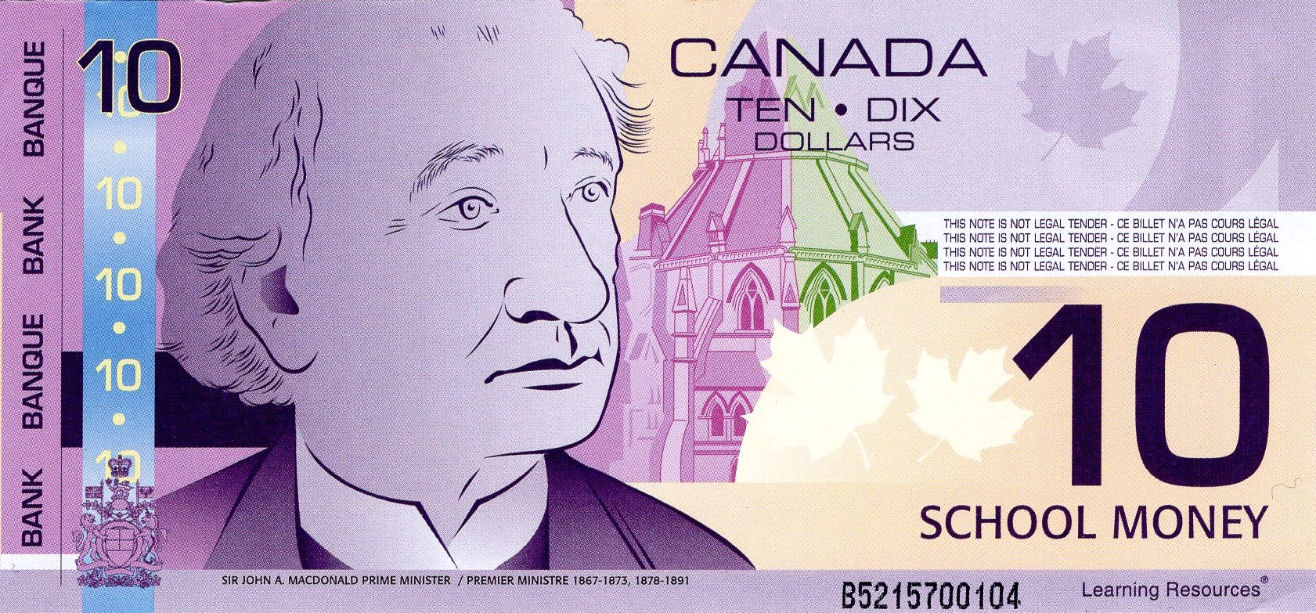
X`
On your mat, show…
Dollars
Cents
$ 10 . 00

Slide 26
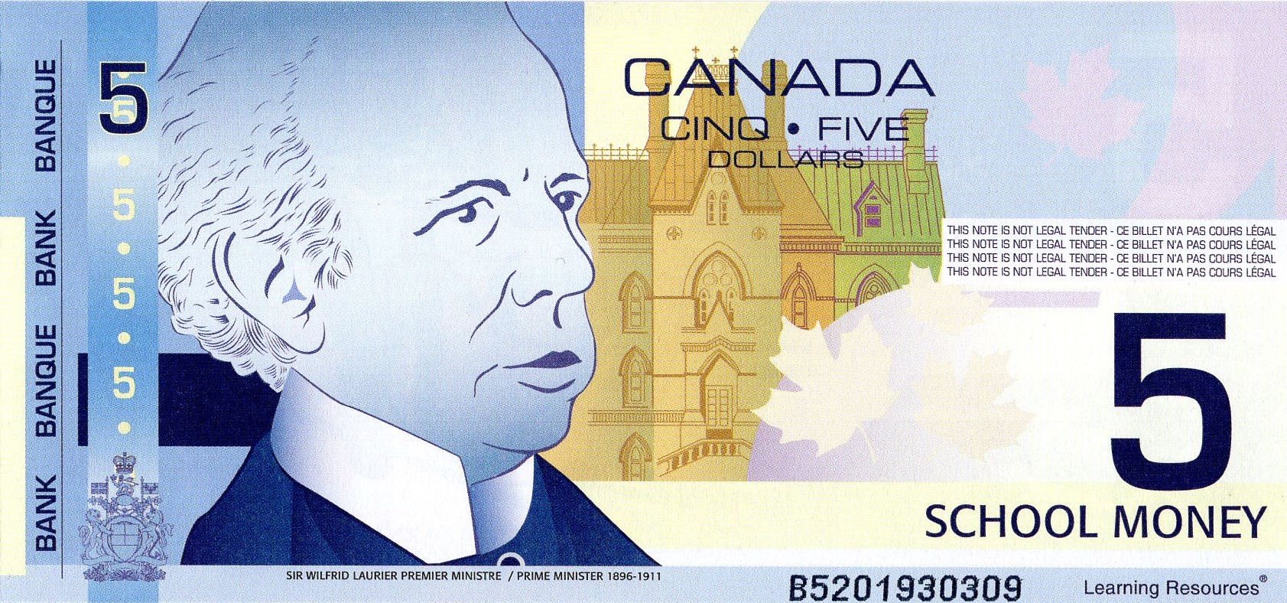
X`
On your mat, show…
Dollars
Cents
$ 10 . 00

Slide 27
X`
On your mat, show…
Dollars
Cents
$ 10 . 00

Slide 28
X`
On your mat, show…
Dollars
Cents
$ 25 . 00

Slide 29
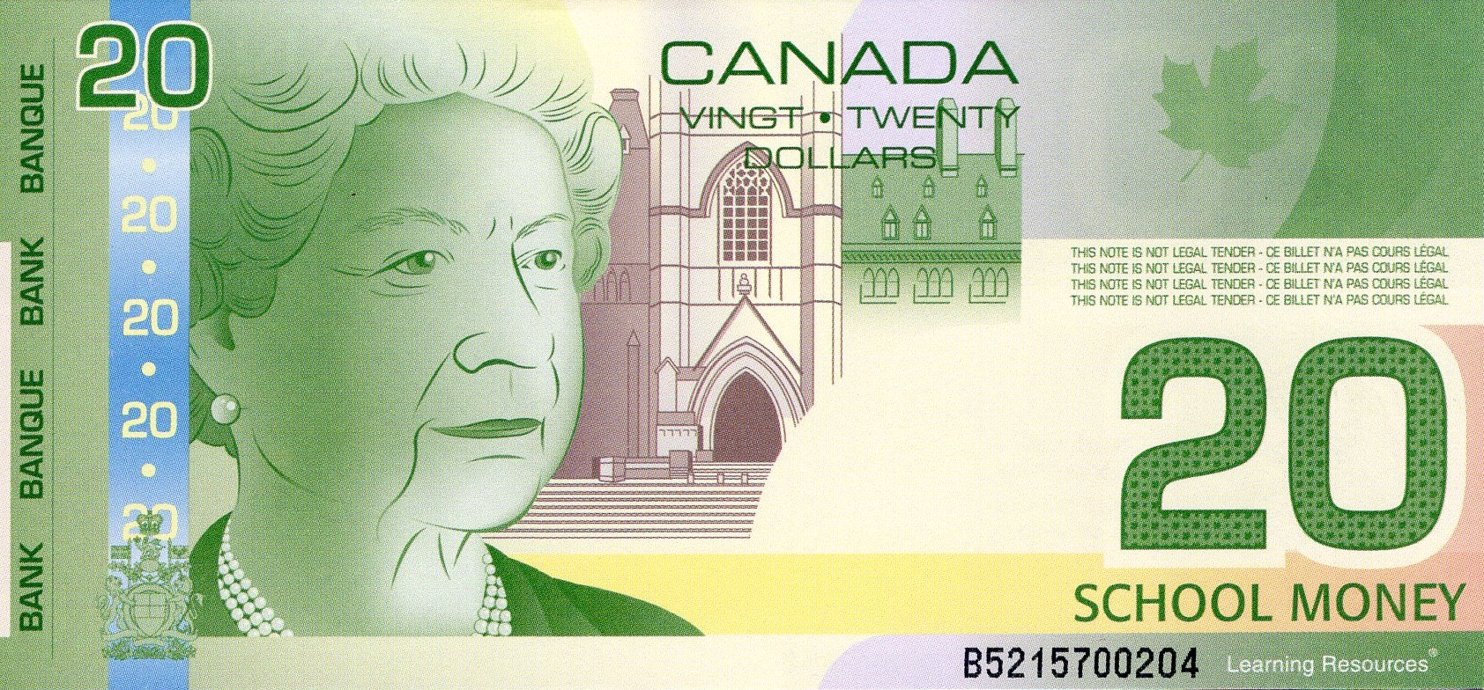
X`
On your mat, show…
Dollars
Cents
$ 25 . 00

Slide 30
X`
On your mat, show…
Dollars
Cents
$ 25 . 00

Slide 31
X`
On your mat, show…
Dollars
Cents
$ 25 . 00

Slide 32
X`
On your mat, show…
Dollars
Cents
$ 14 . 25

Slide 33
X`
On your mat, show…
Dollars
Cents
$ 14 . 25

Slide 34
X`
On your mat, show…
Dollars
Cents
$ 14 . 25

Slide 35
X`
On your mat, show…
Dollars
Cents
$ 32 . 45

Slide 36
X`
On your mat, show…
Dollars
Cents
$ 32 . 45

Slide 37
X`
On your mat, show…
Dollars
Cents
$ 32 . 45

Slide 38
X`
On your mat, show…
Dollars
Cents
$ 32 . 45

Slide 39
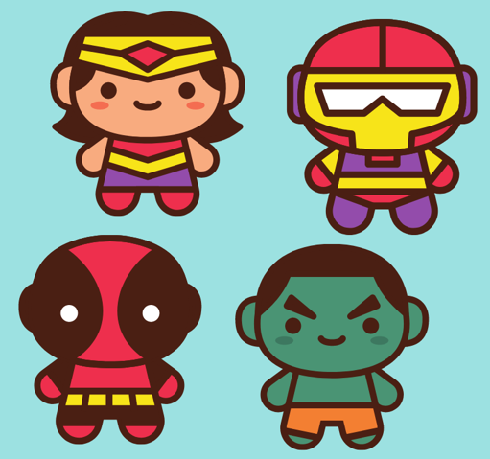
Little Cents can make Mighty Dollars!

Slide 40
X`
How much money is here?
Dollars
Cents
$ _____ . ______

Slide 41
X`
How much money is here?
Dollars
Cents
$ 0 . 25

Slide 42
X`
How much money is here?
Dollars
Cents
$ _____ . ______

Slide 43
X`
How much money is here?
Dollars
Cents
$ 0 . 50

Slide 44
X`
How much money is here?
Dollars
Cents
$ _____ . ______

Slide 45
X`
How much money is here?
Dollars
Cents
$ 0 . 75

Slide 46
X`
How much money is here?
Dollars
Cents
$ _____ . ______

Slide 47

X`
How much money is here?
Dollars
Cents
$ 0 . 100?

Slide 48
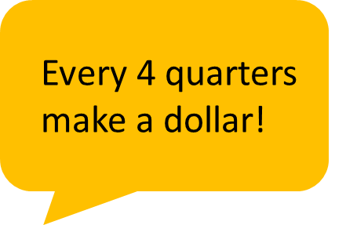


X`
Dollars
Cents
$ 1 . 00

Slide 49
Little Cents → Mighty Dollars
Go through slides 5 to 22 using cents only!

