Slide 1
Where Is My Money?
Grade 4

Slide 2
A Special Note For Teachers

Slide 3
Agenda
Minds On Activity: Think-Pair-Share
Managing My Money
Student Reflection Questions
Closing Activity: Exit Slip

Slide 4
Minds On Activity
Think-Pair-Share
Have you heard of a ‘budget’ before? What is it?
Do you think it is important to budget our money? Why or why not?

Slide 5
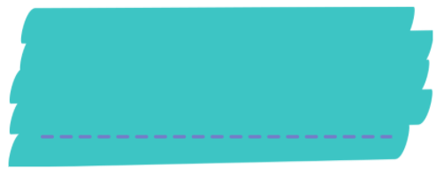
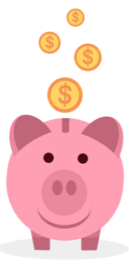
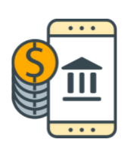
Managing My Money
How much money do you get in one week?
$

Slide 6
Where does money go?
Spending
Saving
Investing
Donating

Slide 7
Spending It Wisely
https://youtu.be/nFGCgnebmc8

Slide 8
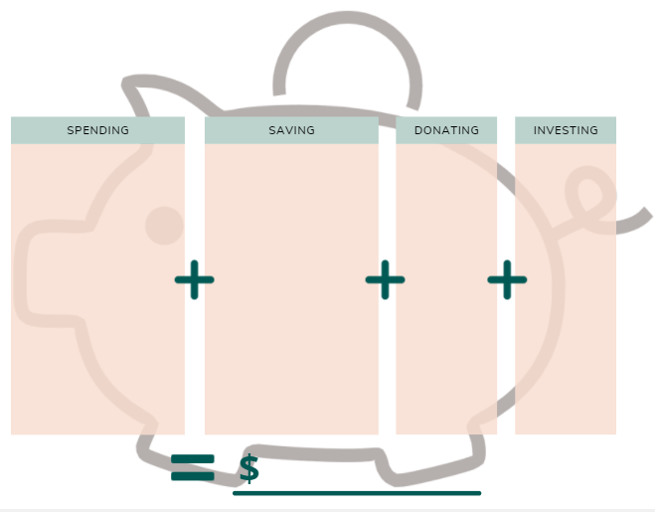
Spending
Spending: Buying something you need or want.
Fried chicken $8
Food delivery fee $3
Video game – Animal Crossing $80
Notes:
Ask students to write down some of things they need or want, and put down the price. Teachers can talk about goods and services.

Slide 9
What is “saving”?
https://www.youtube.com/watch?v=JkCmIxraWlM

Slide 10
Saving
Making an effort not to spend money now, so you can save for something special!
Fried chicken $8
Saving Goal: $80 Video game --Animal Crossing
Food delivery fee $3
Video game – Animal Crossing $80
I will save $5 this week.
Notes:
Make a big purchase your saving goal. Or ask students to write down something special they want to save for.

Slide 11
What is “donating”?
https://www.youtube.com/watch?v=Pbf-mb5L6JY

Slide 12
Donating
Giving to others in need, and it comes from your heart.
Fried chicken $8
Saving Goal: $80 Video game --Animal Crossing
School bake sale $2
Food delivery fee $3
I will save $5 this week.

Slide 13
What is “investing”?
https://www.youtube.com/watch?v=BaJz5UFmkk8

Slide 14
Investing
Having money grow over a long period of time. There are some risks.
Fried chicken $8
Saving Goal: $80 Video game --Animal Crossing
School bake sale $2
Savings account
Food delivery fee $3
RRSP (Retirement Savings Plan)
I will save $5 this week.
TFSA
(Tax-Free Savings Account)
Government bonds
Stocks
Notes:
Students can research on the investment options listed above or look for other options.

Slide 15
Managing My Money
Is the total amount is same as your weekly allowance?
Fried chicken $8
Saving Goal: $80 Video game --Animal Crossing
School bake sale $2
Savings account
Food delivery fee $3
RRSP (Retirement Savings Plan)
I will save $5 this week.
TFSA
(Tax-Free Savings Account)
Government bonds
Stocks
Notes:
Students can research on the investment options listed above or look for other options.

Slide 16
For example…
25.00
Fried chicken $8
Saving Goal: $80 Video game --Animal Crossing
School bake sale $2
RESP (Registered
Education Savings Plan)
$4
Food delivery fee $3
I will save $5 this week.
I spent $3.00 less!
Where can I put this money?
22.00
Notes:
In the case that the total in over the weekly allowance, teacher shows students how to reduce expenses from one of the buckets.

Slide 17
Student Reflection Questions
In pairs or in groups, answer the following questions:
How many dollars a week are you saving?
How many dollars a month are you saving?
a) How much more money do you have to save to reach your savings goal? b) Can you think of some ways to reach your goal sooner?
Did you have leftover allowance money? If so, what did you do with it? OR, Did you spend more than your allowance money? From where did you reduce your expenses?

Slide 18
Closing Activity
Exit Slip
Tell me something new you learned today.

Slide 19
For More Information
Registered Education Savings Plan (RESP)
https://www.canada.ca/en/services/benefits/education/education-savings/resp.html
Registered Retirement Savings Plan (RRSP)
https://www.canada.ca/en/revenue-agency/services/tax/individuals/topics/rrsps-related-plans/registered-retirement-savings-plan-rrsp.html
Tax-Free Savings Account (TFSA)
https://www.canada.ca/en/revenue-agency/services/forms-publications/publications/rc4466/tax-free-savings-account-tfsa-guide-individuals.html

