Slide 1
Money In Words & Numbers
Grade 4

Slide 2
A Special Note For Teachers

Slide 3
Agenda
1. Brainstorm: K-W-L Chart
2. Match the Coin
3. Which One Doesn't Belong?
4. Virtual Trip to the Store
5. The Price Is Good
Notes:
1.Match the coin: Basic literacy & numeracy
2.Which one doesn’t belong? Basic literacy & numeracy
3.Virtual trip to the store: Curriculum standard gr. 4 F1.2, gr. 5 F1.2
4.The Price is Good: Curriculum standard gr. 4 F1.1, gr. 4 F1.5, gr. 5 F1.5

Slide 4
Money!

Slide 5
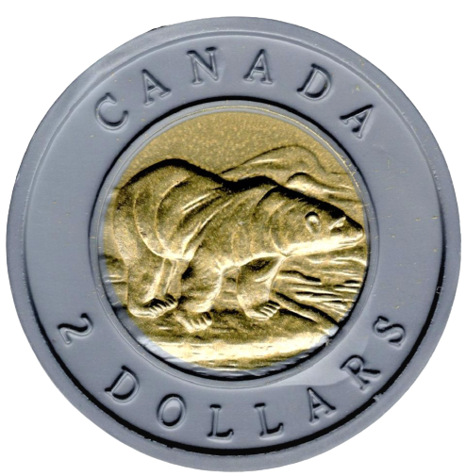
Canadian Coins
Loonie
One Dollar = $1.00
Toonie
Two Dollars = $2.00

Slide 6
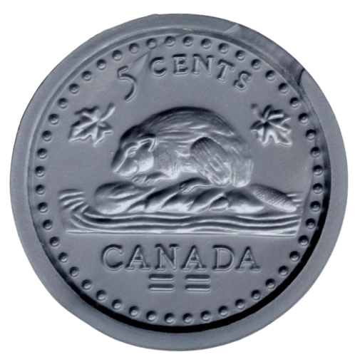
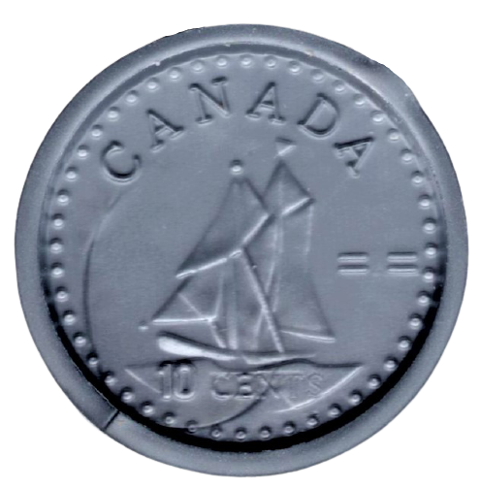
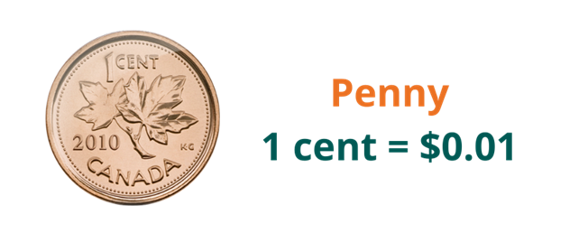
Canadian Coins
Quarter
25 Cents = $0.25
Nickel
5 Cents = $0.05
Dime
10 Cents = $0.10

Slide 7
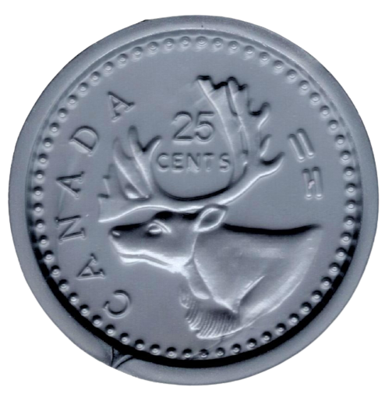
Match the Coin
Toonie
Loonie
Quarter
Dime
Nickel

Slide 8
Match the Coin
Toonie
Loonie
Quarter
Dime
Nickel

Slide 9
Match the Coin
Toonie
Two Dollars = $2.00
Quarter
One Dollar = $1.00
Nickel
Loonie
25 cents = $0.25
Dime
10 cents = $0.10
5 cents = $0.05

Slide 10
Match the Coin
Toonie
Two Dollars = $2.00
Quarter
One Dollar = $1.00
Nickel
Loonie
25 cents = $0.25
Dime
10 cents = $0.10
5 cents = $0.05

Slide 11
Match the Coin
Toonie
Two Dollars = $2.00
Quarter
One Dollar = $1.00
Nickel
Loonie
25 cents = $0.25
Dime
10 cents = $0.10
5 cents = $0.05

Slide 12
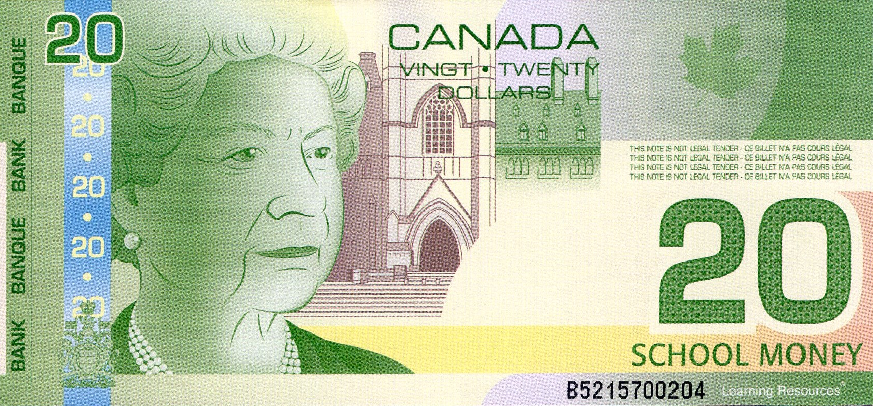
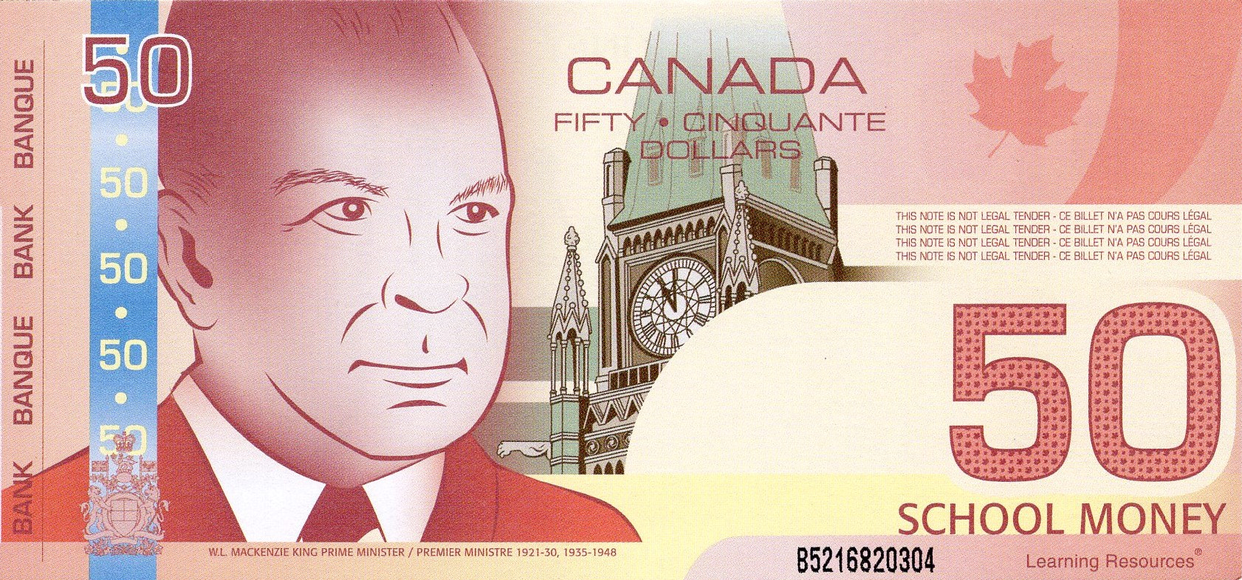
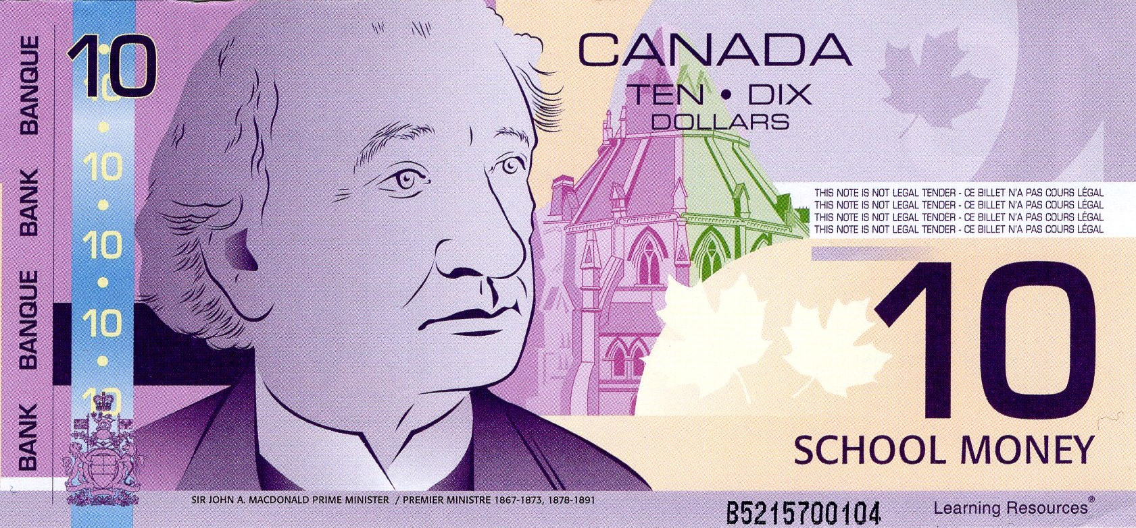
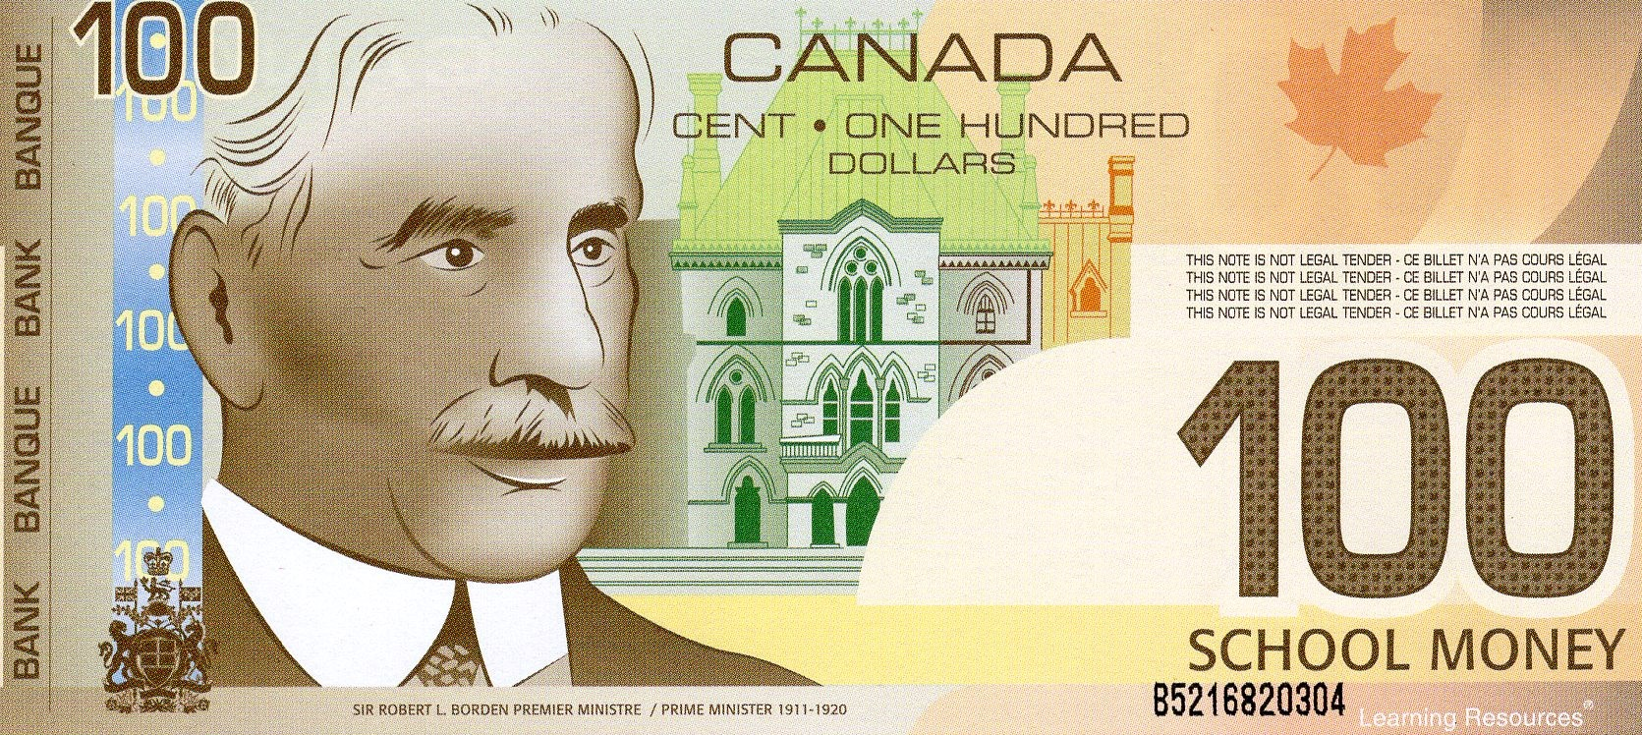
Canadian Bills

Slide 13
Canadian Bills
Five Dollars
$5.00
Ten Dollars
$10.00

Slide 14
Canadian Bills
Twenty Dollars
$20.00
Fifty Dollars
$50.00

Slide 15
Canadian Bills
One Hundred Dollars
$100.00

Slide 16
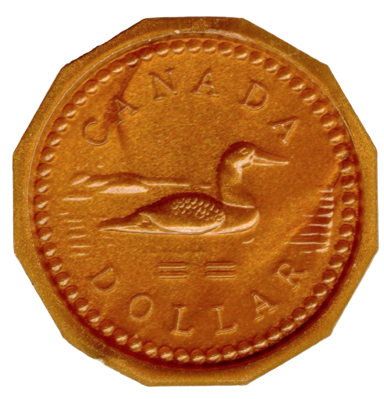
Which One Doesn’t Belong?
$4.00
A
B
C
D
$3.00

Slide 17
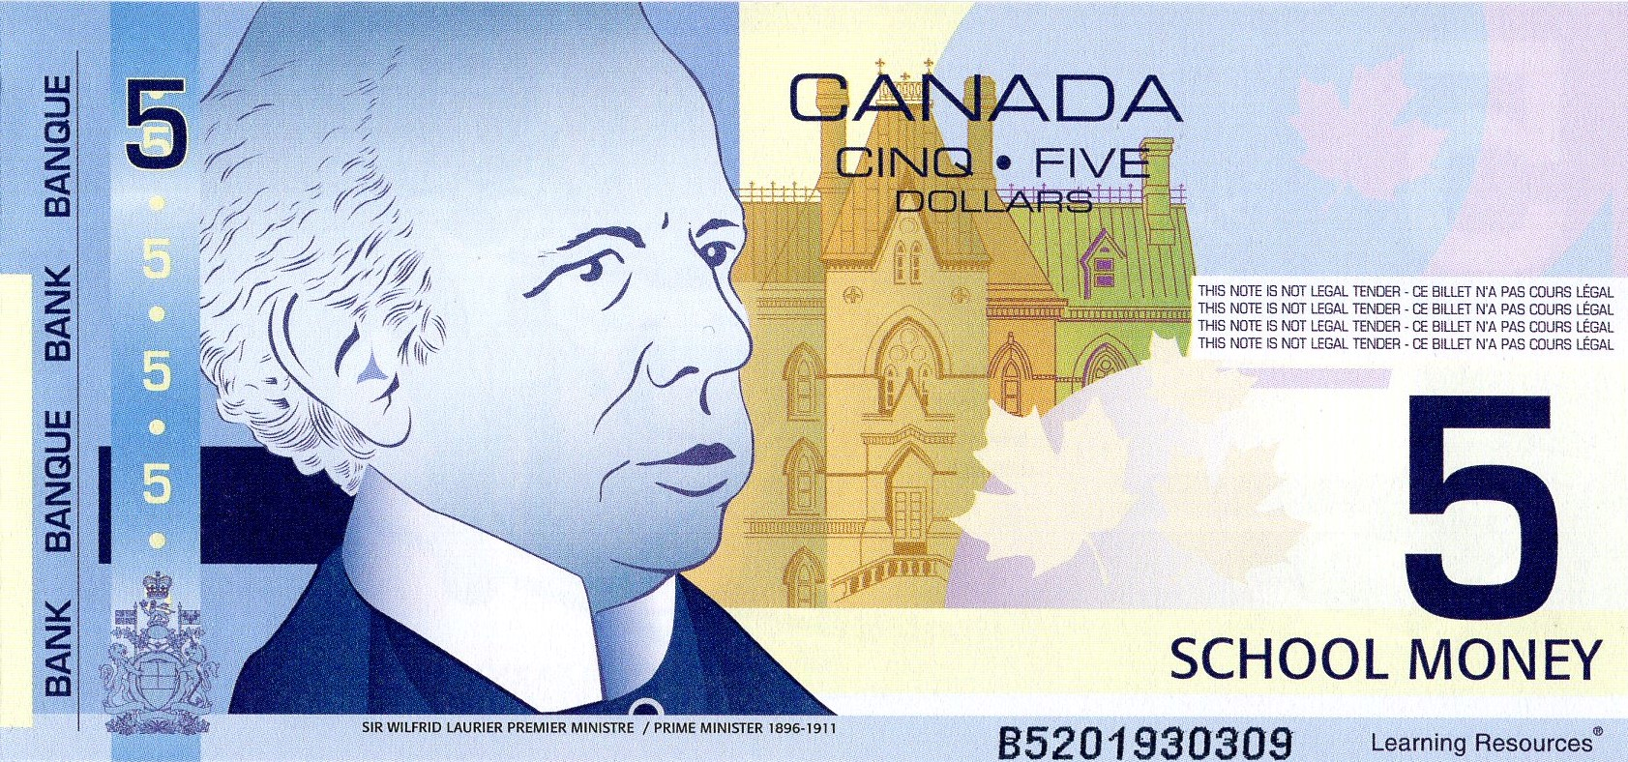
Which One Doesn’t Belong?
$6.00
A
$8.00
B
C
D

Slide 18
Which One Doesn’t Belong?
$10.00
A
B
$8.00
C
D

Slide 19
Which One Doesn’t Belong?
$3.00
A
B
C
D
$2.15

Slide 20
Which One Doesn’t Belong?
$14.00
A
$14.20
B
C
D

Slide 21
Which One Doesn’t Belong?
$53.00
A
B
$54.00
C
D

Slide 22
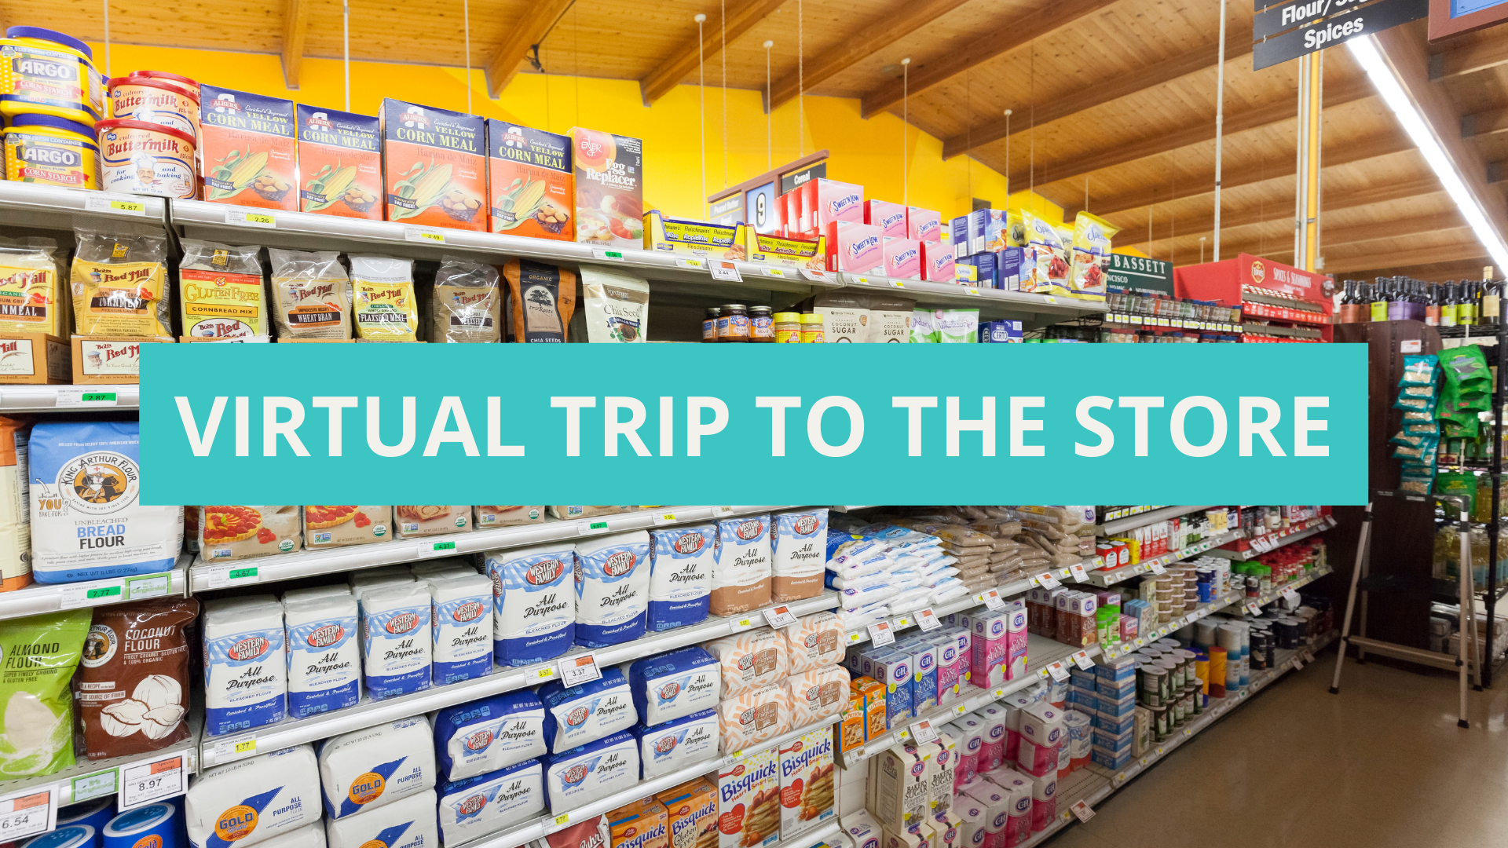

Slide 23
Virtual Trip to the Store
An option for classrooms with available technologies:
Which grocery store do you go to most often?
No Frills
Food Basics
Superstore
Sobeys
Walmart
Neighbourhood grocery store
Students look for an online flyer and “purchase” items for the next week
Students work in groups and shop at different stores. The whole class can compare prices afterwards.

Slide 24
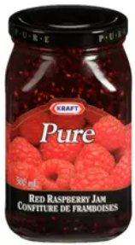
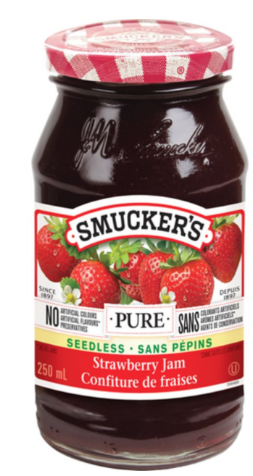
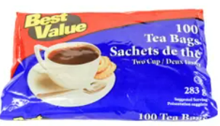
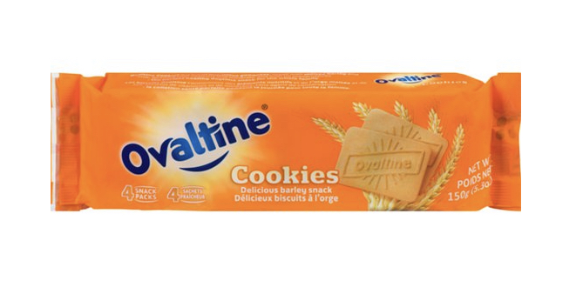
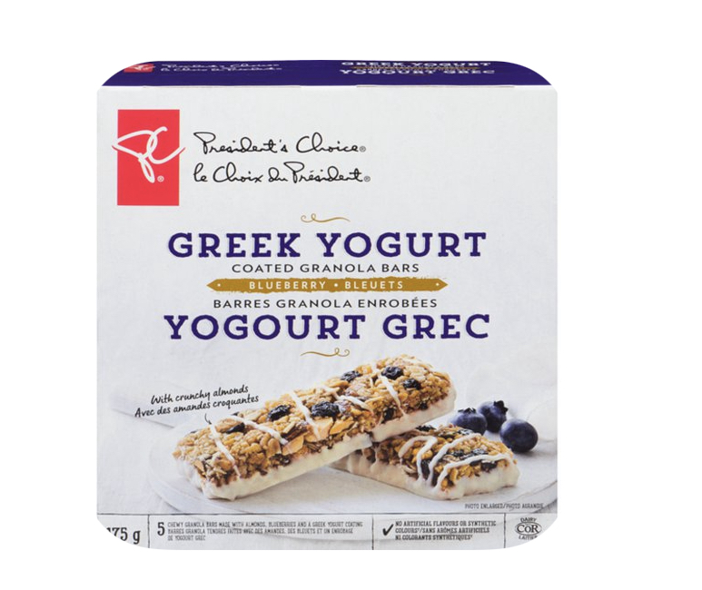
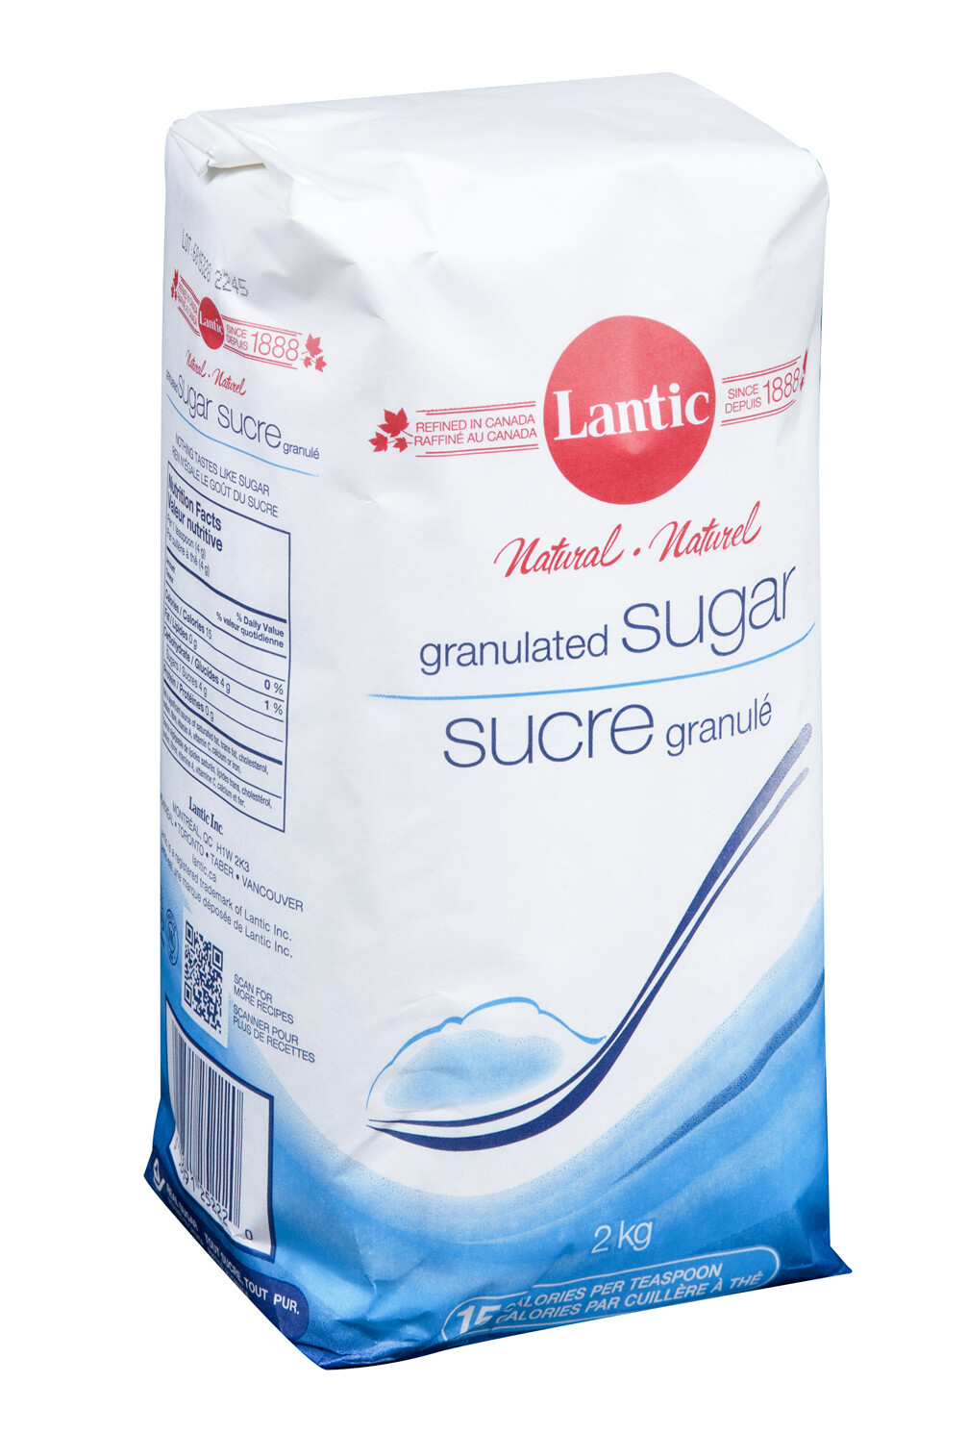
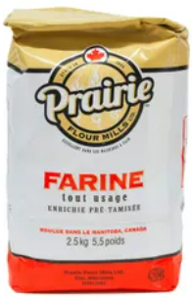
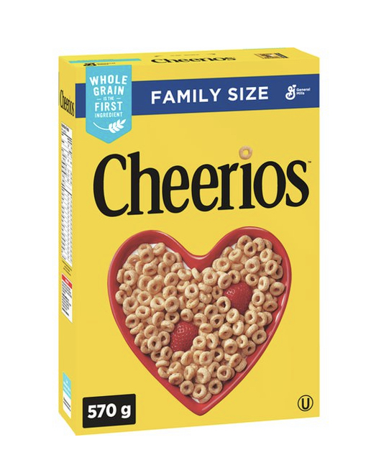
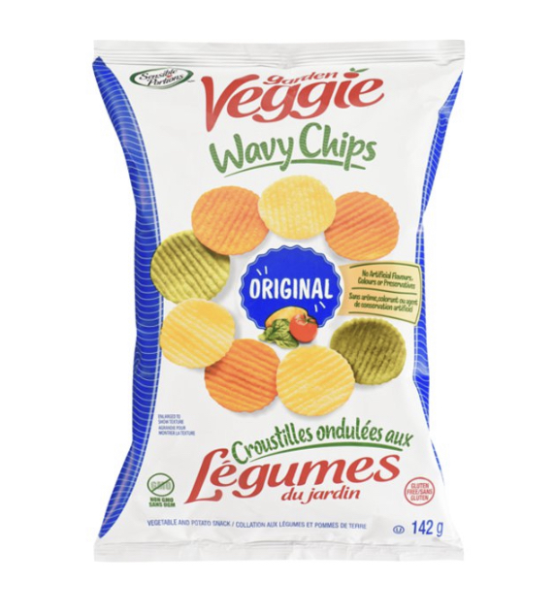
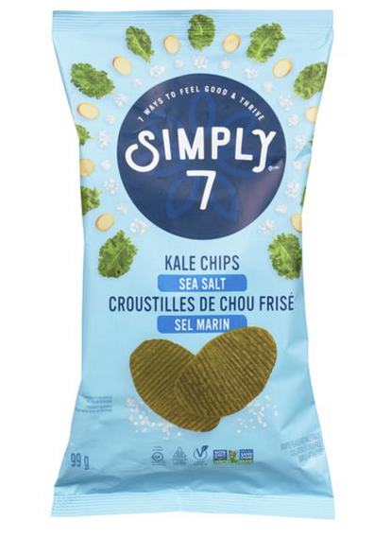
PANTRY
Hot Chocolate (500 g)
$5.00
Tea Bags (100 count)
$3.00
Jam (250ml)
Sale $4.00
Ovaltine
Sale $2.00
Jam (250ml)
$6.00
Greek Yogurt & Blueberry Granola Bars
$3.00 +tax
All Purpose Flour
(2.5 kg)
$5.00
Kale Chips
$6.00
Granulated Sugar (2kg)
$2.00
Veggie Chips
$4.00
Cereal
(Family Pack)
$7.00
Notes:
Disclaimer

Slide 25
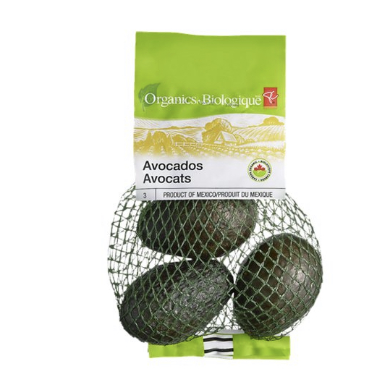
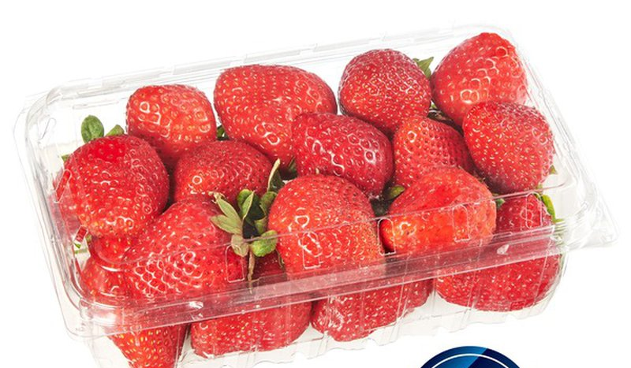
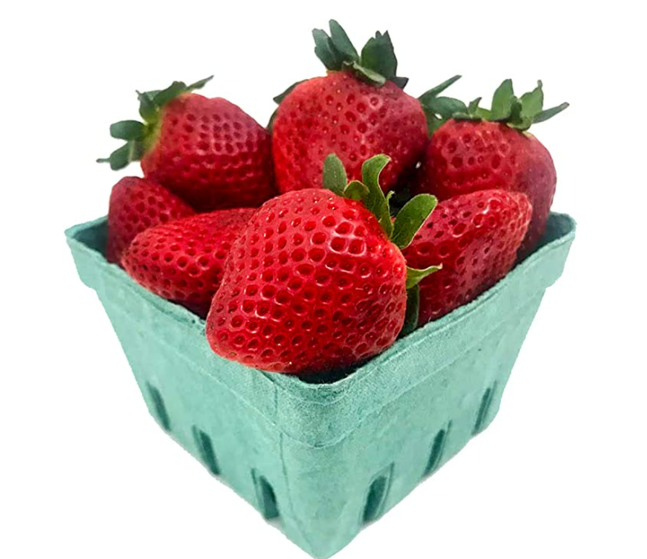
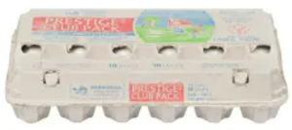
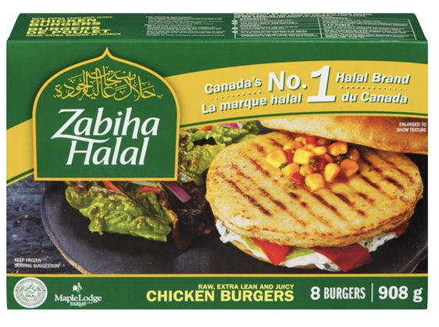
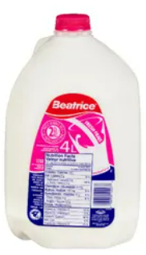
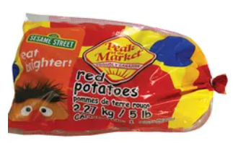
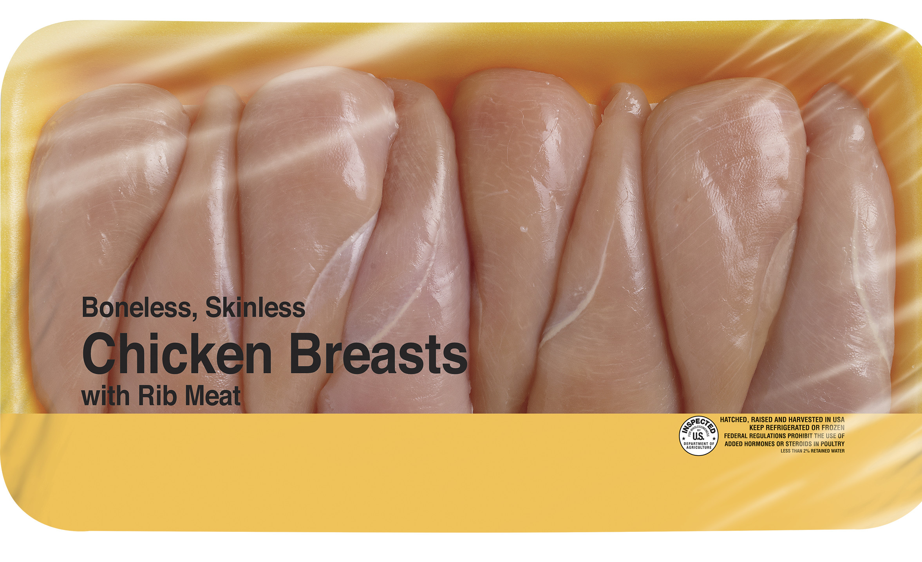
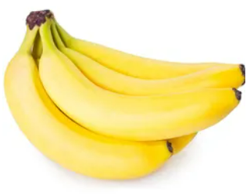
FRESH
Avocados (Bag)
$6.00
Organic Strawberries (10 oz)
$7.00
Eggs Large (18 count)
$6.00
Strawberries (12oz)
$5.00
Halal Chicken Burgers
$15.00
Potatoes (5 pounds)
Sale $3.00
Chicken Breast
$9.00
2% Milk (4 L)
$4.00
2% Milk (1 L)
$3.00
Bananas (1 kg)
$1.00

Slide 26
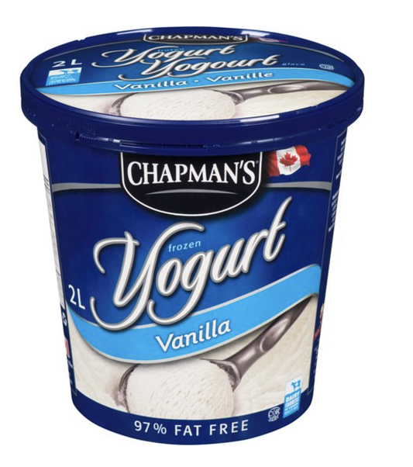
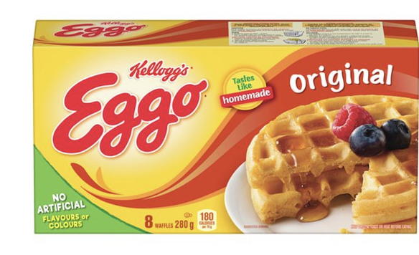
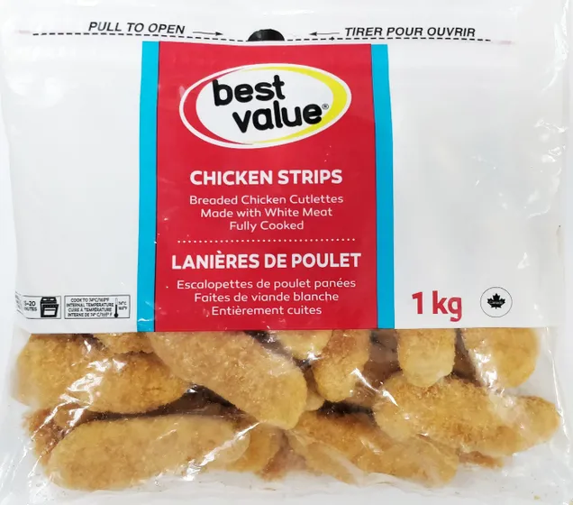
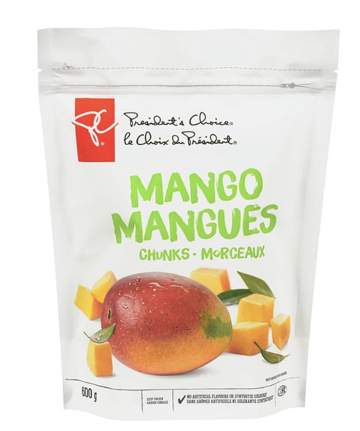
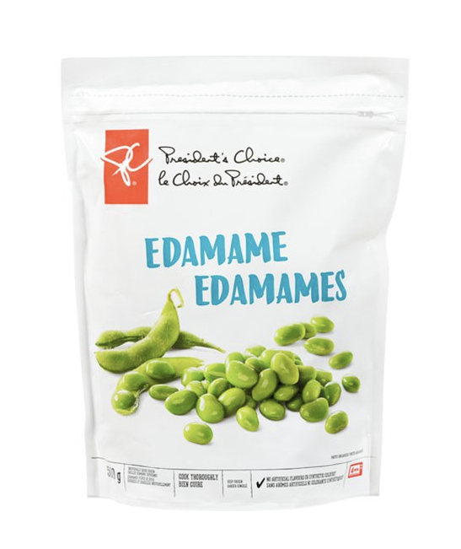
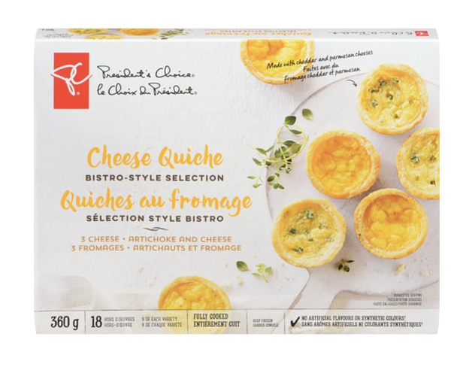
FROZEN
Cauliflower Crust Frozen Pizza
$7.00
Frozen Waffles
$3.00
Frozen Yogurt
$7.00
Frozen Broccoli
$5.00
Chicken Fingers (Club Size)
$11.00
Organic Frozen Mango
$8.00
Frozen Quiche
$8.00
Frozen Mango
$5.00
Frozen Edamame
$5.00

Slide 27
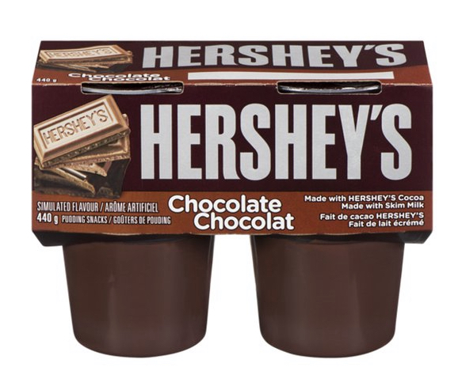
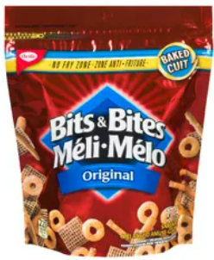
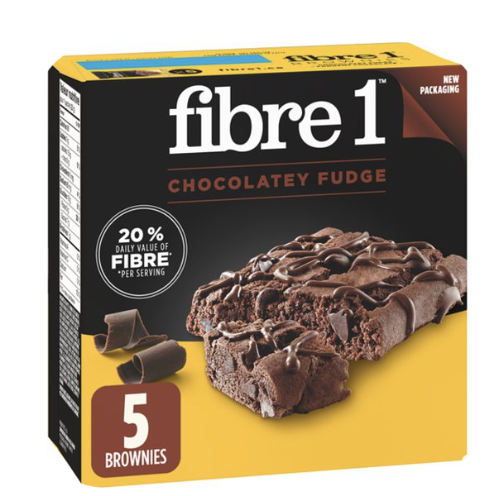
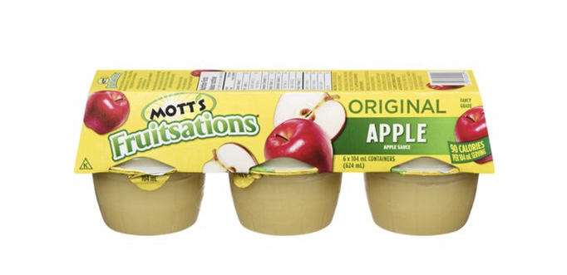
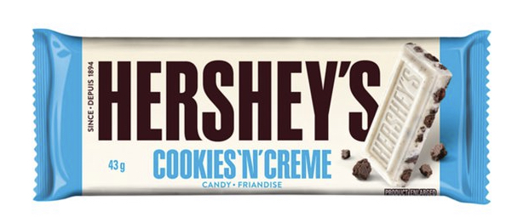
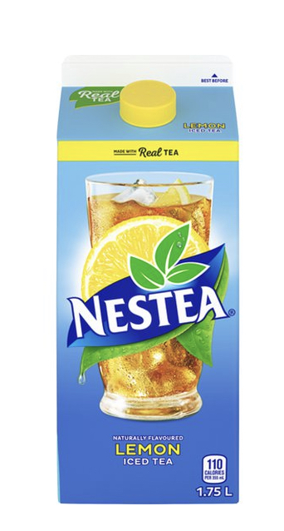
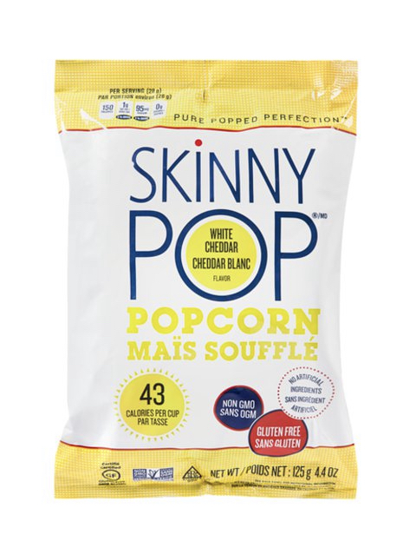
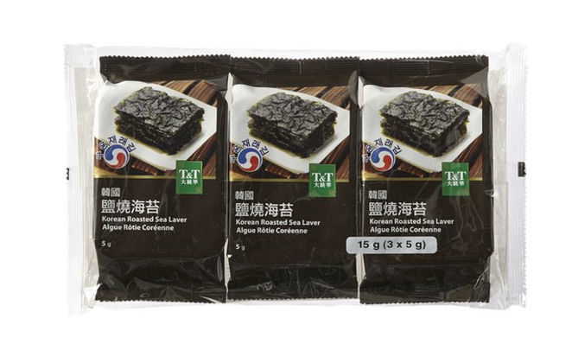
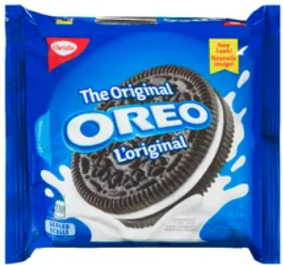
SNACKS
Hershey’s (5 pack)
$4.00
Apple Sauce
$3.00
Fiber 1
Brownie (5 pack)
$ 4.00
Chocolate Bar
$1.00
Bits & Bites Snack
Sale $3.00
Korean Roasted Seaweed (100 grams)
$2.00
Oreo
$5.00
Nestle Iced Tea
$3.00
Popcorn
(100 grams)
$5.00

Slide 28
Online Shopping

Slide 29
The Price Is Good

Slide 30
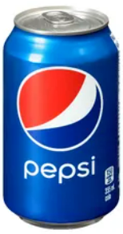
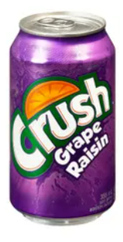
Goods
Pepsi
2 for $6.00
Crush
1 for $2.00

Slide 31
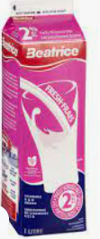
Goods
Pro Tip:
Buying bulk!
Buying a bigger size is usually cheaper.
Milk (4 L)
$8.00
Milk (1 L)
$3.00

Slide 32
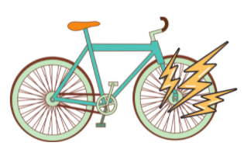
Service
Wonder Woman Package
New wheel
Wash your bike
New chains
Polish wheels
$85.00
Deadpool Package
New wheel
$10.00
What are some questions to consider?
What do I need?

Slide 33
Service
Shipping Cost
Not expedited
(7-10 business days)
$10.00
Shipping Cost
Expedited
(3-day delivery)
$24.00
It depends!
Is it urgent? (ex. Medicine)
What are some questions to consider?
Will it spoil?
Which option do you have money for?

Slide 34
Money!

