Slide 1
Fair Trade and Ethical Consumerism
Grade 10+

Slide 2

A Special Note for Teachers

Slide 3
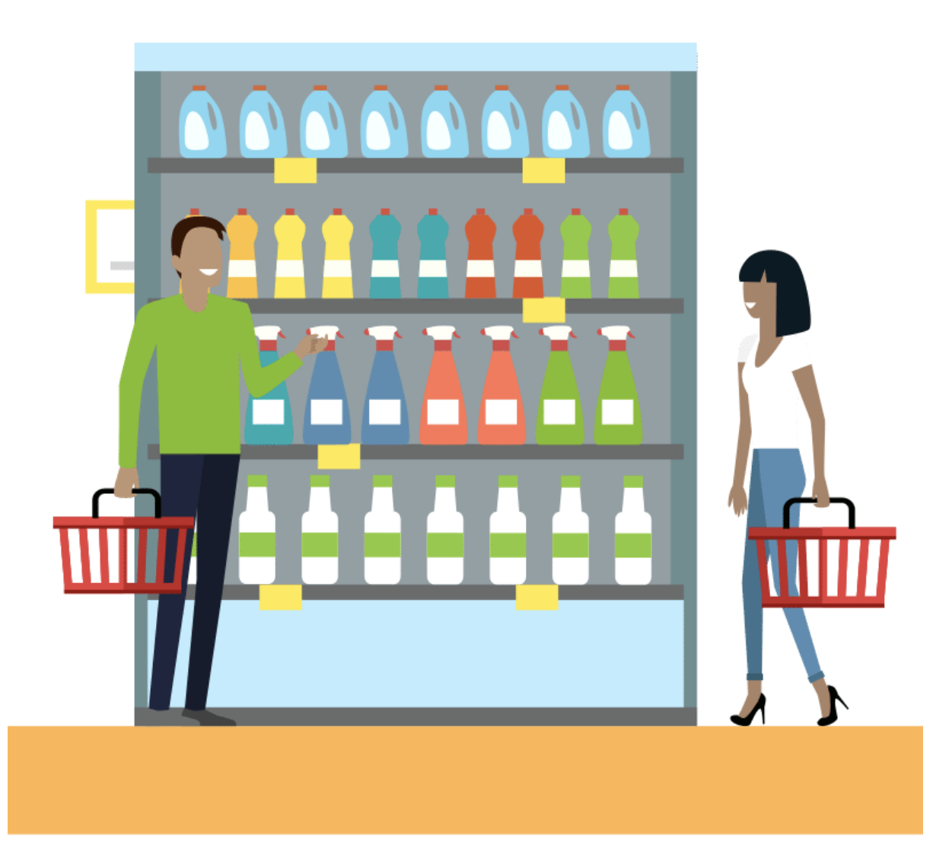
Consumer Choice
The choices we make when we buy something have a larger impact on the world economy. Sometimes at a store we don’t have many options, so we often choose what is available. Other times, we can support companies that are more ethical when we do have a choice!
How do the consumer choices of the population effect the world?

Slide 4

Minds On Activity
Think-Pair-Share
Have you heard of greenwashing?
Have you heard of Fair Trade?
What do you know about these topics?

Slide 5
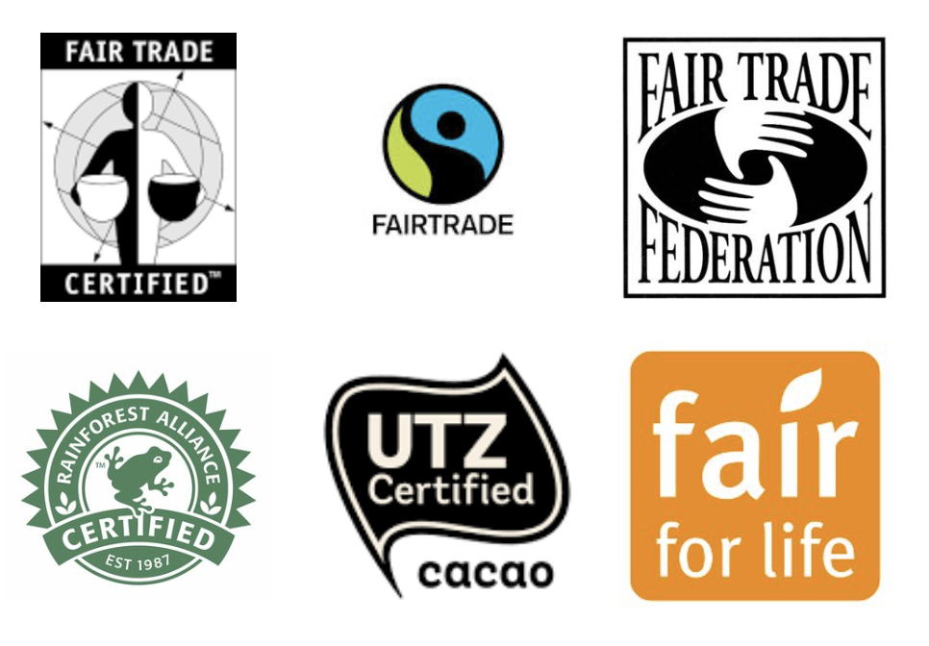
Why Fair Trade?
Fair Trade labels indicate that a food item is free from child labour or slave labour and that the workers who harvested the food were paid fairly and treated well. They also don’t use any chemicals that harm the environment, or genetically modified foods (GMOs).
Here are some examples of labels to look out for that let you know the food is Fair Trade:

Slide 6

What is Greenwashing?
Many consumers choose to pay a little more for products that are environmentally friendly. Some companies greenwash their products, which means they use a label to trick consumers into believing it is good for the environment when really it isn’t.
Can you think of a time that you noticed a company was greenwashing?

Slide 7
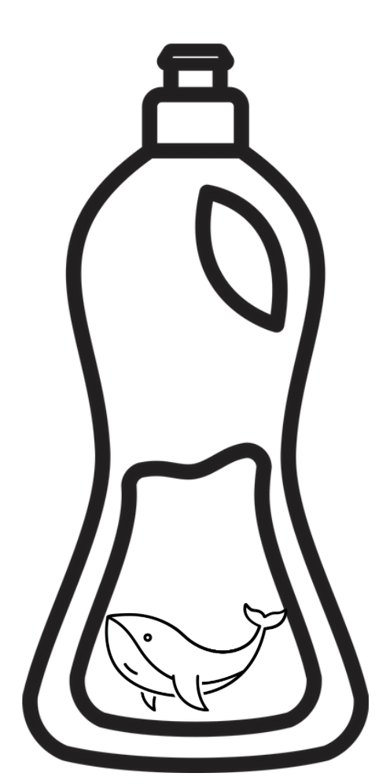
Spot the Greenwashing!
Green World Antibacterial dish soap
Their website says, "We save wildlife.” It tells us that the organization donates to a charity that helps marine wildlife. The package has pictures of whales.
But the soap contains Triclosan, an antibacterial agent, which was recently declared officially toxic to aquatic life. Environmental groups are asking for Triclosan to be banned.
Discus as a class:
Is this company using Greenwashing?
*These names and descriptions are of fictional products. Any similarity to actual products is coincidental.

Slide 8
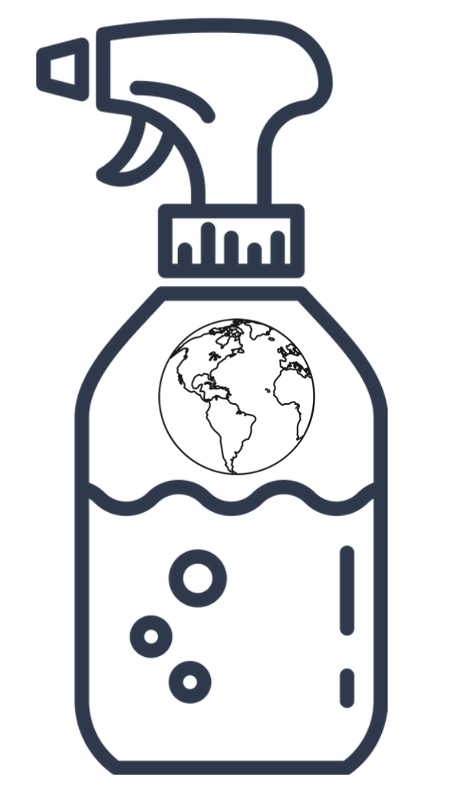
Spot the Greenwashing!
Earth Time All Purpose Cleaner
The label says it's non-toxic. It has the word "Earth" in the name. They say that the product has been tested and confirmed that it is non-toxic.
But it contains the ingredient: 2-butoxyethanol, which is listed by Environment Canada as a toxic health hazard that can damage red blood cells. There are no requirements to list ingredients on cleaning products.
Discus as a class:
Is this company using Greenwashing?
*These names and descriptions are of fictional products. Any similarity to actual products is coincidental.

Slide 9
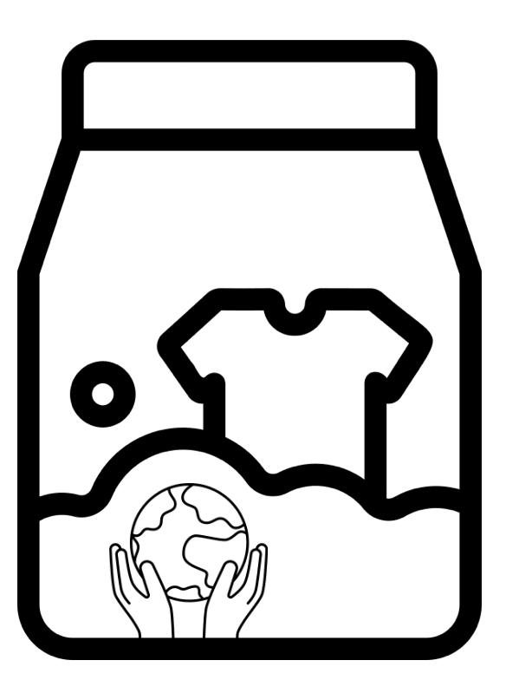
Spot the Greenwashing!
Nature Sunbeam Laundry Detergent
Laundry strips that come in recyclable and compostable packaging. They are lighter than liquid detergent and therefore easier to ship.
Doesn't contain ingredients that are hard on people or the environment. All ingredients are biodegradable.
Discus as a class:
Is this company using Greenwashing?
*These names and descriptions are of fictional products. Any similarity to actual products is coincidental.

Slide 10

Discussion Questions
1. What are some reasons that a company would use greenwashing?
2. What are some words and images that a company can use to greenwash their product?
3. How can we tell the difference between a company that is greenwashing and one that is ethical?

