Slide 1
Understanding Payroll Deductions
Modified lesson for those who may qualify under the Indian Act
Grade 11+

Slide 2
Acknowledgement
We understand that speaking about the Indian Act can be a sensitive topic for many people. The terms “Indian” and “Indian Act” have legal meaning. Qualifying under the Act can impact payroll deductions.
As teachers often do so well, please continue to check-in with your class to create a safe learning environment. Pause, take breaks, and create safe space if needed.
Knowledge is power! Understanding the benefits available to those who qualify is an added advantage.

Slide 3
In this lesson...
Most students who enter the workforce for the first time are often surprised when they do not receive the full amount of their stated salary! In this lesson, students will learn:
Various payroll deductions, where the money goes, and how it is calculated
Income tax exemptions defined by the Indian Act
How to determine eligibility for tax exemptions defined by the Act
How deductions impact net salary
Most of the examples focus on Ontario, but there is information that applies for all other provinces and territories.

Slide 4
Why Taxes?
Think-Pair-Share
Our taxes pay for many services that the citizens of our country use. This includes healthcare and public services.
Can you think of some services in your community that are funded by tax dollars?
Do you benefit from some of these services?
Are there services that are inadequately or not currently funded by tax dollars? What can we do to advocate as a citizen of this country?

Slide 5
Understanding Pay Stubs
We all love getting our first pay cheques!
You might be surprised that the amount you keep is less than the salary stated on the job.
Some amounts will be deducted from your salary before it goes into your pocket. The amounts taken from your salary are called payroll deductions.

Slide 6
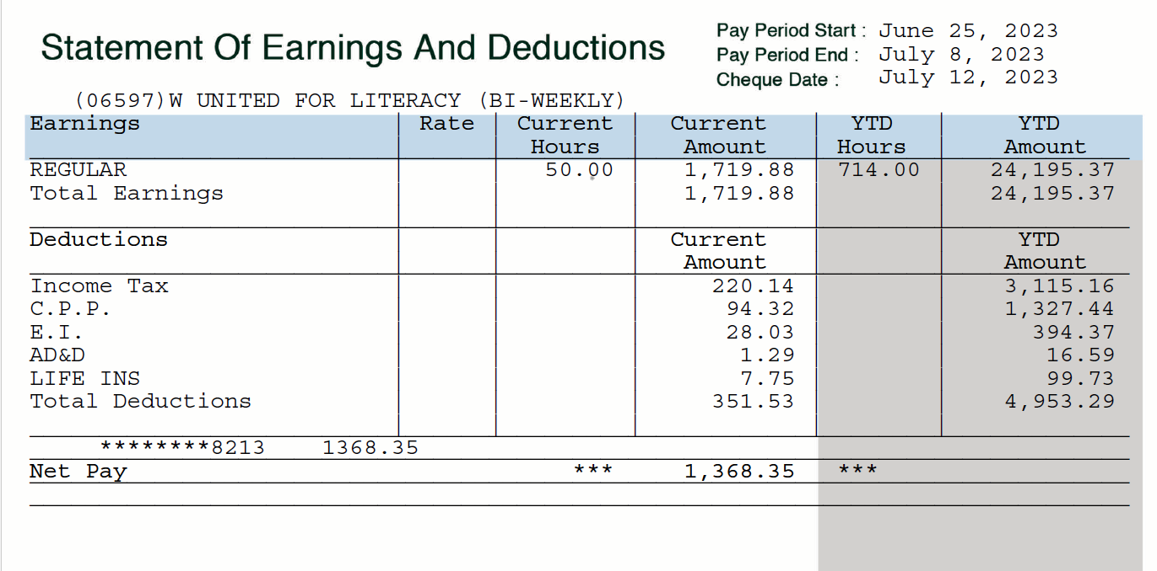
2 weeks
Year To Date

Slide 7
Understanding Pay Stubs
Payroll deductions: Certain amounts of your salary goes to pay taxes and other fees.
We will look at:
Income tax
CPP (Canadian Pension Plan)
E.I. (Employment Insurance)
Union dues
Benefit plan deductions
Let’s see where your money goes and how these deductions are calculated!
Most people pay, with some exceptions.
Depends on your job and what your employer offers.

Slide 8
1. Income Tax
What is it?
Income tax is the percentage of tax you must pay according to your salary level.
It comes directly out of your pay cheque. It’s the largest deduction!
Those with a higher income will pay a higher amount of taxes.
If you are (or could be) registered under the Indian Act, you might not need to pay income tax deductions.

Slide 9
1. Income Tax
There are two types of taxes you will pay in Canada:
Federal and Provincial (Territorial).
Federal taxes are for all of Canada.
Provincial and territorial taxes are for the province or territory in which you live.
The amount of Provincial or Territorial taxes that citizens pay are different for every province or territory.
However, if your income falls below the Basic Personal Amount, you do not need to pay income tax. Basic Personal Amount

Slide 10
1. Income Tax
Income tax deductions are calculated according to income tax brackets. Let’s see what they are. We will look at Federal and Provincial and Territorial.
Here are some links you can start with:
Tax Rates
Federal Income Tax Rates
Provincial Income Tax Rates
Note that the tax rates can change year to year.

Slide 11
1. Income Tax
Follow through to see the deductions for an employee
named Tanya from 2021.
She is an adult and lives in Ontario.
Tanya earns $28,058.68 in a year.
Every two weeks she receives a pay cheque for $1,079.18.
$54.59 of every pay cheque will go towards Provincial Income Tax.
This tax rate is 5.05%.

Slide 12
1. Income Tax
Now let's look at Federal Tax.
We saw that every two weeks Tanya receives a pay cheque
for $1,079.18.
$161.88 of her pay cheque will go towards Federal Income Tax.
This tax rate is 15%.

Slide 13
1. Income Tax
Total = $54.59 + $161.88 = $216.47
Every two weeks, she earns $1,079.18 before deductions.
After tax deductions, she receives $862.71.
Income tax deduction takes away the largest portion of your salary!

Slide 14
1. Income Tax
Important detail! People who make more money pay more taxes.
Here's why:
Income tax is calculated in tiers. This is called the Progressive Tax System.
The first income you make up to a base level is taxed in the lowest bracket.
Additional income higher than that base level is taxed in the next bracket.
The highest earners will be taxed at the highest bracket.
If you are (or could be) registered under the Indian Act, you might not need to pay income tax deductions.

Slide 15
2. CPP (Canadian Pension Plan)
What is it?
The Canada Pension Plan gives people over the age of 65 a source of monthly income. You can apply when you turn 60.
During your working years, you contribute into CPP to support the current retirees. When you retire, others contribute into CPP to support you.
People aged 18-65 are required to pay into the CPP.
If you are (or could be) registered under the Indian Act, you might not need to pay into the CPP.

Slide 16
2. CPP (Canadian Pension Plan)
The employer contributes an equal amount to the employee’s CPP as is deducted from their earnings.
So, for the amount that is deducted from your pay cheque, the employer contributes the same amount.
Example:
If your employer deducts $120.30 in CPP from your pay cheque, they also pay $120.30 into CPP. $120.30 (your deductions) + $120.30 (your employer’s contributions)
= $240.60 (Total CPP contribution)

Slide 17
2. CPP (Canadian Pension Plan)
For every cheque Tanya receives, $51.47
is deducted to go toward her CPP.
In a year, $1,338.44 of her total earnings go to her CPP.
Her employer will match (pay the same amount) her CPP contribution. She has $2,676.88 in her CPP from her own and her employer's contributions combined.
$1, 338.44 × 2 = $2,676.88

Slide 18
2. CPP (Canadian Pension Plan)
More information on CPP is available here:
Canada Pension Plan

Slide 19
3. E.I. (Employment Insurance)
E.I. or Employment Insurance gives people a source of income when they lose their jobs through no fault of their own.
Some examples of this situation are:
The end of a work contract.
Getting laid off. This can happen when a company no longer has the money to pay you to keep your job.
The maximum length of time someone can receive E.I. is usually one year and but can vary depending on circumstances.

Slide 20
E.I. Employment Insurance
Tanya will see some of her pay cheque goes toward E.I.
If she is laid off her job, she will apply for it and have income between jobs.
Tanya's paystub will list $17.05 going toward E.I. Her employer contributes $23.87 for each of her pay periods.
This means that $40.92 is added to the E.I. She might be able to claim it later.
$17.05 + $23.87 = $40.92

Slide 21
E.I. Employment Insurance
You should absolutely apply to E.I. if you think you might be eligible! This gives you some financial security while you are between jobs, which we all deserve.
More information on E.I. can be found here:
https://www.canada.ca/en/services/benefits/ei.html

Slide 22
4. Union Dues
What is it?
A union is an organized association of workers advocating to protect and advance employees’ working rights and interests.
Unionized employees may ask the company:
Better wages
Health benefits
Workplace health and safety
Stable work hours

Slide 23
4. Union Dues
If your job is unionized, then union dues are deducted from your pay cheque.
Some common unionized jobs:
Teachers, principals, etc.
Plumbers, electricians, technicians
Firefighters
Doctors, nurses
Some manufacturing workers
Some coal miners

Slide 24
5. Benefit Plans
What are they?
Some workplaces offer benefit plans to their employees. Plans will vary, and the employer will share the details in advance. Plans may include:
Parental leave: Parents can take time off to care for a new baby or a child and receive wages.
Healthcare: Some additional services that aren't already covered.
Retirement: Additional funds for retirement than the CPP.
Note: The amount is decided in advance.

Slide 25
Benefit Plans
If you would like to learn more about benefit plans, you can do some research online. Here is a starting point:
Benefit Plans

Slide 26
Tax Exemption Under the Act
As we saw, income tax is the biggest deduction from our pay cheques.
You may not need to pay income tax or CPP if:
You are registered under the Indian Act and
Your work on reserve or
You work off-reserve, but you and your employer are both “residents” on reserve
Are you registered, or eligible to register, under the Indian Act?
Is the tract of land considered a reserve under the Act? Contact your band office to find out.

Slide 27
Scenario 1
Johnny is registered under the Indian Act. He works as a mechanic for an automobile repair shop, performing all of his duties on reserve.
Does Johnny satisfy these requirements?
Registered under the Indian Act
Work on reserve or
Work off-reserve, but you and your employer are both “residents” on reserve
Johnny’s income is exempt from income tax and CPP. This means he will not have income tax or CPP deductions on his pay cheque. He gets to keep that money! Johnny still pays towards E.I.

Slide 28
Scenario 2
Maria is registered under the Indian Act. She lives on reserve. She works for a logging company that operates off reserve.
Does Maria satisfy these requirements?
Registered under the Indian Act
Work on reserve or
Work off-reserve, but you and your employer are both “residents” on reserve
Because Maria’s company operates off reserve, her income is taxable. This means she will pay income tax and CPP deductions on her pay cheques.

Slide 29
Scenario 3
Mr. Cloud works for a construction company that is resident on a reserve. He also lives on reserve but works on building sites off reserve. He is registered under the Indian Act.
Does Mr. Cloud satisfy these requirements?
Registered under the Indian Act
Work on reserve or
Work off-reserve, but you and your employer are both “residents” on reserve
Mr. Cloud’s income is exempt from income tax and CPP. He works off-reserve, but he is a resident on a reserve, and his company is a resident on reserve.

Slide 30
Employment Scenarios
There are a lot more possible scenarios, and it gets quite complicated.
The Canadian government provides guidelines. For more info:
Indian Act Exemption for Employment Income Guidelines
Examples of uncommon employment situations where the guidelines do not apply
Let’s look at our pay stub activity for common employment scenarios.
All of the scenarios used in this lesson are modified from the Canadian government websites.

Slide 31
Reference
Canada Revenue Agency. (2013, November 21). Indian Act Exemption for Employment Income Guidelines. Canada.ca. https://www.canada.ca/en/revenue-agency/services/indigenous-peoples/indian-act-exemption-employment-income-guidelines.html

