Slide 1
Why ‘Interest’ Should Interest You: OSAP Student Loan
Grade 11+

Slide 2
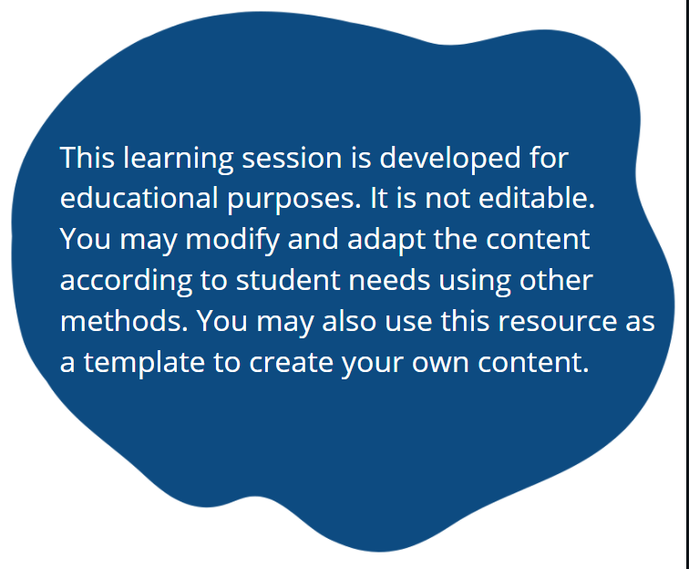
A Special Note for Teachers

Slide 3

Introduction
Let’s apply our knowledge of simple interest to a real-life situation: OSAP student loan.
There are many types of student loans. This lesson focuses on OSAP ─ a Canadian federal and provincial loan for Ontario students.

Slide 4
In this lesson…
We will learn:
Different ways to fund your education
How OSAP works
Calculate interest on an OSAP loan
Repayment strategies to save you money
Resources
(We compiled all the resources for this lesson into an OSAP Resource Kit. You can download at: www.unitedforliteracy.ca/resources)

Slide 5




Minds On Activity
Think-Pair-Share
What do you think is the current market price for the following items?
Vinyl record
Ear pods
Post-secondary diploma
Spotify subscription

Slide 6

How To Fund Your Education
As you are planning to go to post-secondary education, you must also be thinking about how you will pay for it.
This is a huge question. If you are confused, you are not alone.

Slide 7
How To Fund Your Education
  Money you do not need to pay back:
    Scholarships and bursaries
    OSAP grants
    Work-study programs
    Employment
    Savings
    Investments
    Contributions from relatives
    For Indigenous communities: band or community sponsorship
  Money you need to pay back:
    OSAP loans
    Emergency loans from your school
    Bank loans
    Borrowing from relatives

Slide 8

How To Fund Your Education
Of course, the best strategy is to borrow as little debt as possible! Utilize the options that you do not need to pay back.
Can you work through the summer?
Can you budget and save more money towards your education?
Can you set aside time to apply for scholarships and bursaries?
Can you invest your money and start earning interest?
Canadian scholarships are available throughout the year, even through the summer!

Slide 9
Ontario Student Assistance Program (OSAP)
OSAP offers two funding options:
Grants: money you don’t have to pay back
Student loan: money you need to repay
“When you apply for OSAP, we automatically consider you for both grants and a loan. If you don’t want to take a loan, and you’re a full-time or part-time student, you can decline it after your application is approved.”
Source: OSAP website
This lesson focuses on OSAP student loan.

Slide 10
Total Cost of OSAP: Principal
Every loan is made up of a principal and interest.
Principal: The total amount of money you borrow as an OSAP loan.
Your principal (OSAP loan) is separated into two portions:
80% Federal portion (Canada Student Loan)
20% Provincial portion (Canada-Ontario Integrated Student Loan)
Most students don’t know that their OSAP loan is split 80/20 into two portions!*
*Call the National Student Loans Service Centre (NSLSC) to verify that their regulation has not changed. NSLSC manages your OSAP loan.

Slide 11
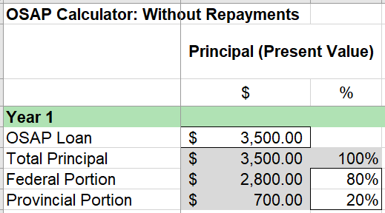

Student Activity
In the performance task, read through the “Scenario” and “Part 1: Principal” sections.
Use the “Grade 11 OSAP Calculator: No Repayments” spreadsheet to answer questions 1-2.
Verify with NSLSC that the 80/20 split is still true. You can change the percentage if necessary.

Slide 12
Total Cost of OSAP: Interest
Now that we learned about the principal of an OSAP loan, let’s look at interest.
OSAP student loan charges daily simple interest.
Your OSAP loan does not accrue interest while you are in school!
(In the scenario, your principal increased because you borrowed more money every year. But the principal is not accruing interest.)
Federal portion: No interests!
Provincial portion: It does accrue interest after you leave school.
OSAP defaults to a 9.5 years of repayment (114 months).

Slide 13

Total Cost of OSAP: Interest
Great news!
Effective April 1st, 2023, the Government of Canada has permanently eliminated the accumulation of interest on the federal portion of student loans.
This means 80% of your student loan will never accrue interest!
Only 20% (the Provincial portion) will accrue interest.
With this new change, students will save a lot of money in interest payments! Hooray!

Slide 14
Total Cost of OSAP: Interest
When to start repaying?
6 months after you graduate or leave the program
You do not need to repay OSAP while you are in school. (But if you can, it will greatly benefit you. We will learn why that is.)
Where to repay?
You will make payments to the National Student Loans Service Centre (NSLSC), not to OSAP.
NSLSC website: https://www.csnpe-nslsc.canada.ca/

Slide 15
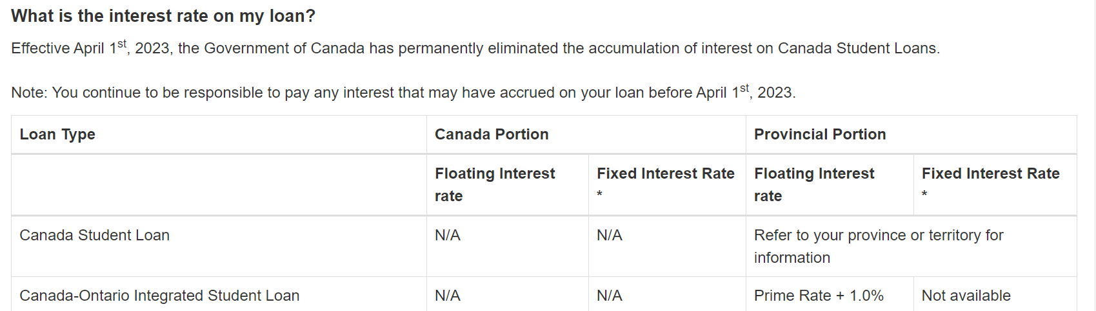
Total Cost of OSAP: Interest
It is important to know that the principal is split into two portions, because they carry different interest rates!
NSLSC shows the interest rates for the two portions: NSLSC Interest Rate section
For example: The interest rates for 2023

Slide 16
Total Cost of OSAP: Interest
Whoa! There were some new terms. For key terms that you do not understand, the NSLSC Glossary Page is helpful.
Prime Rate: “The Prime Rate used by the NSLSC is based on the variable reference rates of interest declared by the five largest Canadian financial institutions. The Prime Rate is calculated by ignoring both the highest and the lowest of those five rates and taking the average of the remaining three rates.”
The prime rate is determined by the Bank of Canada and the five largest financial institutions. It changes from time to time. The prime rate affects interest rates on loans, mortgages, savings accounts, etc.

Slide 17

Total Cost of OSAP: Interest
The Bank of Canada website keeps track of the most current prime rate: https://www.bankofcanada.ca/rates/daily-digest/
Look and see: What is the current prime rate?

Slide 18
Total Cost of OSAP: Interest
Example:
Prime rate as of April 2023 = 6.70%
Federal portion (Canada portion): Floating interest rate = 0%!
Fixed interest rate = 0%!
Provincial portion (for Ontario): Floating interest rate = 6.70% + 1.0% = 7.70%
Fixed interest rate = not available
These are the interest rates for the two portions of the principal!

Slide 19
Floating vs. Fixed Rates
Floating Interest Rate: “A rate of interest that varies over time with the prime rate. This means that the interest you are charged during repayment of your loan will increase and decrease along with the prime rate.”
Fixed Interest Rate: “A stable rate of interest. If you choose a fixed rate, you will be charged the same interest rate throughout your repayment period.”
Source: NSLSC Glossary

Slide 20
Floating vs. Fixed Rates
For the federal portion, you do not need to worry about interest rates!
For the provincial portion, you do not have a choice. Only a floating interest rate is available.

Slide 21

Dig Deeper: Floating vs. Fixed Rates
We can no longer choose between a variable or fixed rate. But it benefits us to learn about their implications. Let's spend a few minutes to examine their differences.
Choosing between a floating and fixed interest rate is very tricky!
Take a look at the history of Canada prime rates to see how it fluctuated: https://moneywise.ca/news/economy/what-is-the-prime-rate-in-canada
Then, answer the discussion questions on the next slide.

Slide 22

Pause and Discuss
Think-Pair-Share
When the prime rate was relatively high (for example, 4.70%), do you think it is beneficial to fix your interest rate at this level as you repay your student loan?
When the prime rate was relatively low (for example, 2.50%), do you think it is beneficial to fix your interest rate at this level as you repay your student loan?

Slide 23
Dig Deeper: Floating vs. Fixed Rates
General guidelines:
Floating interest rates can be riskier because it can change any time. However, you will benefit if the prime rate goes down.
Fixed interest rates can be less risky, because you know in advance how much you will pay, so you can budget better for it.
Applying what you learned so far, complete “Part 2: Interest” section of your activity.

Slide 24

Total Cost of OSAP: No Repayments
As you pay back your OSAP loan, your principal and interest amounts will decrease over time.
To calculate how your loan decreases, we must understand the concept of “amortization”. You will learn this in Grade 12.
For Part 3 of the activity, we will calculate how the OSAP loan grows if you do not make repayments.

Slide 25

Total Cost of OSAP: No Repayments
Reminder:
OSAP student loan charges daily simple interest.
Your OSAP loan does not accrue interest while you are in school!
Federal portion: It does not accrue interest within 6 months after you leave school. This is the 6-month grace period.
Provincial portion: It does accrue interest after you leave school. There is no grace period.
OSAP defaults to 9.5 years of repayment (or 114 months).
Our OSAP Calculator considers all of these factors.
However, it is beneficial to repay your loan faster. We will look at this.

Slide 26
Student Activity
Read through “Part 3: Future Value Without Repayments” section. Enter the necessary information in the OSAP Calculator and answer questions 7-10.
See the next slide for a special feature in the OSAP calculator.

Slide 27
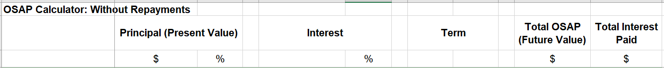
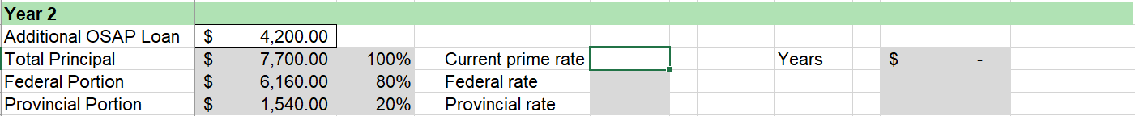

Student Activity
Students have the option to calculate the “total interest paid” using the spreadsheet or by hand. This applies to questions 8-10.
Students may enter a formula in these cells to calculate the “total interest paid”.

Slide 28

Important Reminder
In Part 3 of the activity, we looked at how OSAP loan grows without repayments. In reality, you will make payments along the way. Your total OSAP loan will be less than our calculations today.
You can do calculations that are more realistic using the amortization method. You will learn about amortization in a Grade 12 math class.

Slide 29
OSAP Repayment
The biggest question about OSAP is: “How do I repay it?”
For example: If you make a monthly payment of $100, $80 goes to pay down your federal loan, and $20 goes to pay down your provincial loan.
Yes! Your OSAP principal is split 80/20. Your repayments are also split 80/20*!
*Call NSLSC to verify that their regulation has not changed.
Students may not know: When you repay OSAP, 80% of the repayment goes toward the federal loan, and 20% of the repayment goes toward the provincial loan*.

Slide 30
OSAP Repayment
Is there a way to save money?
Is it possible to lower the total OSAP loan (future value)?
Can we lower the total interest that we will pay?
Yes!
We will look at two repayment strategies:
Make lump sum payments
Increase your monthly payment

Slide 31
Strategy 1: Lump Sum Payments
Making lump sum payments will reduce your principal and all of the future interest payments! Paying more money upfront will help you save money in the long run.
There are two possible scenarios:
Option A: Make a lump sum payment before you leave the program
Option B: Make a lump sum payment after you leave the program

Slide 32
Option A: Make a lump sum payment before you leave the program
OSAP Loan ($)
Money you
saved
Federal
Portion
Money you
saved
Federal portion you will actually pay.
Federal portion you would have paid.
Provincial portion you would have paid.
Provincial
Portion
Provincial portion you will actually pay.
Time
Make a lump sum
payment
Leave school
Federal: No interest
Provincial: accrues interest immediately

Slide 33
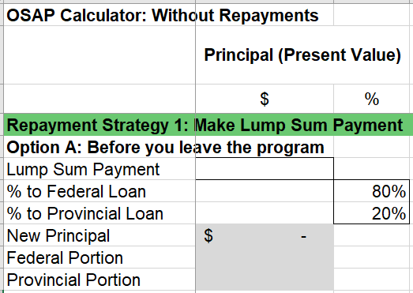
Student Activity
For “Part 4: Make Lump Sum Payments”, we will look at “Option A: Before you leave the program”. Use the OSAP Calculator for questions 11-15.
Verify with NSLSC that the repayment split is still true. You can change the percentage if necessary.

Slide 34
Student Activity
For question 15, see what happens when you change the lump sum amount.
Increase/decrease the lump sum amount. Keep the other variables the same.

Slide 35
Option B: Make a lump sum payment after you leave the program
OSAP Loan ($)
Money you saved
Federal
Portion
Money you saved
Federal portion you would have paid.
Federal portion you will actually pay.
Provincial portion you will actually pay.
Provincial portion you would have paid.
Provincial
Portion
Time
Leave school
Federal: No interest
Provincial: accrues interest immediately
Make a lump sum
payment

Slide 36
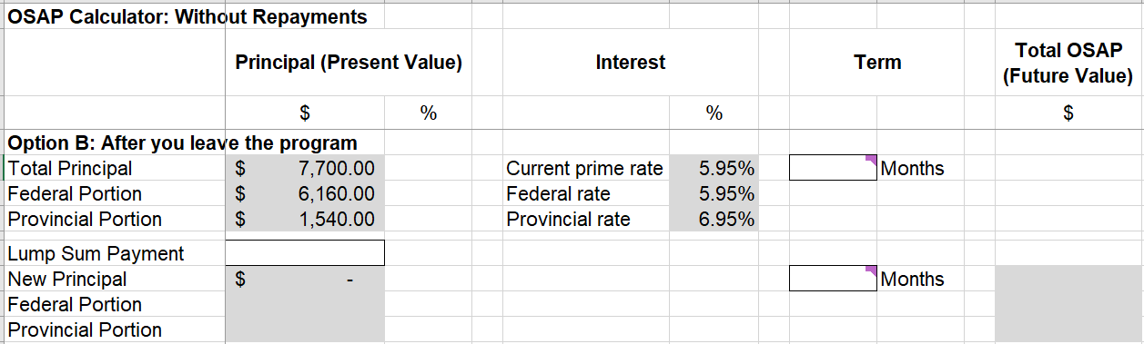
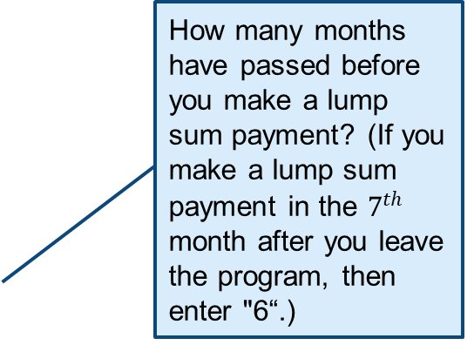
Student Activity
For “Option B: After you leave the program”, use the OSAP Calculator for questions 16-19.
How many months have passed before you make a lump sum payment? (If you make a lump sum payment in the $7^{th}$ month after you leave the program, then enter "6“.)
Enter the number of remaining months in the repayment period.

Slide 37
Student Activity
For question 19, see what happens when you delay the lump sum payment.
To delay the lump sum payment:
Increase the number of months before the payment.
Decrease the number of months after the payment.
Months before the lump sum payment
Months after the lump sum payment

Slide 38

Student Activity
For questions 20-24, compare Options A and B to see which is more beneficial. Reflect on how you might want to apply these strategies when you take on student loans in the future.

Slide 39
Strategy 2: Increase Your Monthly Payment
When you leave the post-secondary program, NSLSC gives you a repayment package detailing how to repay your student loan.
OSAP defaults to a 9.5-year repayment period. According to this assumption, they estimate a monthly payment amount for you.
Let’s see how much money you can save if you shortened the repayment period. You can do this by increasing the monthly payments.
Go to Hellosafe Student Loan Calculator. This calculator uses amortization, which gives realistic calculations of OSAP.

Slide 40
Student Activity
For “Part 5: Increase Your Monthly Payment” section, use the Hellosafe Student Loan Calculator to answer questions 25-26.
Note: This calculator rounds up the 9.5-year repayment period to 10 years. However, it gives a good estimate.

Slide 41
Student Activity
For question 27, to complete Chart 2, use the information from Chart 1.
For example:
Find the differences:
Chart 1 | Default Option | Option 1
Repayment Periods: | 9.5 Years | 8 Years
Monthly Payment | $ 90 | $ 105
Total Interest Paid | $ 2,000 | $ 1,200
Total Payment (Total Loan) | $ 10,800 | $ 10,000
Chart 2 |  | Option 1
Time Saved:
Monthly Payment Increase
Total Payment Saved
9.5 – 8 =
1.5 Years
105 – 90 =
+ $15
10,800 – 10,000 =
$ 800

Slide 42

Sacrifice Now, Win Later
As we saw…
Increasing your monthly payment now can save you a lot of money in the future.
Making a lump sum payment now will help you save a lot of money later.
So really, it’s a choice between now vs. later.
Would you rather benefit now, or benefit a lot in the future?

Slide 43

Sacrifice Now, Win Later
Everyone has a different circumstance.
If the best you can do is to follow the default repayment plan, there’s nothing wrong with that!
If it is within your reach to pay a little more every month…
Can you hold off from buying something you don’t actually need?
Are there some small ways you can save money?
Have a goal to contribute $15, $20, or $45 more every month to pay off your student loan faster and save big in the future!

Slide 44
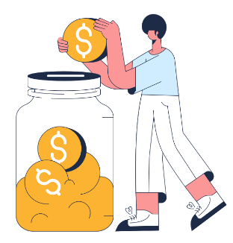
Sacrifice Now, Win Later
Everyone has a different circumstance.
If the best you can do is to follow the default repayment plan, there’s nothing wrong with that!
Or do you have the means to make a lump sum payment?
Can you hold off a big purchase and put that money towards your student loan?
This can save you a lot of money!

Slide 45
Student Activity
Making personal application of everything that we learned, complete “Part 6: Final Reflections”.

Slide 46


