Slide 1
The Finance of Adulting
Student Version
Grade 7+

Slide 2

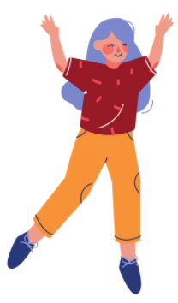
A Note For Students

Slide 3
Students will learn…
Through this game of simulation, students will learn:
Monthly budgeting and longer-term financial planning
Common living expenses and paying bills
Interest rates on debt
Interest rates on investment
How marketing influences our buying decisions and financial planning

Slide 4
Task: The Finance of Adulting
Help your avatar organize their monthly budget while they live on their own! It can be easy to fall into debt if we are not careful with our bills, or if we don’t have strong budgeting habits.
In this task, you pick an avatar and you will:
Pay bills and make financial decisions for 2 years,
Choose a financial goal and achieve it within 2 years (see slide 6),
Have no debt after 2 years.

Slide 5


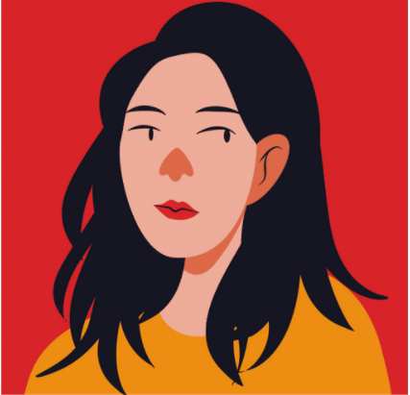

Choose Your Avatar…
Tanisha
DeShawn
Age: 17, currently in high school
Interests: Watch cat videos on YouTube, snowboarding and coffee
Life goals: Travel around the world
Age: 17, currently in high school
Interests: Reading, soccer, guitar and making music
Life goals: Start his own business
Brie
Toshi
Age: 18, currently in high school
Interests: Baking, surfing and watercolors
Life goals: Become a certified scuba diver, research about the oceans
Age: 18, currently in high school
Interests: Basketball, rock music and stand-up comedies
Life goals: Become a sports coach

Slide 6
Choose Your Financial Goal…
Within the next 2 years, what would you like to achieve financially?
Choose your amount:
$ 1,200
$ 1,100
$ 1,000
$ 900
$ 800
$ 700
Choose your goal:
Money for post-secondary tuition!
Payment going towards your first car!
Vacation to a destination you choose…
Or anything else - Pick your own financial goal!

Slide 7

Task Overview
You will create monthly budgets and see how a monthly budget affects a 2-year financial plan.
Overspending across many months will have a negative impact on your 2-year financial plan. You would be in debt.
Creating a monthly budget is a great way to track your income and spending!
You can see if you underspent or overspent.

Slide 8
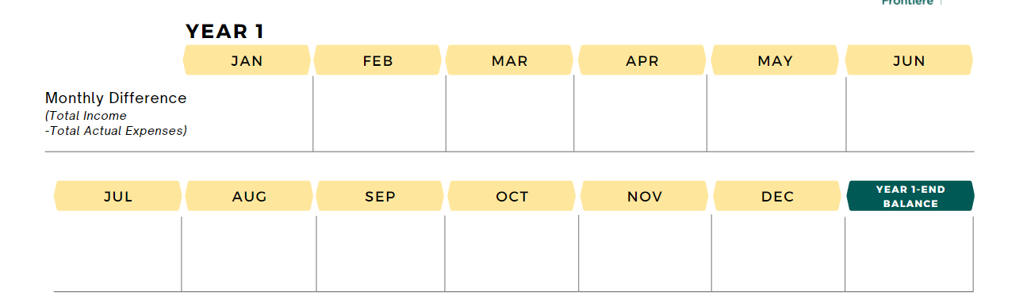

Task Overview
Overspending can lead to debt. Debt is written as a negative number in math. Overspending for many months can have a negative impact on your financial health!
For example:
− $100
$15
− $150
− $40
− $70
− $65
$55
− $95
$20
− $125
− $30
$40
− $545
In this task, you will learn how to complete a monthly budget and a financial plan.

Slide 9


Slide 10

Build a Monthly Budget
In Year 1 January, your avatar found a part-time job at a restaurant that pays minimum wage and tips. They earn $1,920 every month. They also do chores around the house and earns $40 a month. These are the income or earnings.
Using the Monthly Budget sheet, fill in:
Month: January
Income #1
Income #2
Calculate “Total Income”

Slide 11
Build a Monthly Budget
Budget
A plan for how you will use your money.
Your avatar knows some of the monthly expenses that come with living on their own. Here is the amount they budgeted. Fill in the “budget” column.
Expenses | Budget
Rent | $ 700
Utilities | $35
Internet & Cable | $120
Cell Phone Plan | $60
Transportation | $50
Personal Items | $35
Medical Expenses | $40

Slide 12

Flexible Expenses
Help your avatar decide how to budget for 4 flexible expenses.
You will make decisions for saving, food, clothing, and entertainment.
Rules:
You must choose one of the available options (expenses cannot be $0).
You cannot pick Option 3 for all flexible expenses.
The key to financial wellbeing is trying your best to spend only the money you earn.

Slide 13

Flexible Expenses
Decision 1: Saving
Budget how much your avatar will save this month.
“Do not save what is left after spending, but spend what is left after saving.”
~Warren Buffett

Slide 14

Flexible Expenses
Decision 2: Food
Option 1
Order take-outs very often
Almost never buy groceries to cook at home
Best tasting meals
Often have desserts and snacks
$ 800 per month
Option 2
Order take-outs sometimes
Buy groceries and make meals at home
Good quality & good-tasting meals
Occasionally have desserts and snacks
$ 650 per month
Option 3
Order take-outs once in a while
Groceries are mostly fresh, but not always
Mostly good quality & good-tasting meals
Snacks and desserts once in a while
$ 535 per month

Slide 15

Flexible Expenses
Decision 3: Clothing
Option 1
Best quality
You shop to follow fashion trends
You do not like buying clothing on sale
You prefer branded clothing
Newest and hottest trends
$ 140 per month
Option 2
Good quality
You shop occasionally
You like to look at discounted items first
Some purchases are name brands, others are not
$ 85 per month
Option 3
Medium quality
You shop once in a while
You are saavy with online selling and trading platforms to get deals
You mostly buy what you need, not what you want
$ 50 per month

Slide 16

Flexible Expenses
Decision 4: Entertainment (movies, concerts, music festivals, etc.)
Option 1
Entertainment events are very important to you
You enjoy the VIP experience, so you buy more expensive tickets
You attend at least 2 entertainment events a month
$ 100 per month
Option 2
You sometimes go to entertainment events
You buy medium-priced event tickets
You attend an entertainment event every few months
$ 65 per month
Option 3
You go to entertainment events once in a while
You compare prices and search for the best value tickets
You attend 2 entertainment events a year
$ 40 per month

Slide 17
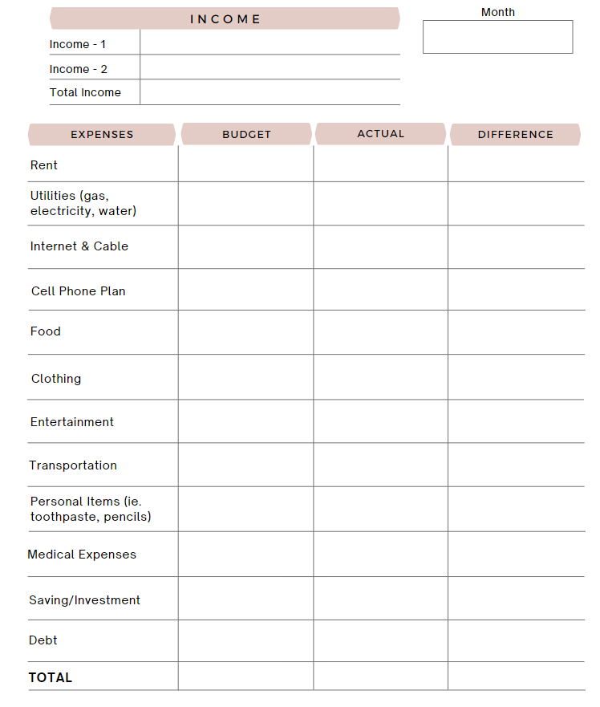

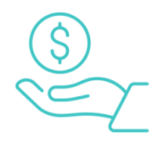
Balance Your Budget
January
Does your “Total Budget” equal “Total Income”?
Pro Tip:
Try to spend only the money you earn.
If your budgeted expenses are more than your income, where can you reduce expenses?
If your budgeted expenses are less than your income, where do you want to put the extra money?

Slide 18

Actual Expenses
Avatars, pause here!
Your teacher will show you the actual expenses for the month.

Slide 19
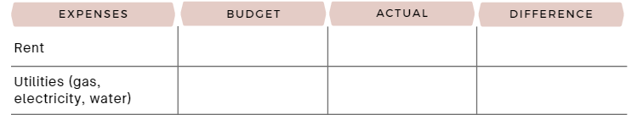
Budget vs. Actual
Difference = Budget − Actual
$ 1,000
$ 1,000
1,000 − 1,000
= $0
$ 35
$ 25
35 − 25
= $10
$ 50
$ 55
50 − 55
= − $5
If you spent the budgeted amount, the difference is zero.
If you underspend, the difference is a positive number.
If you overspend, the difference is a negative number.
Calculate the difference.

Slide 20
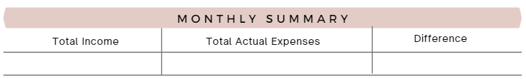
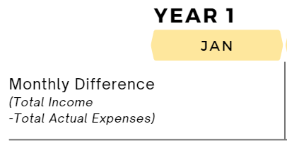
Monthly Summary: Year 1 Jan
Did you spend within your income this month?
Input your monthly difference into the 2-year financial plan,
in Year 1 January.
Notes:
Notes for Teachers: Teachers can go back to slide 8 to remind students of the potential dangers of overspending across many months. The key is “many months”. Overspending in the short-term may not have a significant impact. For example, if you overspend this month but underspend in the next month, it may balance out depending on the situation.

Slide 21



Savings
Input your actual savings amount (not budgeted) in your financial plan.

Slide 22
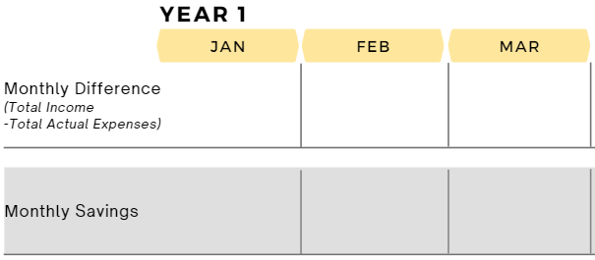
Monthly Summary: Year 1 Feb-Mar
Your avatar maintains the same level of income and expenses for the months of February and March in Year 1. Therefore, the monthly difference and saving will remain the same as January.
Input the monthly difference and actual saving in your 2-year financial plan.

Slide 23


Slide 24
Scenario 1
Starting in May, your avatar has a new extracurricular activity after-school, so they have to work less hours. Their income decreases, and they earn $1,640 every month. They continue doing chores and earns $40 a month.
According to the new level of income, create a new monthly budget.
Below are some budgeted expenses:
Expenses | Budget
Rent | $ 700
Utilities | $35
Transportation | $25
Personal Items | $45
Medical Expenses | $50
Your avatar estimates:
Possibly lower transportation cost because they are going to work less?

Slide 25
Flexible Expenses
Because of the new income, your avatar wants to adjust some of their flexible expenses. It is up to you whether you want to adjust those expenses. Your avatar also wants to shop around for a different internet plan and cell phone plan.
Rules:
You must choose one of the available options (expenses cannot be $0).
You cannot pick Option 3 for all flexible expenses.

Slide 26

Flexible Expenses
Decision 1: Saving
Do you want to adjust your saving?

Slide 27
Flexible Expenses
Decision 2: Food
Option 1
Order take-outs very often
Almost never buy groceries to cook at home
Best tasting meals
Often have desserts and snacks
$ 800 per month
Option 2
Order take-outs sometimes
Buy groceries and make meals at home
Good quality & good-tasting meals
Occasionally have desserts and snacks
$ 650 per month
Option 3
Order take-outs once in a while
Groceries are mostly fresh, but not always
Mostly good quality & good-tasting meals
Snacks and desserts once in a while
$ 535 per month

Slide 28
Flexible Expenses
Decision 3: Clothing
Option 1
Best quality
You shop to follow fashion trends
You do not like buying clothing on sale
You prefer branded clothing
Newest and hottest trends
$ 140 per month
Option 2
Good quality
You shop occasionally
You like to look at discounted items first
Some purchases are name brands, others are not
$ 85 per month
Option 3
Medium quality
You shop once in a while
You are saavy with online selling and trading platforms to get deals
You mostly buy what you need, not what you want
$ 50 per month

Slide 29
Flexible Expenses
Decision 4: Entertainment (movies, concerts, music festivals, etc.)
Option 1
Entertainment events are very important to you
You enjoy the VIP experience, so you buy more expensive tickets
You attend at least 2 entertainment events a month
$ 100 per month
Option 2
You sometimes go to entertainment events
You buy medium-priced event tickets
You attend an entertainment event every few months
$ 65 per month
Option 3
You go to entertainment events once in a while
You compare prices and search for the best value tickets
You attend 2 entertainment events a year
$ 40 per month

Slide 30

Flexible Expenses
Decision 5: Internet & Cable
Currently your avatar uses Option 1.
Option 1
Unlimited 5G high-speed internet
Internet is always reliable
Basic cable + 20 TV channels
$ 120 per month
Option 2
Unlimited 4G internet
Internet is often reliable
No cable
Includes Netflix & Crave
$ 90 per month
Option 3
Unlimited 3G internet
Internet is unstable during busy hours
No cable TV, no streaming platforms
$ 60 per month

Slide 31

Flexible Expenses
Decision 6: Cell Phone Plan
Currently your avatar uses Option 1.
Option 1
Data: 10GB per month
Unlimited calling and texting
Includes Caller ID and voicemail
Stable connection
$ 60 per month
Option 2
Data: 2.5GB per month
Unlimited calling and texting
No Caller ID, no voicemail
Connection is okay
Pay-as-you-go plan
$ 35 per month
Option 3
Data: 500 MB per month
100 minutes calling
Unlimited texting
No Caller ID, no voicemail
Connection not always stable
Pay-as-you-go plan
$ 25 per month

Slide 32



Slide 33


Slide 34
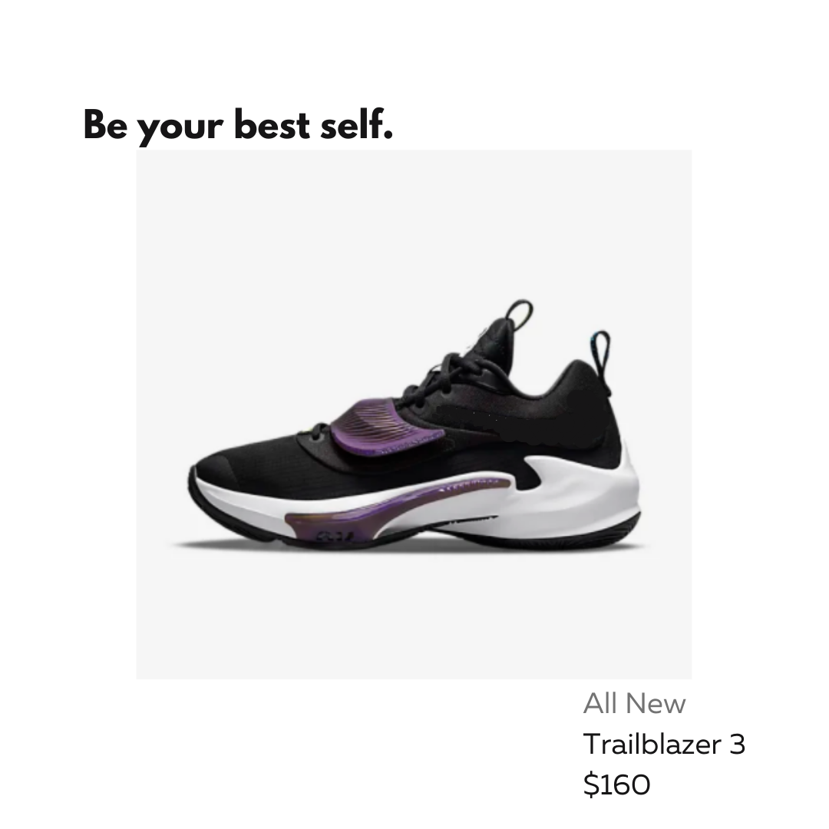

Slide 35


Slide 36


Slide 37


Slide 38
Balance Your Budget
Did you buy anything? Include the cost in your monthly budget. Add it to your “personal items” expense.
Remember to balance your budget! Does your “Total Budget” equal “Total Income”?

Slide 39
Actual Expenses
Avatars, pause here!
Your teacher will show you the actual expenses for the month.

Slide 40
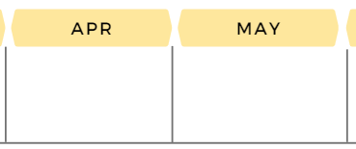

Monthly Summary: Year 1 April
Calculate the monthly difference for April.
Input the monthly difference and actual saving in the financial plan for Year 1 April.

Slide 41
Monthly Summary: Year 1 May
If you made purchase(s) from the Instagram ads, cancel the cost from your expenses in May. Re-calculate your monthly difference and input it for Year 1 May.
If you did not purchase anything, input the same monthly difference as April for Year 1 May.
Input your actual saving.

Slide 42
Student Reflection
At this point, let’s take a pause and reflect on what we have learned so far.
Did you make compromises on some of the flexible expenses? Why or why not?
Do you think it is easy to make compromises in real-life? For example, opting for slower internet or less data on your phone?
Do you think it is necessary to make compromises in real-life? Why or why not?
How do you think ads, “good deals”, and promotions can interrupt our financial goal in life?
What are some ways we can minimize these interruptions and focus on our financial goal(s)?

Slide 43
Scenario 2
Your avatar comes across an opportunity:
1) You may borrow money and achieve your financial goal now, OR
2) Invest your money and achieve the financial goal later.
To understand the available options, let’s learn more about debt and investment and their pro’s and con’s.
Watch video: Interest on Borrowing vs. Investing
https://www.youtube.com/watch?v=-tXFAVMyl7I

Slide 44
Activity: Lender or Borrower?
Situation A
Jose lends $10 to Abby.
Questions:
Who is the lender?
Who is the borrower?
Who earns interest?
Who pays interest?

Slide 45
Activity: Lender or Borrower?
Situation B
Danny borrows $20 from David.
Questions:
Who is the lender?
Who is the borrower?
Who earns interest?
Who pays interest?

Slide 46
Activity: Lender or Borrower?
Situation C
Amelia lends Jasmine $15.
Questions:
Who is the lender?
Who is the borrower?
Who earns interest?
Who pays interest?

Slide 47
Scenario 2 continues…
So…you can either earn interest or pay interest.
Now, let’s see some of the pro’s and con’s for debt and investment.
Watch video: Debt vs. Investment – The Pro’s and Con’s
https://www.youtube.com/watch?v=xZ6qBfLdcsM

Slide 49

Borrow or Invest?
Now that you understand a little more about debt and investment, help your avatar:
1) To borrow money and achieve the financial goal now, OR
2) To invest money and achieve the financial goal later.
Look through the options carefully on slides 50 and 51. Choose an option that best fits your financial goal. You can only choose one option.

Slide 50




Borrow or Invest?
Borrowing Debt
Debt A: Credit Card Borrowing
You borrow $400 starting in Year 1 June
Interest rate of 19.99% collected monthly
You repay the debt over the next 18 months (until Year 2 December)
You pay $27.21 per month to pay off your debt
$ 27.21 per month
(for the next 18 months)
Debt B: Personal Loan
You borrow $400 starting in Year 1 June
Interest rate of 10% collected annually
You repay the debt over 18 months (until Year 2 December)
You pay $24.57 per month to pay off your debt
$ 24.57 per month
(for the next 18 months)
You can have these things NOW!

Slide 51


Borrow or Invest?
Making an Investment
Investment A:
Stock Market
Interest rate of 30% collected monthly
You make monthly deposits of $30 starting in Year 1 June
You will pay $50 in fees when you take the money out in Year 2 Dec
By Year 2 December, you will have $688.38 in total investment
$ 30 per month
+ $50 one-time fee
Investment B:
High-Interest Savings Account
Interest rate of 15% collected monthly
You make monthly deposits of $25 starts in Year 1 June
You will pay $15 in fees when you take the money out in Year 2 Dec
By Year 2 December, you will have $507.42 in total investment
$ 25 per month
+ $15 one-time fee
Notes:
Notes for Teachers: There is no instant gratification when it comes to investment. We can watch our money grow over time. Teachers can show the calculations included in the guide and/or additional videos illustrating that a high vs. low interest rate makes a difference over time.

Slide 52


If you chose debt…
The amount you borrowed is your extra income for Year 1 June.
Did you reach your financial goal? Are you close?
New car
Vacation

Slide 53
If you chose debt…
It’s time to budget for the repayment of your debt. Input the monthly payment amount under “Debt” expenses.
For example: Debt A monthly payments are $27.21
$ 27.21
$ 27.21
$ 0
Putting away money in savings is optional while you repay your debt.

Slide 54
If you chose investment…
You will budget for the monthly deposit of your investment. Input the monthly amount under “Investment” expenses.
For example: Investment A requires a monthly deposit of $30.
$ 30
$ 30
$ 0
Optional: You can save money in addition to your investment option.

Slide 55
Monthly Budget: Year 1 June
Create a new monthly budget for Year 1 June to include the new debt or investment option:
You can use your May budget as a starting point.
Add in the amounts for your debt or investment option.
You may need to re-adjust your budgeted amounts for the other expenses. (For food, clothing, entertainment, internet & cable, cell phone options: see slides 27-31)
Remember to balance your budget.

Slide 56
Actual Expenses
Avatars, pause here!
Your teacher will show you the actual expenses for the month.

Slide 57
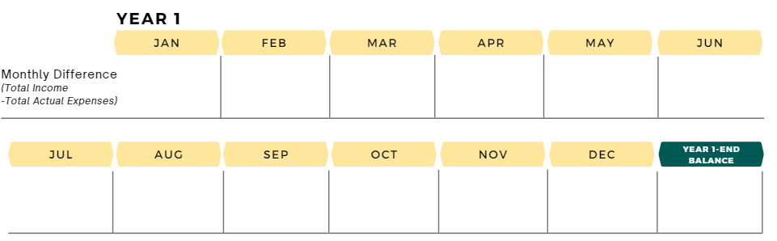
Year 1 End Balance
Input your monthly difference and saving for Year 1 June through December.
Find out your “Year 1 End Balance” by adding the monthly differences from January to December. Are you in the positive or negative by the end of Year 1?

Slide 58
Year 1 Savings
Find out your total savings at the end of Year 1 by adding your saving amounts from January to December.

Slide 59
Student Reflection
Congratulations on reaching the end of Year 1! At this point, let’s take a pause and reflect on what we have learned so far.
Did you end Year 1 in the positive or negative?
Is there something you would like to do differently in Year 2?
Looking at your total savings for Year 1, would you like to save more in Year 2? Save less? Maintain the same level? (To help answer the question, look at the financial goal you chose and compare the two amounts.)
Would you like to keep working towards the same financial goal, or would you like to choose a new one?
How did you decide between borrowing debt and investing your money?
Why did you pick your debt or investment option over the other option?

Slide 60

Year 2
Input the same monthly difference and saving from Year 1 December in Year 2 January through June.
If your monthly difference continues to be negative, you may want to adjust your monthly budget and expenses starting in Year 2 January. Remember, overspending for many months can have a negative impact on your financial health! (See slide 8)
If you are happy with your monthly difference and saving,
no adjustments are needed.

Slide 61
PAUSE
Avatars, pause here!

Slide 62
PAUSE
Avatars, double pause!

Slide 63
Year 2 July
Your teacher will give you instructions about Year 2 July calculations.

Slide 64
Year 2 August - December
Your avatar maintains the same level of income and expenses for Year 2 August through December.
Input the monthly difference and savings from Year 2 June for August through December.

Slide 65

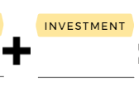
For those who invested…
It is time to collect your reward!
If you borrowed debt, move on to the next slide.
If you invested in Option A High-Interest Rate Savings Account, you earned $688.38. You must pay $50 as a withdrawal fee.
If you invested in Option B Regular Savings Account, you earned $507.42. You must pay $15 as a withdrawal fee.
Input in your financial planner (Make sure
you subtracted the withdrawal fee):

Slide 66
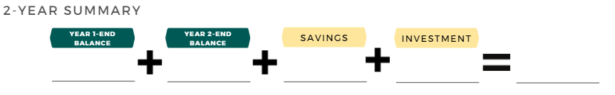
Were you successful in adulting?
Did you…
Pay bills successfully and make wise financial decisions for 2 years,
Achieve your financial goal, and
Do not have any debt.
If you borrowed debt, leave this blank.
If the grand total is negative, it means you are in debt.
Enter your total savings amount.

Slide 67


Slide 68
Student Reflection
What did you enjoy learning the most?
What would you do differently if you were to play this game again?
Did you choose a different financial goal halfway through the game? Did you make it close to your financial goal? Or did you overachieve it?
a) If you reached your financial goal, what were some decisions that helped you? OR
b) If you did not achieve your financial goal, what do you think affected your outcome?
a) If you do not have any debt by the end of Year 2, what were some decisions that helped you? OR
b) If you have debt, what may have contributed to that? What could you have done differently?

