Slide 1
Currencies & Exchange Rates
Grade 8+

Slide 2
A Special Note For Teachers

Slide 3
Students will be able to…
Understand how currency exchange rates change daily
Understand and identify the domestic and foreign currency, and the stronger and weaker currency
Identify some advantages and disadvantages of payment methods when dealing with different currencies

Slide 4
Why is Currency Exchange Important?
A main reason to learn about foreign currency exchange is for travelling and for buying or selling things in other countries.
When converting currencies, we need to know the exchange rate, which tells us the difference in value between currencies.
Exchange rates (or the value of money) change everyday.
Watch the video: Finance 101: What is Currency and Exchange Rate? Easy Peasy Finance for Kids and Beginners – YouTube

Slide 5
True or False
A. When one currency value falls, another shoots up.
True! After all, these currencies are trading against each other and this balance has to be maintained.
B. Currencies rise and fall almost every second, they might be extremely high one minute and low the next.
True!
C. ForEx trading is called by another name “Foreign Exchange Trading”
True!

Slide 6
Class Exploration Activity
Let’s look at how currency exchange rate fluctuates!
On Google, search for “Canadian Dollar to US Dollar”. You may see something like the screenshot below.
Hover your mouse on the graph, and look for the exchange rate for 1 day, 5 day, 1 month, 1 year, and 5 year. What do you notice?
What do you think this means: “1 Canadian Dollar equals 0.80 United States Dollar”?

Slide 7
Class Exploration Activity
In this scenario, you are converting from Canadian Dollar to US Dollar.
So…your domestic currency is Canadian Dollar
And the foreign currency is US Dollar

Slide 8
Class Exploration Activity
Let’s flip it!
What about from US Dollar to Canadian Dollar?
On Google, search for “US Dollar to Canadian Dollar”. Then, discuss the questions below:
How much is one US Dollar worth in Canadian Dollars?
Is US Dollar the stronger currency or the weaker one?
Is Canadian Dollar the stronger currency or the weaker one?
In this scenario, which is your domestic currency? (The currency you are converting from)
Which is your foreign currency? (The currency you are converting to)

Slide 9
Australian Dollar to Japanese Yen
In this scenario:
Which is your domestic currency? (The currency you are converting from)
Which is the foreign currency? (The currency you are converting to)

Slide 10
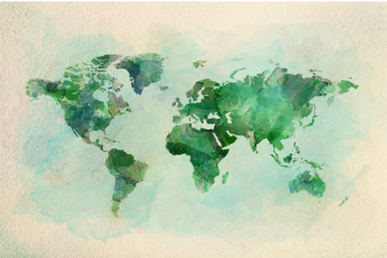
Class Exploration (Optional)
Feel free to flip the Australian Dollar and Japanese Yen and see what you find!
Find out how much currencies are worth in:
Egypt
South Africa
Argentina
Brazil
China
India
France
Germany
Iceland
Or any other countries you can think of!

Slide 11
Pro’s & Con’s of Payment Methods
Payment Methods | Advantages | Disadvantages
Cash | Exchange rates change daily! You can exchange money when your domestic currency is strong, and the foreign currency is weak. | You pay a fee to convert cash. The fees are usually lower compared to credit card fees. Different locations charge different fees (e.g. airports charge high fees)
Credit Card | Convenient & quick | Credit cards charge high fees (1-5% per purchase) on top of the exchange rate Credit cards generally do not offer favorable exchange rates
Electronic Wire Transfers | Secure - it goes directly to the bank account Low fees | Minimum of $500-$1000
Traveler’s Cheques | Secure Can get them in different currencies | Traveler’s cheques are not recognized in every country Banks or stores may not want to cash them in the foreign country
Notes:
Some basic things to consider when exchanging currency include:
- Gaining or losing value during currency exchange
- Service fees for exchanging currency
- Fluctuating exchange rates and unpredictability of currencies
- Methods of payment while travelling (e.g., credit card, pre-paid debit, cash, traveler’s cheque, etc.)

Slide 12
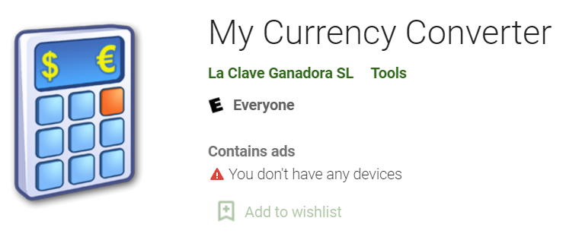
Apps for Phones and Tablets
And many more!

Slide 13
Additional Resources
Additional videos on this topic
Credit Card Foreign Currency Transaction Fees | Tips and Advice | CIBC
Top 5 Payment Options While Travelling Internationally | Active Earth Adventures
Banking Explained – Money and Credit – YouTube

