Slide 1
How Much Does It Really Cost?
Grade 9+

Slide 2
A Special Note for Teachers

Slide 3
Students will be able to…
Explore, compare, and explain the effects of the following four factors on the overall costs of a purchase, when it is bought with a type of loan.
The four factors are:
Interest rate
Compounding periods
Length of borrowing time
Down payment

Slide 4
Before we get Started…
What is a loan?
What do the words “principal”, “interest”, and “loan term” mean?
Watch this 2-min video to find out: https://www.youtube.com/watch?v=AOP5wiu7mRU
Disclaimer: “Principal” is spelled incorrectly in the video.

Slide 5
Minds On Activity
Think-Pair-Share
What is a loan, principal, interest, and loan term?
What goods or services do people usually buy with a type of loan?
Do you think consumers end up paying more for a purchase when they buy it on a loan?

Slide 6
Class Exploration Activity
When we borrow money to make a purchase, how much do we really pay in the end?
We will look at these four factors that affect a loan:
Interest rate (Simple interest vs. compound interest)
Compounding periods
Length of borrowing time
Down payment

Slide 7
Part A: Simple Interest Rate
First, we will look at a loan with a simple interest rate:
Brainstorm something you would like to purchase (a good or service) and research its current price.
Go to https://www.calculatorsoup.com/calculators/financial/simple-interest-plus-principal-calculator.php
The webpage image will be on the following slide.

Slide 8
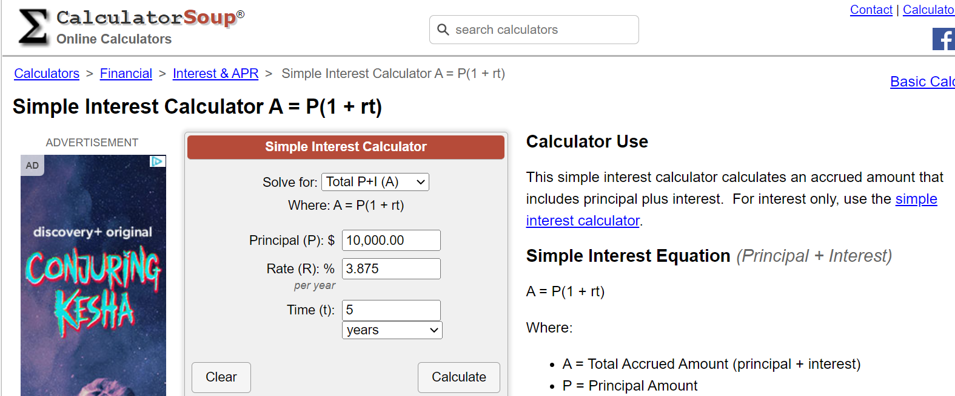
Part A: Simple Interest Rate
You will find the Simple Interest Calculator on your screen:

Slide 9
Part A: Simple Interest Rate
To calculate the interest we will use the formula "Total P+I (A)"
P = Principal Amount
This is the amount of money you start with
I = Interest Amount
This is the amount that your money grows
A = Total Accrued Amount
This is the total of the Principal Amount and the Interest Amount combined

Slide 10
Part A: Simple Interest Rate
Enter these values to get started:
Solve For: Select “Total P+I (A)”.
Principal: Enter the price of your item.
Rate: Choose an interest rate.
Time: Choose the number of years or months.
Write down these values in Part A of your worksheet. This is your default setting.

Slide 11
Part A: Simple Interest Rate
Let’s see how the interest rate affects your loan. (In the next 2 slides, we will change one variable at a time.)
Solve For: Select “Total P+I (A)”.
Principal: Set to default.
Rate: Choose at least 3 different interest rates. See how it affects your total loan amount and total interest.
Time: Set to default.
Write down the different interest rates in the “Exploration” section. Record the total loan amount and total interest for each rate.

Slide 12
Part A: Simple Interest Rate
Now, let’s see how the length of borrowing time affects your loan.
Solve For: Select “Total P+I (A)”.
Principal: Set to default.
Rate: Set to default.
Time: Change the number of years/months. See how the length of borrowing time affects your total loan amount and total interest.
Write down the different years/months in the “Exploration” section. Record the total loan amount and total interest for each length of time.

Slide 13
Part B: Compound Interest Rate
Now, let’s look at a loan with a compound interest rate:
Go to https://www.calculator.net/loan-calculator.html
Scroll down to “Deferred Payment Loan: Paying Back Lump Sum Due at Maturity”
The webpage image and definitions will be on the following slides.

Slide 14
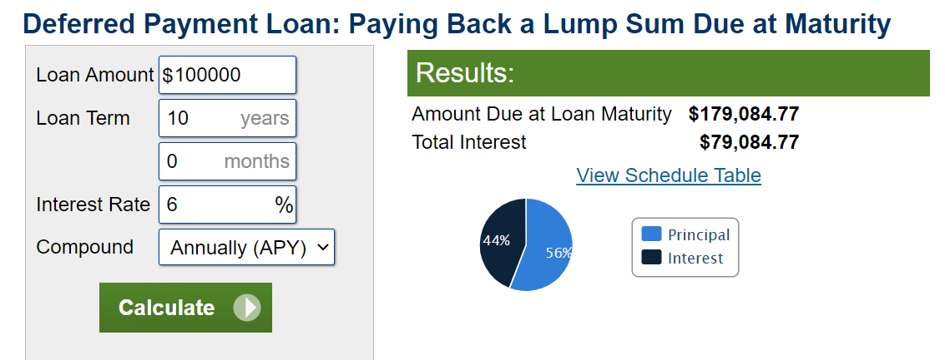
Part B: Compound Interest Rate
You will find the Loan Calculator on your screen:

Slide 15
By the way, loan maturity is the date when your loan is due. The total loan amount plus the total interest must be paid back.
Just like you are growing and maturing over time,
The loan you borrow is also growing and maturing until its maturity date

Slide 16
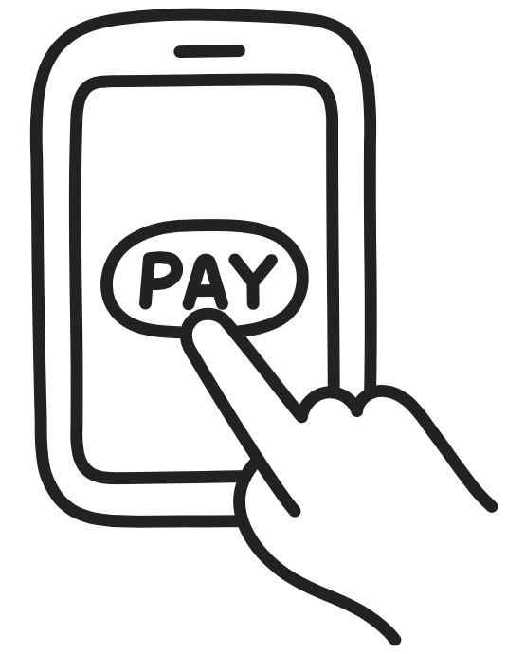
When we're talking about loans, the word deferred means that you don't need to pay interest right away. You will pay it later at the date that the loan specifies.
A lump sum is a large amount that you pay all at once. It is different from installments, where you pay smaller amounts over a period of time.

Slide 17
Part B: Compound Interest Rate
Let’s see how your loan grows until its maturity! Enter these values to get started:
Loan Amount: Same as Principal. Use your default settings from Part A.
Loan Term: Same as Time. Use your default settings from Part A.
Interest Rate: Use your default settings from Part A.
Compound: Choose a compounding period.
Write down these values in Part B of your worksheet. This is your default setting.

Slide 18
Part B: Compound Interest Rate
Let’s see how the length of borrowing time affects your loan.
Loan Amount: Set to default.
Loan Term: Use the different lengths of time from Part A.
Interest Rate: Set to default.
Compound: Set to default.
Record the total loan amount and total interest for each length of time. Compare them to Part A.

Slide 19
Part B: Compound Interest Rate
Now, let’s look at the impact of interest rate! Set the other variables back to your default setting.
Loan Amount: Set to default.
Loan Term: Set to default.
Interest Rate: Use the different interest rates from Part A.
Compound: Set to default.
Record the total loan amount and total interest for each rate. Compare them to Part A.

Slide 20
Part B: Compound Interest Rate
Next, let’s look at the impact of compounding periods! Set the other variables back to your default setting.
Loan Amount: Set to default.
Loan Term: Set to default.
Interest Rate: Set to default.
Compound: Choose different compounding periods. See how it affects your total loan amount and total interest.
Optional: You do not need to record the total loan amount and total interest.

Slide 21
Reflection Questions
Answer the reflection questions on p. 2 of the “How Much Does it Really Cost” worksheet.

Slide 22
Part C: Down Payment
Finally, let’s look at the impact of a down payment! We will look at a specific example: buying a car.
Research the price of a car you would like to purchase.
Go to https://www.calculator.net/auto-loan-calculator.html
The webpage image will be on the following slide.

Slide 23
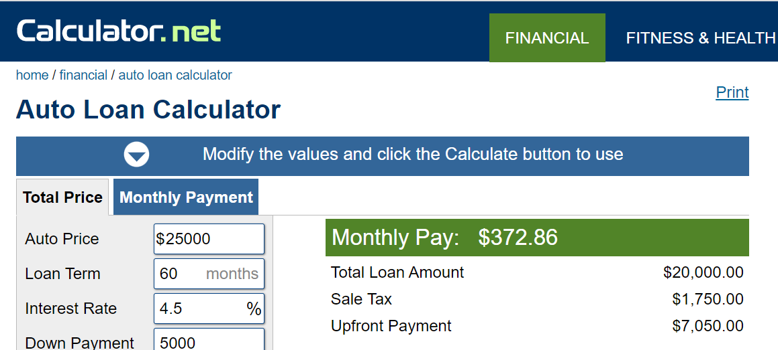
Part C: Down Payment
You will find the Auto Loan Calculator on your screen:

Slide 24
Part C: Down Payment
Enter these values to get started:
Auto Price: Enter the price of the car.
Loan Term: Choose the number of months.
Interest Rate: Enter 13%
Down Payment: Choose a down payment amount in dollars.
Trade-in Value: Enter “$0”.
Your State: Leave blank.
Sales Tax: Enter “0%”. (Your teacher will decide)
Title, Registration and Other Fees: Enter “$0”. (Your teacher will decide)
Write down these values in Part C of your worksheet. This is your default setting.

Slide 25
Part C: Down Payment
Change only your down payment.
Auto Price: No change
Loan Term: No change
Interest Rate: No change
Down Payment: Choose different down payment amounts. See how it affects your total loan interest and the total cost of your car.
Trade-in Value: No change
Your State: Leave blank.
Sales Tax: No change
Title, Registration and Other Fees: No change
Answer the reflection question for Part C.

Slide 26
Exit Slip
If you must make a purchase with a loan (such as a car or a house), what are some specifics you would choose for the loan? To answer this question, use as many terms as you can from the Word Wall.
Why do you think some people borrow money to make a purchase, instead of saving enough money for it?
Word Wall
Principal
Maturity
Simple interest
Compound interest
Annually
Interest rate
Semi-annually
Loan term
Quarterly
Down payment
Monthly

Slide 27
Exit Slip
If you must make a purchase with a loan (such as a car or a house), what are some specifics you would choose for the loan? To answer this question, use as many terms as you can from the Word Wall.
Why do you think some people borrow money to make a purchase, instead of saving enough money for it?
Word Wall
Principal
Maturity
Simple interest
Annually
Compound interest
Semi-annually
Interest rate
Quarterly
Loan term
Monthly
Down payment

