Slide 1
Adjusting Budgets: Individual
Grade 9+

Slide 2
A Special Note for Teachers

Slide 3
Students will Learn…
Common living expenses and bills
Adjusting a budget according to unexpected financial changes
Considerations for budgeting as an individual

Slide 4
Minds On Activity
Think-Pair-Share
What is budgeting?
Why do we need to adjust our budgets?
Examples:
Your schedule changes and you work less hours
Your business is doing great! You made extra money
You want to buy a plane ticket to go on a trip
You injured yourself and have medical expenses

Slide 6
Choose Your Avatar…
Age: 17, currently in high school
Interests: Watch cat videos on YouTube, snowboarding and coffee
Life goals: Travel around the world
Age: 17, currently in high school
Interests: Reading, soccer, guitar and making music
Life goals: Start his own business
Age: 18, currently in high school
Interests: Baking, surfing and watercolors
Life goals: Become a certified scuba diver, research about the oceans
Age: 18, currently in high school
Interests: Basketball, rock music and stand-up comedies
Life goals: Become a sports coach

Slide 7
Build a Monthly Budget
This month, your avatar found a part-time job at a grocery store that pays minimum wage: $15.50 per hour. They work 25 hours per week and earn $1,550 every month. Your avatar also sells hand-made crafts on the side and earns $100 a month. These are the income or earnings.
Using the Monthly Budget sheet, fill in:
Income #1
Income #2
Calculate your “Total Income”

Slide 8
Build a Monthly Budget
Expenses | Initial Budget
Rent | $700
Utilities | $45
Food | $450
Clothing | $40
Entertainment | $60
Internet & Cable | $120
Cell Phone Plan | $60
Transportation | $50
Savings | $125
Budget
A plan for how you will use your money.
Your avatar knows some of the monthly expenses. Here is the amount they budgeted. Fill in the “Initial Budget” column and calculate the total.

Slide 9
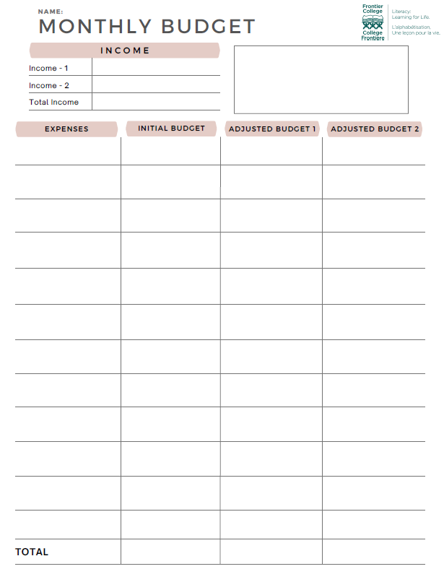
Balance Your Budget
“Total Initial Budget” should equal “Total Income”
Pro Tip:
This means you are only spending the money you earn.

Slide 10
Scenario 1: Rent Increase
You received advanced notice from your landlord that a rent increase will take effect this month. Your new monthly rent will be $900 per month.
How will you adjust your budget?
Review slides 10-14 for options on your expenses.
Adjust your budget and fill in the “Adjusted Budget 1” column.
Note: You have the option to choose which expense(s) to adjust. You are not required to adjust all budgeted expenses shown on slides 10-14.

Slide 11
Expense Options
Savings
Do you want to adjust your savings?

Slide 12
Expense Options
Food
Currently your avatar uses Option 1.
Option 1
Buy meals at a restaurant once and a while
Buy groceries and make meals at home
Occasionally have desserts and snacks
Save on groceries by using coupons
$ 450 per month
Option 2
Buy meals at a restaurant once a month only
Groceries are mostly fresh
Snacks and desserts once-in-a-while
Save on groceries by using coupons
$ 380 per month
Option 3
Do not eat out at restaurants
Groceries are mostly fresh, but not always the best quality
Only buys what you need, not what you want
Only buy items that are on sale
$ 300 per month

Slide 13
Expense Options
Entertainment
Currently your avatar uses Option 1.
Option 1
3 streaming services every month (movies, videos, songs, etc.)
2 gaming apps or video games every month
Brand new hobby supplies (ie. crafts, helmet, exercising equipment, etc.)
$ 60 per month
Option 2
2 streaming services every month (movies, videos, songs, etc.)
1 gaming app
Purchase some hobby supplies on sale
$ 35 per month
Option 3
1 streaming services every month (movies, videos, songs, etc.)
Purchase all hobby supplies on sale, trading platforms
Must wait a few months before getting all the supplies
$ 20 per month

Slide 14
Expense Options
Internet & Cable
Currently your avatar uses Option 1.
Option 1
Unlimited 5G high-speed internet
Internet is always reliable
Basic cable + 20 TV channels
$ 120 per month
Option 2
Unlimited 4G internet
Internet is often reliable
No cable
Includes Netflix & Crave
$ 90 per month
Option 3
Unlimited 3G internet
Internet is unstable during busy hours
No cable TV, no streaming platforms
$ 60 per month

Slide 15
Expense Options
Cell Phone Plan
Currently your avatar uses Option 1.
Option 1
Data: 10GB per month
Unlimited calling and texting
Includes Caller ID and voicemail
Stable connection
$ 60 per month
Option 2
Data: 2.5GB per month
Unlimited calling and texting
No Caller ID, no voicemail
Connection is okay
Pay-as-you-go plan
$ 35 per month
Option 3
Data: 500 MB per month
100 minutes calling
Unlimited texting
No Caller ID, no voicemail
Connection not always stable
Pay-as-you-go plan
$ 25 per month

Slide 16
Balance Your Budget
Does your “Adjusted Budget 1” equal “Total Income”?
Pro Tip:
Try to spend only the money you earn.
If your budgeted expenses are more than your income, where can you reduce expenses?
If your budgeted expenses are less than your income, where do you want to put the extra money?

Slide 18
Scenario 2: Reduced Income
The employer reduced the work hours of your avatar. Instead of 25 hours per week, they will only work 20 hours. Their new income is now $1,240 per month. Your avatar will continue with their crafting business that earns $100 per month.
Fill in the new income:
New Income #1
New Income #2
Calculate your “Total New Income”

Slide 19
Adjusted Budget 2
With your reduced income, how will you adjust your budget?
Review slides 10-14 again for options on expenses.
Adjust your budget, and fill in the “Adjusted Budget 2” column.
Note: Your rent remains at the new level, at $900 per month.
Remember to balance your budget.
Does your “Adjusted Budget 2” equal “Total Income”?

Slide 20
Student Reflection
Was it easy for you to make adjustments to the budget? Why or why not?
Choose one expense that you adjusted and explain how you decided between the options available.
When unexpected changes occur, do you think it is easy to make compromises in our lifestyle? For example, opting for slower internet or less data on your phone?
Do you think your avatar could use their savings to resolve the unexpected financial changes? Would it be a short-term or long-term solution?
What are some ways we can plan for unexpected financial changes in our own life?

