Slide 1
Why ‘Interest’ Should Interest You?
Grade 11+ Introductory Lesson

Slide 2
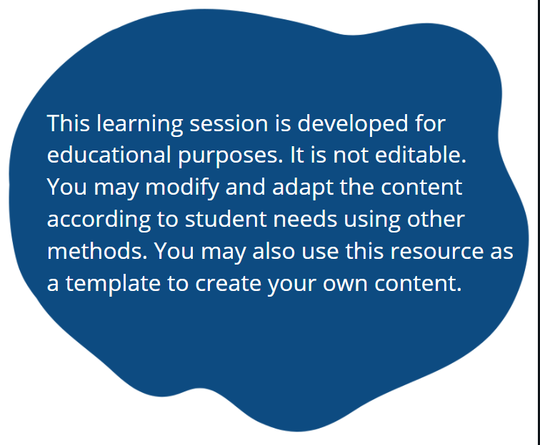
A Special Note for Teachers

Slide 3
Introduction
There is a lot of talk about “interest” and “interest rates”. As a young student, why should you be interested in it?
It affects many things, such as credit cards and student loans. It is also a reason why people say, “Invest while you’re young”.
The key is to understand simple and compound interest, and how these interest rates affect you.

Slide 4
Introduction
In this lesson, we will…
Learn how simple and compound interest rates grow
Understand interest rates as examples of linear and exponential relations
Make real-life application using equations, graphs, and tables of values

Slide 5
Real-Life Application
There are three interactive lessons to help you make real-life application and understand how interest rates affect you:
  Credit cards
  TFSAs (Tax-Free Savings Accounts)
  OSAP student loan

Slide 6

Exploration Activity
What is the difference between simple interest vs. compound interest? Let’s do a little exploration!
Click the links below and open both calculators:
Simple Interest Calculator:
https://www.calculatestuff.com/financial/simple-interest-calculator
Compound Interest Calculator:
https://www.calculatestuff.com/financial/compound-interest-calculator

Slide 7
Review: Academic Language
Present value The original sum of money borrowed in a loan or put into an investment.
Final Amount or Future Value: The value of a loan or investment at a specific date.
Interest Rate: The amount charged on top of the principal by a lender to a borrower. It is calculated as a percentage of the principal.
Rate of Return: Same concept as interest rate, but for investments. The amount an investor earns on top of the principal. It is calculated as a percentage.
Term: Length of time of a loan or investment.
Compounding Period: Applies only to compound interest. It is the interval of time that your loan or investment compounds interest. Common compounding periods are annually and monthly. We will learn more in this lesson.
Principal or Present Value:
Final Amount or Future Value:
Interest Rate:
Rate of Return:
Term:
Compounding Period:

Slide 8
Exploration Activity
Let’s use the same numbers in both calculators, so we can compare between simple and compound interest. Enter these suggested values to get started:
Simple Interest Calculator:
Principal: $100
Interest Rate: 5%
Term: 30 years
Start Date: Choose today’s date
Compound Interest Calculator:
Principal: $100
Interest Rate: 5%
Term: 30 years
Compounding: Annually

Slide 9
Exploration Activity
Suggestion: Try changing the interest rate on both calculators.
8%
12%
20%
12.75%
19.99%
0%
Etc.
As you make changes, scroll down and look at the graphs on both calculators.

Slide 10

Pause and Reflect
What did you notice?
Scroll down and look at the graphs on both calculators. With every adjustment that you made, what happened to…
total interest?
future value (Future Value = Principal + Interest)?
the pie charts and the bar graphs?
Comparing the bar graphs of simple interest vs. compound interest, what are some similarities and differences?

Slide 11

Exploration Activity
Explore further!
Feel free to change the principal, interest rate, term, and compounding period on your own.
Some suggestions are on the next few slides.

Slide 12
Exploration Activity
Suggestion: Try changing the principal on both calculators.
$200
$1,500
$10,000
$0
Etc.
As you make changes, scroll down and look at the graphs on both calculators.

Slide 13
Exploration Activity
Suggestion: Try changing the compounding period. Of course, this only applies to compound interest.
Semi-Annually: Every 6 months or half year. Interest compounds twice a year.
Quarterly: Every 3 months. Interest compounds 4 times a year.
Monthly: Every month. Interest compounds 12 times a year.
Bi-weekly: Every 14 days. Interest compounds 26 times a year.
Etc.
As you make changes, scroll down and look at the graph.

Slide 14
Pause and Reflect
What did you notice?
Scroll down and look at the graphs on both calculators. With every adjustment that you made, what happened to…
total interest?
future value (Future Value = Principal + Interest)?
the pie charts and the bar graphs?
Comparing the bar graphs of simple interest vs. compound interest, what are some similarities and differences?

Slide 15
Exploration Activity
Let’s use the same numbers in both calculators, so we can compare between simple and compound interest. Let’s see what happens if we change the term.
Simple Interest Calculator:
Principal: $1,000
Interest Rate: 8%
Term: 10 years
Start Date: Choose today’s date
Compound Interest Calculator:
Principal: $1,000
Interest Rate: 8%
Term: 10 years
Compounding: Annually

Slide 16
Exploration Activity
Now, let’s try changing the term on both calculators.
20 years
30 years
40 years
Etc.
As you make changes, scroll down and look at the graphs on both calculators.

Slide 17
Pause and Reflect
What did you notice?
What happens with simple interest and compound interest as you increase the term?
Did you know?
Simple interest is calculated annually. In this exploration of compound interest, we chose the compounding period of “annually” too. If both interests are calculated annually, why does compound interest grow so much faster? What do you think?
Let’s dive deeper to see how simple interest and compound interest grow!

Slide 18
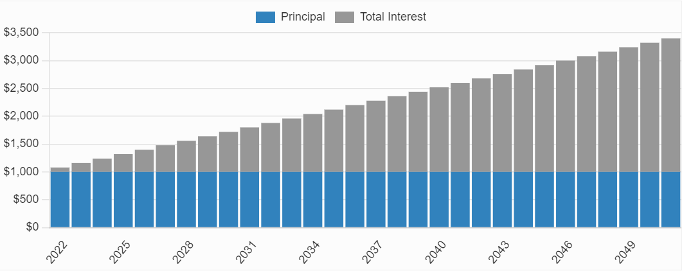


Simple Interest
On the simple interest calculator, look at the bar graph.
Do you think the growth is linear or non-linear?
Linear
$$y$$
Balance
$$x$$
Year

Slide 19
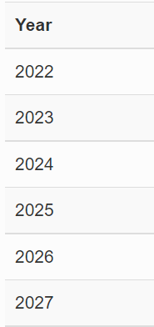
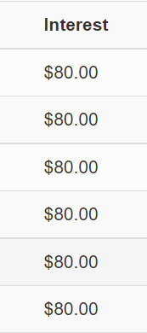
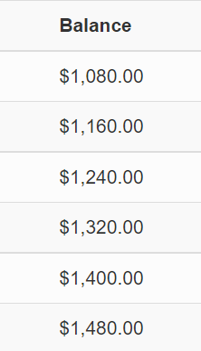













Simple Interest
On the simple interest calculator, look at the table of values.
As $x$ (Year) increases, how much does $y$ (Balance) increase?
The balance increases by the interest amount.
$$(x)$$
$$(y)$$
$$+1$$
$$+80$$
$$+1$$
$$+80$$
$$+1$$
$$+80$$
$$+1$$
$$+80$$
$$+1$$
$$+80$$

Slide 20







Simple Interest
For simple interest, when $x$ increases, $y$ increases at a constant rate.
Do you recall?
A constant rate of change is linear.
Simple interest rates are linear growth!
$$y$$
$$Change of y=\$80$$
Balance
$$Change of x=1$$
$$Change of y=\$80$$
$$Change of x=1$$
Year
$$x$$

Slide 21
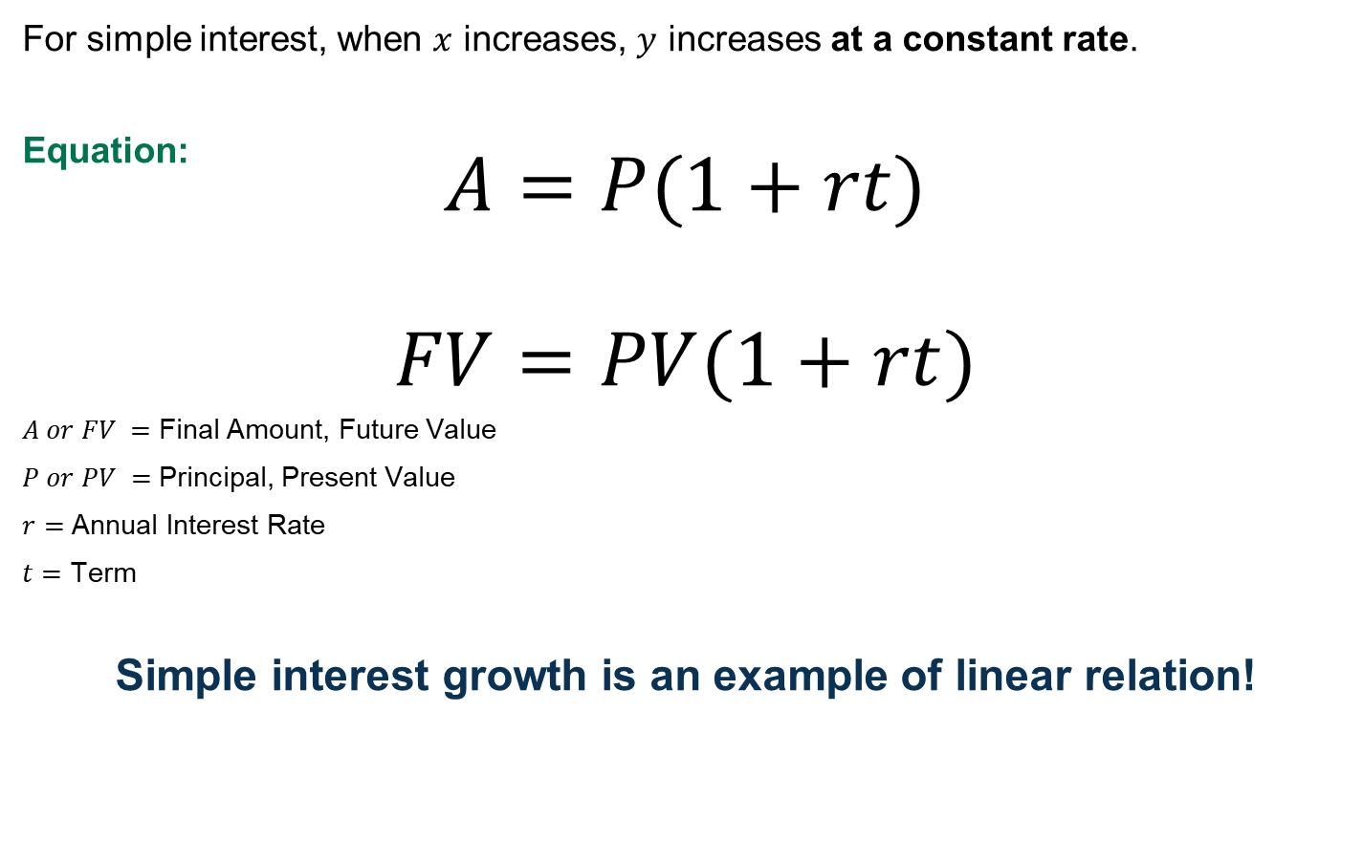
Simple Interest
For simple interest, when $x$ increases, $y$ increases at a constant rate.
Equation:
$$A=P(1+rt)$$
$$FV=PV(1+rt)$$
$A or FV =$ Final Amount, Future Value
$P or PV =$ Principal, Present Value
$r=$ Annual Interest Rate
$t=$ Term
Simple interest growth is an example of linear relation!
or

Slide 22
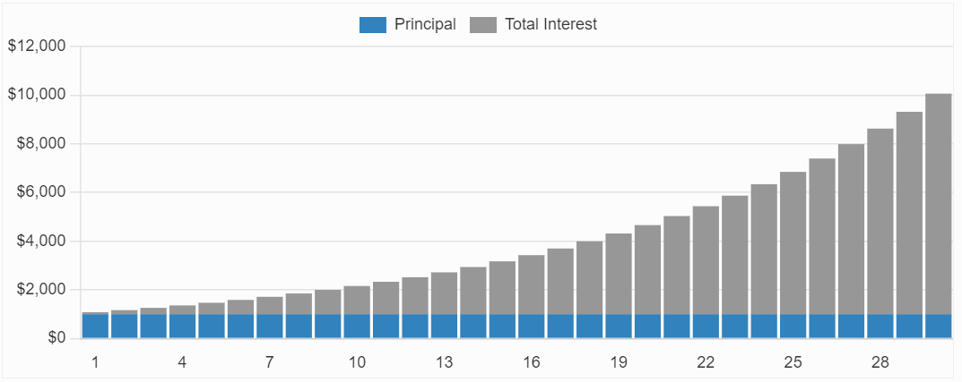


Compound Interest
On the compound interest calculator, look at the bar graph.
Do you think the growth is linear or non-linear?
Non-linear
$$y$$
Balance
$$x$$
Year

Slide 23
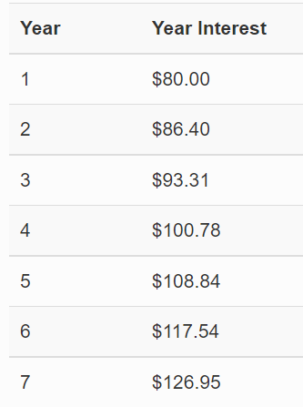
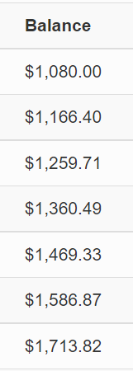













Compound Interest
On the compound interest calculator, look at the table of values.
As $x$ (Year) increases, how much does $y$ (Balance) increase?
The balance increases at an increasing rate.
$$(x)$$
$$(y)$$
$$+1$$
$$+86.40$$
$$+1$$
$$+93.31$$
$$+1$$
$$+100.78$$
$$+1$$
$$+108.84$$
$$+1$$
$$+117.54$$

Slide 24
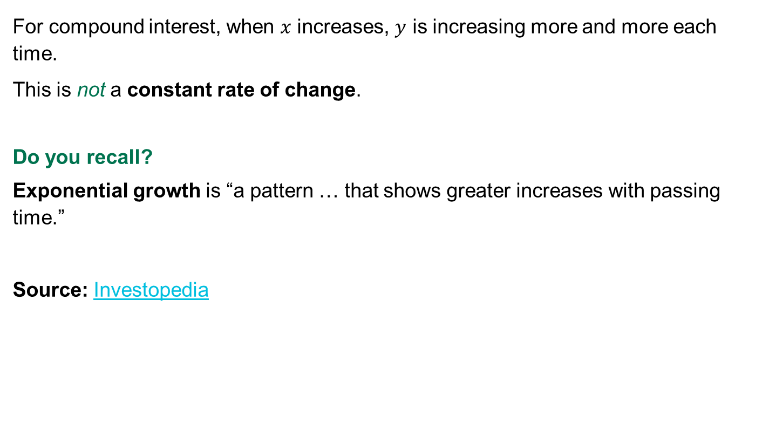
Compound Interest
For compound interest, when $x$ increases, $y$ is increasing more and more each time.
This is not a constant rate of change.
Do you recall?
Exponential growth is “a pattern … that shows greater increases with passing time.”
Source: Investopedia

Slide 25
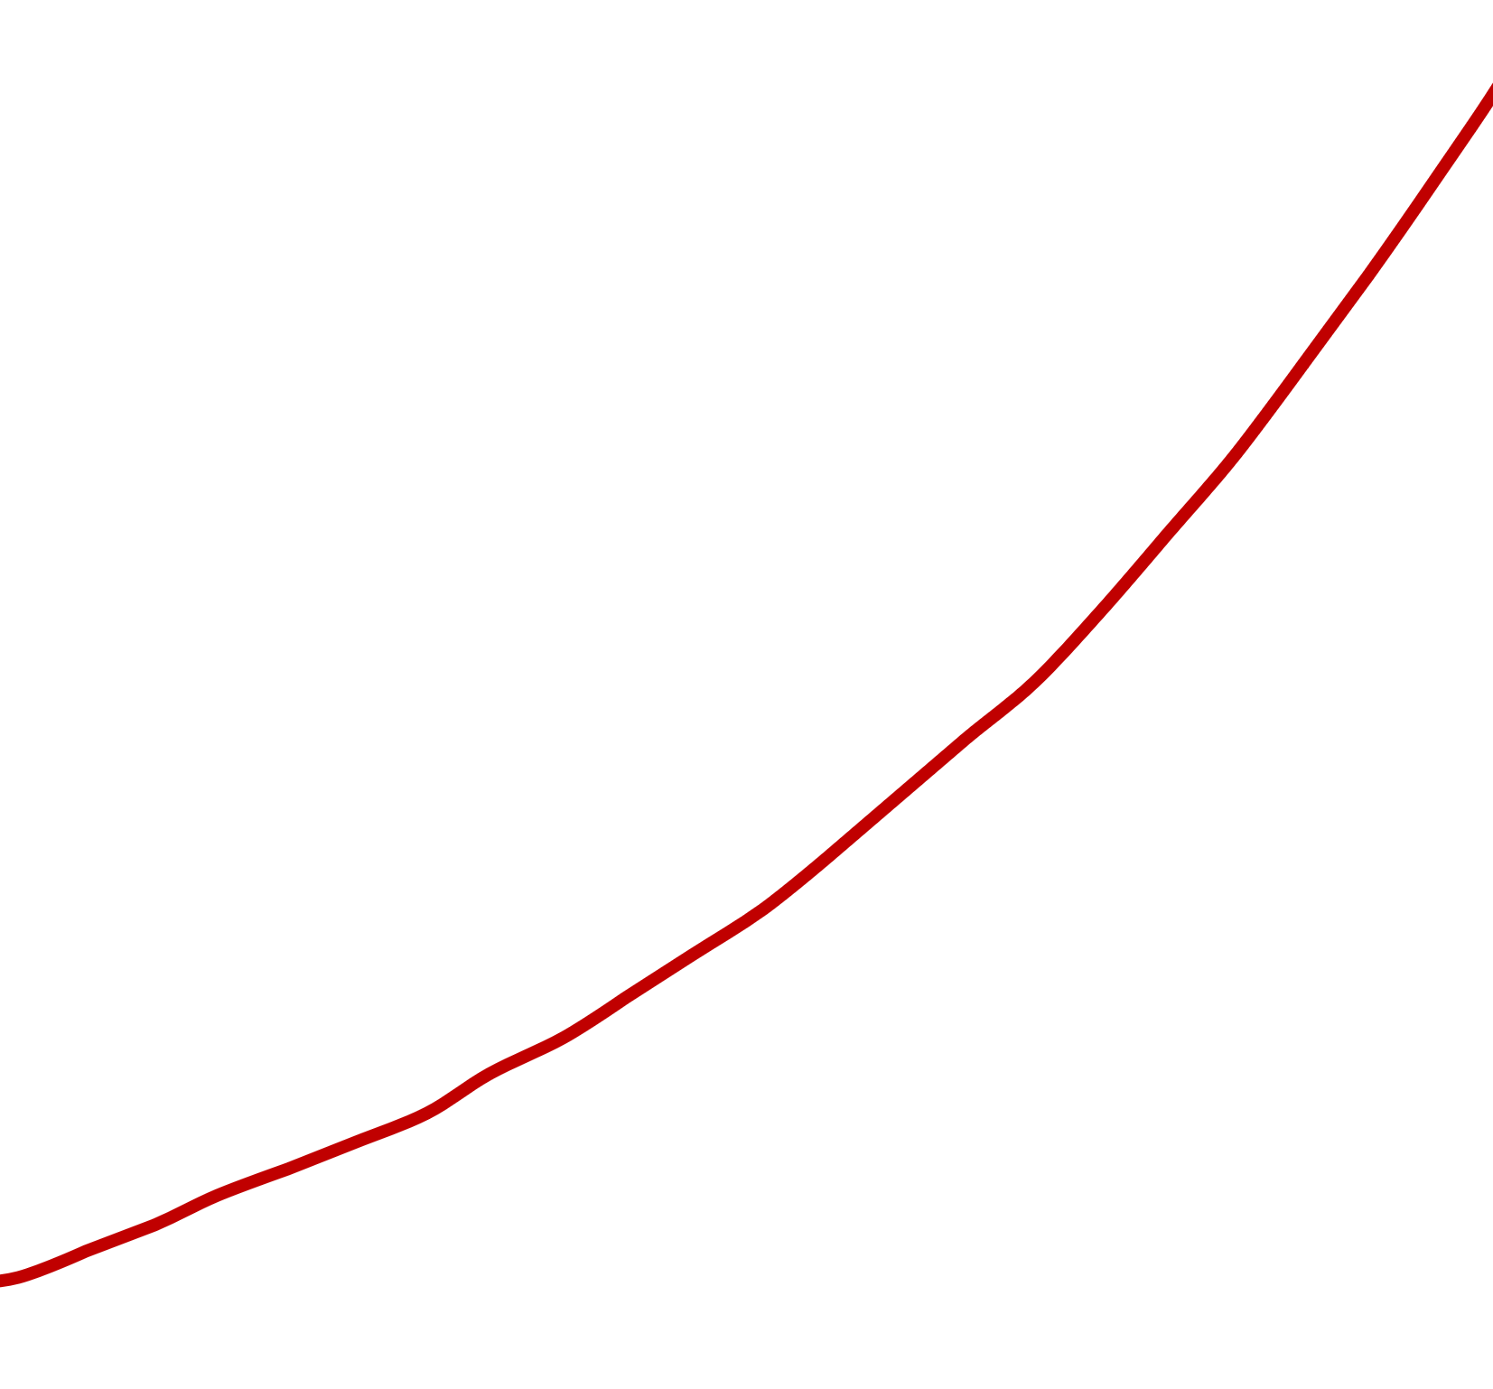








Compound Interest
For compound interest, when $x$ increases, $y$ increases more and more each time.
Compound interest rates are exponential growth!
$$y$$
$$Change of y=\$100.78$$
Balance
$$Change of x=1$$
$$Change of y=\$93.31$$
$$Change of x=1$$
$$Change of y=\$86.40$$
$$Change of x=1$$
Year
$$x$$

Slide 26









Compound Interest
According to our example, how is $y$ (Balance) growing?
We know that our balance is growing because of interest.
In this example, the interest rate is 0.08, or 8%.
Increasing by a multiple of 1.08
$$(x)$$
$$(y)$$
$$+1$$
$$\frac{1,166.40}{1,080}=1.08$$
$$+1$$
$$\frac{1,259.71}{1,166.4}=1.08$$
$$+1$$
$$\frac{1,360.49}{1,259.71}=1.08$$

Slide 27
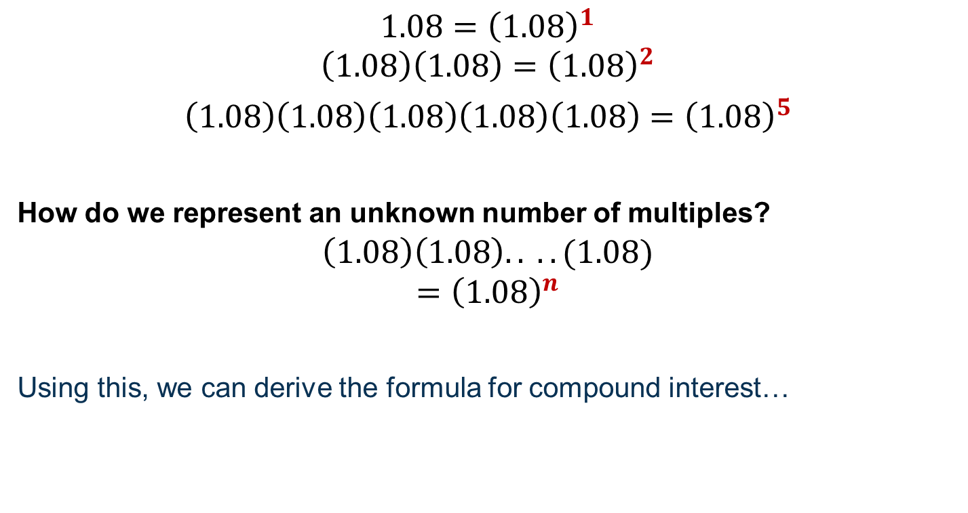
You may recall…
$$1.08={\left(1.08\right)}^{1}$$
$$\left(1.08\right)\left(1.08\right)={\left(1.08\right)}^{2}$$
$\left(1.08\right)\left(1.08\right)\left(1.08\right)\left(1.08\right)\left(1.08\right)=$ ${\left(1.08\right)}^{5}$
How do we represent an unknown number of multiples?
$$\left(1.08\right)\left(1.08\right).. ..(1.08)$$
$$={\left(1.08\right)}^{n}$$
Using this, we can derive the formula for compound interest…

Slide 28
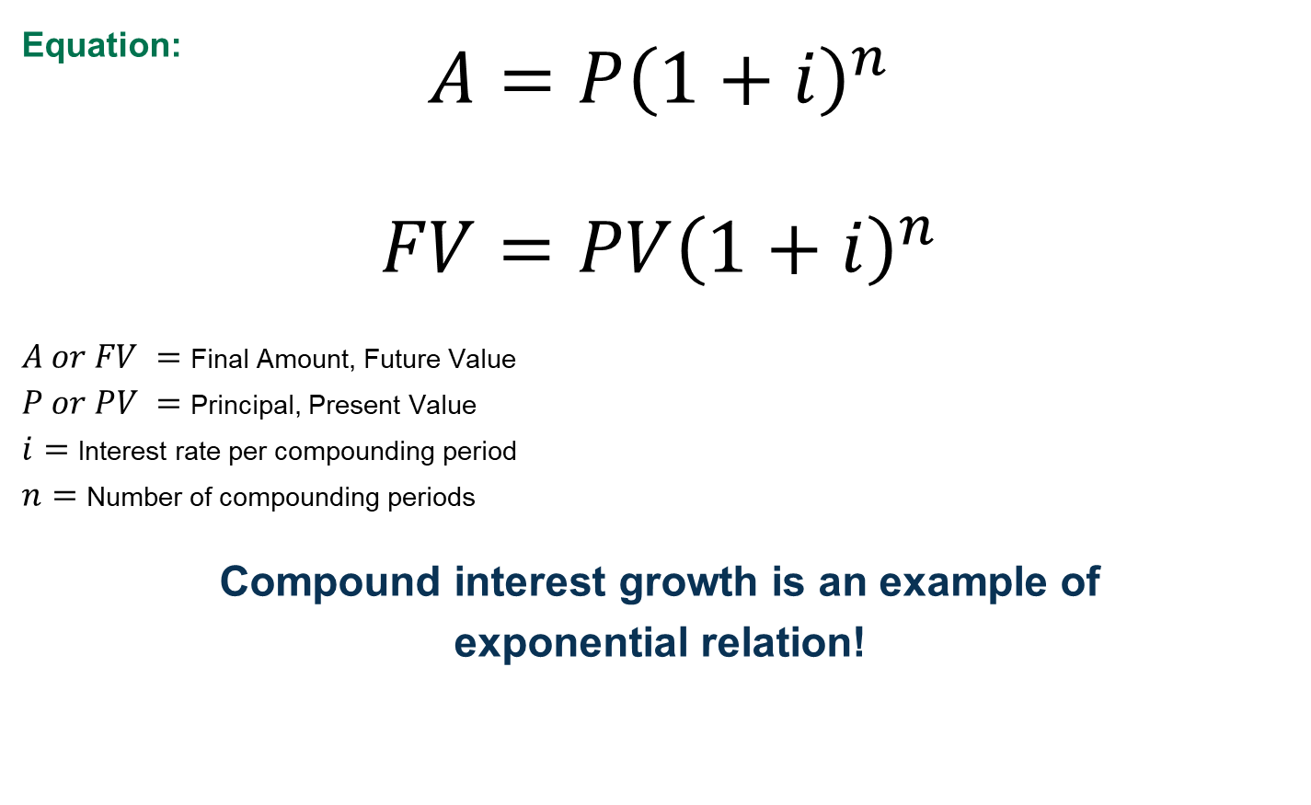
Compound Interest
Equation:
$$A=P{\left(1+i\right)}^{n}$$
$$FV=PV{\left(1+i\right)}^{n}$$
$A or FV =$ Final Amount, Future Value
$P or PV =$ Principal, Present Value
$i=$ Interest rate per compounding period
$n=$ Number of compounding periods
Compound interest growth is an example of
exponential relation!
or

Slide 29


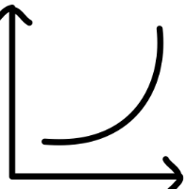
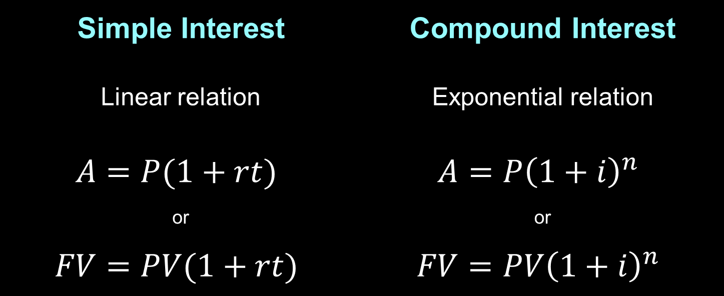
Quick Summary
Simple Interest | Compound Interest
Linear relation | Exponential relation
$$A=P(1+rt)$$ | $$A=P{\left(1+i\right)}^{n}$$
or | or
$$FV=PV(1+rt)$$ | $$FV=PV{\left(1+i\right)}^{n}$$
Using these equations, you can solve for any variable.

Slide 30
Student Activity
Using the information you learned in the previous slides, complete “Part 1. Graphic Organizer” in the student activity.

Slide 31
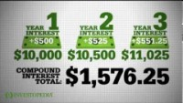
Simple vs. Compound Interest
Why is compound interest an exponential growth? How does it affect us in real-life?
Watch this video: https://www.youtube.com/watch?v=wf91rEGw88Q&t=9s

Slide 32
Simple vs. Compound Interest
So, compounding earns interest on interest.
Another way to think about this…
The interest becomes part of the principal. So, the principal keeps growing, and the interest it earns grows larger and larger.
This is great news when you are investing! (You earn interest)

Slide 33
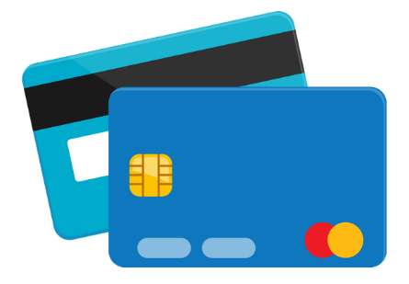
Simple vs. Compound Interest
But the power of compounding can work against you too!
This happens when you borrow money, like when you use a credit card or take out a loan.
You pay interest.

Slide 34

Calculating Interest
Whether it is simple or compound interest, the difference between the final amount and the principal is the interest amount.
How do you think we can calculate interest?
$$I=A−P$$
or
$$I=FV−PV$$

Slide 35
Student Activity
Let’s practice using these formulas to solve problems.
Complete “Part 2. Practice Questions” in the student activity.
There are two examples on the following slides…

Slide 36
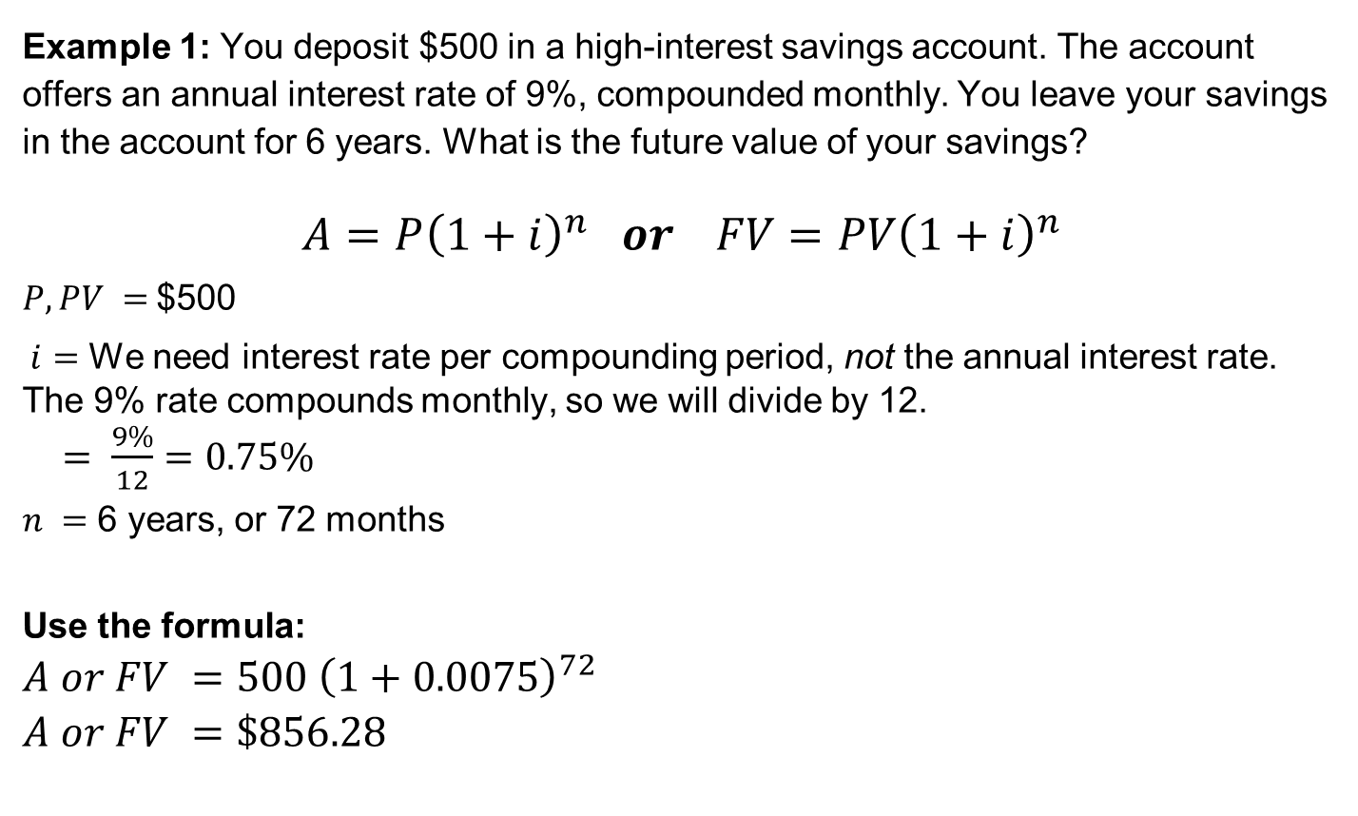
Practice
Example 1: You deposit $500 in a high-interest savings account. The account offers an annual interest rate of 9%, compounded monthly. You leave your savings in the account for 6 years. What is the future value of your savings?
$$A=P{\left(1+i\right)}^{n} or FV=PV{\left(1+i\right)}^{n}$$
$P, PV =$$500
$i=$ We need interest rate per compounding period, not the annual interest rate. The 9% rate compounds monthly, so we will divide by 12.
$= \frac{9\%}{12}=0.75\%$
$n =$ 6 years, or 72 months
Use the formula:
$$A or FV =500 {\left(1+0.0075\right)}^{72}$$
$$A or FV =\$856.28$$
Convert to decimal: 0.0075

Slide 37
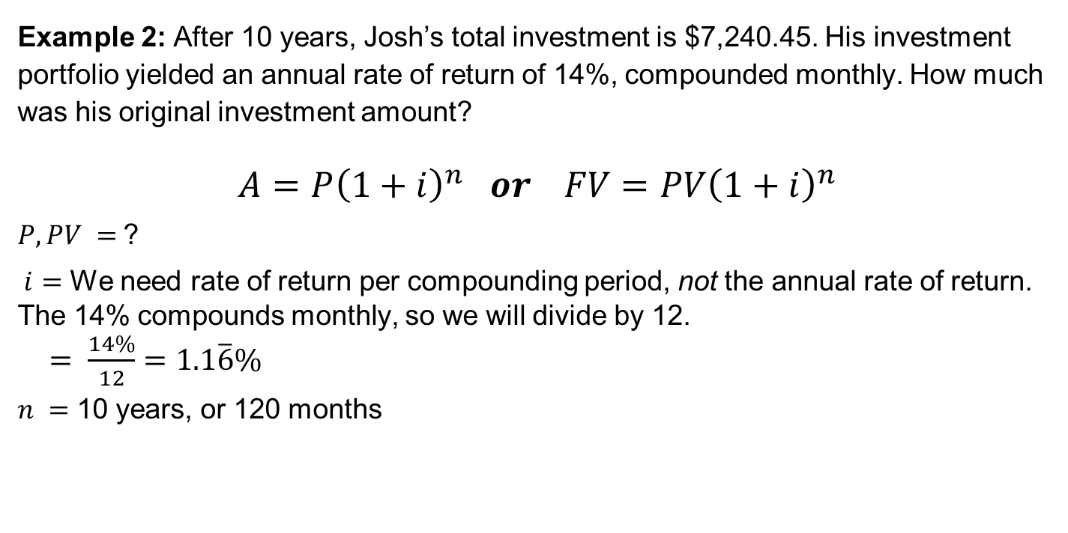
Practice
Example 2: After 10 years, Josh’s total investment is $7,240.45. His investment portfolio yielded an annual rate of return of 14%, compounded monthly. How much was his original investment amount?
$$A=P{\left(1+i\right)}^{n} or FV=PV{\left(1+i\right)}^{n}$$
$P, PV =$?
$i=$ We need rate of return per compounding period, not the annual rate of return. The 14% compounds monthly, so we will divide by 12.
$= \frac{14\%}{12}=1.1\overline{6}\%$
$n =$ 10 years, or 120 months
Convert to decimal: 0.011666…

Slide 38

Practice continued
Solve for $PV$:
$$7,240.45 =PV {\left(1+0.011\overline{6}\right)}^{120}$$
$$\frac{7,240.45}{{(1.011\overline{6})}^{120}} =PV$$
$$\left(7,240.45\right){\left(1.011\overline{6}\right)}^{−120}=PV$$
$$PV=\$1800$$
Or can be written as…

Slide 39
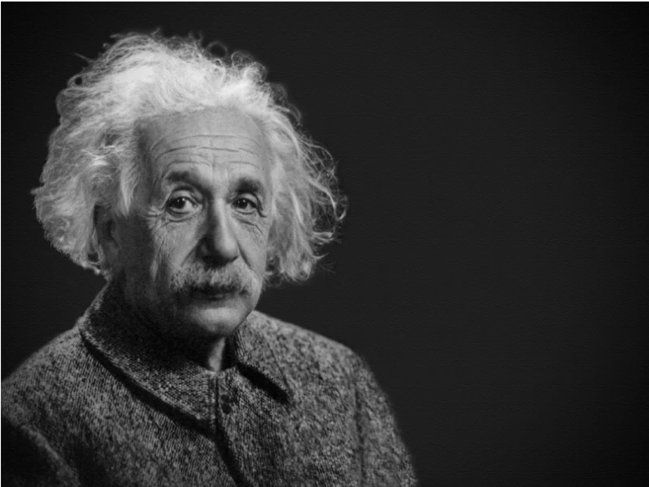
About compound interest,
Albert Einstein said:
“[One] who understands it, earns it;
[one] who doesn’t,
pays it.”

Slide 40
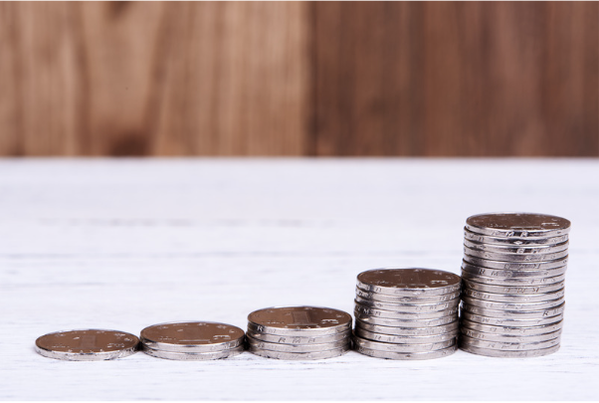
Activities: Real-Life Application
Who wants to pay when they can earn?
When we understand how simple and compound interests affect us, we are more equipped to make informed financial decisions.
So let us apply what we have learned in real-life situations.
Compound interest can work for you or against you.

Slide 41
Activities: Real-Life Application
There are three interactive lessons to help you make real-life application and understand how interest rates affect you:
  Credit cards
  TFSAs (Tax-Free Savings Accounts)
  OSAP student loan
Your teacher will choose the appropriate lesson(s).

