Slide 1
Ethical Standards in Companies?
Grade 12+

Slide 2
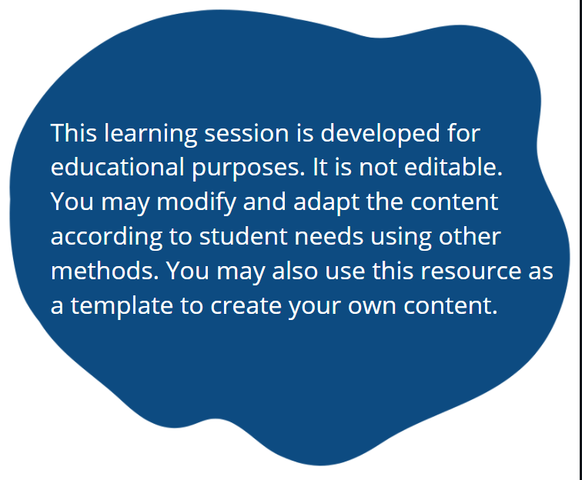
A Special Note for Teachers

Slide 3
Students will…
Learn about government regulations such as minimum wage and workplace safety, and apply them to a real-life situation
Complete an open research project about resource extraction
Engage in various points of view including employees, employers, consumers, and community members

Slide 4

Minds On Activity
Think-Pair-Share
Why is it important to know our rights as an employee before entering the workforce?
What are some obligations that the government requires employers to follow? Can you think of a few?
What can we do when these rights are not respected?

Slide 5
Government Regulations
  There are regulations in place that ensure worker safety. Certain types of jobs carry more risks, but all jobs have some level of risk.
  Employers must follow safety measures to keep their employees safe. This is something to be aware of as you enter the workforce.
  If you ever encounter unsafe conditions, please speak up and step back.
  The next slides will highlight a few regulations and provide links for you to learn more!

Slide 6
Minimum Wage
  Minimum wage is the lowest amount that an employee must be paid. It varies by province, territory, and by year.
  There is a standard minimum wage as well as different requirements for certain types of employment. Servers who receive tips may have different guidelines compared to hunting, fishing and wilderness guides.
  Learn more about Ontario’s minimum wage: Employment Standards Act Minimum Wage

Slide 7




WHMIS
  Workplace Hazardous Materials Information System (WHMIS)
  WHMIS is a system used to label materials so that people know the risks. You may have seen them on household products or appliances. Can you guess what these are?

Slide 8
WHMIS
  Workplace Hazardous Materials Information System
  Answers:
  Flammable Corrosive Explosive Poisonous
  (burns the skin)

Slide 9
WHMIS
  Want to check your knowledge? Try this online WHMIS Symbols Quiz together as a class:
  WHMIS Symbols Quiz

Slide 10
WHMIS
  WHMIS: Workplace Hazardous Materials Information System
  Workplaces are required to label materials and provide training so that workers understand the risks and how to use products safely.
  To find more information, visit this link:
  Workplace Hazardous Materials Information System

Slide 11
Your Rights as an Employee
  The Canada Labour Code says that workers have the right to form unions and go on strike if there are issues with their working conditions.
  It also says that the employer is responsible for the health and safety of workers and anyone on site.
  There are standard hours, wages, vacations and holidays that employers must abide by.
  To learn more about your rights as an employee, browse through this link: Canada Labour Code

Slide 12
Additional Resources
  For more information on workplace health and safety: Workplace health and safety - Canada.ca
  For more information on employment standards, visit: Ontario Employment Standards

Slide 13

What’s Next?
  In the next slides we will be looking at examples of projects on the land that employed people to work for certain periods of time.
  You will do research and learn more about these projects. Also, you will consider how the safety and security of the workers and community members are impacted by these projects.

Slide 14

What is resource extraction?
Any time that a company uses materials that are found in the natural environment.
  Logging trees for construction
  Oil for vehicles
  Mining gold or diamonds to sell
  Mining coal for fuel

Slide 15
What is resource extraction?
Think-Pair-Share
When people are working in physically demanding situations, what types of risks are involved?
Can you think of examples where a company used resource extraction?
  What resource were they getting?
  What do they use it for?
  You can use examples in your community or abroad.

Slide 16
Resource Extraction
The natural environment in Canada has many different resources that large companies would like to use for profit.
Who is impacted when they do this?
Some examples include:
      The environment
      The people who live in the area
      The workers at the company

Slide 17
Resource Extraction
In almost all cases, there are different views around resource extraction.
You will choose an example to research and fill out the Resource Extraction worksheet. The next slides will have some examples you can choose from, but feel free to find something different!
You will consider the viewpoints of different groups of people:
The people who live there (community members), employees, environmentalists, and the company owners.

Slide 18
The Victor Mine in Attawapiskat
Choose one
DeBeers Diamonds employed residents while they mined for diamonds from 2013 to 2019.
While the project was running, people were employed and able to make a living. After the project was over the employees no longer had work in their community. DeBeers wanted to create a landfill to put waste from the project in a culturally important area near the James Bay wetlands, potentially harming the environment.
https://www.cbc.ca/news/canada/sudbury/de-beers-attawapiskat-reaction-1.5047368

Slide 19
The Coastal GasLink Pipeline
Choose one
TC Energy from Alberta is building a pipeline across central B.C. that connects to the Pacific Ocean.
They say they have permission from 20 First Nations along the pipeline route, but none of those First Nations have land where the pipeline is passing through. The pipeline crosses through Wet’suwet’en territory, who did not agree to the pipeline. The B.C. government agreed to the pipeline anyway.
https://thenarwhal.ca/coastal-gaslink-map-wetsuweten/

Slide 20
Le Plan Nord
Choose one
The Plan Nord was a development project in Northern Quebec that would involve mining and forestry projects.
It would create jobs for locals and transplants for the duration of the project. Many of the Crees and the Inuit supported the project, but the Innus and environmentalists did not.
https://canadians.org/analysis/news-innu-walk-900-km-protest-plan-nord-and-la-romaine-dams/

Slide 21
An example of your choice
Choose one
Is there an example in your community or abroad that you would like to explore? That’s great! Verify with your teacher before you begin.

Slide 22

Reflection
After completing the Open Research Project worksheet, what is your viewpoint on the project you chose?
Did you support the project or not?
What changes would you make to the project?

