Slide 1
Macroeconomics: Central Banks
Grade 12+

Slide 2
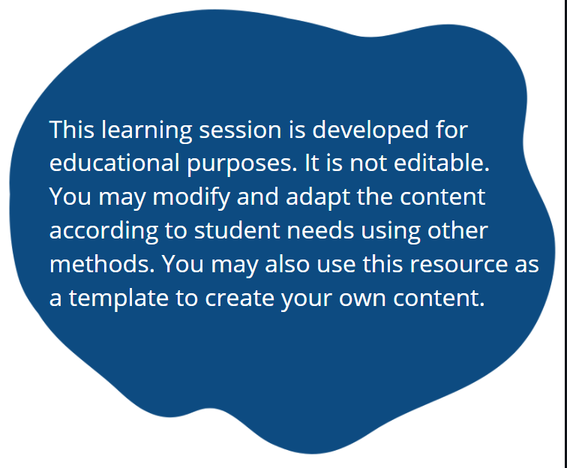
A Special Note for Teachers

Slide 3

Minds On Activity
People talk about “the economy” a lot. Have you ever wondered why?
Do you think the economy affects you as an individual? Does it affect your family?

Slide 4
Macroeconomics
“Macroeconomics is a branch of economics that studies how an overall economy – the markets, businesses, consumers, and governments – behave.”
Source: Investopedia
Macroeconomics include:
Inflation
Price levels
National income
Gross Domestic Product (GDP)
Unemployment rate
…and more

Slide 5
Students will learn…
How central banks play a role in manipulating a country’s economy
What central banks do
How their monetary policy affects us personally:
  Our spending power
  Our debt and investments
  Our employment
Important note: Macroeconomics is a complex branch of study. Many factors play a role. This lesson shows only a few aspects of macroeconomics related to central banks. Please keep in mind that there are exceptions to the general ideas presented in this lesson.

Slide 6
What is a central bank?
Do a quick search:
Find the definition of a central bank.
Find the main goals of a central bank.
Some suggested resources:
Wikipedia
Investopedia

Slide 7
What is a central bank?
Definition:
A central bank is a financial institution that is responsible for the monetary policy of a country or group of countries.
Goals:
Keep the country’s economy running smoothly
Achieve price stability (low and stable inflation)

Slide 8


What is a central bank?
There are many central banks in the world.
Find the central banks for these countries or country group:
Canada
United States
India
Hong Kong
Brazil
England
Germany
European Union
etc. (Other countries of your choice)
Bank of Canada
Federal Reserve System (Federal Reserve, or the Fed)
Central Bank of India
Hong Kong Monetary Authority
Banco Central do Brasil
Bank of England
Deutsche Bundesbank
European Central Bank

Slide 9

Quick Facts: Bank of Canada (BOC)
The Bank of Canada was established on March 11th 1935, making the institution almost 100 years old.
The Bank of Canada is a Crown Corporation, meaning it belongs to the federal government.
It is alleged to be “independent”, able to make its own decisions.
Source: Bank of Canada – Our History

Slide 10
Quick Facts: Bank of Canada (BOC)
One person, the Chief Executive Officer, has “full control of the business of the Bank [of Canada].”
Think about that for a moment: essentially one person decides the economic fate of Canada!
The governor is appointed by the board of governors for a seven-year term.
Source: Bank of Canada – About Us

Slide 11
What does BOC do?
Monetary policy: Influence the supply of money circulating in the economy, keep inflation low and stable.
Financial system: Promote a stable and efficient financial infrastructure, which includes banks, credit unions, financial markets, and electronic payment functions.
Currency: Design, issue and distribute Canada’s bank notes.
Funds management: “Fiscal agent” for the Government of Canada, managing its public debt programs and foreign exchange reserves.
Retail payments supervision: Supervise payment service providers, including money transfers, digital wallets, and other payment technology companies used in retail services.
In this lesson, we will focus on…

Slide 12
How do central banks control inflation?
BOC, like other central banks, has a goal to control inflation.
Think-Pair-Share
What is inflation?
Have you heard of this term in news reports, media, or general conversations?
Inflation is an increase in prices of goods and services.
Inflation impacts all of us. How our central bank tries to control inflation should interest us.

Slide 13
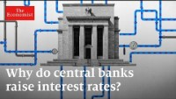
How do central banks control inflation?
Watch this video: https://www.youtube.com/watch?v=R8VBRCs2jTU&t=493s

Slide 14
How do central banks control inflation?
Increase interest rate
Less consumer spending
Businesses keep prices the same
Summary from the video:
When prices stay the same, inflation is under control.

Slide 15
Interest rate vs. inflation
Summary from the video:
Increases
Interest Rate
Decreases
Spending,
Inflation

Slide 16

BOC and Inflation
Aims to keep inflation at an annual increase of 2% per year
Central banks have stated that an inflation of about 2% is well-balanced to drive the economy, while maintaining consumer confidence and spending power.
Learn more:
Consumer confidence explained by Britannica
Purchasing power by Investopedia
How does the BOC try to maintain inflation at 2%?
Let’s find out…

Slide 17
How BOC tries to control inflation
The BOC raises rates to slow down spending, maintain prices (therefore, control inflation).
Interest Rate
Higher rates mean higher payments on debt, so you have less money to spend.
Spending Power

Slide 18
How BOC tries to control inflation
How does this look in the real world? If you borrowed $10,000 to buy a car at 1% interest rate…
5%
$$\$10,000 × 0.01=\$100$$
Interest Rate
But now, BOC raises interest rate, and your car loan rate goes up to 5%...
1%
$$\$10,000 × 0.05=\$500$$
Your spending power decreases by $400! You can’t afford as much as you did before. Now it costs 5 times as much to borrow the money.
Spending Power
−$400

Slide 19
How BOC tries to control inflation
5%
This works in reverse as well. If inflation is too low, BOC lowers interest rate.
Interest Rate
1%
Now, your spending power increases by $400! The lowered rates made borrowing cheaper, so you have more money to spend.
+$400
Spending Power

Slide 20
How BOC tries to control inflation
To review:
BOC raises interest rates
Inflation and spending power goes down
BOC lowers interest rates
Inflation and spending power goes up

Slide 21
BOC and Inflation
Is the BOC achieving its inflation goal?
Discussion Questions:
What is the current inflation rate?
What is the current interest rate?
How does the BOC try to maintain the target inflation of 2%? Has it been successful?
Are wages generally rising below, at, or above the 2% inflation?
If BOC aims to raise prices by 2% every year, what does this do to your purchasing power as a consumer?

Slide 22
BOC and Your Investments
When BOC raises interest rate, it affects your investments in bonds and stocks.
The relationship is complicated. We generally expect to see:
Interest Rate
Bond Prices
Interest Rate
Stock Prices

Slide 23

BOC and Your Investments
How do interest rate hikes impact bonds and stock prices?
An MIT economist explains: https://youtu.be/X-obZcJZL-o?t=66
(The video will start at the 1:06 mark)

Slide 24
BOC and Your Investments
If inflation is… | Interest rate is likely… | Effects on debt and borrowing | Effects on savings and investments
Low interest earned on savings. More people choose to invest. Bond and stock prices remain strong.
Low
Low
Low interest on debt. Easy to borrow money from banks.
Likely higher interest on debt. Could be wise to choose fixed rate to lock in a lower interest rate.
Higher interest earned on savings.
Bond and stock prices may start to fall.
Rising
To rise
High interest on debt. Harder to borrow money. Banks want to keep their money at BOC.
High interest earned on savings.
Bond and stock prices likely fall.
High
High
Interest rate decreases on debt. A variable rate would decrease along with decreasing interest rate.
Lower interest earned on savings.
Bond and stock prices may start to rise.
Falling
To fall

Slide 25

BOC and Employment
Lowering inflation means slowing down the economy.
If BOC slowed down the economy too much, then we can enter into a recession.
During a recession, we see:
Decline of real GDP (Gross Domestic Product)
A drop in consumer spending (decline in industrial production, retail sales)
Decline of real income
High unemployment, staff layoffs
This sounds important. Let’s explore this further.

Slide 26
BOC and Employment
Unemployment is measured by the unemployment rate.
Find the definition of unemployment rate.
Different countries can measure unemployment a little differently.
In Canada, unemployment rate is the number of unemployed people as a percentage of the labour force.
The labour force is the unemployed plus the employed.

Slide 27
BOC and Employment
2. Find the current unemployment rate in Canada. What does the rate tell you?
For example, the unemployment rate is at 10%. This means of all the people who are available to work, 10% of them are unemployed. In other words, 1 out of 10 people who want to work do not have a job.
3. Dig a little deeper: Find the current unemployment rate for specific demographic groups: male vs. female, younger vs. older, etc. What do the different rates tell you?
Suggested resource: Statistics Canada

Slide 28

BOC and Employment
If the BOC decreases inflation too much, it slows down the economy and raises unemployment.
What the BOC decides to do has an impact on how easy it is for you to find a job.
Understanding the wider economic environment allows us to see the bigger picture and how external factors affect us personally. If you have a hard time finding a job, don’t be down on yourself. It’s not necessarily you! It may just be the economy.

Slide 29
BOC and Your Money
The Bank of Canada is the only institution that can issue bank notes. In other words, they print money.
The Canadian bills and coins are designed, printed, and distributed by our central bank.
So, why doesn’t the BOC just print more money?
The answer to this question ties together what we have learned: inflation and unemployment.

Slide 30

BOC and Your Money
Watch this video: https://www.youtube.com/watch?v=XNu5ppFZbHo
(Disclaimer: This video is in the American context, but the idea applies to Canada.)

Slide 31
Closing Discussion
Why doesn’t BOC just print more money?
In trying to control inflation, what are the ripple effects the BOC has on average Canadians in terms of:
  Prices of goods and services
  Debt
  Savings
  Investments
  Employment
  Money
3. The BOC has an enormous impact on Canadians. What do you think about having one person solely influencing the entire business of the BOC?
4. How much influence does the Canadian government really have on the BOC? If it is owned by the government, can it truly be independent?

Slide 32
To learn more…
We only looked at two of five core functions of the BOC. Click on the links below to learn more about each function:
Monetary policy: Influence the supply of money circulating in the economy, keep inflation low and stable.
Financial system: Promote a stable and efficient financial infrastructure, which includes banks, credit unions, financial markets, and electronic payment functions.
Currency: Design, issue and distribute Canada’s bank notes.
Funds management: “Fiscal agent” for the Government of Canada, managing its public debt programs and foreign exchange reserves.
Retail payments supervision: Supervise payment service providers, including money transfers, digital wallets, and other payment technology companies used in retail services.

