Slide 1
What’s Next: First Year After High School
Grade 10+ Project

Slide 2
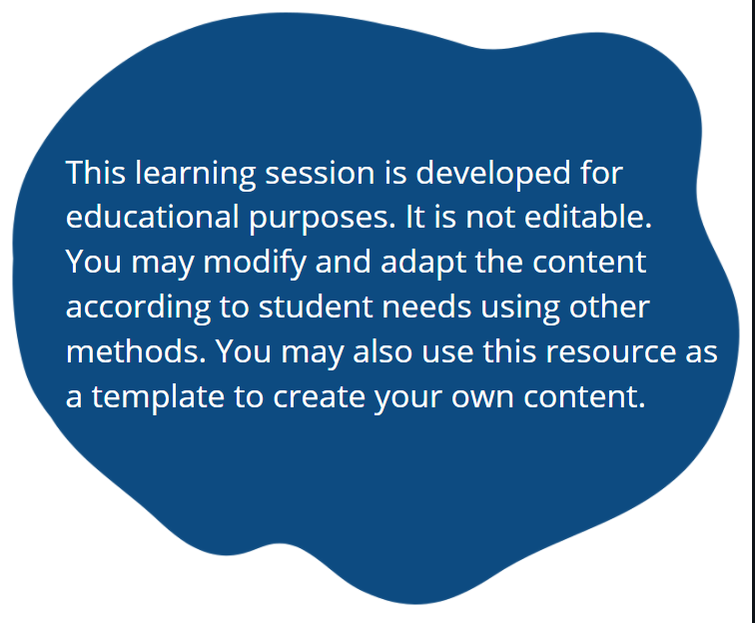
A Special Note for Teachers

Slide 3
Students Will…
Plan for your first year after graduating high school
Consider various pathways including post-secondary education, apprenticeship, entrepreneurship, the workforce, and gap year programs
Develop practical skills in budgeting and making choices for post-secondary life
Learn about available resources and funding

Slide 4
Project Introduction
Soon, you will have the opportunity to make your own decisions about life after high school!
But this can feel daunting!
This project will help you to learn about the variety of options you have, and some of the resources available that can help you!
Take your time, do your research, and use this project as your journey to learn more.
Remember, in the future you can always change your mind.

Slide 5

Project Introduction
The project is divided into three stages:
Stage 1: Research about a life pathway that interests you, and the associated benefits and costs
Stage 2: Define “financial responsibility” for yourself, your family, and community
Stage 3: Create a one-year financial plan that supports your pathway by using an online budgeting tool that comes with this project (Note: Paper option is available)

Slide 6

Stage
My Pathway

Slide 7

Minds On Activity
Think-Pair-Share
What thoughts come to mind when you think of your life after high school?
Are there education or career options you would like to pursue?
What have you heard of other people doing?

Slide 8
Student Discussion
There are many options for your future. There are no right or wrong answers! Here are some ideas:
Post-secondary education
Apprenticeship program for the trades
Entrepreneurship (start your own business)
Employment (find a job)
Gap-year program
Others?

Slide 9

Post-Secondary Options
Let’s take a moment to discuss these questions!
Can you think of any other possible options for your future?
What are some benefits of each choice?
What are some drawbacks of each?
What situations may make it difficult to pursue a particular option?

Slide 10

Stage 1: My Pathway
Which pathways interest you?
What would you like to learn more about?

Slide 11

Stage 1: My Pathway
Begin your research.
Select an option to explore for the rest of the project. Complete “Stage 1: My Pathway” of your project booklet.
Realistically, you may pursue more than one pathway at the same time.
For example: Some work a part-time job and attend post-secondary school at the same time.
In Stage 3, you will reflect this in your one-year financial plan.

Slide 12

Resources
For students who identify as Indigenous, you will find information about the following:
  Post-Secondary Institutions in Ontario
  Apprenticeships Options
  Financial Aid
  https://www.ontario.ca/page/indigenous-students#section-0
  For general information about how to apply for student loans on the OSAP website (Ontario Student Assistance Program):
  https://www.ontario.ca/page/osap-ontario-student-assistance-program

Slide 13

Resources
Student Aid Estimator
Put your information into the Student Aid Estimator and it will give you an estimate of the federal funding you can receive for post-secondary education!
Student Aid Estimator
In Stage 3 of this project, you will need the amount of aid provided by the estimator to help you with the financial plan.

Slide 14

Resources
Learn about the various scholarships and bursaries you can apply for post-secondary funding:
https://oeshighschool.com/post-secondary-scholarships-and-bursaries-in-ontario/
Indigenous students can apply for the Indigenous Student Bursary:
https://osap.gov.on.ca/OSAPPortal/en/A-ZListofAid/PRDR019231.html
There is also funding available for young people and Indigenous people who are interested in starting a business. You can read more here:
https://www.ontario.ca/page/entrepreneurship-funds-and-resources-people-under-30

Slide 15
Resources
Funding is available for young people who are interested in starting a business (including funding specifically for Indigenous youth:
https://www.ontario.ca/page/get-help-finding-youth-or-student-job#section-15
According to circumstances, some choose to travel, volunteer, and meet new people through a Gap Year Program. Some programs are funded, while others have expenses.
https://katimavik.org/
https://www.cangap.ca/
https://www.canada.ca/en/services/youth/canada-service-corps/about.html
https://www.international.gc.ca/world-monde/study_work_travel-etude_travail_voyage/youth_internship-stages_jeunes.aspx?lang=eng

Slide 16

Stage
“Financial Responsibility”

Slide 17
Stage 2: Financial Responsibility
What is “financial responsibility”? How can we be a “financially responsible” person?
These are important questions. The answer depends on:
Our personal values
What we prioritize in life
Our possible limitations
The society we live in…and more
So, how we define “financial responsibility” will be different from person to person.

Slide 18
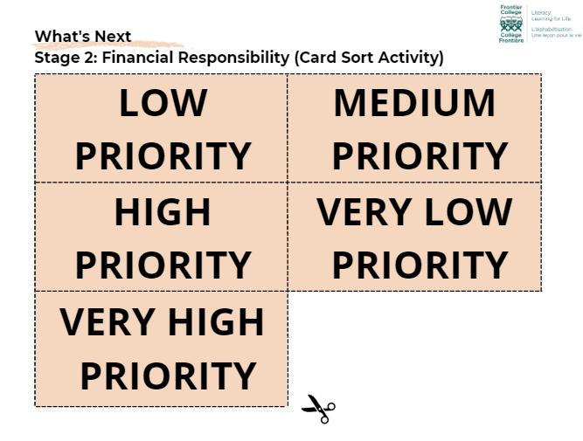
Stage 2: Financial Responsibility
Individually or in small group, complete the “Stage 2: Financial Responsibility Card Sort Activity”:
Rank the priorities from “Very Low” to “Very High”.
In the “Very High” category, you can only have a maximum of 7 priorities/cards.
Think about:
What is the most important to you? To your family? Within your community?
What might you need to sacrifice so that you can prioritize the more important things?

Slide 19

Stage 2: Financial Responsibility
After completing the card sort activity, fill in “Stage 2: Reflection (Financial Responsibility)”.
What has this activity shown you about your personal values and priorities?

Slide 20

Stage
One-Year Financial Plan

Slide 21

Stage 3: My One-Year Financial Plan
Nothing happens without a plan! In the final stage of this project, you will create a one-year financial plan to support the pathway you chose. This will help you to budget and to make your plan a reality!
Remember, your plan is not written in stone. You can change your mind in the future.
So do your best. Be as realistic as possible with the financial plan. And enjoy the learning journey!

Slide 22
Stage 3: My One-Year Financial Plan
Instructions:
The next 5 slides are quick tutorials on how to use the financial plan. Choose the video tutorials that apply to the pathway(s) you chose.
If you choose more than one pathway, you might have to complete more than one tab in the financial plan. Find out more as you watch the video tutorials.
Slide 24 shows you how to use the “Savings & Investment” tab. For Education and Employment pathways, you must choose at least one savings option or one investment option. For Entrepreneurship and Gap-Year pathways, it is optional.
We encourage you to choose more than one, so you can start saving and investing at a young age.

Slide 23

Education and Apprenticeship Tab

Slide 24

Employment Tab

Slide 25

Entrepreneurship Tab

Slide 26

Gap-Year Program Tab

Slide 27
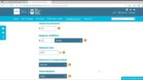
Savings and Investments Tab

Slide 28

Stage 3: My One-Year Financial Plan
After completing your “What’s Next: One-Year Financial Plan”, answer the reflection questions on page 5 of your project booklet.

Slide 29


Congratulations!
You completed all three stages of this personal journey!
We hope this project helped you to learn more about the options out there and to start a plan for your first year after high school.
To let everything sink in, reflect on the journey and complete the “Project Reflection” questions on page 6 of your booklet.

