Slide 1
Personal Income Tax
Grade 12+

Slide 2
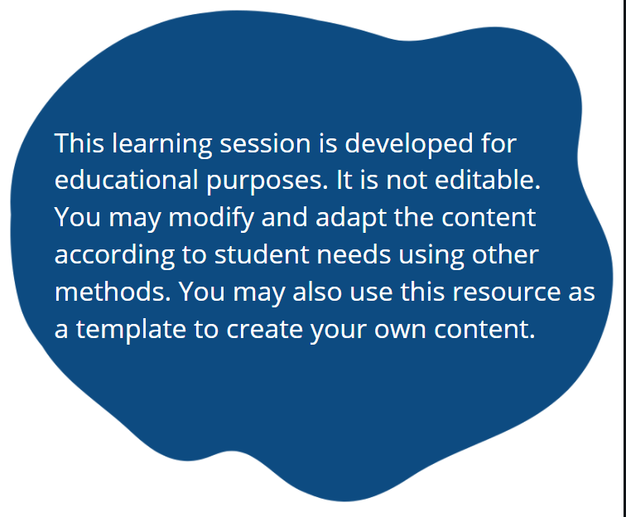
A Special Note for Teachers

Slide 3
Students will…
Learn the basics of income taxes in Canada
Gather, interpret, and describe the information and documents required to file a personal tax return
Prepare a simple personal income tax return (paper and electronic)

Slide 4

Part
Learn the Basics of
Income Taxes in Canada

Slide 5
Minds On Activity
  Have you ever wondered why taxes need to be completed?
  Or have you ever been curious about how personal income taxes came to be?
  On your worksheet:
  (Personal Income Taxes Handout – Section 1)
  Take a minute to record your answers BEFORE the lesson to the following TRUE or FALSE questions.

Slide 6
Minds On Activity
  BEFORE LESSON
  An income tax is a martial arts technique designed to extract pain.
TRUE
FALSE

Slide 7
Minds On Activity
  BEFORE LESSON
  The government collects taxes to pay for public services the government offers.
TRUE
FALSE

Slide 8
Minds On Activity
  BEFORE LESSON
  The Canada Revenue Agency (CRA) is responsible for collecting taxes.
TRUE
FALSE

Slide 9
Minds On Activity
  BEFORE LESSON
  The income tax was established in 1939 to pay for the healthcare system.
TRUE
FALSE

Slide 10
Minds On Activity
  Now,
  Let's examine the what and why of taxes.

Slide 11
Why Taxes?
  Taxes have existed in civilizations dating as far back as ancient Egypt (3000-2800 BC)
  An income tax is a financial charge on the financial income of persons, corporations or other entities.
  Taxes owed by individual citizens is a personal tax.
  Personal taxes are a mandatory civic obligation.

Slide 12
What’s in it for you?
  In Canada, these taxes are used by the Canadian government to fund and carry out public services such as:
    Education and schools
    Health care and hospitals
    National defense
    Social services and welfare
    Roads and bridges
    Parks and playgrounds
    And many more…

Slide 13
What’s in it for you?
  Top 3 reasons to complete your taxes:
  Get a refund (money back from the government).
  Become eligible for benefits like:
    Canada Child Benefit (to help raise children under 18)
    Canada Workers Benefit (for low-income earners)
    HST rebate (payments to offset the HST you've paid)
  Become eligible for the Registered Retirement Savings Plan that can reduce taxes and support your retirement.

Slide 14
History of Taxes in Canada
  In this world, nothing can be said to be certain except death and taxes.
  - Benjamin Franklin
  Income tax was first imposed in Canada in 1917 as a “temporary” means of supporting the war effort in Europe.
  The tax was not lifted after the war ended, in fact, it was permanently legislated. More on the History of Taxes
  The Income Tax Act contains all tax legislature in Canada.
  The branch of the government responsible for collecting taxes is called the Canada Revenue Agency (CRA).

Slide 15
Check In
  On your worksheet:
  (Personal Income Taxes Handout – Part 1)
  Take a minute to record your answers AFTER the lesson to the previous TRUE or FALSE questions.

Slide 16
Check In
  AFTER LESSON
  An income tax is a martial arts technique designed to extract pain.
TRUE
FALSE

Slide 17
Check In
  AFTER LESSON
  The government collects taxes to pay for public services the government offers.
TRUE
FALSE

Slide 18
Check In
  AFTER LESSON
  The Canada Revenue Agency (CRA) is responsible for collecting taxes.
TRUE
FALSE

Slide 19
Check In
  AFTER LESSON
  The Income tax was established in 1939 to pay for the healthcare system.
TRUE
FALSE

Slide 20
Minds On Activity
  Are taxes incredibly complicated?
  What can I do to pay less income tax?
  On your worksheet:
  (Personal Income Taxes Handout – Section 2)
  Take a minute to record your answers BEFORE the lesson to the following TRUE or FALSE questions.

Slide 21
Minds On Activity
  BEFORE LESSON
  The basic tax equation is:
  Taxable Income x Tax Rate = Tax Liability
TRUE
FALSE

Slide 22
Minds On Activity
  BEFORE LESSON
  Employment Income includes income such as salary, wages, commissions etc.
TRUE
FALSE

Slide 23
Minds On Activity
  BEFORE LESSON
  Canada uses a regressive tax system.
TRUE
FALSE

Slide 24
Minds On Activity
  BEFORE LESSON
  RRSP stands for Random Round Soup Pots.
TRUE
FALSE

Slide 25
Minds On Activity
  Now,
  Let's discover how to calculate our income taxes and pay less!

Slide 26
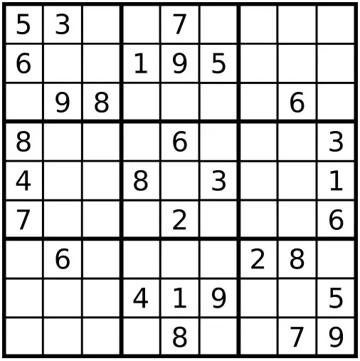
Sudoku Challenge
  A common myth is that taxes are too complicated for the average person to do.
  The good news is that if you have ever played this game,
  YOU CAN DO TAXES!
  Rules of Sudoku are:
  You can use only numbers from 1 to 9.
  Each 3×3 block can only contain numbers from 1 to 9.
  Each vertical column can only contain numbers from 1 to 9.
  Each horizontal row can only contain numbers from 1 to 9.

Slide 27
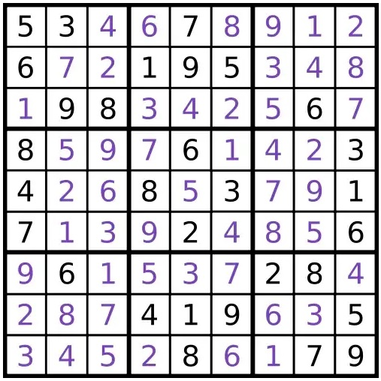
Sudoku Challenge
  Just like Sudoku, if you use a few rules as guides, you can complete your personal income taxes the right way!
  The next few slides introduce the basic rules of the income tax act.

Slide 28

The Basic Tax Calculation
You can calculate what taxes you owe with this calculation:
Taxable Income $×$ Tax Rate $=$ Tax Liability
Let’s look at each one of these rules.
The portion of your income used to calculate income taxes.
The amount of taxes that you owe.
The percent of your income that taxes are paid on.

Slide 29
Taxable Income Sources
Not all of what you earn is taxed.
Non-taxable income include earnings such as lottery winnings, gifts and inheritances, strike pay, and a few others.
Taxable Income is the portion of your income used to calculate income taxes.
Taxable income is found by first identifying all your income sources.

Slide 30
Taxable Income Sources
Total Income: All of your reportable sources of income.
The following sources of income are included in total income: (which do you have?)
Employment: income from salary, wages, commissions, etc.
  Indigenous peoples may be exempt from certain types of employment income. Exemption Guidelines for Indigenous People
Property: income from owning an investment (interest, dividends, etc.)
Business: self-employment (business income, sole-proprietorship)
Capital Gains: income from selling investments or property for a gain (only 50% of capital gains is included in income!)
* Total income adds up fast, but we can reduce it to pay less taxes!

Slide 31
Deductions
Total income can be reduced by claiming deductions.
Deductions: Certain types of expenditures (things you’ve spent money on) can be used to deduct (reduce) your taxable income.
The more deductions you have, the lower your tax!
Some examples:
RRSP (Registered Retirement Savings Plan): a plan designed to help save money for your retirement. Payments into this plan reduce taxes.
Union dues: payments to your employment related union.
Northern residents: costs of living in a prescribed northern zone.
Moving expenses: payments for moving more than 40 km to take a job.
Child Care expenses: payments to care for children under 16 years old.
Tip: Keep receipts of these kinds of expenditures!

Slide 32
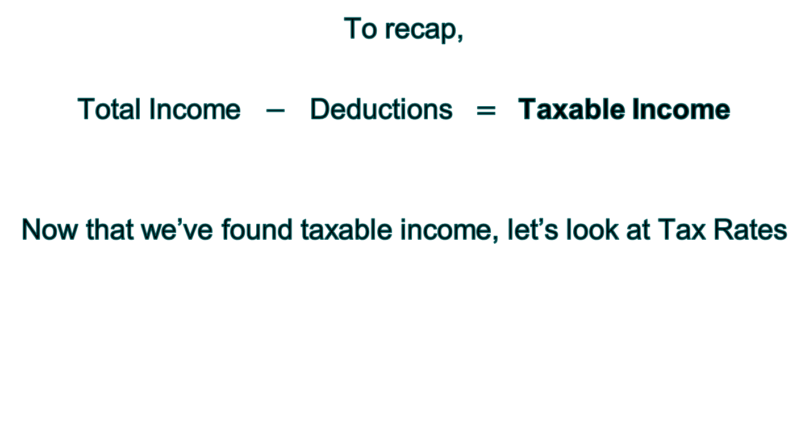
The Basic Tax Calculation
To recap,
Total Income $−$ Deductions $=$ Taxable Income
Now that we’ve found taxable income, let’s look at Tax Rates

Slide 33
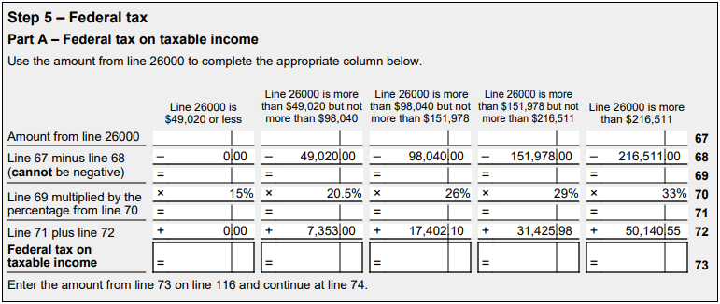

Tax Rates
  Taxable income is now used to determine Federal tax using tax rates.
  A progressive tax system in Canada is used.
  Additional Income earned is taxed at higher tax rates.
  Which means: The more income you make, the more you are taxed.
  see Current Tax Rates for a list of the most recent rates.
  Using example tax rates below, Federal Tax on $50,000 taxable income is:
  ($49,020 $×$ 15%) + (980 $×$ 20.5%) $=$ $7,553.90

Slide 34
Tax Rates
  Taxable income is also used to determine Provincial and Territorial tax
  Tax for all provinces and territories (except Quebec) is calculated the same way as federal tax, except different tax rates are used.
  see Current Tax Rates for a list of tax rates used in each province.

Slide 35

The Basic Tax Calculation
Remember:
Taxable Income $×$ Tax Rate $=$ Tax Liability
Let’s look at Tax Liability
The portion of your income used to calculate income taxes.
The amount of taxes that you owe.
The percent of your income that taxes are paid on.

Slide 36
Tax Liability
After you have calculated your taxable income and found the tax rates for your income level, you calculate the tax owed to the Federal and Provincial government.
Both are added together and the total amount is to be paid to the Federal government (CRA).
This is your tax liability.
This also includes tax amounts not paid from previous years.

Slide 37
Check In
  On your worksheet:
  (Personal Income Taxes Handout – Part 2)
  Take a minute to record your answers AFTER the lesson to the previous TRUE or FALSE questions.

Slide 38
Check In
  AFTER LESSON
  The basic tax equation is
  Taxable Income x Tax Rate = Tax Liability
TRUE
FALSE

Slide 39
Check In
  AFTER LESSON
  Employment Income includes income such as salary, wages, commissions etc.
TRUE
FALSE

Slide 40
Check In
  AFTER LESSON
  Canada uses a regressive tax system.
TRUE
FALSE

Slide 41
Check In
  AFTER LESSON
  RRSP stands for Random Round Soup Pots.
TRUE
FALSE

Slide 42
Check In
  On your worksheet:
  (Personal Income Taxes Handout – Part 2)
  Please complete section A & B of the sample tax scenario.

Slide 43
Minds On Activity
  How else do I lower my taxes?
  Can I really get a refund of taxes from the government?
  On your worksheet:
  (Personal Income Taxes Handout – Part 3)
  Take a minute to record your answers BEFORE the lesson to the following TRUE or FALSE questions.

Slide 44
Minds On Activity
  BEFORE LESSON
  Non-refundable tax credits can be used to pay your credit card bill.
TRUE
FALSE

Slide 45
Minds On Activity
  BEFORE LESSON
  All taxpayers receive a basic personal non-refundable tax credit.
TRUE
FALSE

Slide 46
Minds On Activity
  BEFORE LESSON
  Interest on student loans are a non-refundable tax credit.
TRUE
FALSE

Slide 47
Minds On Activity
  BEFORE LESSON
  The payroll deduction for “Income Tax” is an example of a tax credit.
TRUE
FALSE

Slide 48
Minds On Activity
  BEFORE LESSON
  A refund occurs when your tax credits are greater than your tax liability.
TRUE
FALSE

Slide 49
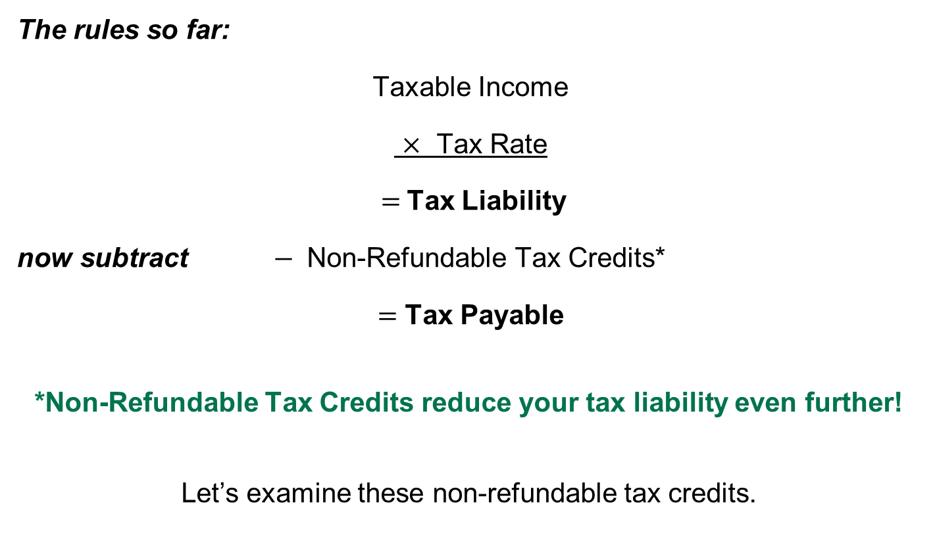
Tax Breaks From the CRA
The rules so far:
Taxable Income
$×$ Tax Rate
$=$Tax Liability
now subtract $−$ Non-Refundable Tax Credits*
$=$ Tax Payable
*Non-Refundable Tax Credits reduce your tax liability even further!
Let’s examine these non-refundable tax credits.

Slide 50
Tax Breaks From the CRA
Non-Refundable Tax Credits
On certain types of spending (expenditures), you receive tax credits to reduce your tax liability.
Add up these expenditures and multiply it by the allowable government rate. (In 2022, it is 15% - adjusted by the CRA as needed)
If these tax credits exceed your tax liability (i.e., you get a negative amount), you cannot receive a refund on your expenditures, hence non-refundable tax credit.
Non-refundable tax credits are available for both Federal and Provincial tax levels.

Slide 51
Tax Breaks From the CRA
Some examples of Federal Non-Refundable Tax Credits:
Basic Personal: everyone is given an amount to start! (in 2022 – the first $14,398 of your income is essentially tax-free!)
CPP or EI Payments: amounts your employer deducted from your pay to contribute to the Canada Pension Plan and Employment Insurance.
Interest on Student Loans: interest paid on your government student loans.
Tuition Paid, Textbooks: amounts paid for tuition and textbooks.
Donations and gifts (15% on first $200, 29% above $200): donations made to registered charities or qualified donees.
Medical expenses (lesser of $2,421 or 3% of net income): any medical expenses not reimbursed by a health or insurance plan
Digital News Subscriptions: cost of subscription to a qualified Canadian journalism organization.
Disability Tax Credit: people with impairments, or their support people receive this by providing documentation from their medical practitioner.

Slide 52
Tax Breaks From the CRA
Some examples of Provincial Non-Refundable Tax Credits:
Same as the Federal
Plus:
Low-income individuals and families tax (LIFT) credit: for low-income earners to reduce their Ontario personal

Slide 53
Tax Breaks From the CRA
Better news!
In Ontario, residents receive Refundable Tax Credits and Benefits
Refundable Tax Credits: You are entitled to receive cash for these even if you don’t owe any taxes!
  Ontario Staycation: up to $200 can be recovered for spending on leisure stays at an Ontario accommodation.
  Jobs Training: eligible tuition fees paid to Canadian educational institutions. (maximum $2,000)

Slide 54
Tax Breaks From the CRA
Better news!
In Ontario, residents receive Refundable Tax Credits and Benefits
Grants and Benefits:
  Ontario sales tax credit (OSTC):
  Ontario energy and property tax credit (OEPTC):
  Northern Ontario energy credit (NOEC):
  Ontario senior homeowners' property tax grant (OSHPTG):

Slide 55
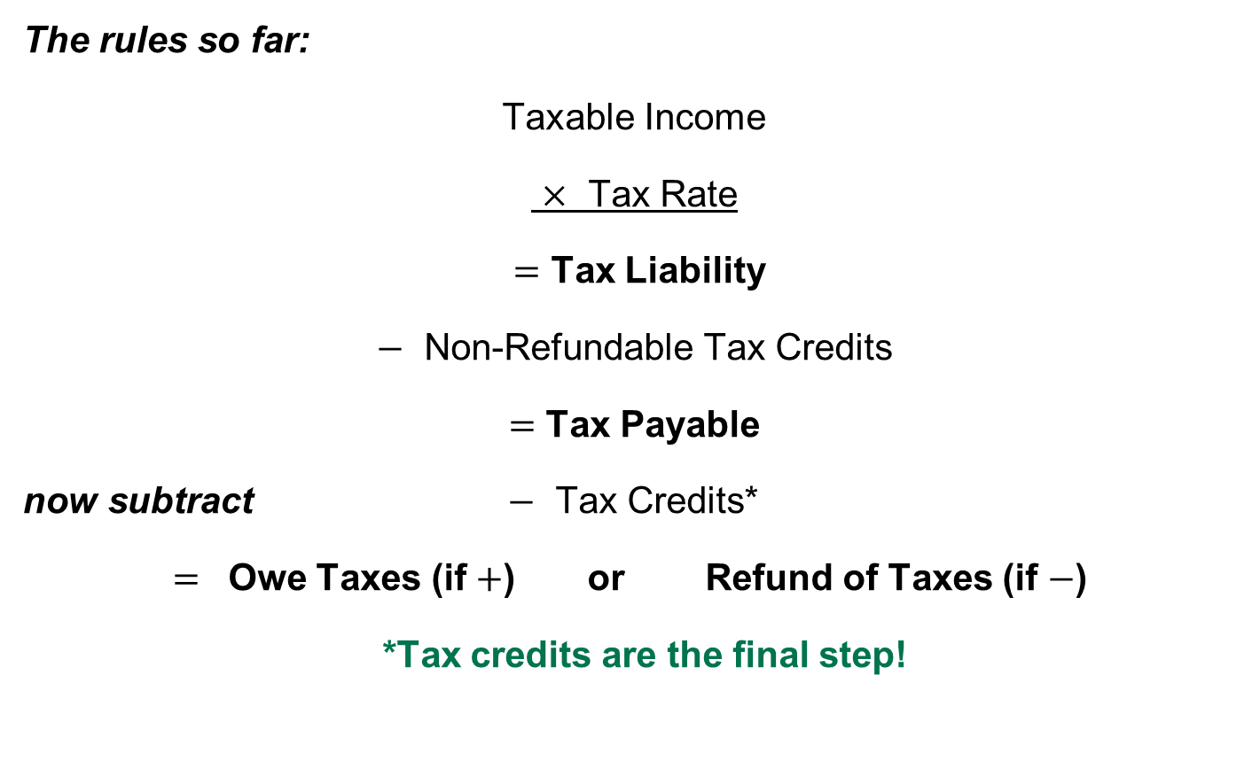
Income Tax Rules Summarized
The rules so far:
Taxable Income
$×$ Tax Rate
$=$ Tax Liability
$−$ Non-Refundable Tax Credits
$=$ Tax Payable
now subtract $−$ Tax Credits*
$=$ Owe Taxes (if $+$) or Refund of Taxes (if $−$)
*Tax credits are the final step!

Slide 56
Tax Credits
Some types of tax credits are refundable.
They differ from non-refundable tax credits because they can lead to the government paying money to you.
If you still have refundable tax credits even after your tax has been reduced to zero, what remains is refunded.
The next few slides provide the most common tax credits.

Slide 57
Payroll Deductions
Your employer is required by the CRA to withhold income from you when they pay you.
These withholdings are called payroll deductions. (See the Grade 11 "Understanding Payroll Deductions" lesson for more details. Download at: https://www.unitedforliteracy.ca/resources)
This income is sent to the CRA in anticipation of you owing taxes.
The biggest payroll deduction is Income Tax.
Other deductions are CPP (Canada Pension Plan) and EI (Employment Insurance) payments
The T4 form discloses these amounts.

Slide 58
Other Tax Credits
CPP Overpayments: if you had too much deducted from your payroll for CPP, you get a refundable tax credit for the difference.
EI Overpayments: if you had too much deducted from your payroll for EI, you get a refundable tax credit for the difference.
CWB (Canada Worker Benefit): helps families or individuals who are working and earning low income.

Slide 59


The Bottom Line
If your tax credits are more than your tax payable, you get money back from the government.
  This is called a refund.
If your tax credits are less than your tax payable, you owe money to the government.
  This is called a balance owing.

Slide 60
Check In
  On your worksheet:
  (Personal Income Taxes Handout – Part 3)
  Take a minute to record your answers AFTER the lesson to the previous TRUE or FALSE questions.

Slide 61
Check In
  AFTER LESSON
  Non-refundable tax credits can be used to pay your credit card bill.
TRUE
FALSE

Slide 62
Check In
  AFTER LESSON
  All taxpayers receive a basic personal non-refundable tax credit.
TRUE
FALSE

Slide 63
Check In
  AFTER LESSON
  Interest on student loans are a non-refundable tax credit.
TRUE
FALSE

Slide 64
Check In
  AFTER LESSON
  The payroll deduction for “Income Tax” is an example of a tax credit.
TRUE
FALSE

Slide 65
Check In
  AFTER LESSON
  A refund occurs when your tax credits are greater than your tax liability.
TRUE
FALSE

Slide 66
Check In
  On your worksheet:
  (Personal Income Taxes Handout – Part 3)
  Please complete section C & D of the sample tax scenario.

Slide 67
Sudoku Challenge
  Congratulations!
  You now have the basics of Income Taxes in Canada!
  YOU CAN DO IT!

Slide 68

Part
Gather, interpret, and describe the information and documents required to file a personal tax return

Slide 69
Documents Needed
In Canada, each taxpayer calculates their own taxes payable and informs the CRA what they owe each year.
Now that you know the basics in personal income taxes, you can do, or file, an income tax return.
This is where you provide your tax information to the CRA.
In Canada, the T1 Form is used to report your tax information each year.
The T1 form is updated yearly for any tax changes from the CRA.
You'll need to gather your personal tax documents to support your tax calculation.

Slide 70
Documents Needed
Let's look at some examples of tax documents needed.
Personal Information, Social Insurance Number (SIN).
Notice of Assessments (for prior year tax returns)
Income T-Slips (T4, T5, T3 etc.).
Receipts for tax deductions
  RRSP Contributions
  Moving Expenses
  Northern Residents
Receipts for non-refundable tax credits
  Tuition, education, textbooks
  Medical Expenses
  Charitable Donations

Slide 71
Personal Information
The CRA needs your personal information to verify that the income tax return you file is for you and not someone else.
Social Insurance Number (SIN): 9-digit number the government uses to identify you.
Name & Address: your home address.
Netfile Access Code: this is a code given to you by the CRA to authenticate your tax submission using the CRA's Netfile internet service.
If you have already registered, the above information can be found on the CRA's My Account website. (Must have filed a tax return already)

Slide 72
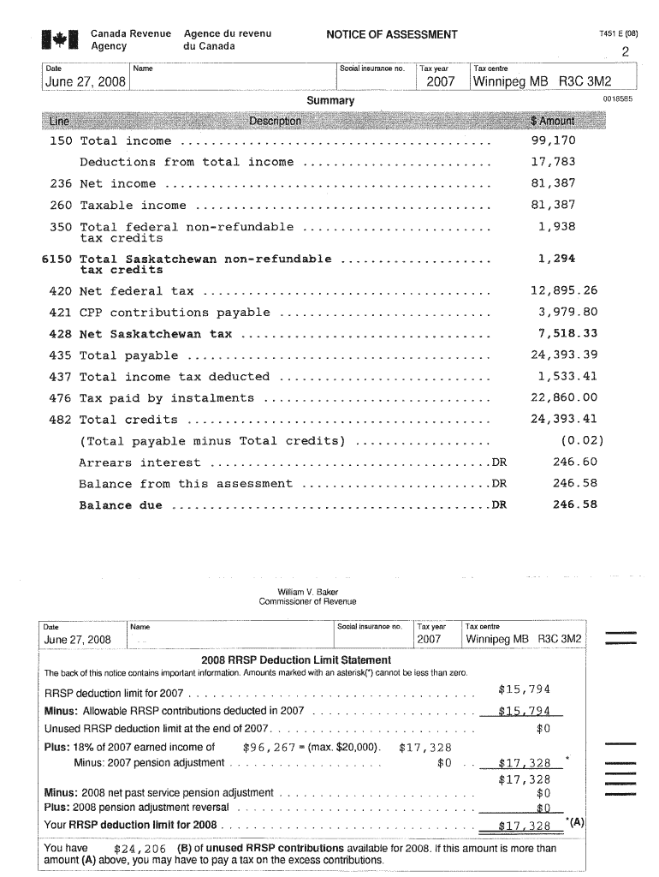
Notice of Assessment (NOA)
The notice of assessment (NOA) is the official evaluation of the tax return you filed for the year.
It contains details of your refund or balance owing, and how it was calculated.
RRSP deduction limits are also given.
If you have already registered, the NOA can be found on the CRA's My Account website. (Must have filed a tax return already)

Slide 73
Income T-Slips
T-Slips report the different sources of income you earned in the year.
Also reports tax credits
These must be given to you by your employer or the organization that provided income to you.
You will need all of your information slips for the income you earned during the year.
Income T-Slips start with a T (T4, T5, T3 etc.)
Let's identify the most common types of T-Slips.

Slide 74
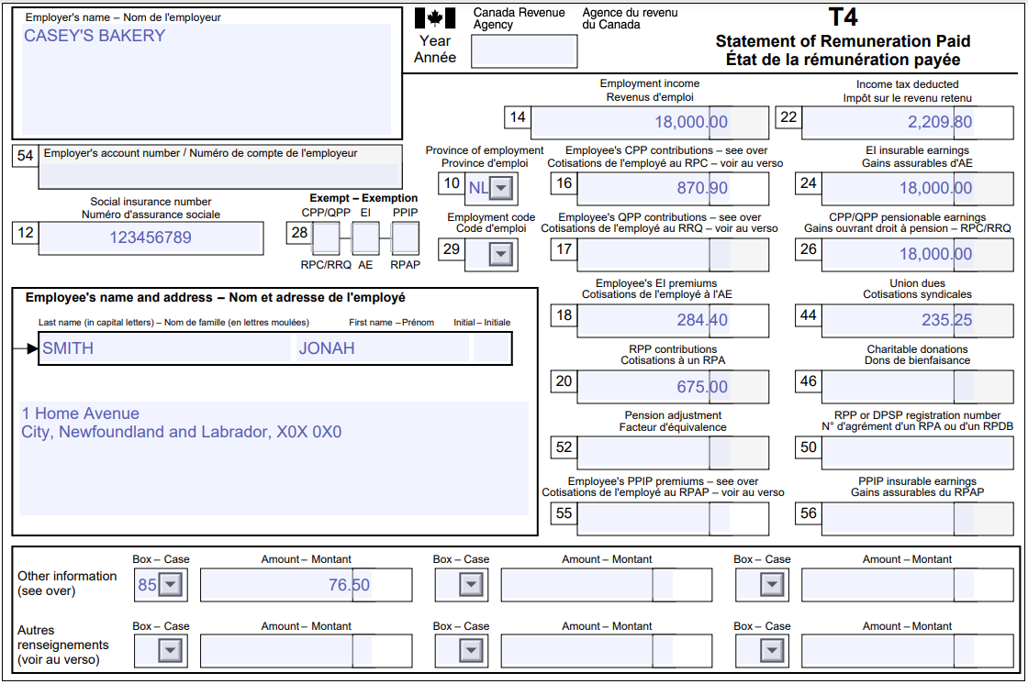
Income T-Slips
The T4 Statement of Remuneration Paid
Reports employment income (box 14) [Taxable Income]
Income tax deducted (box 22) [Refundable Tax Credit]
Tip – employers must provide T4's by the end of February. Contact them if you haven't received it yet.

Slide 75
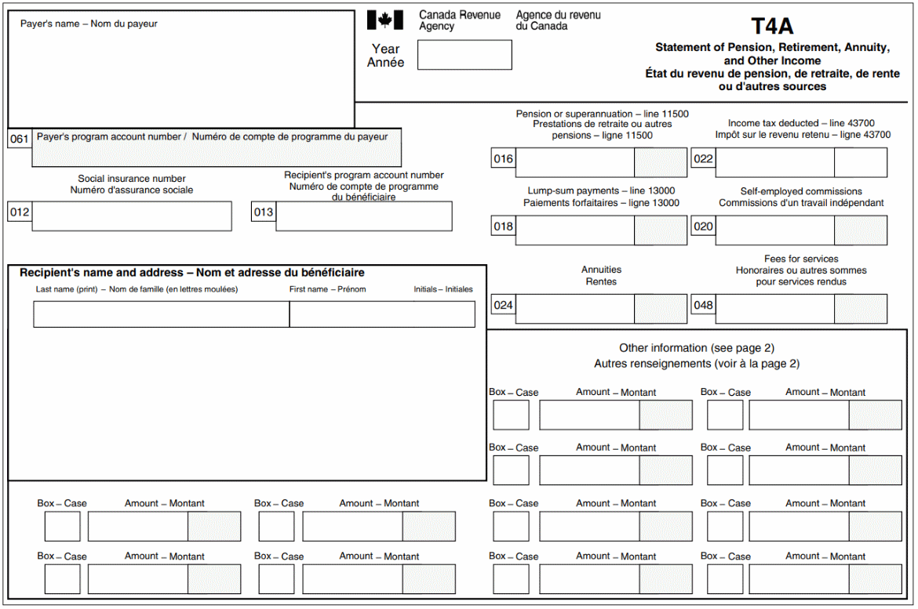
Income T-Slips
The T4A Statement of Pension, Retirement, Annuity and Other Income
Reports scholarship and bursary income (box 105) [Taxable Income]
Reports other income like pension, commissions [Taxable Income]
Income tax deducted (box 22) [Refundable Tax Credit]

Slide 76
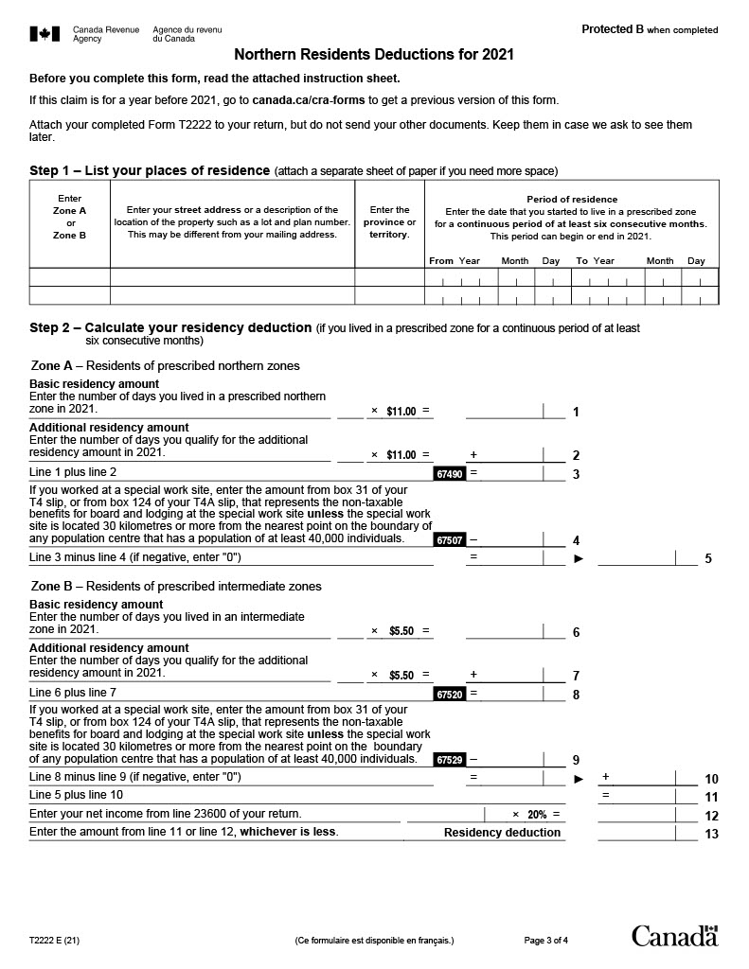
Deductions
Northern Residents [Deduction]
Eligible residents living in a prescribed northern zone fill out the T2222 form.
Receipts for costs of living and travel are required in case the CRA wants to see them.

Slide 77
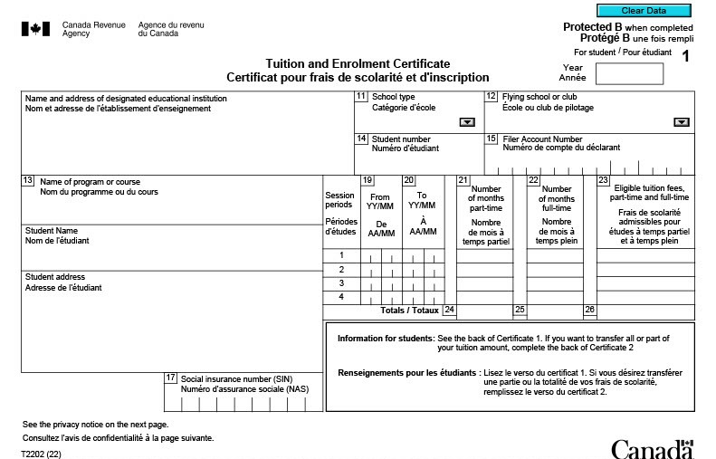
Non-Refundable Tax Credits
Tuition T2202 [Non-Refundable Tax Credit]
Students may request this document from the Office of the Registrar at their educational institution.

Slide 78
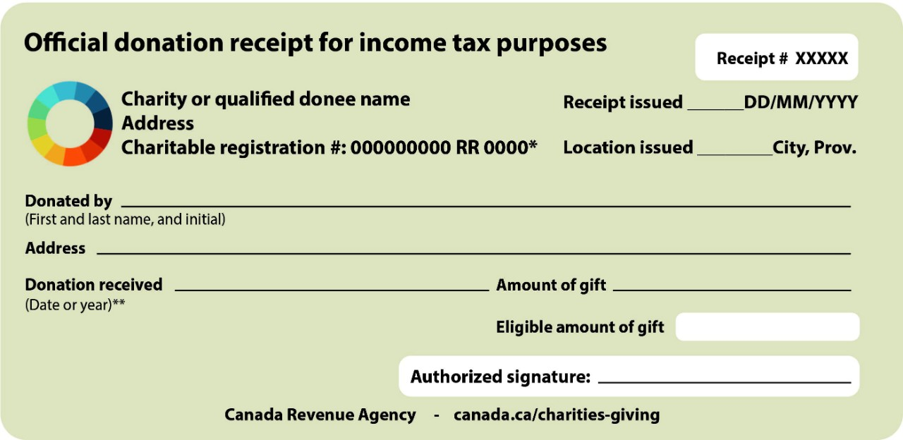
Non-Refundable Tax Credits
Charitable Donations [Non-Refundable Tax Credit]
The charity will provide a receipt for your donations during the year.
Tip: Keep these receipts in case the CRA wants to see them.

Slide 79

Part
Prepare a simple personal income tax return
(paper and electronic)

Slide 80
Preparing an Income Tax Return
Now that your documents have been gathered, we file the income tax return by filling out the T1 Form (Income Tax and Benefit Return).
This is the form you send to the CRA to report your final refund or balance owing.
For Indigenous peoples, the Credit and Benefit Return is available to simplify tax filing.
The T1 and any balance owing is due April 30 for the previous tax year.
The T1 can be completed using either:
  Certified Tax Software
  Paper (Manual)

Slide 81
Using Certified Tax Software
NETFILE is an electronic tax-filing service that lets you do your personal taxes online and send your T1 directly to the CRA.
It simplifies tax-filing and offers the following benefits:
You can file your tax returns directly through a NETFILE-certified tax software, which is more accurate with fewer chances of errors.
You get immediate confirmation of receipt.
You don’t have to send in receipts, unless asked for.
You get your refund faster through NETFILE; with direct deposit, you may receive your refund in 2 weeks.

Slide 82
Using Certified Tax Software
The following link takes you to the CRA’s listing of free and paid NETFILE certified software providers. (Online and Mobile)
Certified Tax Software (click to explore)
Tax software guides you along with specific questions and greatly simplifies tax preparation by walking you through it.

Slide 83
Using Certified Tax Software
Auto-Fill
If you have registered to use the CRA's My Account service and are using NETFILE certified tax software, you have the option to use the Auto-Fill feature.
This feature quickly and accurately fills in your T1 with tax information the CRA already has on file for you.
See About Auto-Fill

Slide 84
Using Paper Forms (Manual)
The T1 can also be completed by paper.
You can get an income tax package (guide, return, forms and schedules) online, by mail or calling the CRA.
Download Paper Forms
Order by mail
Note: paper returns will require manual calculations.

Slide 85
Useful Resources
Free Tax Clinics
The CRA also organizes free tax clinics to help taxpayers complete their taxes.
Find out if you qualify to attend a tax clinic.
Free Tax Clinics

Slide 86

Well done!
You have just finished a lesson about a topic that intimidates and confuses most people! Pat yourselves on the back for a job well done.
Write down 3 things you learned from this lesson.
How confident do you feel about filing your own income tax return? Write down 2 things that you feel confident about, and 1 thing you want to learn more about. (Share with one other person in this session.)

